Slide 1


Slide 2
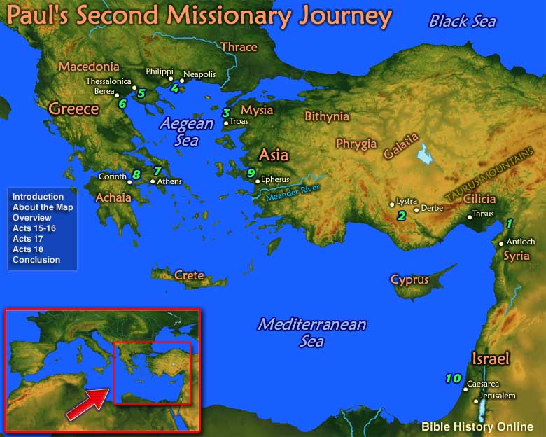

Slide 3
KNOWING GOD’S WILL
How can we know God’s will?
Some matters are black and white; right or wrong. No question here.
But what if it is a gray area? Not so simple.
Some think God only directs missionaries and preachers. Not true.

Slide 4
GRAY AREAS
WHAT THINGS DO YOU WORRY ABOUT?
WHAT DO YOUR PARENTS SAY?
WHAT DOES YOUR PASTOR, S.S. TEACHER, DEACON SAY?

Slide 5
GRAY AREAS
The Amish have lots of rules, but so do we.
In Moldova the ladies wore head coverings at first but, then they didn’t.
Wearing of jewelry, makeup, tattoos, beards, etc.
Working on Sunday, or shopping, mowing the lawn, etc.
2-piece swimsuits, pant suits, skirts above the knee, etc.
Smoking, drinking wine in moderation, gambling, etc.
Playing instruments in church, esp. drums and guitars, etc.
Can/should I get married? Who should I marry?

Slide 6
1 CORINTHIANS 8:1-3
1) Now about food sacrificed to idols: We know that we all possess knowledge. Knowledge puffs up, but love builds up. 2) The man who thinks he knows something does not yet know as he ought to know. 3) But the man who loves God is known by God.

Slide 7
1 CORINTHIANS 8:4-5
4) So then, about eating food sacrificed to idols: We know that an idol is nothing at all in the world and that there is no God but one. 5) For even if there are so-called gods, whether in heaven or on earth (as indeed there are many "gods" and many "lords"),

Slide 8
1 CORINTHIANS 8:6-7
6) Yet for us there is but one God, the Father, from whom all things came and for whom we live; and there is but one Lord, Jesus Christ, through whom all things came and through whom we live. 7) But not everyone knows this. Some people are still so accustomed to idols that when they eat such food they think of it as having been sacrificed to an idol, and since their conscience is weak, it is defiled.

Slide 9
1 CORINTHIANS 8:8-10
8) But food does not bring us near to God; we are no worse if we do not eat, and no better if we do. 9) Be careful, however, that the exercise of your freedom does not become a stumbling block to the weak. 10) For if anyone with a weak conscience sees you who have this knowledge eating in an idol's temple, won't he be emboldened to eat what has been sacrificed to idols?

Slide 10
1 CORINTHIANS 8:11-13
11) So this weak brother, for whom Christ died, is destroyed by your knowledge. 12) When you sin against your brothers in this way and wound their weak conscience, you sin against Christ. 13) Therefore, if what I eat causes my brother to fall into sin, I will never eat meat again, so that I will not cause him to fall.

Slide 11
KNOWING GOD’S WILL
How can we know God’s will in the difficult gray areas?

Slide 12
3 GUIDING LIGHTS
Like navigational buoys lining up to guide a ship.
Some people want something like GPS, “God told me to do…”
Be careful here.

Slide 13
THE WAY OF WISDOM
3 GUIDING LIGHTS TO KNOW GOD’S WILL IN GRAY AREAS.
1. Knowledge.
2. Love.
3. The glory of God.

Slide 14
1. KNOWLEDGE 8:1-6
You must know God’s Word.
Be careful though, “Knowledge puffs up.” 8:1
In Corinth the issue was meat sacrificed to idols.

Slide 15
1. KNOWLEDGE 8:1-6
MEAT SACRIFICED TO IDOLS.
A. The idol is nothing. 8:4
B. Only 1 true God. 8:4-6
C. So, go ahead and eat. You are FREE. 8:9
But there is a 2nd Guiding Light….

Slide 16
2. LOVE 8:7-13
How will this affect others?
A. You might defile their conscience. 8:7
B. Your freedom could become a stumbling block. 8:9-12
C. They could be destroyed/ruined. 8:11

Slide 17
2. LOVE 8:7-13
If you violate the principle of LOVE there are 2 dangers:
A. Sin against a brother or sister. 8:12a
B. Sin against Christ. 8:12b
What would Jesus do? WWJD

Slide 18
2. LOVE 8:7-13
Knowledge must be mixed with Love. WWJD
There is a 3rd Guiding Light…

Slide 19
3. THE GLORY OF GOD 10:31
“So whether you eat or drink or whatever you do, do it all for the glory of God.” 10:31
Freedom is not a license. You must consider all 3 of these guiding lights.

Slide 20
GOAL OF EVERY BELIEVER IN GRAY AREAS
Make wise decisions on the basis of Scripture and love for the weaker brother with the glory of God in view.

Slide 21
THE WAY OF WISDOM
3 GUIDING LIGHTS TO KNOW GOD’S WILL IN GRAY AREAS.
1. Knowledge.
2. Love.
3. The glory of God.

Slide 22
APPLICATIONS
Amish have lots of rules, but so do we.
In Moldova the ladies wore head coverings at first but then they didn’t.
Wearing of jewelry, makeup, tattoos, beards, etc.
Working on Sunday, or shopping, mowing the lawn, etc.
2 piece swim suits, pant suits, skirts above the knee, etc.
Smoking, drinking wine in moderation, gambling, etc.
Playing instruments in church, esp. drums and guitars, etc.
Bible translations other than the KJV.
Can/should I get married?

Slide 23
GOAL OF EVERY BELIEVER IN GRAY AREAS
Make wise decisions on the basis of Scripture and love for the weaker brother with the glory of God in view.

Slide 24
I SURRENDER ALL
HYMN #275

