Slide 1
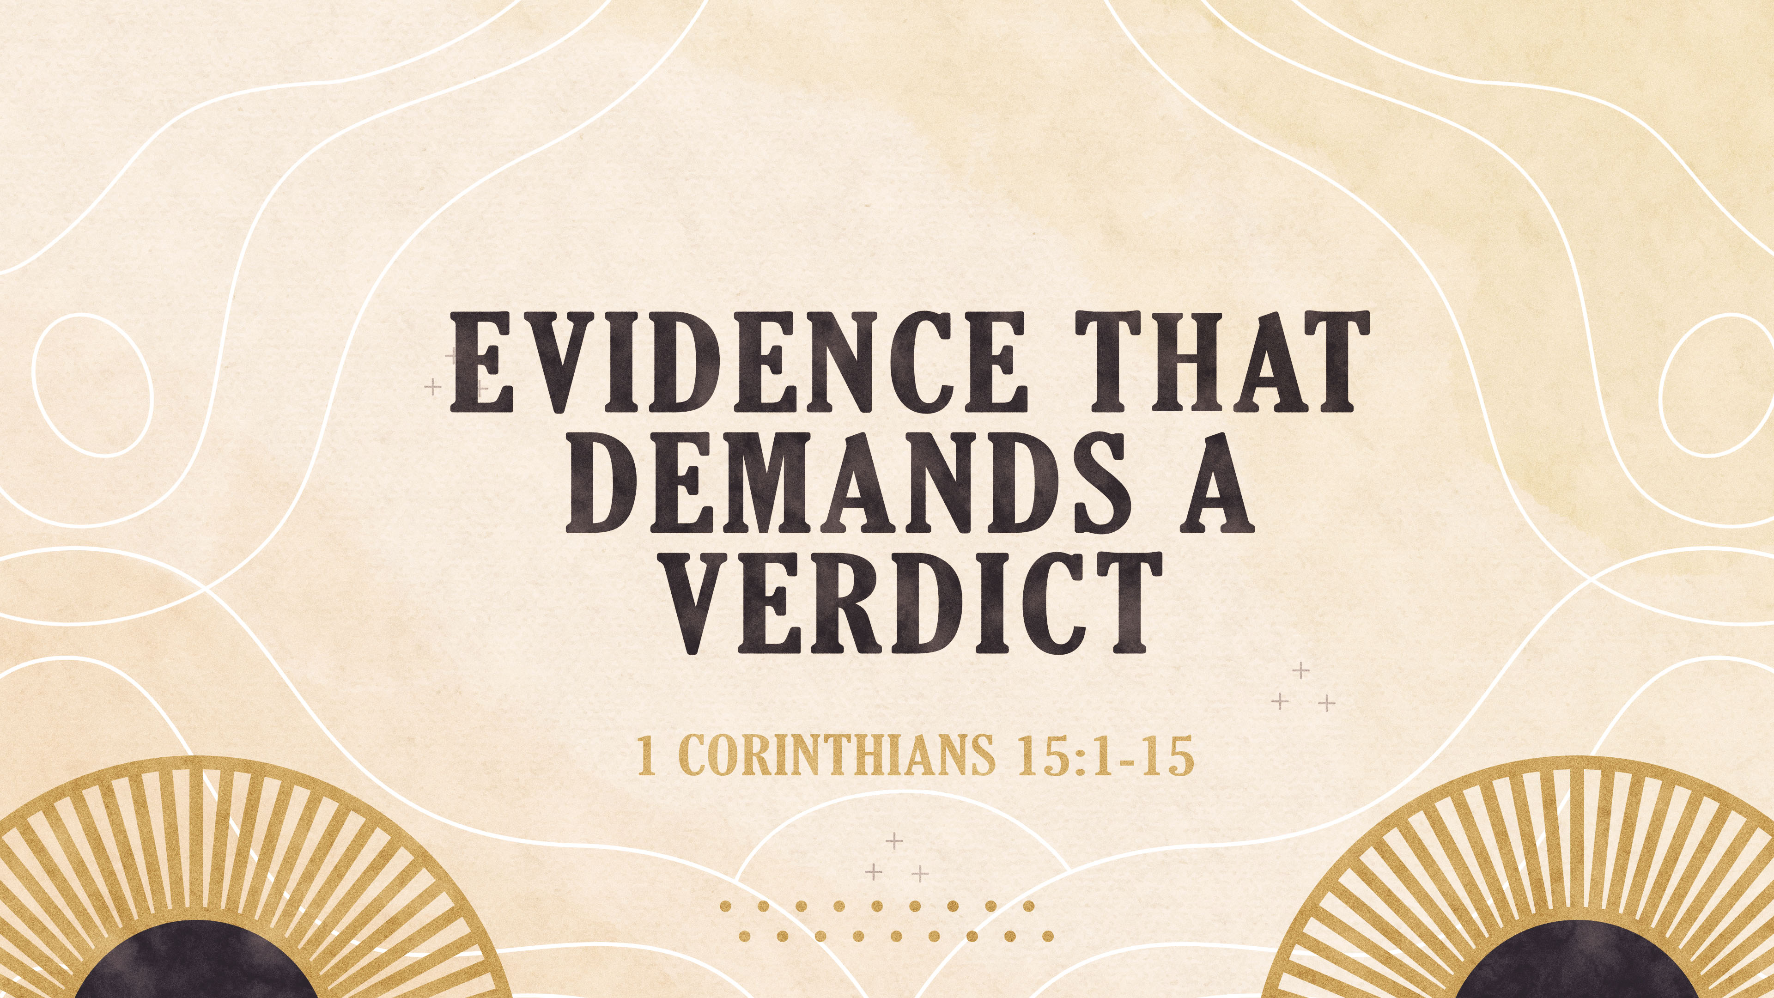

Slide 2
JOB 14:14
“If a man dies, will he live again?”

Slide 3
The age-old questions of death and immortality are only answered in the resurrection of Christ.

Slide 4
Just as the human body depends on the heart…
…The heart of the gospel of every true church depends on the death, burial and resurrection of Christ.

Slide 5
1 CORINTHIANS 15:1-2
1) Now, brothers, I want to remind you of the gospel I preached to you, which you received and on which you have taken your stand. 2) By this gospel you are saved, if you hold firmly to the word I preached to you. Otherwise, you have believed in vain.

Slide 6
1 CORINTHIANS 15:3-5
3) For what I received I passed on to you as of first importance : that Christ died for our sins according to the Scriptures, 4) that he was buried, that he was raised on the third day according to the Scriptures, 5) and that he appeared to Peter, and then to the Twelve.

Slide 7
1 CORINTHIANS 15:6-8
6) After that, he appeared to more than five hundred of the brothers at the same time, most of whom are still living, though some have fallen asleep. 7) Then he appeared to James, then to all the apostles, 8) and last of all he appeared to me also, as to one abnormally born.

Slide 8
1 CORINTHIANS 15:9-10
9) For I am the least of the apostles and do not even deserve to be called an apostle, because I persecuted the church of God. 10) But by the grace of God I am what I am, and his grace to me was not without effect. No, I worked harder than all of them--yet not I, but the grace of God that was with me.

Slide 9
1 CORINTHIANS 15:11-12
11) Whether, then, it was I or they, this is what we preach, and this is what you believed. 12) But if it is preached that Christ has been raised from the dead, how can some of you say that there is no resurrection of the dead?

Slide 10
1 CORINTHIANS 15:13-15
13) If there is no resurrection of the dead, then not even Christ has been raised. 14) And if Christ has not been raised, our preaching is useless and so is your faith. 15) More than that, we are then found to be false witnesses about God, for we have testified about God that he raised Christ from the dead. But he did not raise him if in fact the dead are not raised.

Slide 11
THERE ARE 5 WHO GIVE TESTIMONY TO THE RESURRECTION OF CHRIST
EVIDENCES THAT DEMAND A VERDICT!!!!

Slide 12
1st TESTIMONY—THE CHURCH
The church at Corinth and every true church around the world then and now is built on this foundation.

Slide 13
1st TESTIMONY—THE CHURCH
“Now, brothers, I want to remind you of the gospel I preached to you, which you received and on which you have taken your stand. By this gospel you are saved, if you hold firmly to the word I preached to you. Otherwise, you have believed in vain.” 1 Cor. 15:1-2

Slide 14
1st TESTIMONY—THE CHURCH
2000 years of church history is additional proof since that day.

Slide 15
2ND TESTIMONY—THE SCRIPTURES
1 Cor. 15:3-4 -- “For what I received I passed on to you as of first importance: that Christ died for our sins according to the Scriptures, that he was buried, that he was raised on the third day according to the Scriptures…”

Slide 16
2ND TESTIMONY—THE SCRIPTURES
Acts 26:22-23 – “I (Paul) am saying nothing beyond what the prophets and Moses said would happen– that the Christ would suffer and, as the first to rise from the dead, would proclaim light to his own people and to the Gentiles.”

Slide 17
2ND TESTIMONY—THE SCRIPTURES
Psalm 16:10 – “You will not abandon me to the grave, nor will you let your Holy One see decay.”

Slide 18
2ND TESTIMONY—THE SCRIPTURES
Matthew 28
Mark 15
Luke 24
John 20

Slide 19
3RD TESTIMONY—THE EYEWITNESSES
1 Cor. 15:5-7 – “He appeared to Peter, and then to the Twelve. After that, he appeared to more than 500 of the brothers at the same time, most of whom are still living, though some have fallen asleep. Then he appeared to James, then to all the apostles…”

Slide 20
3RD TESTIMONY—THE EYEWITNESSES
Peter
The Twelve
500 Brothers
James
All the Apostles

Slide 21
3RD TESTIMONY—THE EYEWITNESSES
Mary Magdalene– John 20:11-18
Other women—Matthew 28:9
2 disciples on the road to Emmaus—Luke 24.
Later—Stephen—Acts 7:55ff
Paul—Acts 9
John on Patmos—Rev. 1

Slide 22
4TH TESTIMONY—THE APOSTLE PAUL
1 Cor. 15:8– “And last of all he appeared to me also, as to one abnormally born. For I am the least of the apostles and do not even deserve to be called an apostle, because I persecuted the church of God.”

Slide 23
4TH TESTIMONY—THE APOSTLE PAUL
The Damascus road—Acts 9
At Corinth in a vision—Acts 18:9-10
In the Temple at Jerusalem—Acts 22:17ff
Later in Jerusalem—Acts 23:11
In a vision—2 Cor. 12:1-4

Slide 24
5TH TESTIMONY—THE COMMON MESSAGE
OF ALL TRUE BELIEVERS
1 Cor. 15:10 – “But by the grace of God I am what I am, and his grace to me was not without effect. No, I worked harder than all of them—yet not I, but the grace of God that was with me.”

Slide 25
5TH TESTIMONY—THE COMMON MESSAGE
OF ALL TRUE BELIEVERS
1 Cor. 15:11 – “Whether, then, it was
I or
they, this is what
we preach, and this is what
you believed.”

Slide 26
5TH TESTIMONY—THE COMMON MESSAGE
OF ALL TRUE BELIEVERS
The true gospel, (which includes the resurrection, wherever and whenever it was or is preached) is what makes us Christian.

Slide 27
5TH TESTIMONY—THE COMMON MESSAGE
OF ALL TRUE BELIEVERS
ARE YOU A TRUE BELIEVER?

Slide 28
5 TESTIMONIES
TO THE RESURRECTION
THE CHURCH,
THE SCRIPTURES,
THE EYEWITNESSES,
THE APOSTLE PAUL,
THE COMMON MESSAGE.

Slide 29
ARE YOU A TRUE BELIEVER?
The evidence demands a verdict, but just believing the evidence is not enough.
“You believe that there is one God. Good! Even the demons believe that– and shudder.” James 2:19.
You need to believe/trust in Jesus.

Slide 30
Acts 16:31
“Believe in the Lord Jesus, and you will be saved.”

Slide 31
John 1:12
“Yet to all who received him, to those who believed in his name, he gave the right to become children of God.”

Slide 32
Hebrews 7:25
“He is able to save completely (to the uttermost-- KJV) those who come to God through him…”

Slide 33
Hebrews 9:27
“…Man is destined to die once, and after that to face judgment.”

Slide 34
Proverbs 29:1
“A man who remains stiff-necked after many rebukes will suddenly be destroyed—and that without remedy.”

Slide 35
Acts 4:12
“Salvation is found in no one else, for there is no other name under heaven given to men by which we must be saved.”

Slide 36
Romans 10:9 & 13
“That if you confess with your mouth, “Jesus is Lord,” and believe in your heart that God raised him from the dead, you will be saved.”
“Everyone who calls on the name of the Lord will be saved.”

Slide 37
John 3:7
“You must be born again.” Jesus
The decision is yours. What will you do?

Slide 38
Romans 10:9
“That if you confess with your mouth, “Jesus is Lord,” and believe in your heart that God raised him from the dead, you will be saved.”

Slide 39
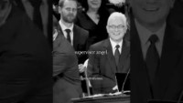

Slide 40
LOW IN THE GRAVE HE LAY
HYMN # 160

