Slide 1
Ezra &
Nehemiah
Restoring God’s People and Community

Slide 2
Ezra / Nehemiah
Authors: Ezra and Nehemiah
Most agree that these two books were once combined
Written in 500 “ish” BC
Continues off where 2 Chronicles ends.
Ezra – Rebuilding the temple
Nehemiah – Rebuilding the city and walls
Ezra / Nehemiah – Restoring God’s people
“Ezra and Nehemiah both serve as examples of God’s power in covenant faithfulness, moving even pagan kings to accomplish his redemptive purposes.”

Slide 3
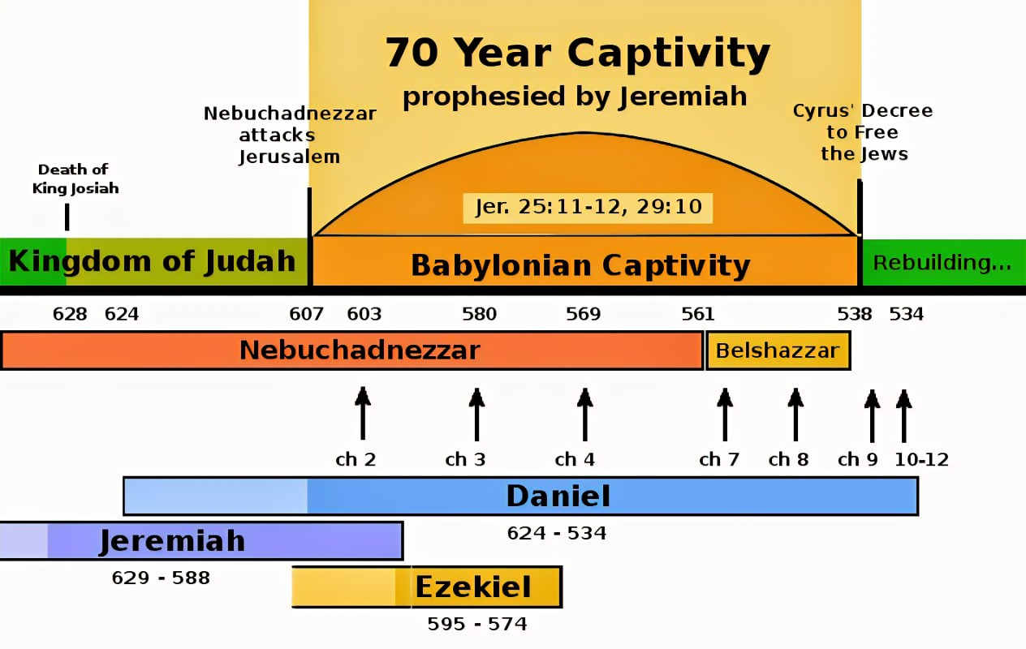
Timeline of Captivity and Exile
Ezra

Slide 4
Ezra 1
God Stirs Up His People

Slide 5
Ezra 1:1 – God Stirs Up Cyrus
“In the first year of Cyrus king of Persia, that the word of the LORD by the mouth of Jeremiah might be fulfilled, the LORD stirred up the spirit of Cyrus king of Persia, so that he made a proclamation throughout all his kingdom and also put it in writing:”
Isaiah 42:28 “who says of Cyrus, ‘He is my shepherd, and he shall fulfill all my purpose’; saying of Jerusalem, ‘She shall be built,’ and of the temple, ‘Your foundation shall be laid.”

Slide 6
Ezra 1:2-4 – Cyrus Responds
“Thus says Cyrus king of Persia: The LORD, the God of heaven, has given me all the kingdoms of the earth, and he has charged me to build him a house at Jerusalem, which is in Judah. Whoever is among you of all his people, may his God be with him, and let him go up to Jerusalem, which is in Judah, and rebuild the house of the LORD, the God of Israel—he is the God who is in Jerusalem. And let each survivor, in whatever place he sojourns, be assisted by the men of his place with silver and gold, with goods and with beasts, besides freewill offerings for the house of God that is in Jerusalem.”

Slide 7
Ezra 1:5 – God Stirs Up His People
“Then rose up the heads of the fathers’ houses of Judah and Benjamin, and the priests and the Levites, everyone whose spirit God had stirred to go up to rebuild the house of the LORD that is in Jerusalem.”

Slide 8
Ezra 1:6-11 – Israel Responds
“And all who were about them aided them with vessels of silver, with gold, with goods, with beasts, and with costly wares, besides all that was freely offered. Cyrus the king also brought out the vessels of the house of the LORD that Nebuchadnezzar had carried away from Jerusalem and placed in the house of his gods. Cyrus king of Persia brought these out in the charge of Mithredath the treasurer, who counted them out to Sheshbazzar the prince of Judah. And this was the number of them: 30 basins of gold, 1,000 basins of silver, 29 censers, 30 bowls of gold, 410 bowls of silver, and 1,000 other vessels; all the vessels of gold and of silver were 5,400. All these did Sheshbazzar bring up, when the exiles were brought up from Babylonia to Jerusalem.”

Slide 9
Key Takeaway #1
God is still stirring up His people
Hebrews 10:24 “And let us consider how to stir up one another to love and good works”

Slide 10
Key Takeaway #2
When God stirs, God provides
Philippians 4:19 “And my God will supply every need of yours according to his riches in glory in Christ Jesus.”
Matthew 6:31-32 “Therefore do not be anxious, saying, ‘What shall we eat?’ or ‘What shall we drink?’ or ‘What shall we wear?’ For the Gentiles seek after all these things, and your heavenly Father knows that you need them all.”

Slide 11
Luke 4:18-19
“The Spirit of the Lord is upon me, because he has anointed me to proclaim good news to the poor. He has sent me to proclaim liberty to the captives and recovering of sight to the blind, to set at liberty those who are oppressed, to proclaim the year of the Lord’s favor.”

