Slide 1


Slide 2
Israel’s Messiah is Coming
Israel taken captive by Babylon --- 600 years before Christ.
70 years in captivity.
Daniel’s prophecy---70 weeks (of years).
Daniel 9:26 --- From a decree to restore and rebuild Jerusalem…after 69 weeks (483 years) Messiah will be cut off.
Nehemiah 2:1-8 --- March 14, 445 B.C.

Slide 3
Israel’s Messiah is Coming
Some people were counting the years.
Simeon---”He was waiting for the consolation of Israel” Luke 2:25.
Anna the prophetess---”…was looking forward to the redemption of Jerusalem” (Luke 2:38).
Magi--- “We have seen His star in the East” (Matt. 2:2).

Slide 4
Luke 1:26-27
“In the sixth month, God sent the angel Gabriel to Nazareth, a town in Galilee, to a virgin pledged to be married to a man named Joseph, a descendant of David. The virgin’s name was Mary.”

Slide 5
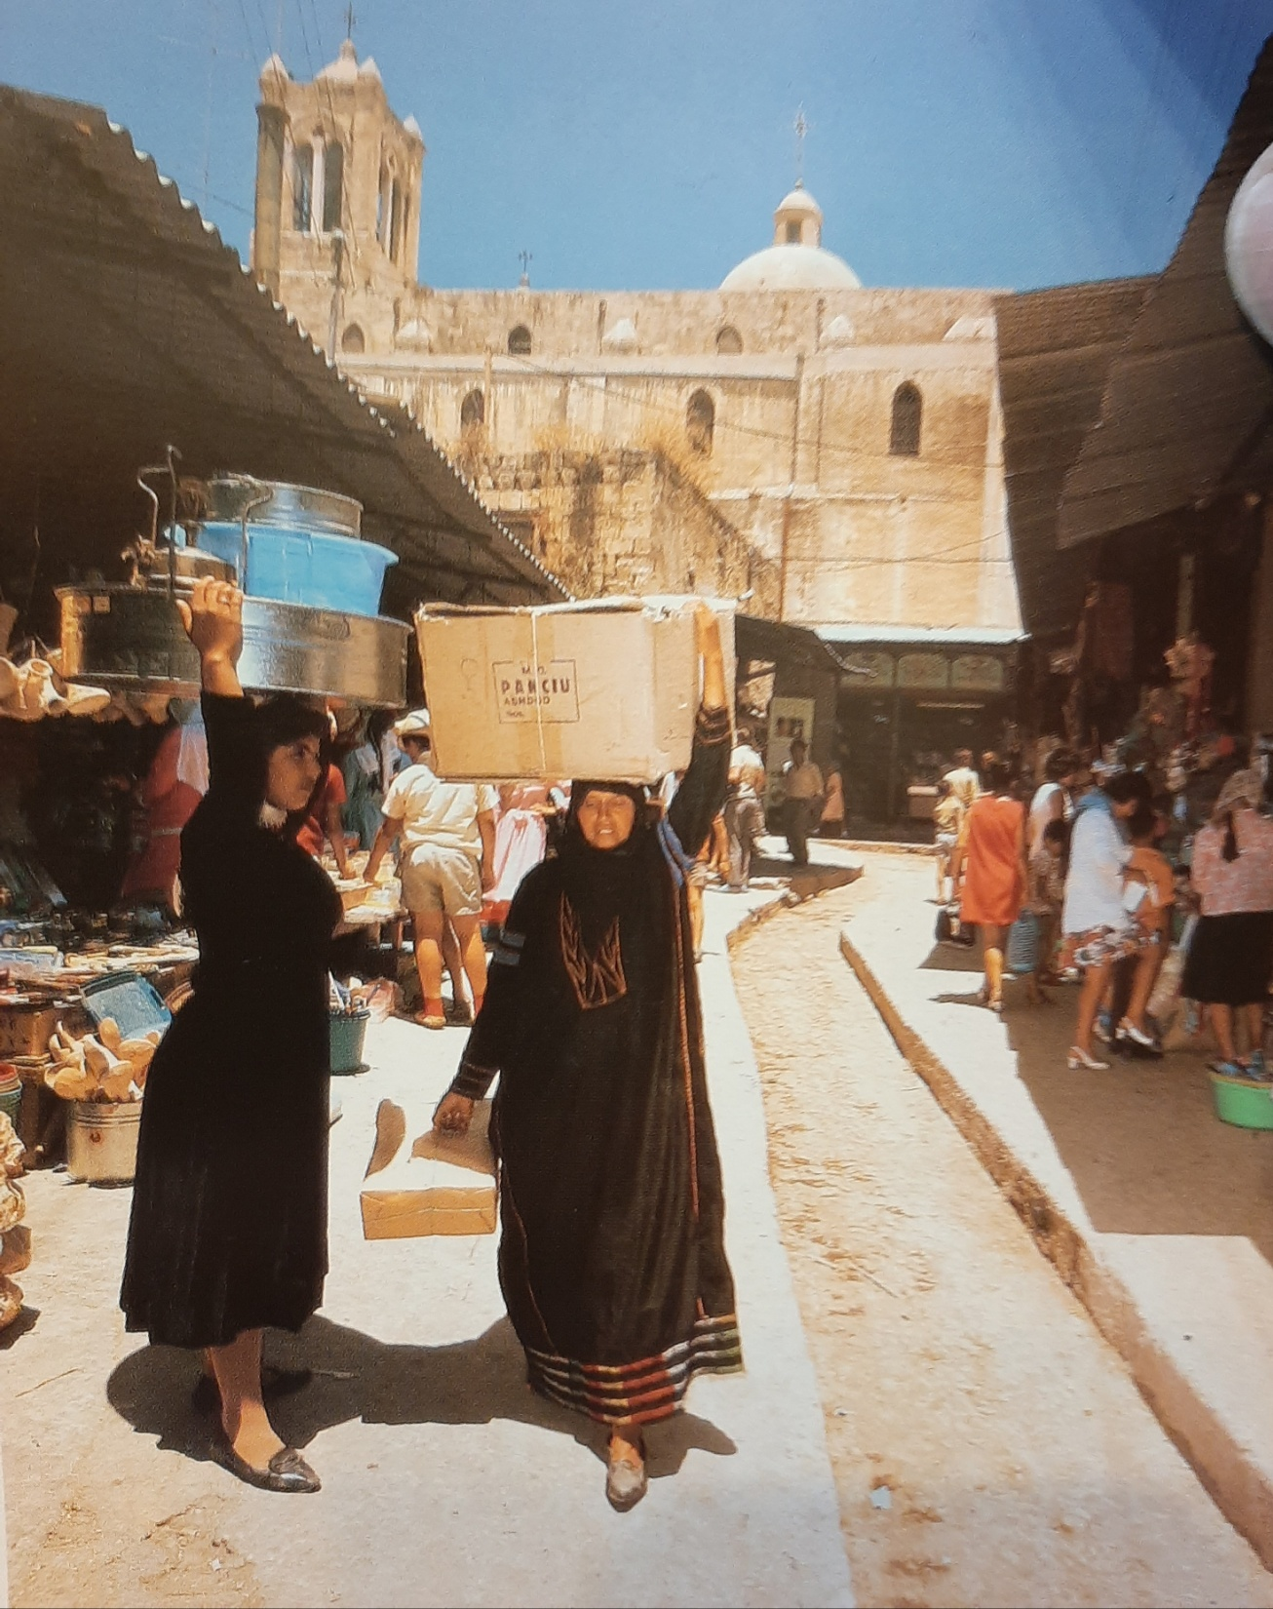
Market in Nazareth

Slide 6
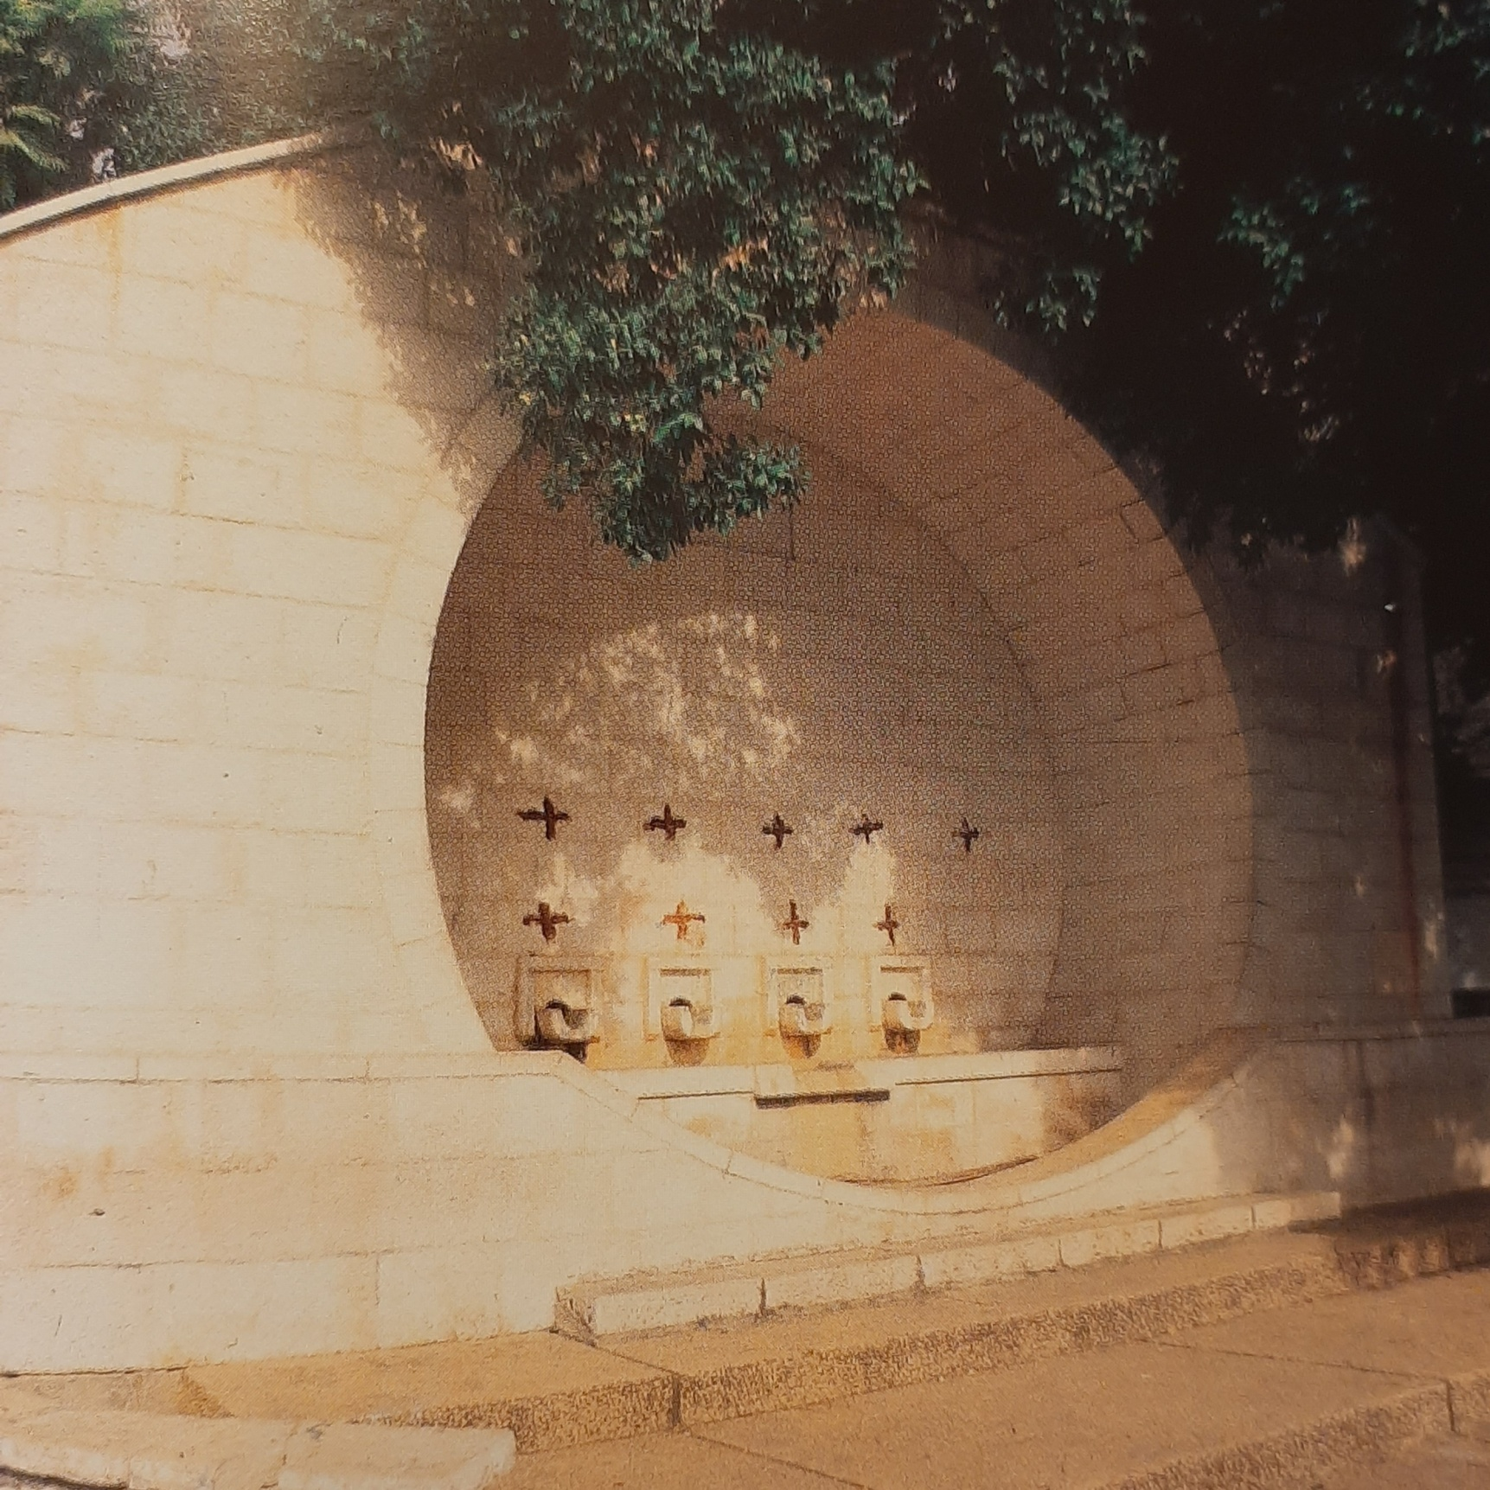
Mary’s Well

Slide 7
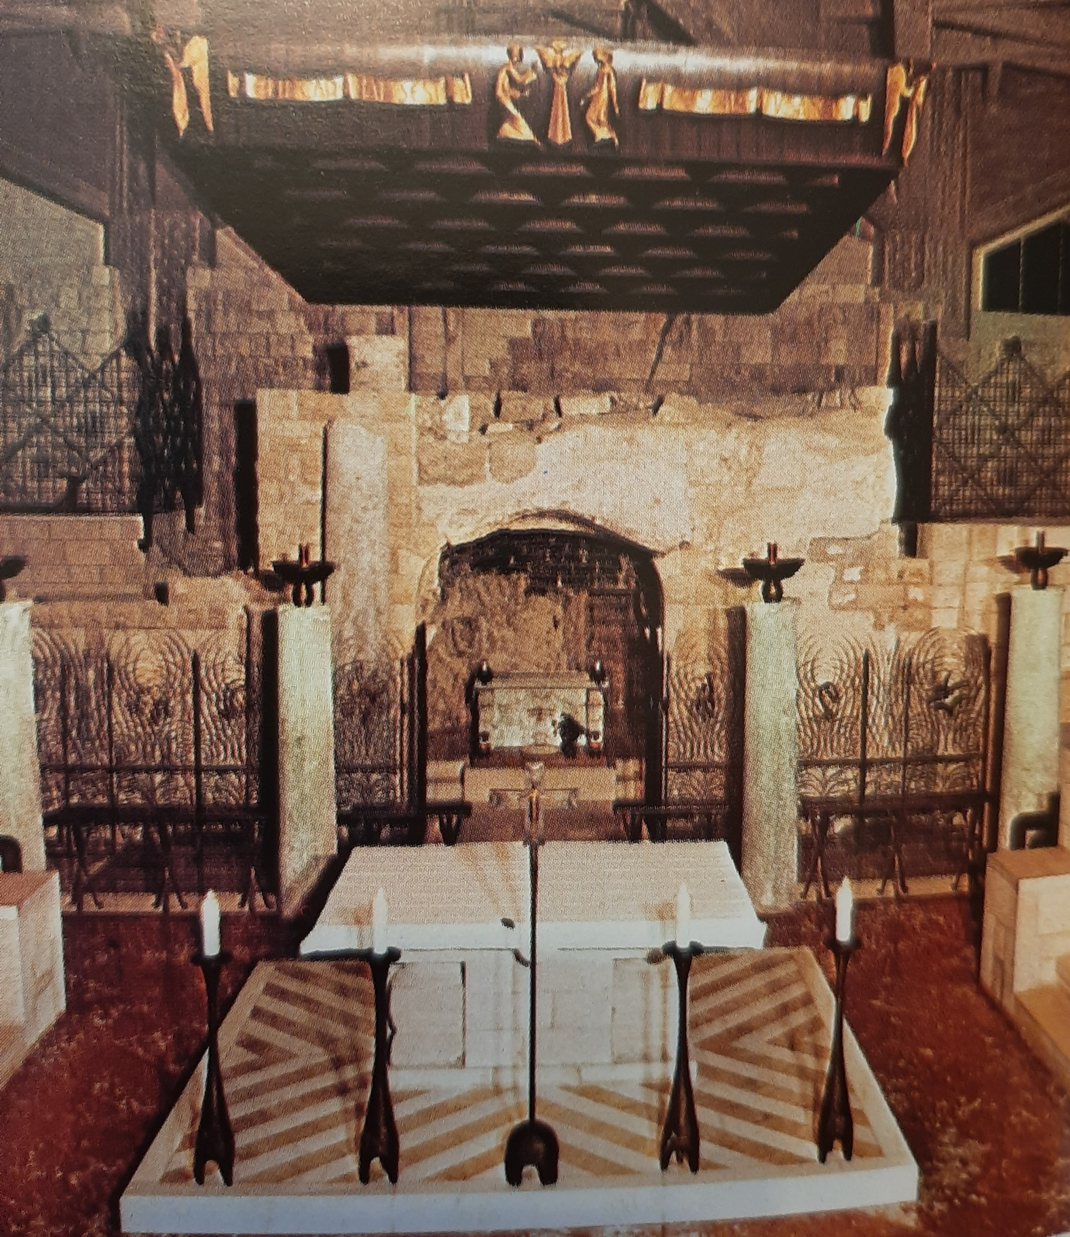
Grotto of the Annunciation

Slide 8
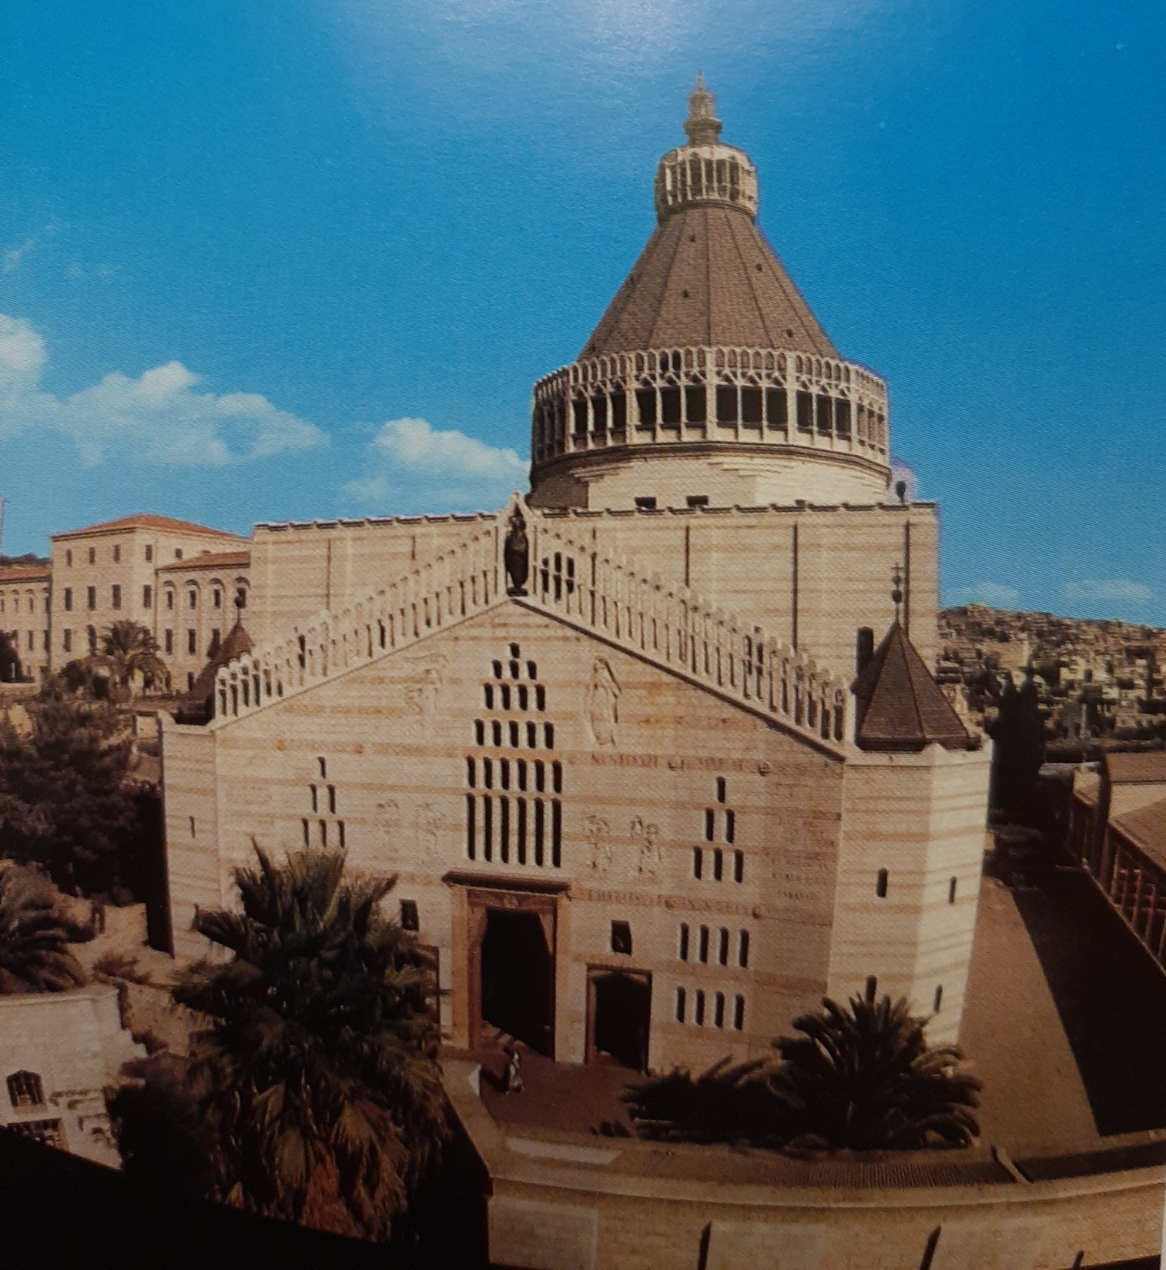
The Church of the Annunciation

Slide 9
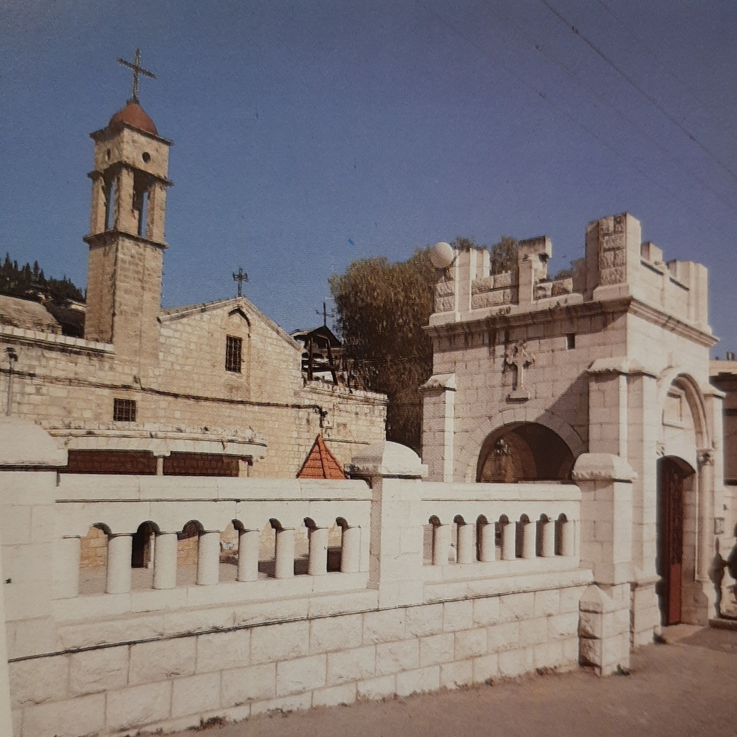
Church of St. Gabriel 12th Century

Slide 10
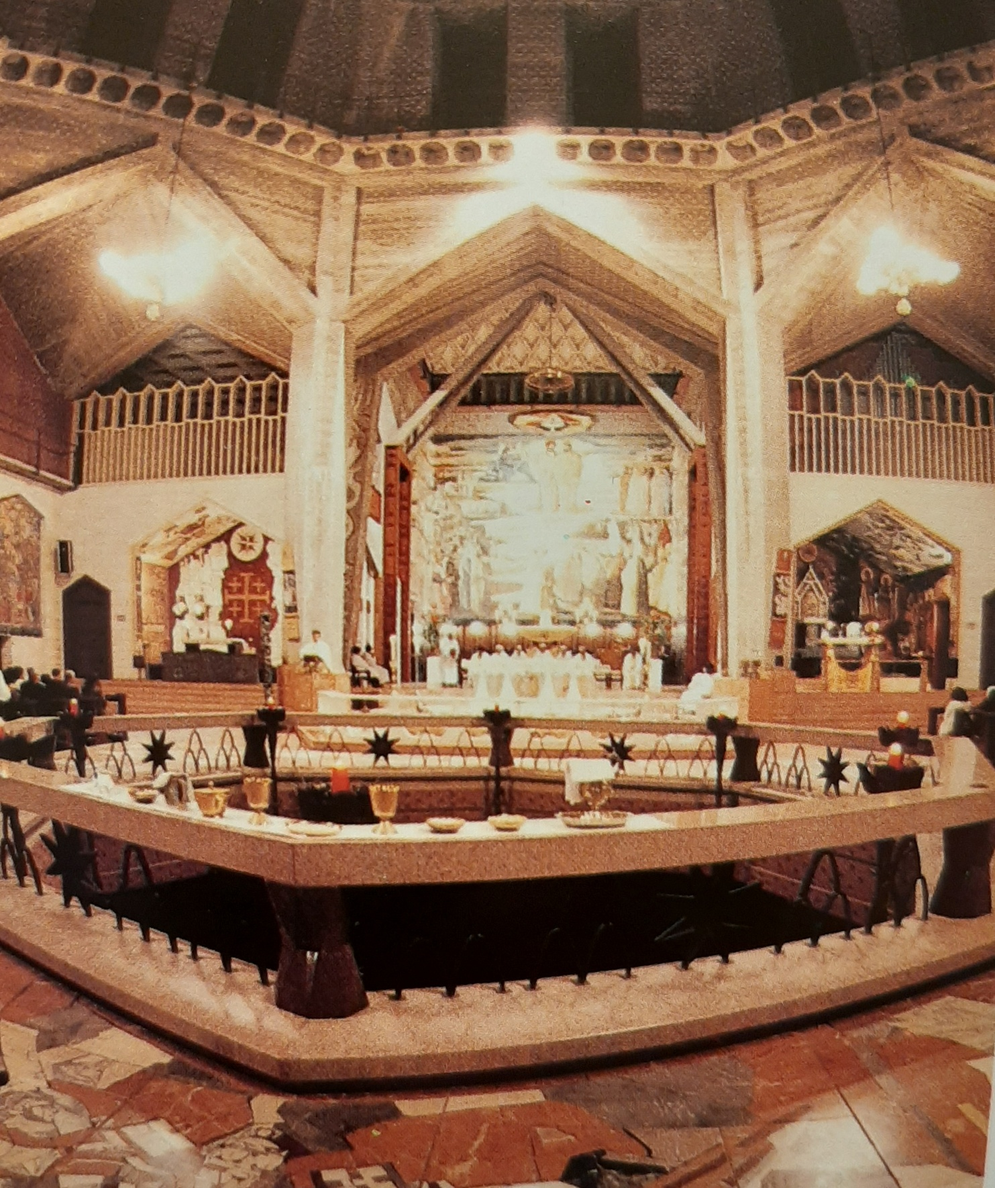
Church of St. Gabriel

Slide 11
Luke 1:26-38

Slide 12
Luke 1:26-27
“In the sixth month, God sent the angel Gabriel to Nazareth, a town in Galilee, to a virgin pledged to be married to a man named Joseph, a descendant of David. The virgin’s name was Mary.”

Slide 13
Luke 1:28
“The angel went to her and said, “Greetings, you who are highly favored! The Lord is with you.”

Slide 14
Luke 1:29-30
“Mary was greatly troubled at his words and wondered what kind of greeting this might be. But the angel said to her, “Do not be afraid, Mary, you have found favor with God.”

Slide 15
Luke 1:31-32
“You will be with child and give birth to a son, and you are to give him the name Jesus. He will be great and will be called the Son of the Most High. The Lord God will give him the throne of his father David.”

Slide 16
Luke 1:33
“And he will reign over the house of Jacob forever; his kingdom will never end.”

Slide 17
Luke 1:34
“How will this be,” Mary asked the angel, “since I am a virgin?”

Slide 18
Luke 1:35
“The angel answered, “The Holy Spirit will come upon you, and the power of the Most High will overshadow you. So the holy one to be born will be called the Son of God.”

Slide 19
Luke 1:36-37
“Even Elizabeth your relative is going to have a child in her old age, and she who was said to be barren is in her sixth month. For nothing is impossible with God .”

Slide 20
Luke 1:38
“Behold the handmaid of the Lord” (KJV)
“I am the Lord’s servant,” Mary answered. “May it be to me as you have said.” Then the angel left her.” (NIV)

Slide 21
The heavens have been silent for 400 years.
God was right on schedule.
“The plan of him who works out everything in conformity with the purpose of his will” (Eph. 1:11).

Slide 22

The heavens have been silent for 400 years.
“But when the time had fully come, God sent his Son, born of a woman, born under law, to redeem us…” (Gal. 4:4).

Slide 23
4 Crucial Facts Mary needs to know.
1. The virgin will conceive and give birth to a human baby boy. (Luke 1:31)

Slide 24
Luke 1:34
“How will this be,” Mary asked the angel, “since I am a virgin?”

Slide 25
Isaiah 7:14
“Therefore the Lord himself will give you a sign: The virgin will be with child and will give birth to a son, and will call him Immanuel.”

Slide 26
4 Crucial Facts Mary needs to know.
1. The Virgin will conceive.

Slide 27
4 Crucial Facts Mary needs to know.
2. God Himself will become man. (Luke 1:32)

Slide 28
Luke 1:31-32
“You will be with child and give birth to a son, and you are to give him the name Jesus. He will be great and will be called the Son of the Most High.”

Slide 29
4 Crucial Facts Mary needs to know.
1. Virgin will conceive.
2. God will become Man.

Slide 30
4 Crucial Facts Mary needs to know.
3. “He will save His people from their sins.” (Luke 1:31 & Matthew 1:21)

Slide 31
Acts 4:12
“Salvation is found in no one else, for there is no other name under heaven given to men by which we must be saved.”

Slide 32
Acts 2:38
“Peter replied, “Repent and be baptized, every one of you, in the name of Jesus Christ for the forgiveness of your sins.”

Slide 33
Hebrews 10:10
“…We have been made holy through the sacrifice of the body of Jesus Christ once for all.”

Slide 34
4 Crucial Facts Mary needs to know.
1. Virgin will conceive.
2. God will become Man.
3. Jesus will save His people from sin.

Slide 35
4 Crucial Facts Mary needs to know.
4. Jesus will be the King of Israel. (Luke 1:32-33)

Slide 36
Luke 1:32
“The Lord God will give him the throne of his father David.”

Slide 37
Luke 1:33
“And he will reign over the house of Jacob forever; his kingdom will never end.”

Slide 38
The Future Kingdom Reign
God has had this in His plan from the beginning.
Israel as a nation rejected Him, but it did not thwart God’s plan.

Slide 39
The Lord’s Prayer
“Your kingdom come, your will be done on earth as it is in heaven…” (Matthew 6:10).

Slide 40
Romans 11:1-2
“I ask then: Did God reject his people? By no means!...God did not reject his people, whom he foreknew.”

Slide 41
Romans 11:25
“I do not want you to be ignorant of this mystery, brothers, so that you may not be conceited: Israel has experienced a hardening in part until the full number of the Gentiles has come in.”

Slide 42
Romans 11:26,27
“And so all Israel will be saved…”
“When I take away their sins.”

Slide 43
Revelation 19:11ff
“I saw heaven standing open and there before me was a white horse, whose rider is called Faithful and True…His name is the Word of God…He will rule them with an iron scepter….KING OF KINGS AND LORD OF LORDS.”

Slide 44
4 Crucial Facts Mary needs to know.
1. Virgin will conceive.
2. God will become Man.
3. Jesus will save His people from sin.
4. Jesus will be king over Israel forever.

Slide 45
HOW DID MARY RESPOND?
“Behold the handmaid of the Lord.” (KJV)
“I am the Lord’s servant,” Mary answered. “May it be to me as you have said.” Luke 1:38 (NIV)

Slide 46
How will you respond to God’s Word?
“Why do you call me, ‘Lord, Lord’ and do not do what I say?” (Luke 6:46).

Slide 47
How will you respond to God’s Word?
“I can do everything through him who gives me strength.” (Phil. 4:13).
“If you love me, you will obey what I command.” (John 14:15)

Slide 48
How will you respond to God’s Word?
“And this is his command: to believe in the name of his Son, Jesus Christ, and to love one another as he commanded us. (1 John 3:23).

Slide 49
PASS ME NOT, O GENTLE SAVIOR
HYMN #308

