Slide 1
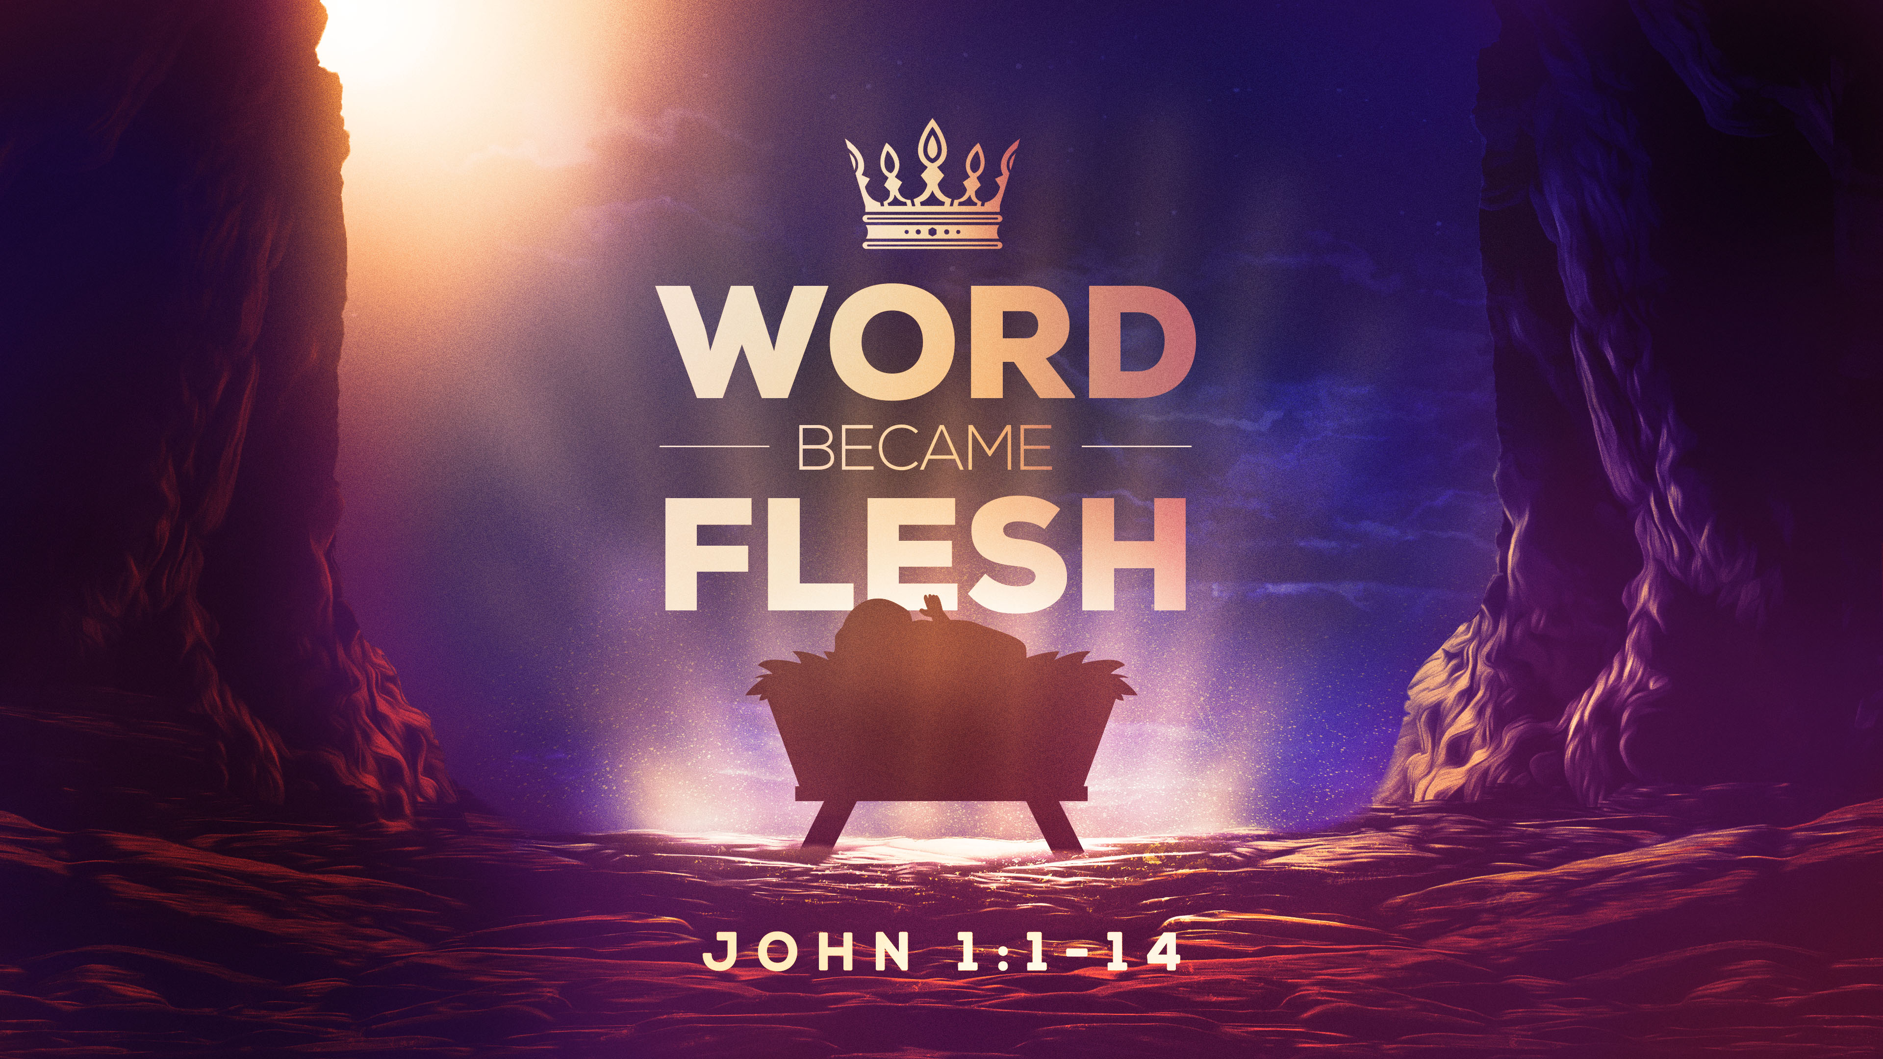

Slide 2
JOHN 1:14
“THE WORD became flesh and made his dwelling among us. We have seen his glory, the glory of the One and Only who came from the Father, full of grace and truth.”

Slide 3
John 1:1-5
“In the beginning was the Word, and the Word was with God, and the Word was God. He was with God in the beginning. Through him all things were made; without him nothing was made that has been made. In him was life, and that life was the light of men. The light shines in the darkness, but the darkness has not understood it.”

Slide 4
JOHN 1:6-9
There came a man who was sent from God; his name was John. 7 He came as a witness to testify concerning that light, so that through him all men might believe. 8 He himself was not the light; he came only as a witness to the light. 9 The true light that gives light to every man was coming into the world.

Slide 5
JOHN 1:10-13
He was in the world, and though the world was made through him, the world did not recognize him. 11 He came to that which was his own, but his own did not receive him. 12 Yet to all who received him, to those who believed in his name, he gave the right to become children of God– 13 children born not of natural descent, nor of human decision or a husband's will, but born of God.

Slide 6
JOHN 1:14
“THE WORD became flesh and made his dwelling among us. We have seen his glory, the glory of the One and Only who came from the Father, full of grace and truth.”

Slide 7
THE WORD
“The Word” is one of the names for Jesus.
He is also called Wonderful Counselor, Almighty God, Prince of Peace, Redeemer, Lord, the Way the Truth and the Life, etc.

Slide 8
THERE ARE 3 IMPORTANT PARTS TO THE CHRISTMAS STORY.
1. GOD’S PART
2. THEIR PART
3. OUR PART

Slide 9
1. GOD’S PART
“The Word became flesh.”
God became man.

Slide 10
1. GOD’S PART
Isaiah 7:14– “The Lord himself will give you a sign: The virgin will be with child and will give birth to a son, and will call him Immanuel.”

Slide 11
1. GOD’S PART
Immanuel=“God with us”.
The Creator, eternal and everlasting Ruler of the whole earth---is with us sinners!!!!!

Slide 12
1. GOD’S PART
He “made his dwelling among us.” John. 1:14
A QUANTUM LEAP FORWARD

Slide 13
1. GOD’S PART
His “dwelling” (Greek--skenoo).
Old Testament “Tabernacle” (LXX--skene).
God’s glory actually dwelt in the Holy of Holies.
He “tabernacled” among us.

Slide 14
2. THEIR PART
“We have seen his glory, the glory of the One and Only, who came from the Father, full of grace and truth.” John 1:14b
Who saw? Mary, Joseph, shepherds, Magi, John and the apostles, etc.

Slide 15
2. THEIR PART
“We have seen” JOHN 1:14(NIV),
“We beheld” (KJV),
Literally, “we gazed upon with understanding”.
Same root word for “theater” (theatron in Greek).

Slide 16
2. THEIR PART
JOHN 1:16-18– “From the fullness of his grace we have all received one blessing after another. 17 For the law was given through Moses; grace and truth came through Jesus Christ. 18 No one has ever seen God, but God the One and Only, who is at the Father's side, has made him known.”

Slide 17
2. THEIR PART
1 John 1:1--- “That which was from the beginning, which we have heard, which we have seen with our eyes, which we have looked at and our hands have touched—this we proclaim concerning the Word of life.”

Slide 18
3. OUR PART
WHAT WILL YOU DO WITH JESUS?
It is not enough to just know the Christmas story.

Slide 19
2. OUR PART
John 20:31--- Jesus did many other things--“But these are written that you may believe that Jesus is the Christ, the Son of God, and that by believing you may have life in his name.”

Slide 20
3. OUR PART
John 1:11-12 -- “He came to that which was his own, but his own did not receive him. Yet to all who received him, to those who believed in his name, he gave the right to become children of God.”

Slide 21
3. OUR PART
Believe in His name=Receive Him.
Synonymous terms.
Both head and heart.

Slide 22
3. OUR PART
“…He gave [us, you & me] the right to become children of God!” John 1:12

Slide 23
John 14:6
“Jesus answered, “I am the way and the truth and the life. No one comes to the Father except through me.”

Slide 24
3 IMPORTANT PARTS TO THE CHRISTMAS STORY.
1. GOD’S PART
2. THEIR PART
3. OUR PART

Slide 25
Romans 10:13
“Everyone who calls on the name of the Lord will be saved.”

Slide 26
O COME, ALL YE FAITHFUL
HYMN # 89

