Slide 1
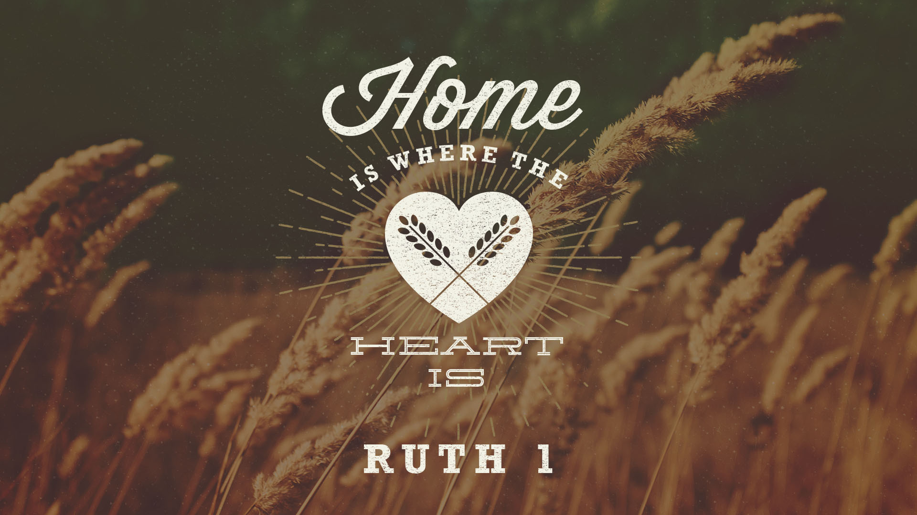

Slide 2
THE PRODIGAL SON, A PARABLE OF JESUS
RUTH 1 IS THE STORY OF A PRODIGAL DAUGHTER.
Set in the time of the Judges—notice the order of OT books.
Located in Israel and Moab.

Slide 3
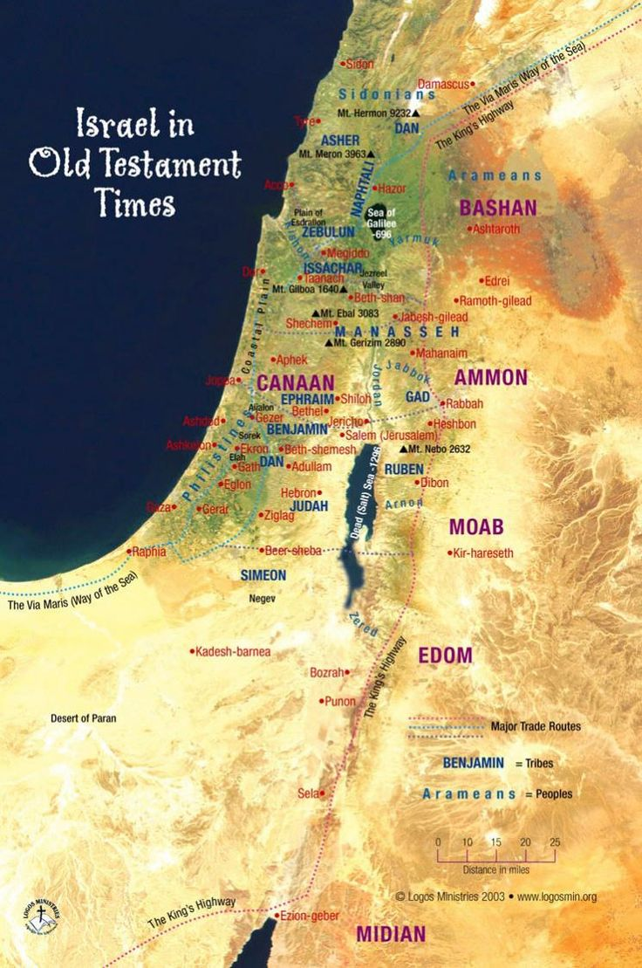
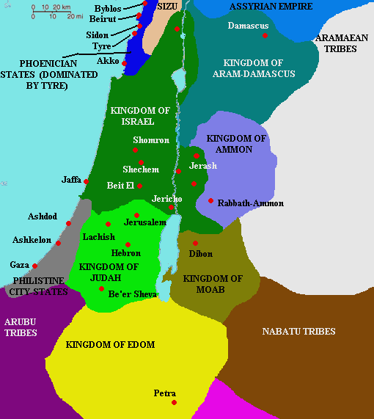

Slide 4
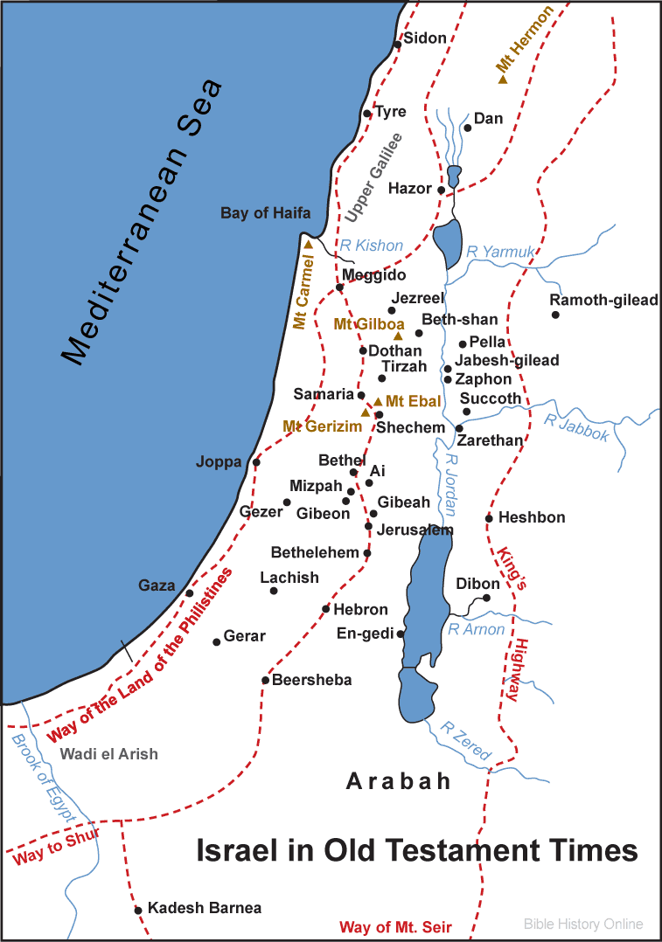

Slide 5
RUTH 1:1
1) In the days when the judges ruled, there was a famine in the land, and a man from Bethlehem in Judah, together with his wife and two sons, went to live for a while in the country of Moab.

Slide 6
RUTH 1:2
2) The man's name was Elimelech, his wife's name Naomi, and the names of his two sons were Mahlon and Kilion. They were Ephrathites from Bethlehem, Judah. And they went to Moab and lived there.

Slide 7
RUTH 1:3-5
3) Now Elimelech, Naomi's husband, died, and she was left with her two sons. 4) They married Moabite women, one named Orpah and the other Ruth. After they had lived there about ten years, 5) both Mahlon and Kilion also died, and Naomi was left without her two sons and her husband.

Slide 8
RUTH 1:6-7
6) When she heard in Moab that the Lord had come to the aid of his people by providing food for them, Naomi and her daughters-in-law prepared to return home from there. 7) With her two daughters-in-law she left the place where she had been living and set out on the road that would take them back to the land of Judah.

Slide 9
RUTH 1:8
8) Then Naomi said to her two daughters in-law, "Go back, each of you, to your mother's home. May the Lord show kindness to you, as you have shown to your dead and to me.

Slide 10
RUTH 1:9-10
9) May the Lord grant that each of you will find rest in the home of another husband." Then she kissed them and they wept aloud 10) and said to her, "We will go back with you to your people.”

Slide 11
RUTH 1:11
11) But Naomi said, "Return home, my daughters. Why would you come with me? Am I going to have any more sons, who could become your husbands?

Slide 12
RUTH 1:12
12) Return home, my daughters; I am too old to have another husband. Even if I thought there was still hope for me-even if I had a husband tonight and then gave birth to sons.”

Slide 13
RUTH 1:13-14
13) “Would you wait until they grew up? Would you remain unmarried for them? No, my daughters. It is more bitter for me than for you, because the Lord 's hand has gone out against me!" 14) At this they wept again. Then Orpah kissed her mother-in-law good-by, but Ruth clung to her.

Slide 14
RUTH 1:15-16
15) "Look," said Naomi, "your sister-in-law is going back to her people and her gods. Go back with her." 16) But Ruth replied, "Don't urge me to leave you or to turn back from you. Where you go I will go, and where you stay I will stay. Your people will be my people and your God my God.”

Slide 15
RUTH 1:17-18
17) “Where you die I will die, and there I will be buried. May the Lord deal with me, be it ever so severely, if anything but death separates you and me." 18) When Naomi realized that Ruth was determined to go with her, she stopped urging her.

Slide 16
RUTH 1:19-20
19) So the two women went on until they came to Bethlehem. When they arrived in Bethlehem, the whole town was stirred because of them, and the women exclaimed, "Can this be Naomi?" 20) "Don't call me Naomi, " she told them. "Call me Mara, because the Almighty has made my life very bitter.”

Slide 17
RUTH 1:21-22
21) “I went away full, but the Lord has brought me back empty. Why call me Naomi? The Lord has afflicted me; the Almighty has brought misfortune upon me." 22) So Naomi returned from Moab accompanied by Ruth the Moabitess, her daughter-in-law, arriving in Bethlehem as the barley harvest was beginning.

Slide 18
This is a Story in the time of the Judges
Probably around the time of Gideon.
Maybe 100 years before King David.
“Everyone did as he saw fit.” Judges 21:25
They are from Bethlehem, “House of Bread.”

Slide 19
This is the Story of a Prodigal Daughter
There is a famine in Israel.
Moab has some food.
“Moab is my washbasin.” Psalm 108:9, think of a garbage can.
Descendants of Lot through his daughter!

Slide 20
This is the Story of 3 Widows
Naomi- “pleasant.”
Orpah- “stiff-necked.”
Ruth- “companion, friend.”
3 husbands– Elimelech- “My God is king.”
Mahlon- “Sickly.”
Kilion- “Puny.”

Slide 21
Home is where the Heart is.
Let’s take a closer look at these 3 ladies.
Let’s see where their hearts are.

Slide 22
1. Orpah
She is a Moabitess.
They worshiped idols, namely Cheosh (1 Kings 11:7, 33 “The detestable god of the Moabites”).
Moab was despised like the Samaritans would be later.
Moab had refused to help Moses.
Moab had hired Balaam.

Slide 23
1. Orpah
Orpah married into a Jewish family.
She becomes a widow after about 10 years.
She is at a crossroads. What will she do?

Slide 24
1. Orpah
She makes the wrong decision. She goes the wrong way. It is a life-changing choice.
We never hear any more about her.
Like many who make a decision for Christ, join the church, but later turn away.
She goes back to idols, to marry, to be comfortable, etc.

Slide 25
Home is where the Heart is.
Where is her heart?
Let’s look at Naomi, and her heart.

Slide 26
2. Naomi
Probably a devout and religious Jewess.
But like the prodigal son she ran away and it turned out badly.
She comes to this crossroads, too.
What will she do?

Slide 27
2. Naomi
3 times she begs them to go back.
Back to home.
Back to remarry.
She tries to talk them out of going to Israel.
A strange law called Levirate marriage. Brothers were to marry the widows of their brothers!

Slide 28
2. Naomi
Naomi worships the true God, but points her daughters away from the truth.
She is like so many Christians; carnal, worldly.
She is more concerned with material things, finding a husband, job, home, etc.
What about the spiritual needs?

Slide 29
John 3:16
“For God so loved the world that he gave his one and only Son, that whoever believes in him shall not perish but have eternal life.”

Slide 30
1 Cor. 7:14
“…The unbelieving wife has been sanctified through her believing husband. Otherwise your children would be unclean, but as it is, they are holy.”
Naomi should have been pointing her to Jehovah God, but…

Slide 31
Home is where the Heart is.
Where is her heart?
Let’s look at Ruth, and her heart.

Slide 32
3. Ruth
She is a Moabitess.
They worshiped idols, namely Cheosh.
Moab was despised like the Samaritans would be later.
Moab had refused to help Moses.
Moab had hired Balaam.

Slide 33
3. Ruth
Ruth- “friend, companion.”
She comes to the same crossroads and makes a completely different choice.

Slide 34
RUTH 1:16
“But Ruth replied, "Don't urge me to leave you or to turn back from you. Where you go I will go, and where you stay I will stay. Your people will be my people and your God my God.”

Slide 35
3. Ruth
She married into a good Jewish family and had watched them for 10 years!
Did they talk much about God?
Did they have family worship?
Naomi did a lot of things wrong, but she must have done a lot of things right.

Slide 36
3.Ruth
“Your God will be my God!”
Biblical faith is saving faith.
It may not be great faith, but it is faith in a Great God.
“Thin ice” kind of faith, possibly.

Slide 37
3. Ruth
Hebrews 11:6- “..without faith it is impossible to please God.”
Hebrews 11:1- “Now faith is being sure of what we hope for and certain of what we do not see.”

Slide 38
3. Ruth
Ephesians 2:8- “For it is by grace you have been saved, through faith—and this not from yourselves, it is the gift of God.”

Slide 39
3. Ruth
John 3:36- “Whoever believes in the Son has eternal like, but whoever rejects the Son will not see life, for God’s wrath remains on him.”

Slide 40
John 3:16
“For God so loved the world that he gave his one and only Son, that whoever believes in him shall not perish but have eternal life.”

Slide 41
Romans 3:23
“For all have sinned and fall short of the glory of God.”
Rom. 3:10– “There is no one righteous, not even one.”
Rom. 3:12– “All have turned away…there is no one who does good, not even one.”

Slide 42
HAVE YOU BEEN SAVED?
“Everyone who calls on the name of the Lord will be saved.” Romans 10:13
“For it is by grace you have been saved, through faith—and this not from yourselves, it is the gift of God—not by works, so that no one can boast.” Ephesians 2:8-9

Slide 43
Rev. 3:20
“Here I am! I stand at the door and knock. If anyone hears my voice and opens the door, I will come in and eat with him, and he with me.”

Slide 44
3 Choices, 3 Women, 3 Life-changing Results
Orpah- Close, but more concerned with the world.
Naomi- Carnal, but still a child of God.
Ruth- Convinced, converted and committed!!
What will you do?

