Slide 1
Christ in you, the hope of glory
COLOSSIANS 1:1-14

Slide 2
THE CHURCH AT COLOSSE
IT WAS A CHURCH IN A SMALL CITY NEAR THE 7 CHURCHES IN REVELATION 3-4.

Slide 3
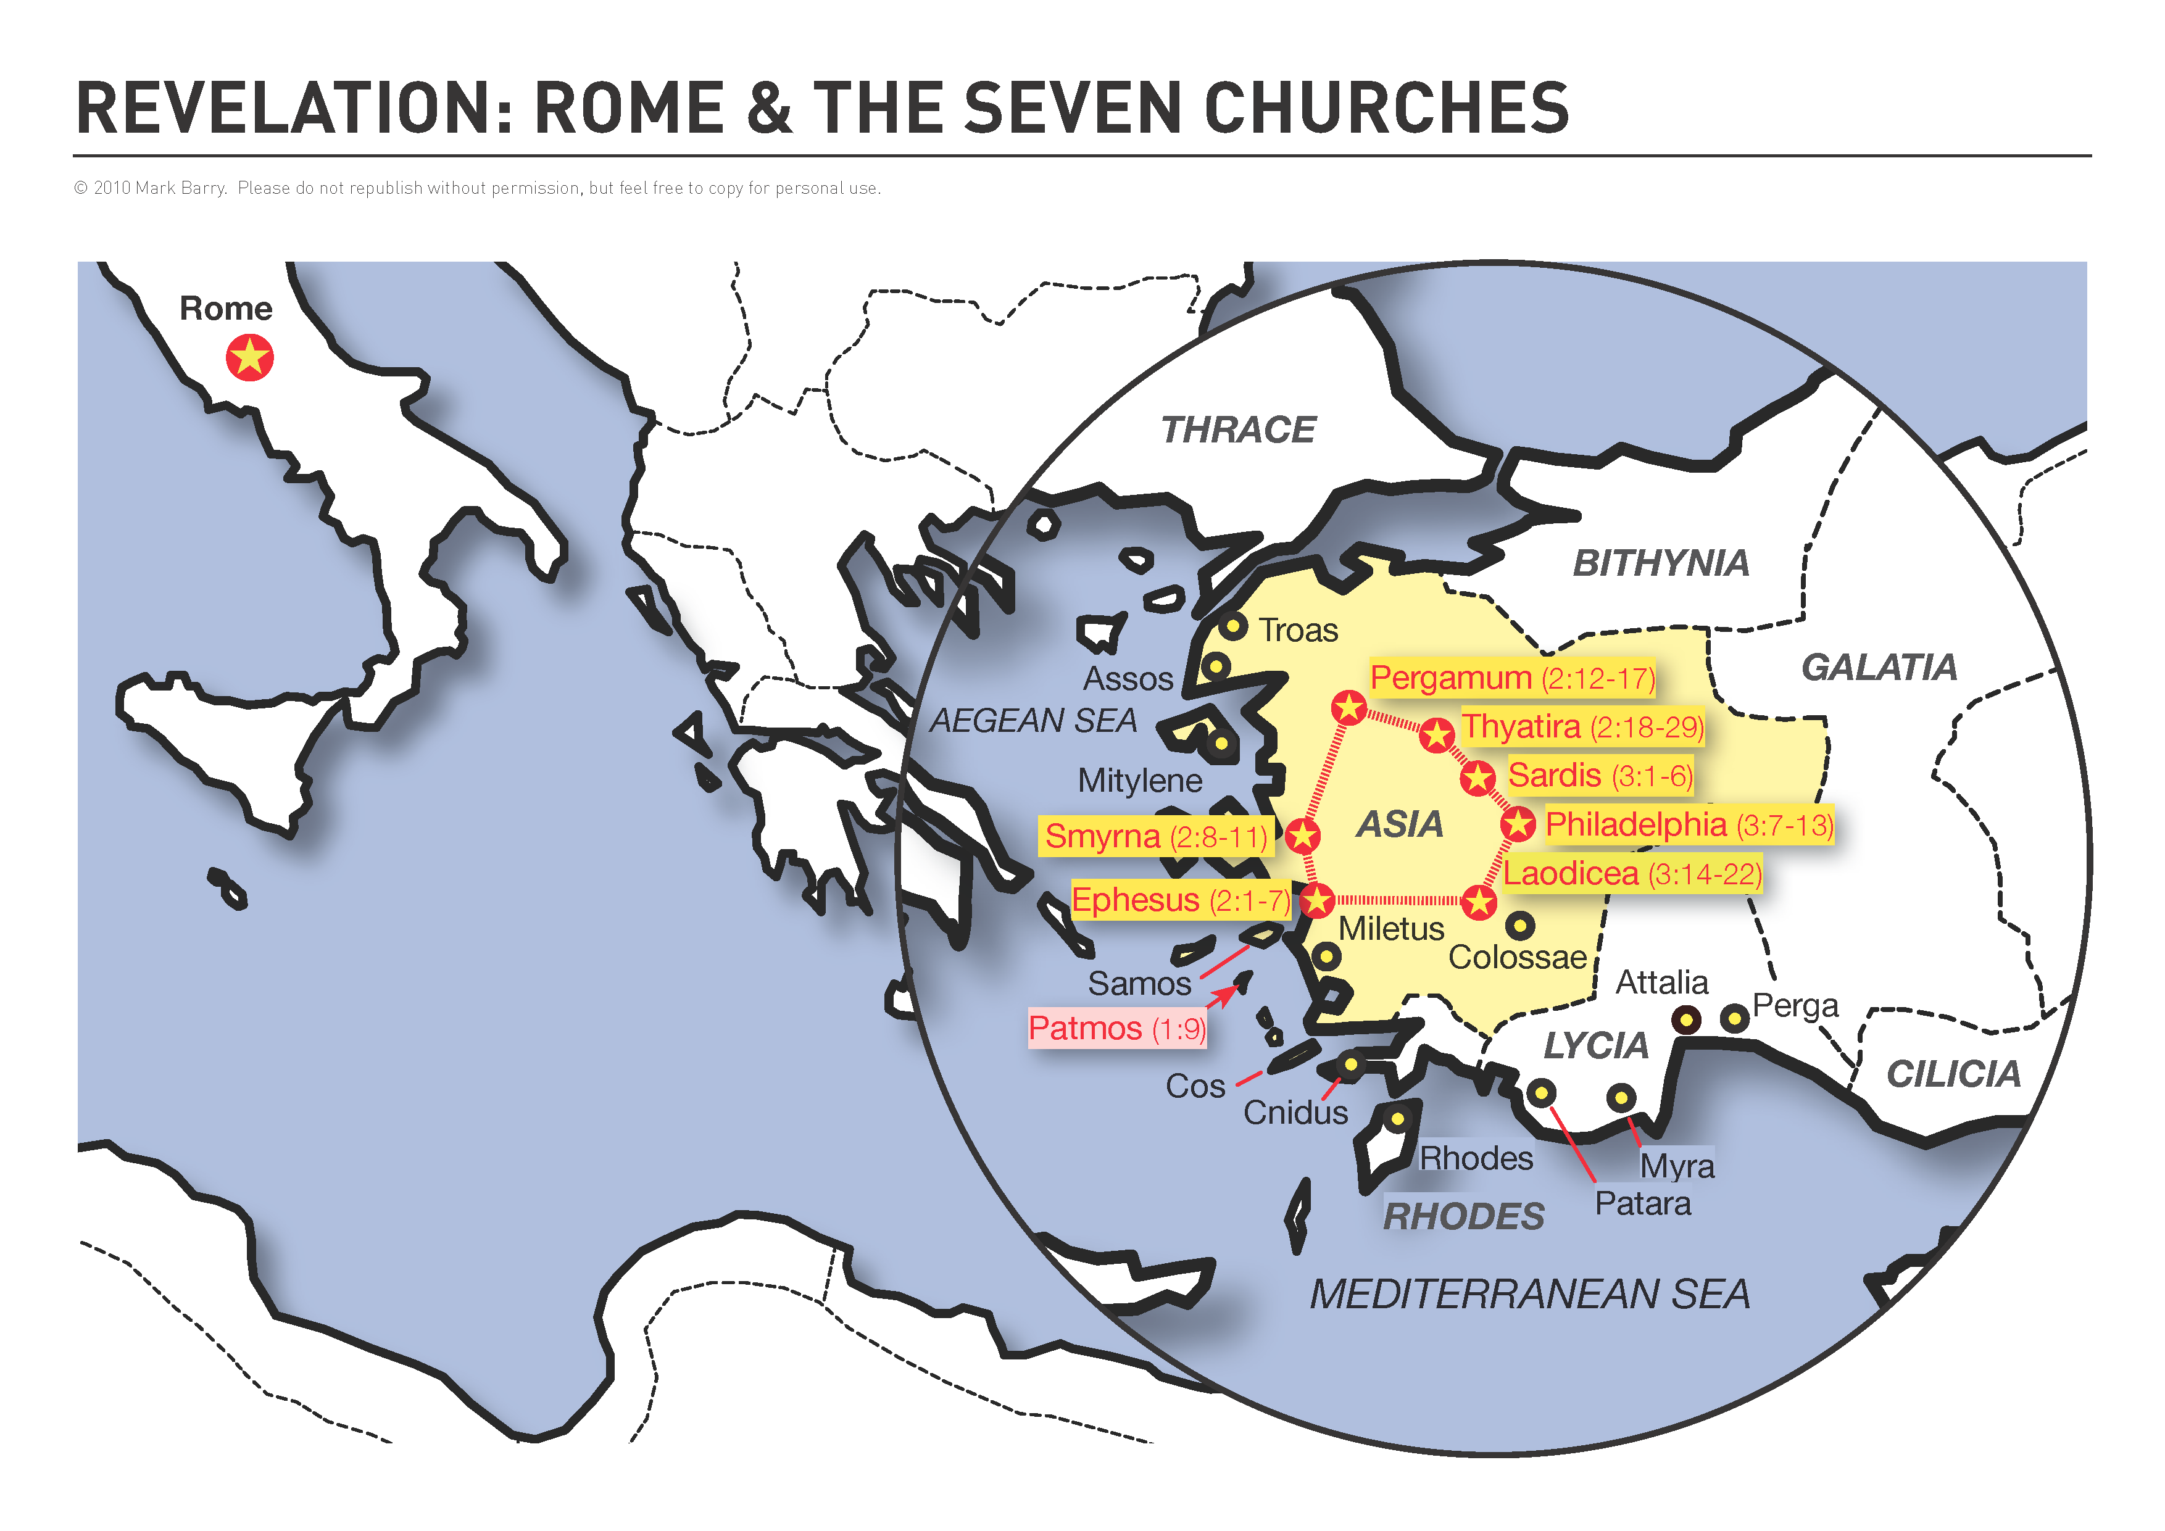

Slide 4
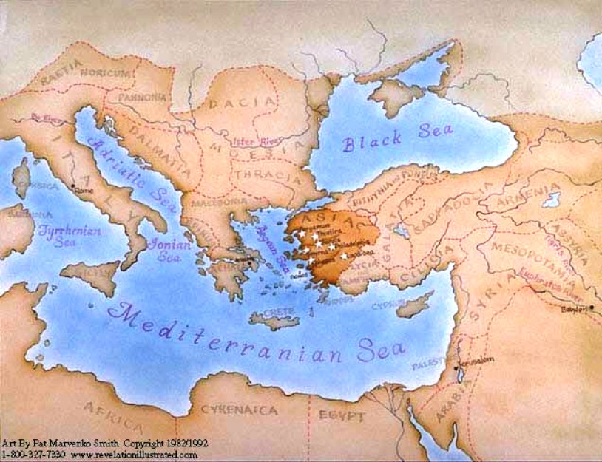

Slide 5
Colosse
House church in Asia Minor.
Paul had been close on his 2nd and 3rd missionary journeys , but he had never actually been there (2:1).
Met in Philemon’s house.
His slave Onesimus was now saved.
Their pastor Epaphras was with Paul in jail (not a prisoner) in Rome (1:7; 4:12; Philemon 23).
This book is one of the Prison Epistles: Ephesians, Philippians, Colossians, Philemon.

Slide 6
To the “Brothers in Christ in Colosse”
What should he say to this church?
“I pray for you.” (1:3-12)
An explanation of salvation.(1:5,12-14)
The Supremacy of Christ. (1:15-23)

Slide 7
Colossians 1:1-3
1) Paul, an apostle of Christ Jesus by the will of God, and Timothy our brother, 2) To the holy and faithful brothers in Christ at Colosse: Grace and peace to you from God our Father. 3 We always thank God, the Father of our Lord Jesus Christ, when we pray for you,

Slide 8
Colossians 1:4-5
4) Because we have heard of your faith in Christ Jesus and of the love you have for all the saints–
5) the faith and love that spring from the hope that is stored up for you in heaven and that you have already heard about in the word of truth, the gospel,

Slide 9
Colossians 1:6-8
6) That has come to you. All over the world this gospel is bearing fruit and growing, just as it has been doing among you since the day you heard it and understood God's grace in all its truth. 7) You learned it from Epaphras, our dear fellow servant, who is a faithful minister of Christ on our (your) behalf, 8) and who also told us of your love in the Spirit.

Slide 10
Colossians 1:9-10
9) For this reason, since the day we heard about you, we have not stopped praying for you and asking God to fill you with the knowledge of his will through all spiritual wisdom and understanding. 10) And we pray this in order that you may live a life worthy of the Lord and may please him in every way: bearing fruit in every good work, growing in the knowledge of God,

Slide 11
Colossians 1:11-12
11) Being strengthened with all power according to his glorious might so that you may have great endurance and patience, and joyfully 12) giving thanks to the Father, who has qualified you to share in the inheritance of the saints in the kingdom of light.

Slide 12
Colossians 1:13-14
13) For he has rescued us from the dominion of darkness and brought us into the kingdom of the Son he loves, 14) in whom we have redemption (through His blood) , the forgiveness of sins.

Slide 13
Before Christ
1. Alienated from God (1:21)
2. Enemies (1:21)
3. Evil (1:21)
4. Sinful nature (2:13; 3:5-9)
5. Dead in sins (2:13)

Slide 14
6 Benefits of our Salvation
1. Eternal Security 1:5
“The hope that is stored up for you in heaven.”

Slide 15
6 benefits
1. Hope stored in heaven. (1:5) This is the Eternal Security of every believer.
Faith and Love spring from this hope (1:4).
“For in this hope we were saved. But hope that is seen is no hope at all. Who hopes for what he already has?” Romans 8:24
“He is no fool who gives what he cannot keep to gain what he cannot lose.” Jim Elliot

Slide 16
6 benefits
2. Inheritance in the kingdom of light. (1:12)
A billionaire may divide his wealth among his heirs…
We have the true riches…
Eternal life. (Matt. 19:29)
Inherit the Earth. (Matt. 5:5)
All the promises of God. (Hebrews 6:12)

Slide 17
6 benefits
3. Rescued from the dominion of darkness. (1:13)
Each one of us, without exception, the moment we believed.
Jesus comes in and the darkness flies.
“Greater is He who is in you than he who is in the world” (1 John 4:4).

Slide 18
6 benefits
4. Brought into the kingdom of the Son. (1:13)
He changed, transferred our citizenship.
Total removal from darkness to light.
From Satan’s kingdom to His. Not just some future kingdom but right now!

Slide 19
6 benefits
5. Redeemed –He bought our freedom through His blood. (1:14)
“To deliver by payment of a ransom”—similar to “emancipation” --3 key parts to this word.
A. He paid our sin debt.
B. He took us out of the slave market of sin.
C. He set us free.

Slide 20
6 benefits
6. Forgiveness of our sins. (1:14)
Part of being redeemed is to be forgiven (Lit. “to send away”).
“As far as the east is from the west, so far has He removed our transgressions from us.” (Ps. 103:12)
The debt must be paid before we could be set free.
Available to all, but only applied to those who believe in Christ.

Slide 21
6 Benefits of Salvation
1. Eternal Security—Hope in heaven. 1:5
2. Inheritance—1:12
3. Rescued—1:13
4. In His Kingdom—1:13b
5. Redeemed—1:14
6. Forgiven— 1:14b

Slide 22
Colossians 1:12
Giving thanks to the Father, who has qualified you to share in the inheritance of the saints in the kingdom of light.

Slide 23
Colossians 1:13-14
For he has rescued us from the dominion of darkness and brought us into the kingdom of the Son he loves, 14 in whom we have redemption (through His blood), the forgiveness of sins.

Slide 24
HAVE YOU BEEN SAVED?
“Everyone who calls on the name of the Lord will be saved.” Romans 10:13
“Faith comes from hearing the message, and the message is heard through the word of Christ.” Romans 10:17

Slide 25
Revelation 3:20
“Here I am! I stand at the door and knock. If anyone hears my voice and opens the door, I will come in and eat with him, and he with me.”

