Slide 1

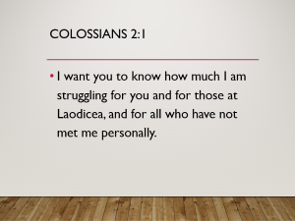
ROOTED AND BUILT UP
IN HIM
COLOSSIANS 2:6-7

Slide 2
COLOSSIANS 1:27-2:7
“CHRIST in you the hope of glory” 1:27
“We proclaim HIM.” 1:28a
“So that we may present everyone PERFECT IN CHRIST.” 1:28b
“Know the mystery of God, namely CHRIST…” 2:2
“I delight to see…how firm your faith in CHRIST is.” 2:5

Slide 3
Colossians 2:1
I want you to know how much I am struggling for you and for those at Laodicea, and for all who have not met me personally.

Slide 4
col. 2:2
My purpose is that they may be encouraged in heart and united in love, so that they may have the full riches of complete understanding, in order that they may know the mystery of God, namely, Christ,

Slide 5
Col. 2:3-4
in whom are hidden all the treasures of wisdom and knowledge. 4 I tell you this so that no one may deceive you by fine-sounding arguments

Slide 6
Col. 2:5
For though I am absent from you in body, I am present with you in spirit and delight to see how orderly you are and how firm your faith in Christ is.

Slide 7
Col. 2:6-7
So then, just as you received Christ Jesus as Lord, continue to live in him, 7 rooted and built up in him, strengthened in the faith as you were taught, and overflowing with thankfulness.

Slide 8
COLOSSIANS 2:6-7
“So then, just as you received CHRIST JESUS AS LORD, continue to live (walk-KJV) in HIM, rooted and built up in HIM, strengthened in the faith as you were taught, and overflowing with thankfulness.”

Slide 9
“So Then”
Because of all that you know about CHRIST…
Because of your convictions of your faith…
Because you have made Jesus your LORD…
‘THEREFORE…’ (KJV) “So Then” (NIV)

Slide 10
COLOSSIANS 2:6-7
“So then, just as you received CHRIST JESUS AS LORD,
continue to live (walk-KJV)in HIM,
rooted and built up in HIM, strengthened in the faith as you were taught, and overflowing with thankfulness.”

Slide 11

1. CONTINUE TO
LIVE IN CHRIST
“Walk ye in Him.” (KJV)
Walking in Christ means to live in union with Him.
To maintain a lifestyle
Patterned after His.

Slide 12
COLOSSIANS 2:6-7
“So then, just as you received CHRIST JESUS AS LORD, continue to live (walk-KJV) in HIM,
rooted in HIM
and built up in HIM, strengthened in the faith as you were taught, and overflowing with thankfulness.”

Slide 13
2. ROOTED IN HIM

Slide 14
COL. 2:7
“Rooted…in Him.”

Slide 15
2. “Rooted in him”
Perfect tense, participle. “Completed action, with a resulting state of being.”
“Having been firmly rooted…”
When?
Rooted at the time we were saved.
An eternal planting.

Slide 16
2. “Rooted in Him”
“Rooted” suggests that Christ is the source of our spiritual nourishment…
Growth…
And fruit.

Slide 17
John 15:5
“I am the vine; you are the branches.”

Slide 18
COLOSSIANS 2:6-7
“So then, just as you received CHRIST JESUS AS LORD, continue to live (walk-KJV) in HIM, rooted and
built up in HIM,
strengthened in the faith as you were taught, and overflowing with thankfulness.”

Slide 19

3. “BUILT UP IN HIM.”

Slide 20
3. “Built up in HIM”
Present tense participle.
That means that the action is continuous.
“Constantly being built up in HIM.”

Slide 21
1 Peter 2:5
“You also, like living stones, are being built into a spiritual house to be a holy priesthood….”

Slide 22
2 Peter 3:14 &18
“Make every effort to be found spotless, blameless and at peace with him.”
“But grow in the grace and knowledge of our Lord and Savior Jesus Christ.”

Slide 23
Ephesians 4:13
“…become mature, attaining to the whole measure of the fullness of Christ.”

Slide 24
COLOSSIANS 2:6-7
“So then, just as you received CHRIST JESUS AS LORD, continue to live (walk-KJV) in HIM, rooted and built up in HIM,
strengthened in the faith as you were taught,
and overflowing with thankfulness.”

Slide 25
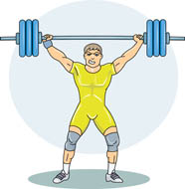
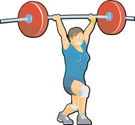
4. “STRENGTHENED IN THE FAITH”
Passive voice participle.
Passive voice means that the strengthening is being done to us.

Slide 26
Colossians 1:29
“To this end I labor, struggling with all his energy, which so powerfully works in me.”

Slide 27
Philippians 4:13
“I can do everything through him who gives me strength.”

Slide 28
COLOSSIANS 2:6-7
“So then, just as you received CHRIST JESUS AS LORD, continue to live (walk-KJV) in HIM, rooted and built up in HIM, strengthened in the faith as you were taught, and
overflowing with thankfulness.”

Slide 29
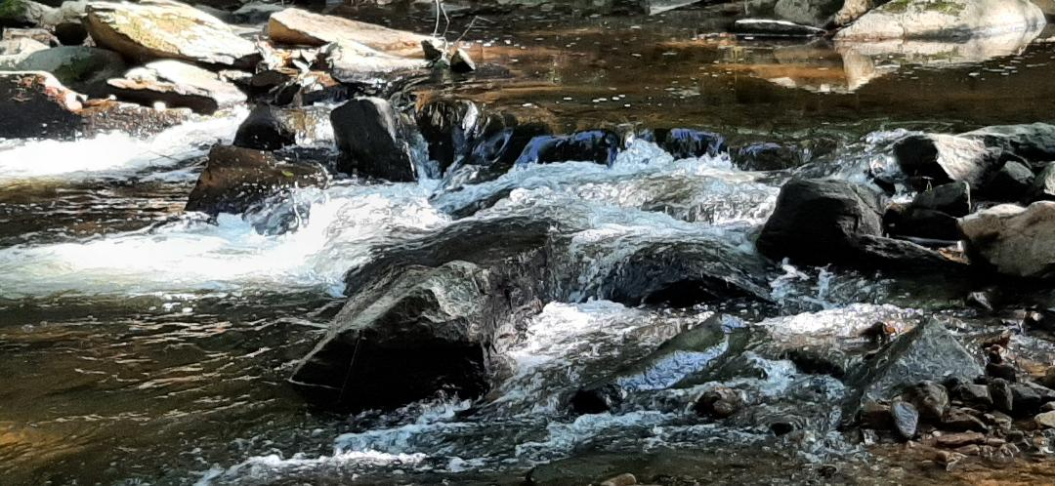
5. OVERFLOWING WITH THANKFULNESS

Slide 30
5. “OVERFLOWING WITH THANKFULNESS.”
Active voice participle.
Active voice means that the believer is doing the action.
We are overflowing with thankfulness because of all that Christ has done.

Slide 31
Hebrews 13:15-16
“Through Jesus, therefore, let us continually offer to God a sacrifice of praise—the fruit of lips that confess his name. And do not forget to do good and to share with others, for with such sacrifices God is pleased.”

Slide 32
1 Thessalonians 5:18
“Give thanks in all circumstances, for this is God’s will for you in Christ Jesus.”

Slide 33
Ephesians 5:20
“Always giving thanks to God the Father for everything, in the name of our Lord Jesus Christ.”

Slide 34
COLOSSIANS 2:6-7
“So then, just as you received CHRIST JESUS AS LORD, continue to live (walk-KJV) in HIM, rooted and built up in HIM, strengthened in the faith as you were taught, and overflowing with thankfulness.”

Slide 35
ROOTED AND BUILT UP IN HIM

