Slide 1


Slide 2
THE KING
IS COMING
Luke 19:28-48

Slide 3
The Triumphal Entry
Palm Sunday
From the Mount of Olives, down the Kidron Valley, and into Jerusalem.

Slide 4
Luke 19:28-48

Slide 5
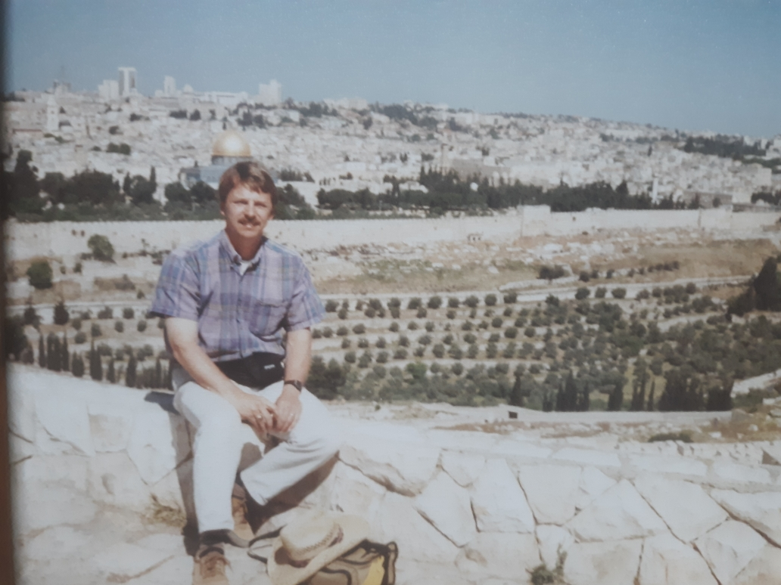

Slide 6
28) “After Jesus had said this, he went on ahead, going up to Jerusalem. 29) As he approached Bethphage and Bethany at the hill called the Mount of Olives, he sent two of his disciples, saying to them,”
Luke 19:28-29

Slide 7
30) "Go to the village ahead of you, and as you enter it, you will find a colt tied there, which no one has ever ridden. Untie it and bring it here. 31) If anyone asks you, 'Why are you untying it?' tell him, 'The Lord needs it.' "

Slide 8
32) “Those who were sent ahead went and found it just as he had told them. 33) As they were untying the colt, its owners asked them, "Why are you untying the colt?" 34) They replied, "The Lord needs it." 35) “They brought it to Jesus, threw their cloaks on the colt and put Jesus on it.

Slide 9
36) As he went along, people spread their cloaks on the road. 37) When he came near the place where the road goes down the Mount of Olives, the whole crowd of disciples began joyfully to praise God in loud voices for all the miracles they had seen:”

Slide 10
38) "Blessed is the king who comes in the name of the Lord!" "Peace in heaven and glory in the highest!" 39) Some of the Pharisees in the crowd said to Jesus, "Teacher, rebuke your disciples!" 40) "I tell you," he replied, "if they keep quiet, the stones will cry out."

Slide 11
41) “As he approached Jerusalem and saw the city, he wept over it 42) and said, "If you, even you, had only known on this day what would bring you peace--but now it is hidden from your eyes.”

Slide 12
43) “The days will come upon you when your enemies will build an embankment against you and encircle you and hem you in on every side. 44) They will dash you to the ground, you and the children within your walls. They will not leave one stone on another, because you did not recognize the time of God's coming to you."

Slide 13
45) “Then he entered the temple area and began driving out those who were selling. 46) "It is written," he said to them, " 'My house will be a house of prayer' ; but you have made it 'a den of robbers.' "

Slide 14
47) “Every day he was teaching at the temple. But the chief priests, the teachers of the law and the leaders among the people were trying to kill him. 48) Yet they could not find any way to do it, because all the people hung on his words.”

Slide 15
THE TRIUMPHAL ENTRY
A grand entrance like the Rose Parade, Mummers Parade, etc.
What impresses you?

Slide 16
LUKE 19:28-48
From Jericho (about 1200 feet below sea level) up to Jerusalem (2680 ft. above sea level), a steep 15 mile journey through barren and dangerous wilderness.
Will it be the coronation of the king or the cross?

Slide 17
Notice the 3 R’s of the KING
R---Regalia of the King.
R---Reception of the King.
R---Response of the King.

Slide 18
1st R---REGALIA OF THE KING
Zechariah 9:9– “See, your king comes to you, righteous and having salvation, gentle and riding on a donkey, on a colt , the foal of a donkey.”

Slide 19
King Solomon’s Inauguration
1 Kings 1:33– “Set Solomon my son on my own mule and take him down to Gihon…anoint him king over Israel. Blow the trumpet and shout, ‘Long live King Solomon!’”

Slide 20
KING JEHU’s Inauguration
2 Kings 9:12-13– “This is what the LORD says: “I anoint you king over Israel.” They hurried and took their cloaks and spread them under him on the bare steps. Then they blew the trumpet and shouted, “Jehu is king.””

Slide 21
2nd R---Reception of the King
The whole crowd of disciples– “Blessed is the king who comes in the name of the Lord! Peace in heaven and glory in the highest.” Luke 19:38

Slide 22
2nd R---Reception of the King
Matthew 21:9 -- “Hosanna to the Son of David!” “Blessed is he who comes in the name of the Lord!” “Hosanna in the highest!”

Slide 23
2nd R---Reception of the King
“Who is this?”
The crowds answered, “This is Jesus, the prophet from Nazareth in Galilee.” Matthew 21:10-11
Muslims could agree, Jesus is a good prophet.

Slide 24
Luke 19:44--Jesus
“You did not recognize the time of God’s coming to you.”

Slide 25
Zech. 9:9
“See your king comes to you, righteous and having salvation, gentle and riding on a donkey, on a colt, the foal of a donkey.”

Slide 26
ISRAEL
Isaiah 1:3– “The ox knows his master, the donkey his owner’s manger, but Israel does not know, my people do not understand.”

Slide 27
PHARISEES
Luke 19:39– “Teacher, rebuke your disciples!”
Luke 19:40– “I tell you, he (Jesus) replied, if they keep quiet, the stones will cry out.”
Luke 19:47- “But the chief priests, the teachers of the law and the leaders among the people were trying to kill him.”

Slide 28
PHARISEES
John 12:19– “The Pharisees said to one another, “See, this is getting us no where. Look how the whole world has gone after him!””

Slide 29
3rd R---RESPONSE
OF THE KING
Luke 19:41-44
Jesus “wept over it” (lit. deep sobs) over Jerusalem.
He knew most were insincere.

Slide 30
3rd R---RESPONSE
OF THE KING
Luke 19:45-48
“Jesus entered the temple area and began driving out those who were selling …’My house will be a house of prayer’, but you have made it ‘a den of robbers.’”

Slide 31
HOW WOULD JESUS RESPOND TO YOU, TO US?
Jesus knows your heart. He knows your soul.

Slide 32
2 Cor. 5:10
“For we must all appear before the judgment seat of Christ, that each one may receive what is due him for the things done while in the body, whether good or bad.” 2 Cor. 5:10

Slide 33
1 Cor. 6:9-10
“Do you not know that the wicked will not inherit the kingdom of God? Do not be deceived: Neither the sexually immoral nor idolaters nor adulterers nor male prostitutes nor homosexual offenders nor thieves nor the greedy nor drunkards nor slanderers nor swindlers will inherit the kingdom of God.” 1 Cor. 6:9-10

Slide 34
2 Cor. 5:17
“If anyone is in Christ, he is a new creation; the old has gone, the new has come!”

Slide 35
James 2:19
“You believe that there is one God. Good! Even the demons believe that---and shudder.” James 2:19

Slide 36
John 1:11-12
“He came to that which was his own, but his own did not receive him. Yet to all who received him, to those who believed in his name, he gave the right to become children of God.”

Slide 37
John 3:36
“Whoever believes in the Son has eternal life, but whoever rejects the Son will not see life, for God’s wrath remains on him.” John 3:36

Slide 38
Matt. 10:28
Jesus says, “Be afraid of the One who can destroy both soul and body in hell.”

Slide 39
1 John 1:9
“If we confess our sins, he is faithful and just and will forgive us our sins and purify us from all unrighteousness.”

Slide 40
“The Lamb of God who takes away the sin of the world.” John 1:29
The Pharisees wanted to kill Jesus, “but not during the feast,” they said, “or there may be a riot among the people.” ( Matt. 26:3-5).
But God’s ordained plan was to be on Passover.
1 Cor. 5:7 “Christ, our Passover Lamb, has been sacrificed.”

