Slide 1
THE CHURCH AT SARDIS:
THE FEEBLE CHURCH
REVELATION 3:1-6

Slide 2
REVELATION 3:1-6

Slide 3
Rev. 3:1
"To the angel of the church in Sardis write: These are the words of him who holds the seven spirits of God and the seven stars. I know your deeds; you have a reputation of being alive, but you are dead.”.

Slide 4
Rev. 3:2
Wake up! Strengthen what remains and is about to die, for I have not found your deeds complete in the sight of my God.
.

Slide 5
Rev. 3:3
Remember, therefore, what you have received and heard; obey it, and repent. But if you do not wake up, I will come like a thief, and you will not know at what time I will come to you.

Slide 6
Rev. 3:4
Yet you have a few people in Sardis who have not soiled their clothes. They will walk with me, dressed in white, for they are worthy.

Slide 7
Rev. 3:5
He who overcomes will, like them, be dressed in white. I will never blot out his name from the book of life, but will acknowledge his name before my Father and his angels.

Slide 8
Rev. 3:6
He who has an ear, let him hear what the Spirit says to the churches.

Slide 9
SARDIS:
THE FEEBLE CHURCH
Nothing very good is said about this church.
They had a good reputation, but Jesus was not impressed.

Slide 10
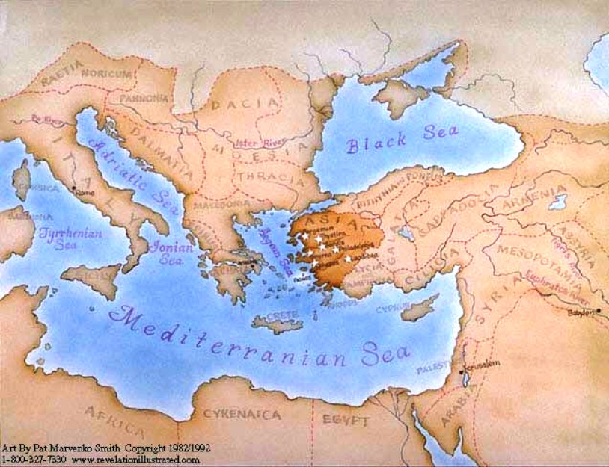

Slide 11
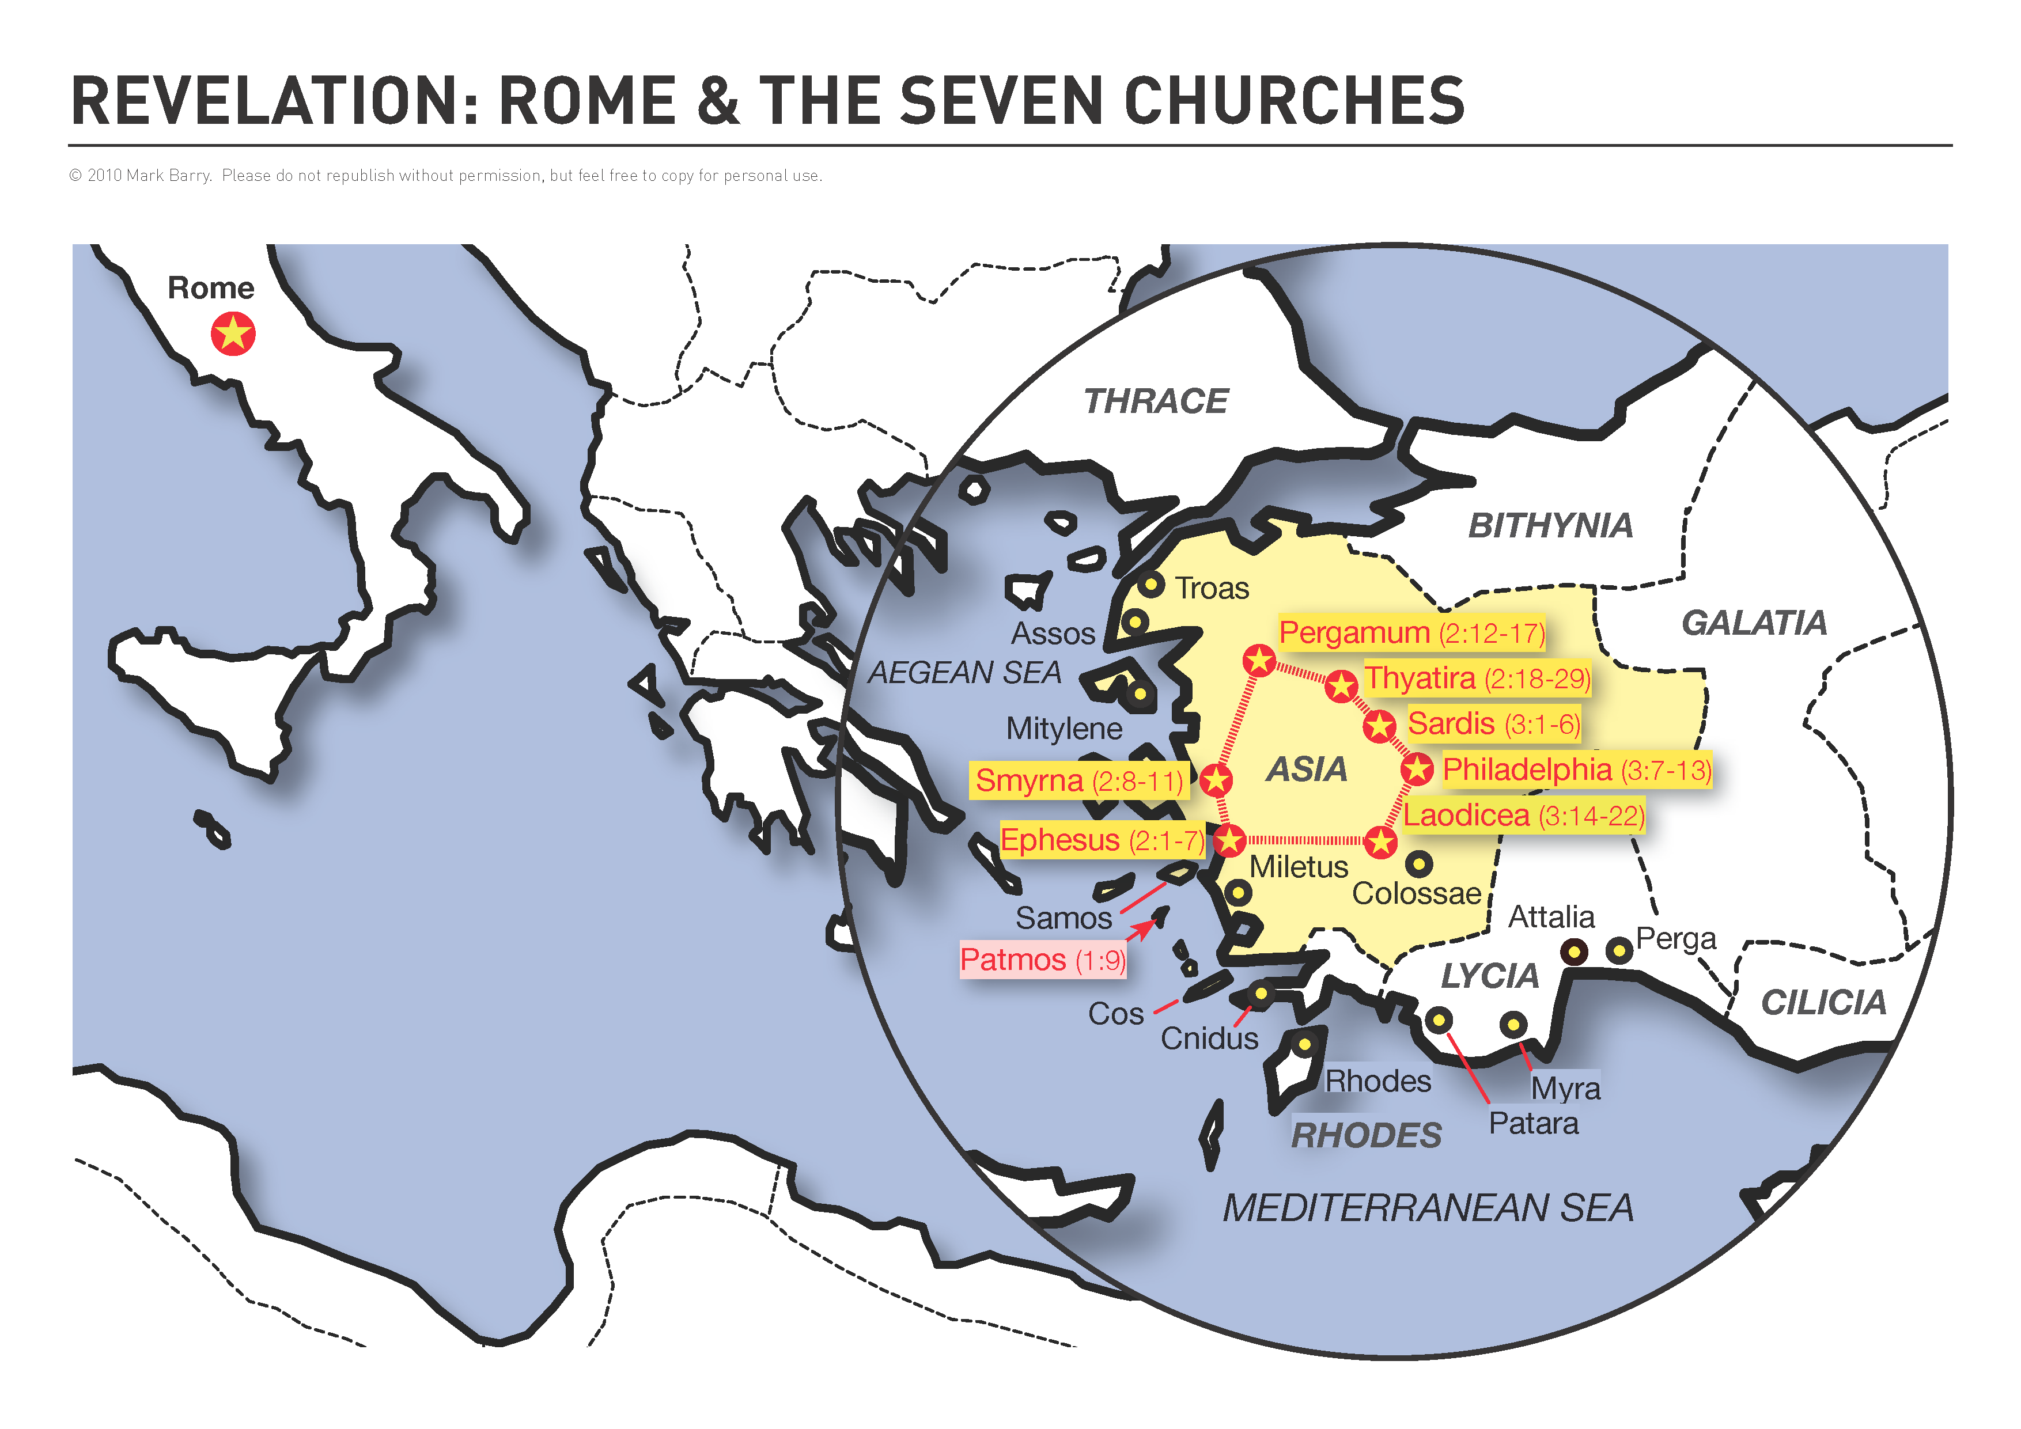

Slide 12
THE CHURCH OF
THE 3 R’S
REPUTATION
REVIVAL
REMNANT

Slide 13
Rev. 3:1B
“…I know your deeds; you have a reputation of being alive, but you are dead.”.

Slide 14
1. REPUTATION
If they had a church calendar every day would be filled, but….
Ask around, everyone knows them.
Ask Jesus.
Dead!!!

Slide 15
1. REPUTATION
The key to any vibrant church is the Holy Spirit of God.
The Word of God must be proclaimed and the Holy Spirit must do His work.

Slide 16
Isaiah 11:2
“The Spirit of the Lord will rest on him, the Spirit of wisdom and of understanding, the Spirit of counsel and of power, the Spirit of knowledge and of the fear of the LORD.”

Slide 17
“WAKE UP”

Slide 18
2. REVIVAL
How can we do this????
A series of commands from Jesus,
1. “ Wake up!!!”
2. “Strengthen what remains.” Like embers from a fire being fanned into flame.

Slide 19
2. REVIVAL
3. “Remember what you have received and heard.”
4. ”Obey it.”
5. “Repent.”

Slide 20
2. REVIVAL
He warned them.
“If you do not wake up, I will come like a thief, and you will not know at what time I will come to you.”

Slide 21
1. REPUTATION
2. REVIVAL
3. REMNANT
The 3RD “R” is REMNANT.
Jesus says, “yet you have a few people… who have not soiled their clothes.” A few is a remnant, there should be more, but there is not.

Slide 22
3. REMNANT
“He who overcomes will, like them, be dressed in white.”

Slide 23
1 JOHN 5:3-5
This is love for God: to obey his commands. And his commands are not burdensome, 4) for everyone born of God overcomes the world. This is the victory that has overcome the world, even our faith. 5) Who is it that overcomes the world? Only he who believes that Jesus is the Son of God.

Slide 24
3. REMNANT
Are you part of those in the remnant?
Are you one of those who overcome by your faith?
Is your name written in the book of life?

Slide 25
“The Book of Life”
What is this?
It is first mentioned in the OT, Psalm 69:28.

Slide 26
Psalm 69:28
“May they be blotted out of the book of life and not be listed with the righteous.”

Slide 27
Luke 10:20
“…Rejoice that your names are written in heaven.”

Slide 28
Philippians 4:3
“…My fellow workers, whose names are in the book of life.”

Slide 29
Rev. 13:8
“All inhabitants of the earth will worship the beast--all whose names have not been written in the book of life belonging to the Lamb that was slain from the creation of the world.”

Slide 30
Rev. 17:8
“…The inhabitants of the earth whose names have not been written in the book of life from the creation of the world will be astonished when they see the beast, because he once was, now is not, and yet will come.”

Slide 31
Rev. 20:12
“And I saw the dead, great and small, standing before the throne, and books were opened. Another book was opened, which is the book of life. The dead were judged according to what they had done as recorded in the books.”

Slide 32
Rev. 20:15
“If anyone's name was not found written in the book of life, he was thrown into the lake of fire.”

Slide 33
Rev. 21:27
“Nothing impure will ever enter it, nor will anyone who does what is shameful or deceitful, but only those whose names are written in the Lamb's book of life.”

Slide 34
3. REMNANT
Are you part of those in the remnant?
Are you one of those who overcome by your faith?
Is your name written in the book of life?

Slide 35
1 JOHN 5:3-5
This is love for God: to obey his commands. And his commands are not burdensome, 4) for everyone born of God overcomes the world. This is the victory that has overcome the world, even our faith. 5) Who is it that overcomes the world? Only he who believes that Jesus is the Son of God.

Slide 37
ONLY TRUST HIM
HYMN # 317

