Slide 1
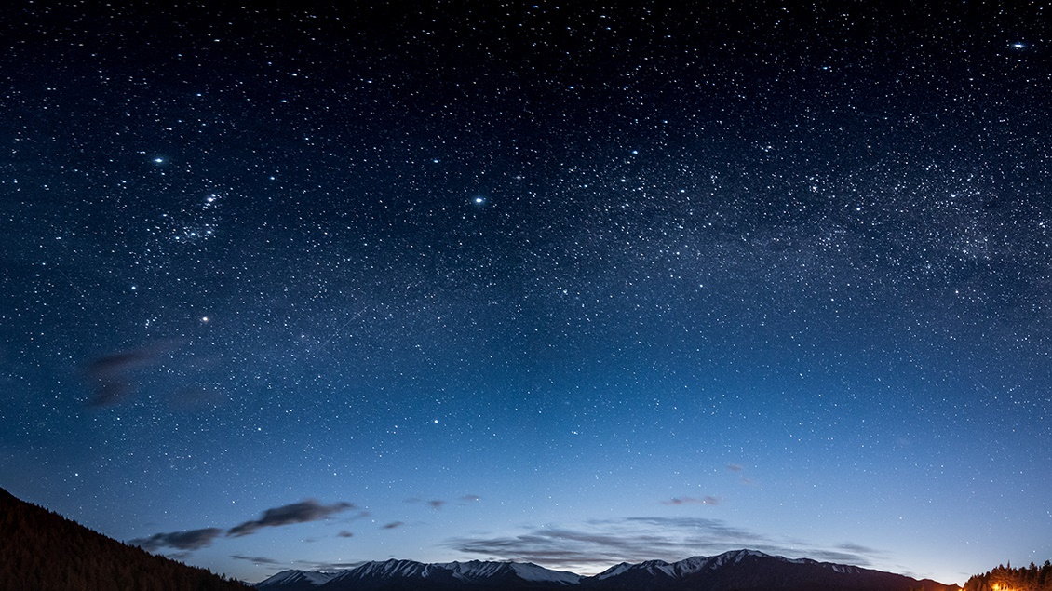
Looking Forward
James 1:16-27

Slide 2
Be The Good Fruit
¹⁶ Do not be deceived, my beloved brothers. ¹⁷ Every good gift and every perfect gift is from above, coming down from the Father of lights, with whom there is no variation or shadow due to change. ¹⁸ Of his own will he brought us forth by the word of truth, that we should be a kind of firstfruits of his creatures.

Slide 3
Be meek in god’s word
¹⁹ Know this, my beloved brothers: let every person be quick to hear, slow to speak, slow to anger; ²⁰ for the anger of man does not produce the righteousness of God. ²¹ Therefore put away all filthiness and rampant wickedness and receive with meekness the implanted word, which is able to save your souls.

Slide 4
Be effectual doers
²² But be doers of the word, and not hearers only, deceiving yourselves. ²³ For if anyone is a hearer of the word and not a doer, he is like a man who looks intently at his natural face in a mirror. ²⁴ For he looks at himself and goes away and at once forgets what he was like. ²⁵ But the one who looks into the perfect law, the law of liberty, and perseveres, being no hearer who forgets but a doer who acts, he will be blessed in his doing.

Slide 5
Key takeaways
BE THE GOOD FRUIT / A CONTINOUS OFFERING
Philippians 1:6 And I am sure of this, that he who began a good work in you will bring it to completion at the day of Jesus Christ.

Slide 6
Key takeaways
BE THE GOOD FRUIT / A CONTINOUS OFFERING
BE MEEK IN GOD’S WORD & IN PRAYER
James 5:16 Therefore, confess your sins to one another and pray for one another, that you may be healed. The prayer of a righteous person has great power as it is working.

Slide 7
Key takeaways
BE THE GOOD FRUIT / A CONTINOUS OFFERING
BE MEEK IN GOD’S WORD & IN PRAYER
BE EFFECTUAL DOERS

Slide 8
Key takeaways
James 1:26-27 If anyone thinks he is religious and does not bridle his tongue but deceives his heart, this person’s religion is worthless. Religion that is pure and undefiled before God the Father is this: to visit orphans and widows in their affliction, and to keep oneself unstained from the world.

