Slide 1


Slide 2
REVELATION 2:18-29

Slide 3
REVELATION 2:18-29
Re. 2:18 “To the angel of the church in Thyatira write: These are the words of the Son of God, whose eyes are like blazing fire and whose feet are like burnished bronze. Re. 2:19 I know your deeds, your love and faith, your service and perseverance, and that you are now doing more than you did at first.

Slide 4
Re. 2:20 Nevertheless, I have this against you: You tolerate that woman Jezebel, who calls herself a prophetess. By her teaching she misleads my servants into sexual immorality and the eating of food sacrificed to idols.

Slide 5
Re. 2:21 I have given her time to repent of her immorality, but she is unwilling.
Re. 2:22 So I will cast her on a bed of suffering, and I will make those who commit adultery with her suffer intensely, unless they repent of her ways.

Slide 6
Re. 2:23 I will strike her children dead. Then all the churches will know that I am he who searches hearts and minds, and I will repay each of you according to your deeds.

Slide 7
Re. 2:24 Now I say to the rest of you in Thyatira, to you who do not hold to her teaching and have not learned Satan’s so-called deep secrets (I will not impose any other burden on you):
Re. 2:25 Only hold on to what you have until I come.

Slide 8
Re. 2:26 To him who overcomes and does my will to the end, I will give authority over the nations — Re. 2:27 `He will rule them with an iron scepter; he will dash them to pieces like pottery’ — just as I have received authority from my Father.

Slide 9
Re. 2:28 I will also give him the morning star.
Re. 2:29 He who has an ear, let him hear what the Spirit says to the churches.

Slide 10
THE CHURCH IN THYATIRA
Longest letter to the smallest church.
This is where Lydia the seller of purple was from (Acts 16:14).

Slide 11

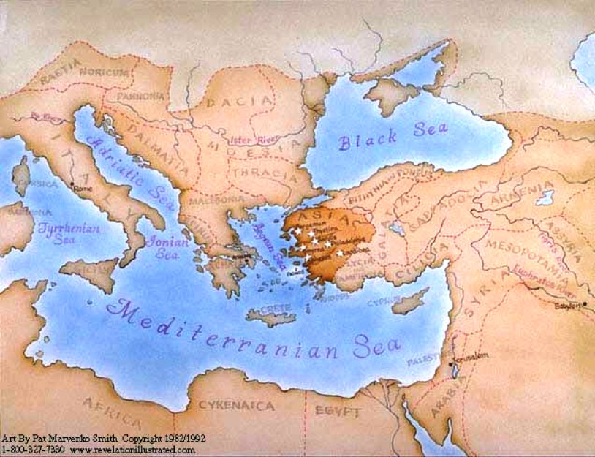

Slide 12
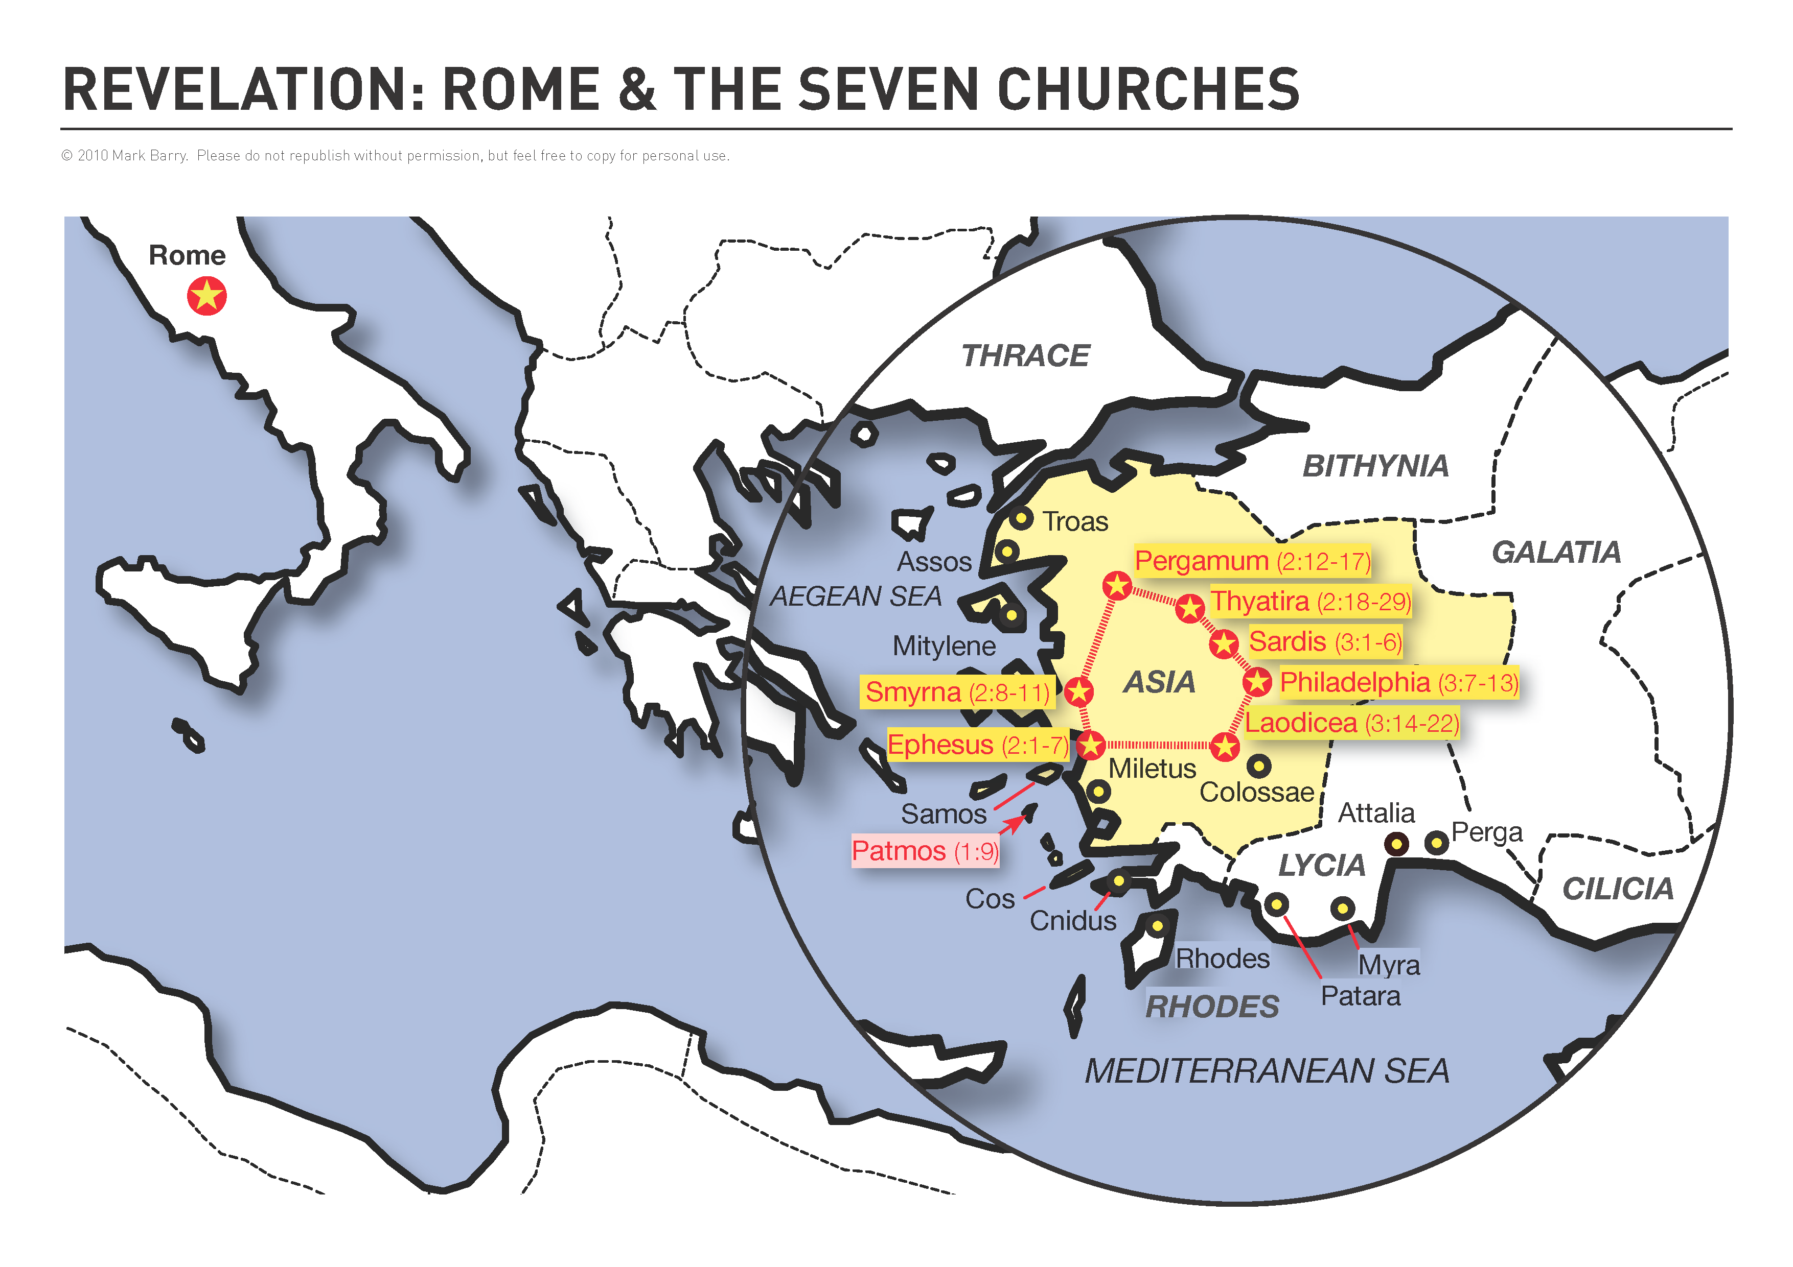

Slide 13
WHAT WOULD JESUS SAY?
…IF HE CAME TO NORTH EAST?
…IF HE SPOKE TO YOU OR ME?

Slide 14
1. APPROVAL (2:19)
Would Jesus come with approval?
Could He commend you?

Slide 15
REVELATION 2:19
I know your deeds, your love and faith, your service and perseverance, and that you are now doing more than you did at first.

Slide 16
REVELATION 2:19
I know your deeds, your love and faith, your service and perseverance, and that you are now doing more than you did at first.

Slide 17
REVELATION 2:19
I know your deeds, your love and faith, your service and perseverance, and that you are now doing more than you did at first.

Slide 18
REVELATION 2:19
I know your deeds, your love and faith, your service and perseverance, and that you are now doing more than you did at first.

Slide 19
REVELATION 2:19
I know your deeds, your love and faith, your service and perseverance, and that you are now doing more than you did at first.

Slide 20
REVELATION 2:19
I know your deeds, your love and faith, your service and perseverance, and that you are now doing more than you did at first.

Slide 21
WHAT WOULD JESUS SAY?
COULD HE SAY THAT OF YOU?

Slide 22
2. ACCUSATION (2:20-23)
NEVERTHELESS…
You tolerate that prophetess Jezebel.
Jezebel is probably a symbolic representation of some teaching of spiritual compromise.

Slide 23
Idolatry and compromise are often pictured as fornication and unfaithfulness to the marriage vows.
Jer. 3:6ff
Hos. 9:1ff

Slide 24
3. ADMONITION (2:23b-29)
“Then all the churches will know that I am he who searches hearts and minds, and I will repay each of you according to your deeds.”

Slide 25
He threatens to make them an example to all of the churches.

Slide 26
WHAT WOULD JESUS SAY?
What would He see when He searches your heart? Your mind?
How would He repay you?

Slide 27
Rev. 2:25
“Only hold on to what you have until I come.”

Slide 28
“To him who overcomes…”
Authority over nations (2:26). We will rule and reign with Christ (Rev. 20:4, 22:5).
The morning star (2:28). Jesus is the bright morning star (Rev. 22:16).

Slide 29
Are you following the so-called deep things of Satan or the bright morning star?

Slide 30
1 JOHN 5:3-5
This is love for God: to obey his commands. And his commands are not burdensome, 4) for everyone born of God overcomes the world. This is the victory that has overcome the world, even our faith. 5) Who is it that overcomes the world? Only he who believes that Jesus is the Son of God.

