Slide 1



Slide 2
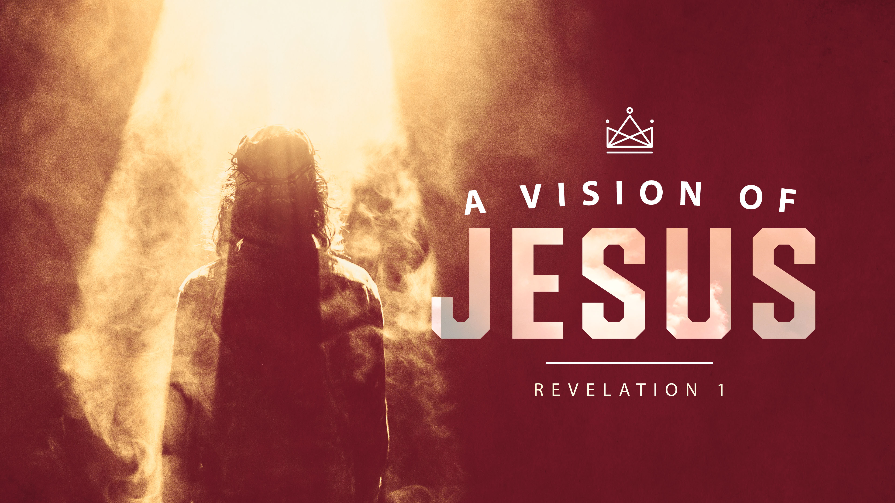

Slide 3
7 Blessings in Revelation
1st Blessing is to those who will:
Read it,
Listen to it,
Take heed to it.

Slide 4
REVELATION 1:1-20
1) The revelation of Jesus Christ, which God gave him to show his servants what must soon take place. He made it known by sending his angel to his servant John, 2) who testifies to everything he saw--that is, the word of God and the testimony of Jesus Christ.

Slide 5
3) Blessed is the one who reads the words of this prophecy, and blessed are those who hear it and take to heart what is written in it, because the time is near. 4) John, To the seven churches in the province of Asia: Grace and peace to you from him who is, and who was, and who is to come, and from the seven spirits before his throne,

Slide 6
5) and from Jesus Christ, who is the faithful witness, the firstborn from the dead, and the ruler of the kings of the earth. 6) To him who loves us and has freed us from our sins by his blood, and has made us to be a kingdom and priests to serve his God and Father--to him be glory and power for ever and ever! Amen

Slide 7
7) Look, he is coming with the clouds, and every eye will see him, even those who pierced him; and all the peoples of the earth will mourn because of him. So shall it be! Amen. 8) "I am the Alpha and the Omega," says the Lord God, "who is, and who was, and who is to come, the Almighty."

Slide 8
9) I, John, your brother and companion in the suffering and kingdom and patient endurance that are ours in Jesus, was on the island of Patmos because of the word of God and the testimony of Jesus. 10) On the Lord's Day I was in the Spirit, and I heard behind me a loud voice like a trumpet,

Slide 9
11) which said: "Write on a scroll what you see and send it to the seven churches: to Ephesus, Smyrna, Pergamum, Thyatira, Sardis, Philadelphia and Laodicea." 12) I turned around to see the voice that was speaking to me. And when I turned I saw seven golden lampstands.

Slide 10
13) and among the lampstands was someone "like a son of man," dressed in a robe reaching down to his feet and with a golden sash around his chest. 14) His head and hair were white like wool, as white as snow, and his eyes were like blazing fire. 15) His feet were like bronze glowing in a furnace, and his voice was like the sound of rushing waters.

Slide 11
16) In his right hand he held seven stars, and out of his mouth came a sharp double-edged sword. His face was like the sun shining in all its brilliance. 17) When I saw him, I fell at his feet as though dead. Then he placed his right hand on me and said: "Do not be afraid. I am the First and the Last.

Slide 12
18) I am the Living One; I was dead, and behold I am alive for ever and ever! And I hold the keys of death and Hades. 19) "Write, therefore, what you have seen, what is now and what will take place later.

Slide 13
20) The mystery of the seven stars that you saw in my right hand and of the seven golden lampstands is this: The seven stars are the angels of the seven churches, and the seven lampstands are the seven churches.

Slide 14
THE REVELATION OF
JESUS CHRIST
THERE ARE 3 AIMS TO THIS CHAPTER—
1. INTRODUCE THE BOOK.
2. INTRODUCE THE TRIUNE GOD.
3. EXPLAIN THE BOOK.

Slide 15
1. INTRODUCE THE BOOK (1-3)
Author-John the Apostle, on Patmos.
Title—Revelation (apocalypse), “unveiling.”
Readers—The 7 churches of Asia Minor, and to all who will read, listen to, and heed this word.

Slide 16
2. INTRODUCE THE TRIUNE GOD (4-18)
He who is, was, and is to come. (1:4)
The 7-fold Spirit. (1:4)
Jesus Christ (5-18).

Slide 17
THE FATHER
The great I AM.
Who was, is, and is to come.

Slide 18
THE 7-FOLD SPIRIT
Isaiah 11:2
“The Spirit of the LORD will rest on him—the Spirit of wisdom and of understanding, the Spirit of counsel and of power, the Spirit of knowledge and of the fear of the LORD.”

Slide 19
5) and from Jesus Christ, who is the faithful witness, the firstborn from the dead, and the ruler of the kings of the earth. 6) To him who loves us and has freed us from our sins by his blood, and has made us to be a kingdom and priests to serve his God and Father--to him be glory and power for ever and ever! Amen

Slide 20
Jesus
1. Faithful witness-5
2. First-born from the dead-5
3. Ruler of the kings of the earth-5
4. The One who loves us-5
5. The One who freed us from sin-5
6. The One who made us to be a kingdom-6
7. The One who made us priests-6

Slide 21
Rev. 1:7
Look, he is coming with the clouds, and every eye will see him, even those who pierced him; and all the peoples of the earth will mourn because of him. So shall it be! Amen.

Slide 22
Jesus
Not the Rapture, this is the 2nd Coming at the end of the Tribulation (Rev. 19).
Reference to Zechariah 12:10

Slide 23
Zech. 12:10
"And I will pour out on the house of David and the inhabitants of Jerusalem a spirit of grace and supplication. They will look on me, the one they have pierced, and they will mourn for him as one mourns for an only child, and grieve bitterly for him as one grieves for a firstborn son.”

Slide 24
8) "I am the Alpha and the Omega," says the Lord God, "who is, and who was, and who is to come, the Almighty.“

Slide 25
Jesus
The God/Man.
“The Word became flesh and made his dwelling among us.” John 1:14
“Someone like the son of man.” Rev. 1:13

Slide 26
Jesus
John hadn’t seen Jesus in 60+ years. How will he react?
Slap on the back? High five?
“I fell at his feet as though dead.” (1:17)

Slide 27
3 AIMS IN REVELATION 1
INTRODUCE THE BOOK.
INTRODUCE THE TRIUNE GOD.
EXPLAIN THE BOOK.

Slide 28
3. EXPLAIN THE BOOK (19-20)

Slide 29
Rev. 1:19
"Write, therefore, what you have seen, what is now and what will take place later.

Slide 30
Rev. 1:19
"Write, therefore, what you have seen, what is now and what will take place later.

Slide 31
Rev. 1:19
"Write, therefore, what you have seen, what is now and what will take place later.

Slide 32
Rev. 1:19
"Write, therefore, what you have seen, what is now and what will take place later.

Slide 33
The Book of Revelation
Past-Rev. 1.
Present-Rev. 2-3.
Future-Rev. 4-22.

Slide 34
7) Look, he is coming with the clouds, and every eye will see him, even those who pierced him; and all the peoples of the earth will mourn because of him. So shall it be! Amen. 8) "I am the Alpha and the Omega," says the Lord God, "who is, and who was, and who is to come, the Almighty."

Slide 36
HYMN # 320
TURN YOUR EYES UPON JESUS

