Slide 1
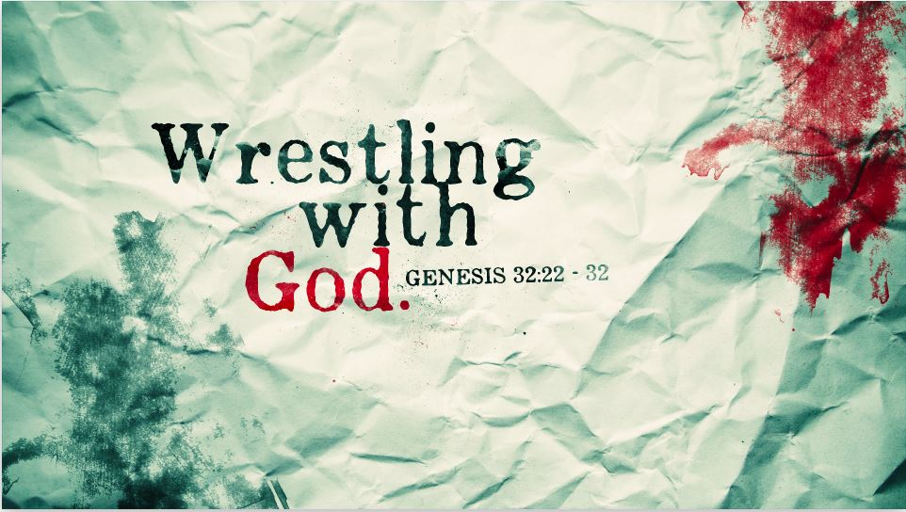

Slide 2
Jacob
Patriarch
Son of Isaac, Grandson of Abraham
Young Brother of Esau (second born twin)
Two Wives
Twelve Sons

Slide 3
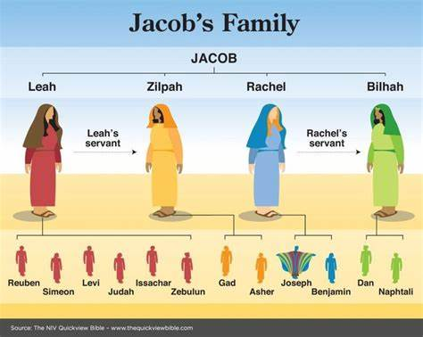

Slide 4
Genesis 28:12-13 (Jacob’s Dream)
¹² And he dreamed, and behold, there was a ladder set up on the earth, and the top of it reached to heaven. And behold, the angels of God were ascending and descending on it! ¹³ And behold, the Lord stood above it and said, “I am the Lord, the God of Abraham your father and the God of Isaac. The land on which you lie I will give to you and to your offspring.

Slide 5
Genesis 28:14-15 (Jacob’s Dream)
¹⁴ Your offspring shall be like the dust of the earth, and you shall spread abroad to the west and to the east and to the north and to the south, and in you and your offspring shall all the families of the earth be blessed. ¹⁵ Behold, I am with you and will keep you wherever you go, and will bring you back to this land. For I will not leave you until I have done what I have promised you.”

Slide 6
Jacob Wrestles With God
God is at work, even when you don’t think so.

Slide 7
Genesis 32:22-23
²² The same night he arose and took his two wives, his two female servants, and his eleven children, and crossed the ford of the Jabbok. ²³ He took them and sent them across the stream, and everything else that he had.

Slide 8
Jacob Wrestles With God
God is at work, even when you don’t so.
God wants you to wrestle with Him

Slide 9
Genesis 32:24-25
²⁴ And Jacob was left alone. And a man wrestled with him until the breaking of the day. ²⁵ When the man saw that he did not prevail against Jacob, he touched his hip socket, and Jacob's hip was put out of joint as he wrestled with him.

Slide 10
Jacob Wrestles With God
“And isn’t it interesting that God did not simply speak to Jacob in a dream or vision as he had at other times and reiterate his promise and speak comforting words? This time God addressed Jacob’s fear by requiring him to wrestle all night. This probably felt to Jacob like a badly timed hassle when he just wanted comfort and assurance. But later he realized just how comforting it was. Sometimes when we want God’s comfort, he sends it in unexpected and even unwanted packages.”
Jon Bloom – DesiringGod.com

Slide 11
Jacob Wrestles With God
God is at work, even when you don’t so
God wants you to wrestle with Him
God will bless you, when you understand his will

Slide 12
Genesis 32:26-29
²⁶ Then he said, “Let me go, for the day has broken.” But Jacob said, “I will not let you go unless you bless me.” ²⁷ And he said to him, “What is your name?” And he said, “Jacob.” ²⁸ Then he said, “Your name shall no longer be called Jacob, but Israel, for you have striven with God and with men, and have prevailed.” ²⁹ Then Jacob asked him, “Please tell me your name.” But he said, “Why is it that you ask my name?” And there he blessed him.

Slide 13
Hebrew = HITPA’EL (To Advance)
“Histarer”

Slide 14
Jacob Wrestles With God
God is at work, even when you don’t so
God wants you to wrestle with Him
God will bless you, when you understand his will
God doesn’t want you to forget what he has done

Slide 15
Genesis 32:30-32
³⁰ So Jacob called the name of the place Peniel, saying, “For I have seen God face to face, and yet my life has been delivered.” ³¹ The sun rose upon him as he passed Penuel, limping because of his hip. ³² Therefore to this day the people of Israel do not eat the sinew of the thigh that is on the hip socket, because he touched the socket of Jacob's hip on the sinew of the thigh.

Slide 16
Key Take-Aways
God is at work
Its OK to wrestle with God
We grow when we understand God’s will for us
We need to be reminded

