Slide 1


GRADES K-5

Slide 2
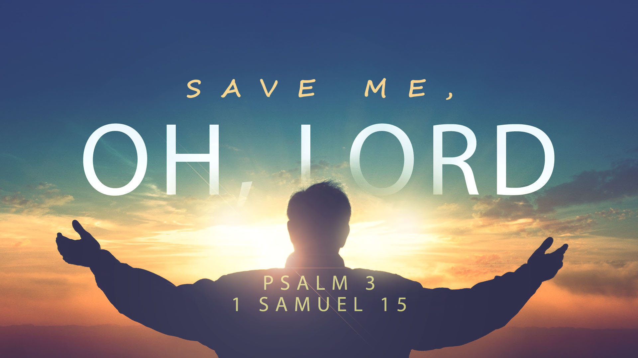

Slide 3
Psalm 3
Save Me, O My God
A Psalm of David, when he fled from Absalom his son.
O Lord, how many are my foes!
Many are rising against me;
² many are saying of my soul,
“There is no salvation for him in God.” Selah

Slide 4
Psalm 3
³ But you, O Lord, are a shield about me,
my glory, and the lifter of my head.
⁴ I cried aloud to the Lord,
and he answered me from his holy hill. Selah

Slide 5
Psalm 3 (cont.)
⁵ I lay down and slept;
I woke again, for the Lord sustained me.
⁶ I will not be afraid of many thousands of people
who have set themselves against me all around.

Slide 6
Psalm 3 (cont.)
⁷ Arise, O Lord!
Save me, O my God!
For you strike all my enemies on the cheek;
you break the teeth of the wicked.
⁸ Salvation belongs to the Lord;
your blessing be on your people! Selah

Slide 7
David
A man after God’s own heart (1 Sam 13:14; Acts 13:22)
  Loved God’s Word (Psalm 119)
  Held God’s Word in his heart (Psalm 119)
  Confessed his sins (Psalm 51:3; 2 Sam 12:13)
Was at the end of his reign (~ 60 years old) at the time of Psalm 3 events

Slide 8
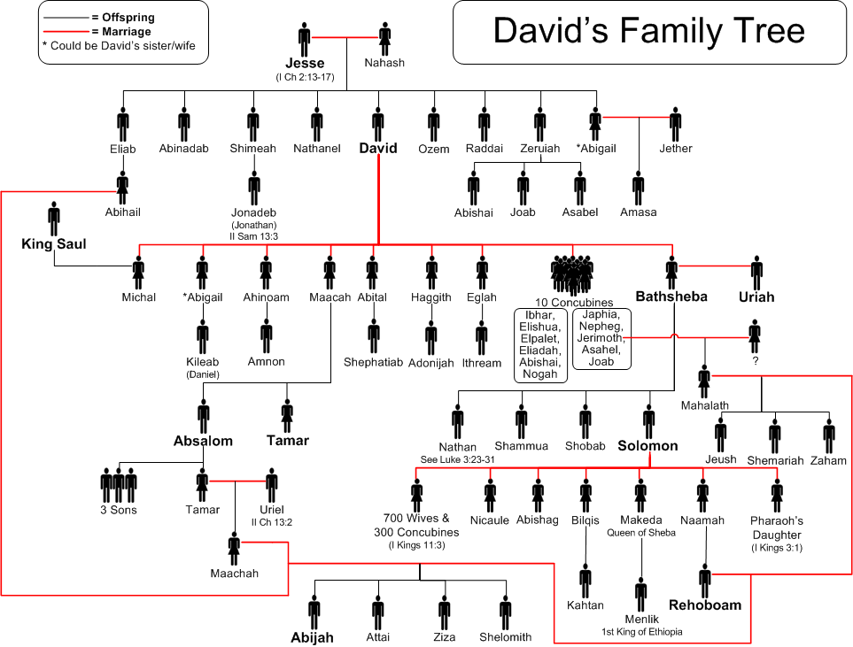

Slide 9
Absalom
Son of David and Maacah
  Full brother to Tamar (sister)
Killed his half brother Amnon
Exiled himself / grew in anger toward David and his throne

Slide 11
David’s Challenges (v.1-2)
O Lord, how many are my foes!
Many are rising against me;
² many are saying of my soul,
“There is no salvation for him in God.” Selah

Slide 12
David’s Challenges (v.1-2)
David was in trouble, and his troubles were building
And his enemies were challenging his faith
But who did he seek?
He called out to God “O’ Lord”

Slide 13
David’s Comfort (v. 3-6)
³ But you, O Lord, are a shield about me,
my glory, and the lifter of my head.
⁴ I cried aloud to the Lord,
and he answered me from his holy hill. Selah

Slide 14
David’s Comfort (v. 3-6)
⁵ I lay down and slept;
I woke again, for the Lord sustained me.
⁶ I will not be afraid of many thousands of people
who have set themselves against me all around.

Slide 15
David’s Comfort (v. 3-6)
He understood God (v. 3)
He communicated with God (v. 4)
He rested in God’s provision (v. 5-6)
What was God’s response?
He gave David rest, and took away his fear

Slide 16
David’s Calling Out (v. 7-8)
⁷ Arise, O Lord!
Save me, O my God!
For you strike all my enemies on the cheek;
you break the teeth of the wicked.
⁸ Salvation belongs to the Lord;
your blessing be on your people! Selah

Slide 17
David’s Calling Out (v. 7-8)
Rested and unafraid, David sought deliverance by God
God had taken care of David; David knew that he would again.
David understood that God’s purpose / will was much greater than his desire
What did David seek most from God?
God’s continued blessing on His people

Slide 18
Key Take Aways
Cry out to Jesus
  Romans 8:15 For you did not receive the spirit of slavery to fall back into fear, but you have received the Spirit of adoption as sons, by whom we cry, “Abba! Father!”
Understand God’s Comfort
  Nahum 1:7 The Lord is good, a stronghold in the day of trouble; he knows those who take refuge in him….
Pray for all of God’s people. Seek salvation for all God’s people!!
  1 Timothy 2:4 who desires all people to be saved and to come to the knowledge of the truth.

