Slide 1
CALL HIS NAME JESUs
MATTHEW 1:18-25

Slide 2
Matthew 1:18
“This is how the birth of Jesus Christ came about: His mother Mary was pledged to be married to Joseph, but before they came together, she was found to be with child through the Holy Spirit.”

Slide 3
Ancient Near Eastern Marriage
1. Families agreed to the arrangement.
2. A public betrothal/pledge took place.
3. The couple was married. The ceremony could last for a week.

Slide 4
Matthew 1:18-25
“This is how the birth of Jesus Christ came about: His mother Mary was pledged to be married to Joseph, but before they came together, she was found to be with child through the Holy Spirit.”

Slide 5
Matthew 1:19
“Because Joseph her husband was a righteous man and did not want to expose her to public disgrace, he had in mind to divorce her quietly.”

Slide 6
Matthew 1:20
“But after he had considered this, an angel of the Lord appeared to him in a dream and said, “Joseph son of David, do not be afraid to take Mary home as your wife, because what is conceived in her is from the Holy Spirit.”

Slide 7
Matthew 1:21
“She will give birth to a son, and you are to give him the name Jesus, because he will save his people from their sins.”

Slide 8
Matthew 1:22-23
“All this took place to fulfill what the Lord had said through the prophet: “The virgin will be with child and will give birth to a son, and they will call him Immanuel”—which means, “God with us.”

Slide 9
Matthew 1:24-25
“When Joseph woke up, he did what the angel of the Lord had commanded him and took Mary home as his wife. But he had no union with her until she gave birth to a son. And he gave him the name Jesus.”

Slide 10

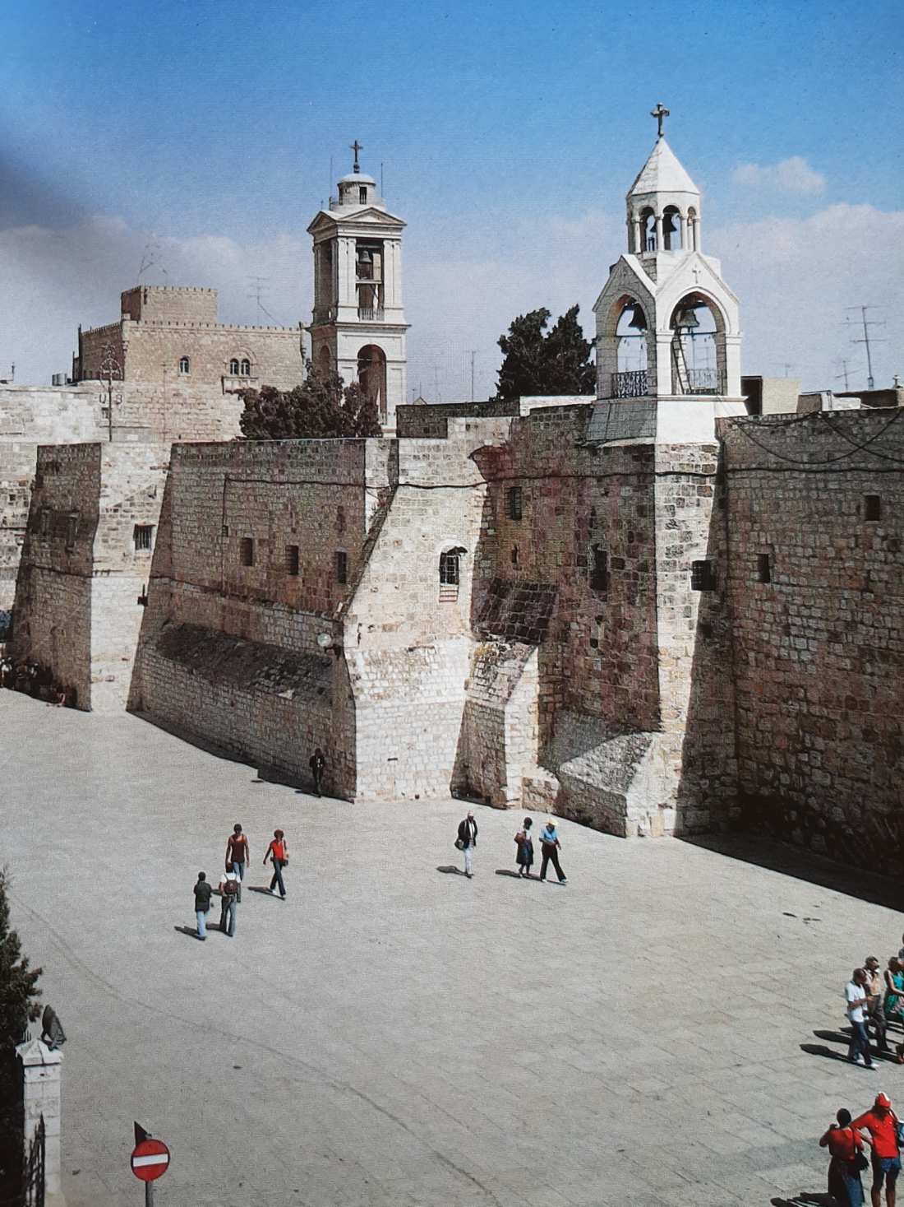
Church of the Nativity

Slide 11
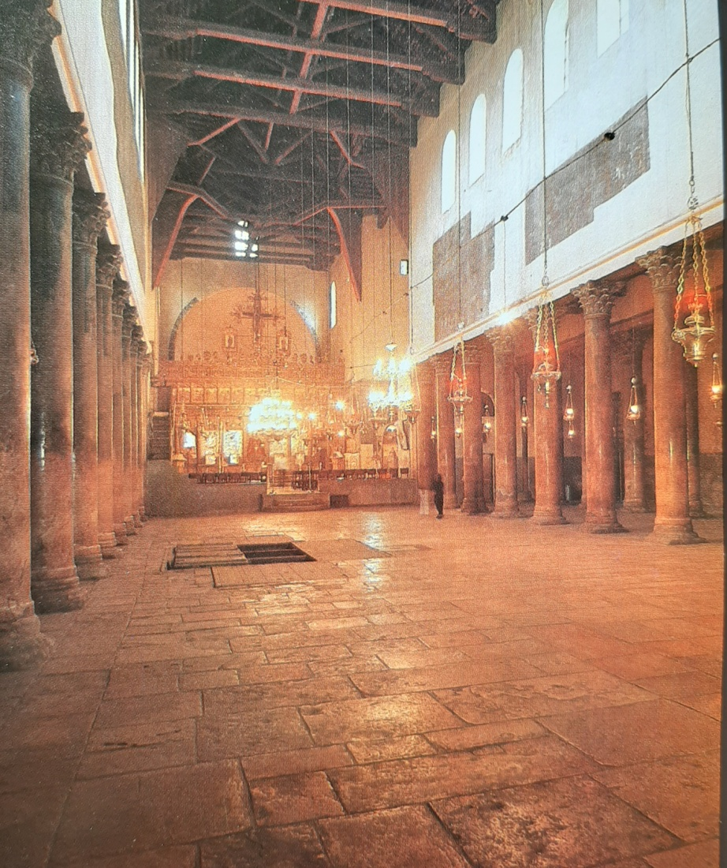
Church of the Nativity

Slide 12
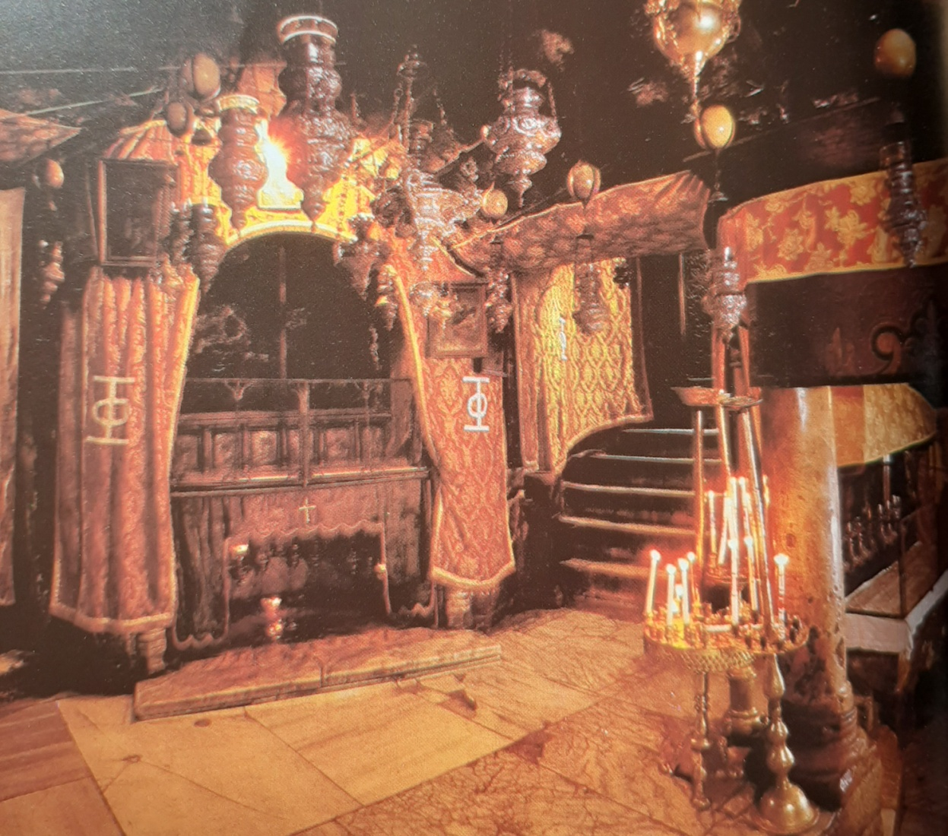
Grotto of the Nativity

Slide 13
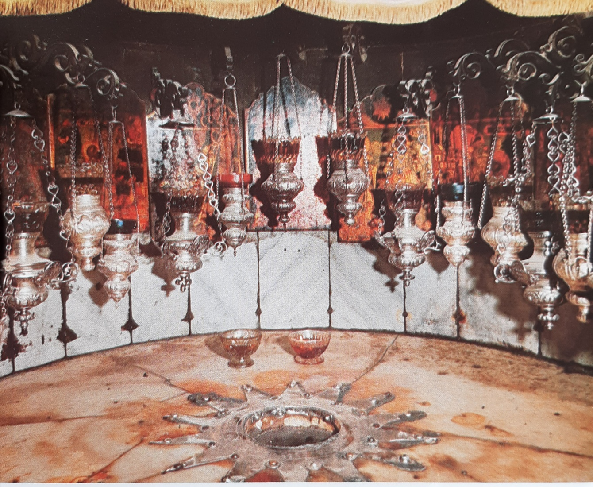
The Spot where Jesus is thought to have been born

Slide 14
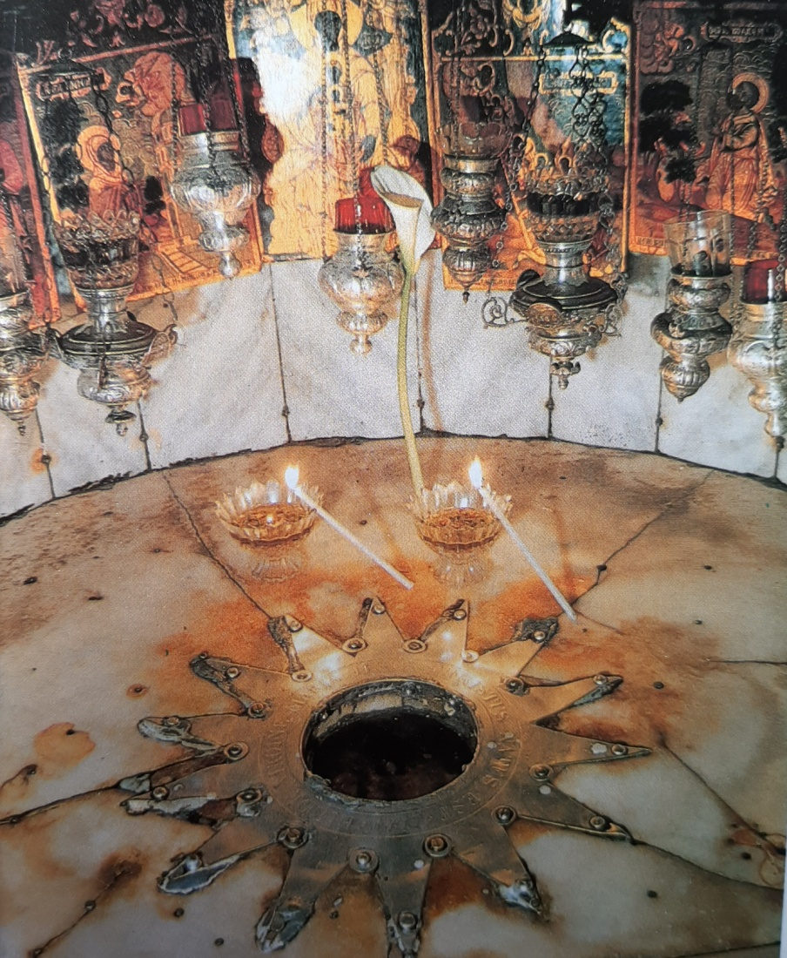
Grotto of the Nativity

Slide 15
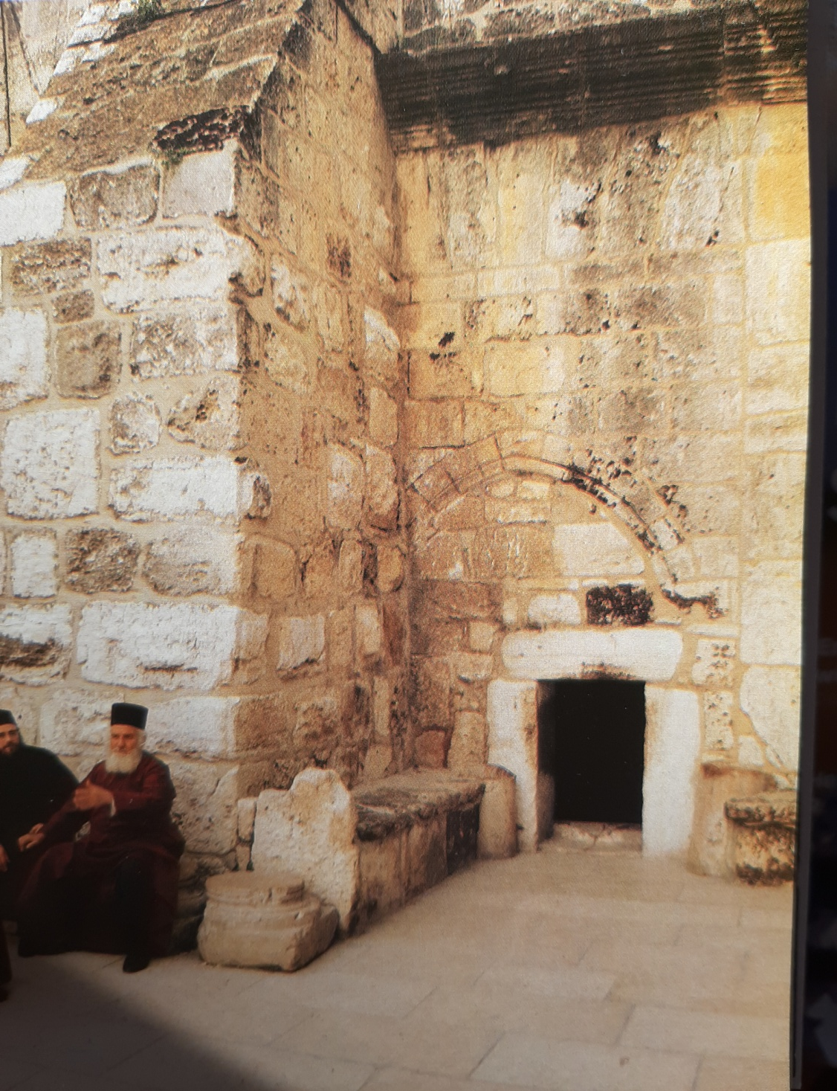
Bethlehem Door of Humility

Slide 16
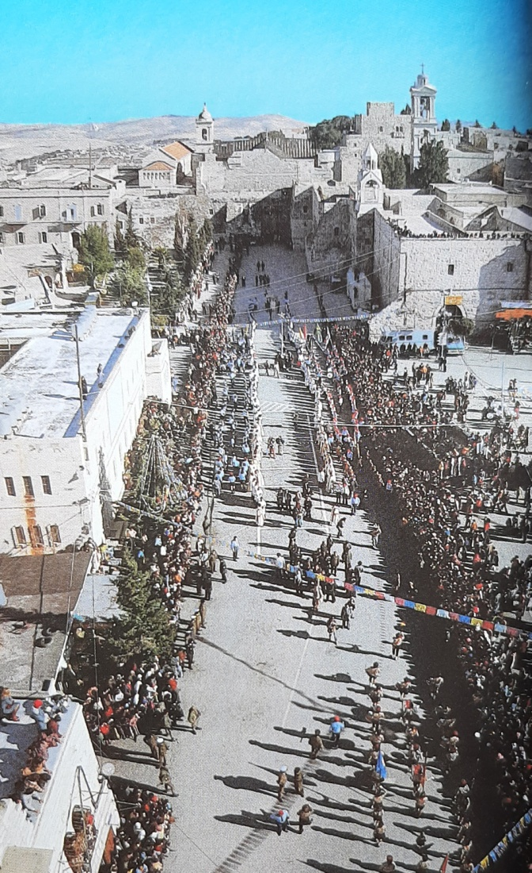
Bethlehem

Slide 17
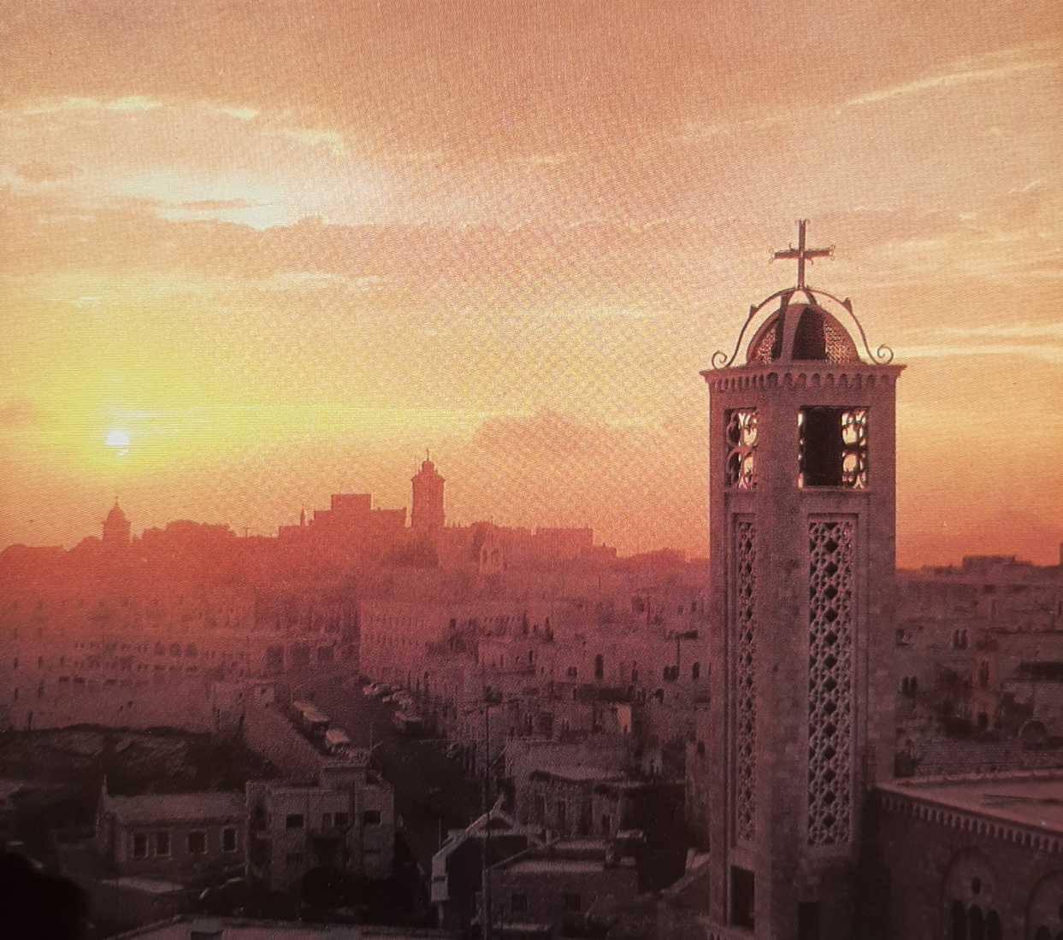
Bethlehem

Slide 18
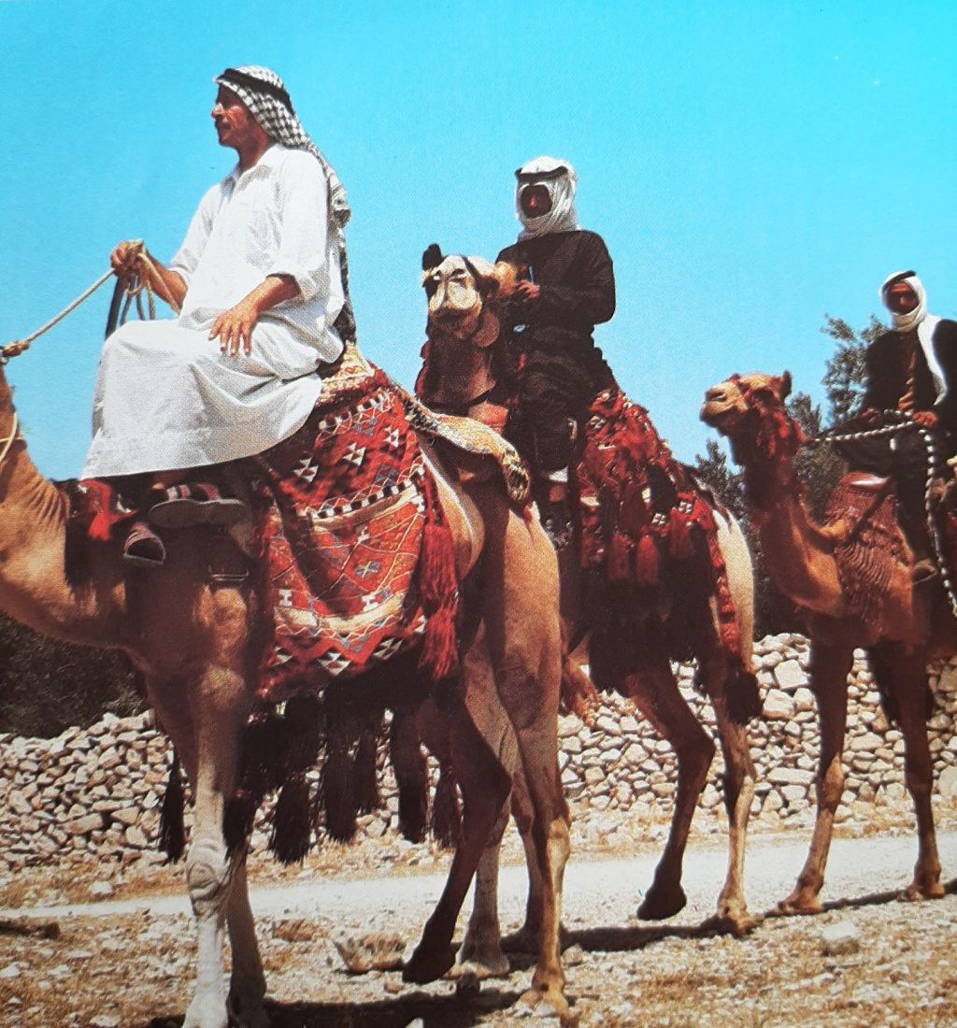

Slide 19
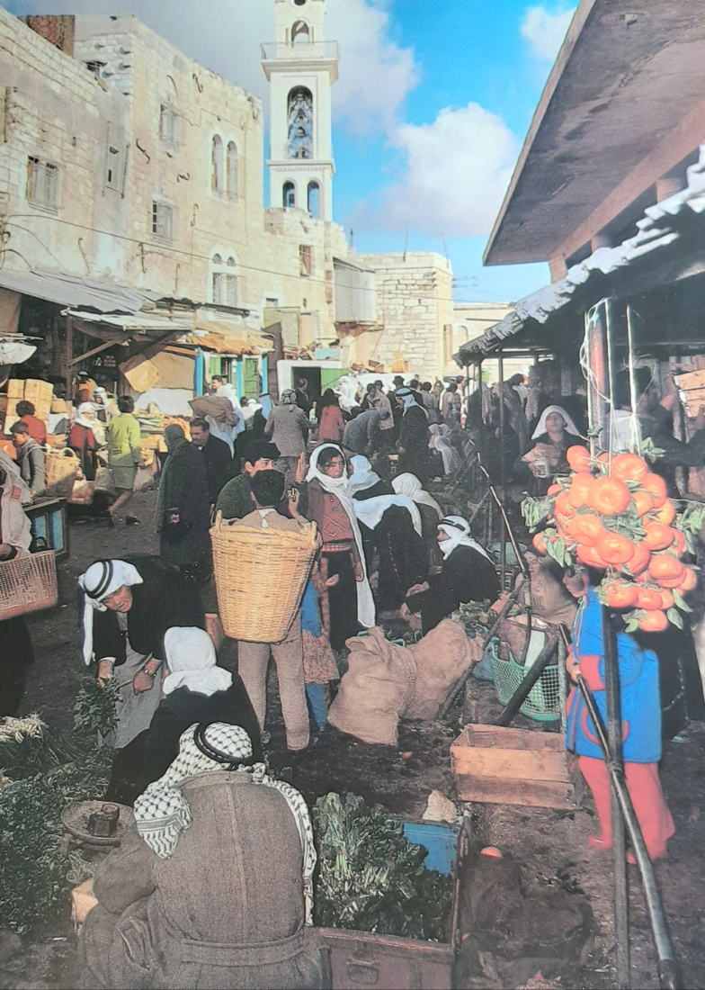
Bethlehem

Slide 20
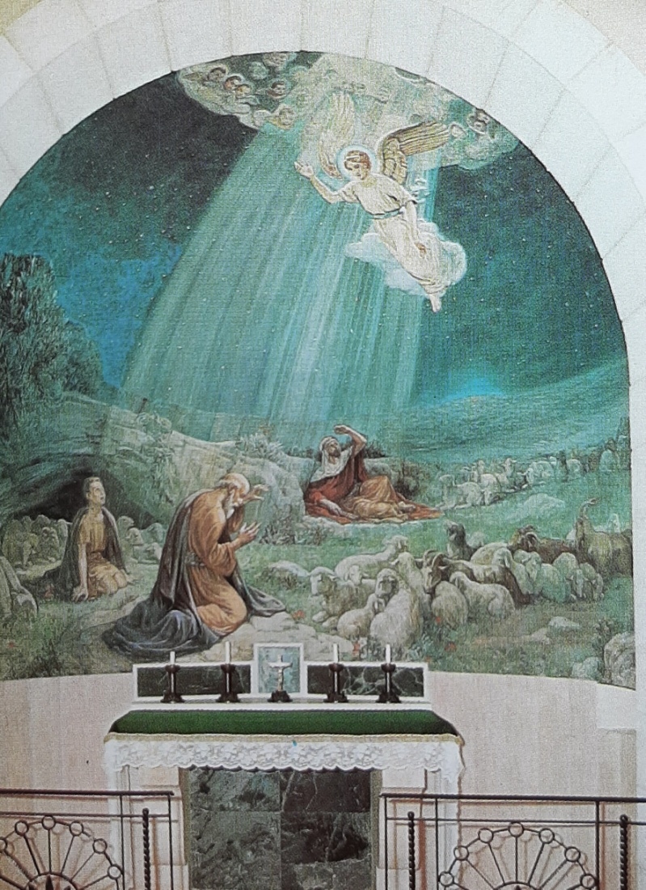
Shepherd’s Field Church

Slide 21
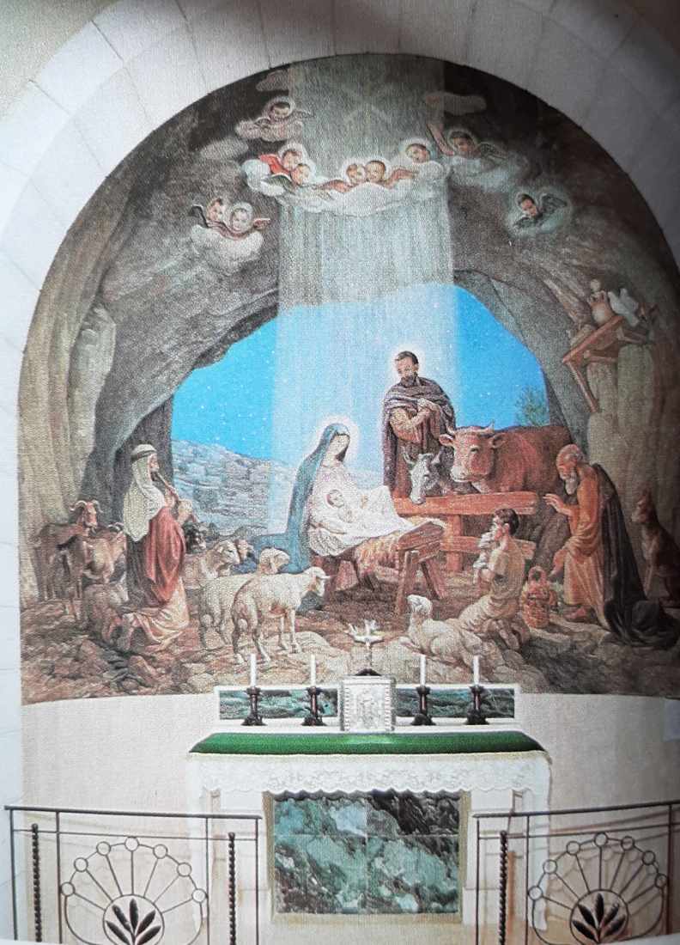
Shepherd’s Field Church

Slide 22
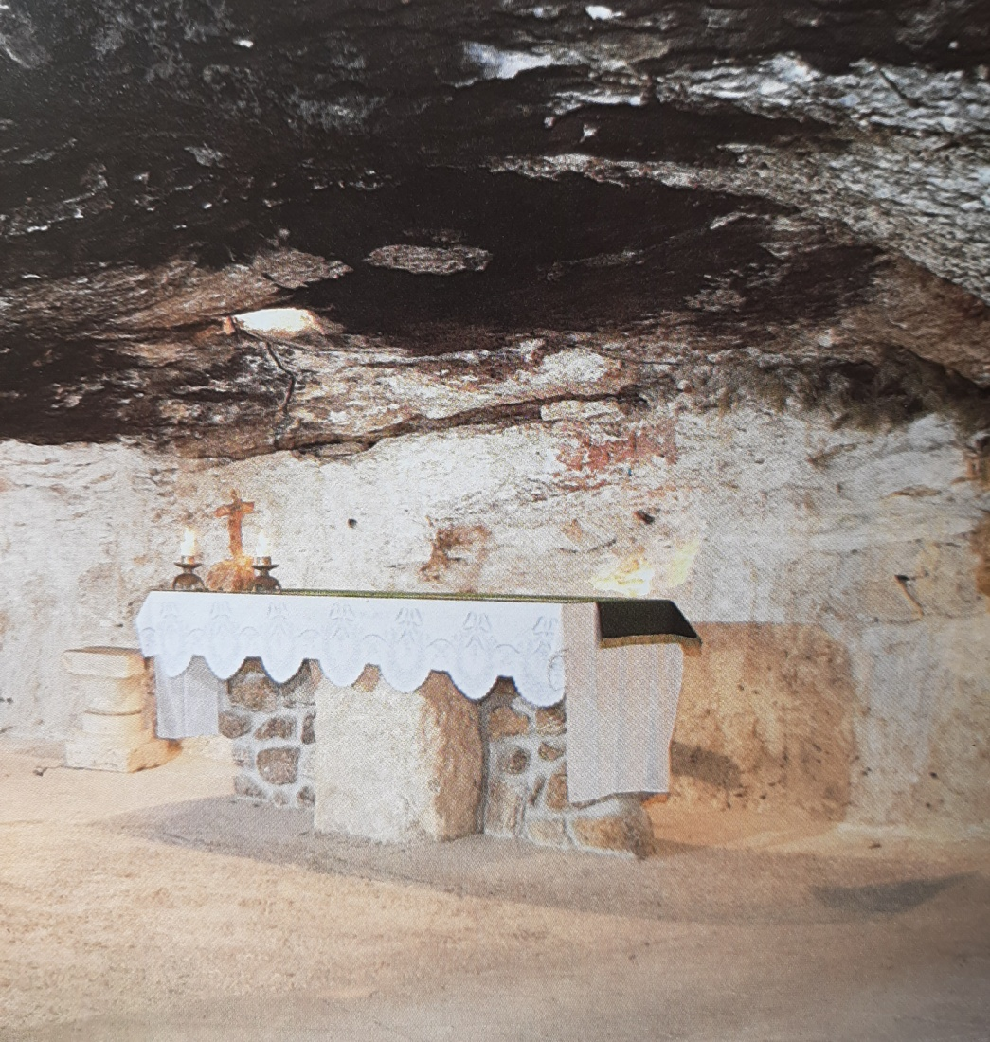
Grotto of the Shepherds

Slide 23
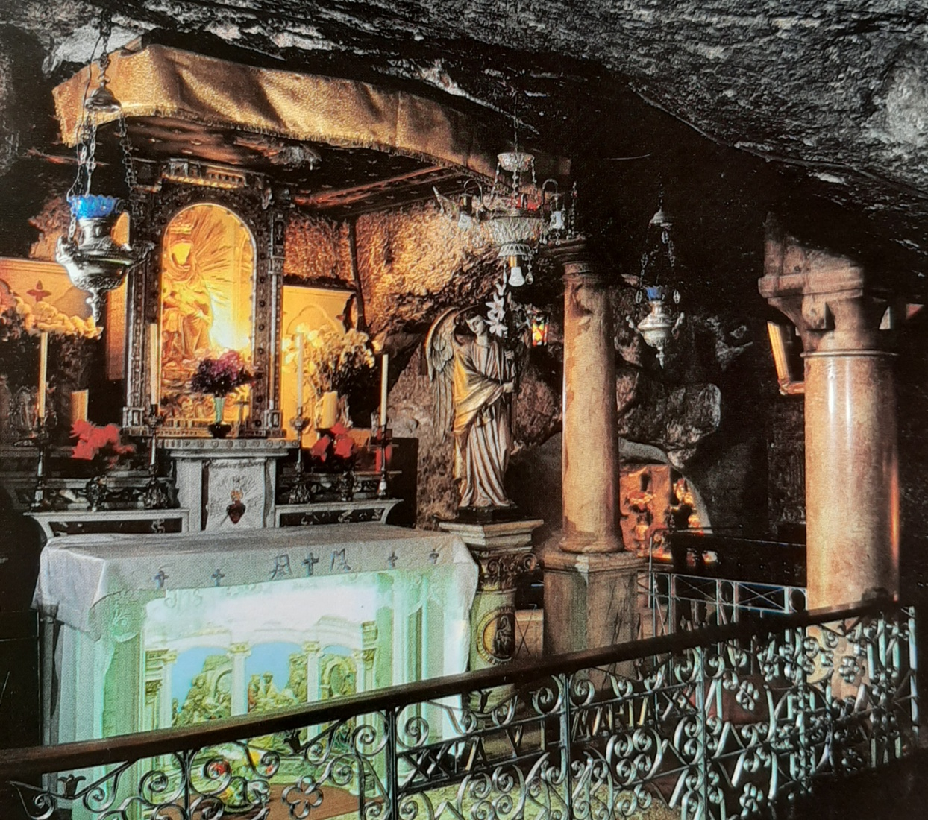
Milk Grotto

Slide 24
1. Joseph Heard (1:20-21)
God sent His angel (Gabriel?) to explain His plan.
1. Reminded him of his royal pedigree.
2. Answered his questions.
3. Showed him the end of the matter.

Slide 25
2.Joseph Believed (1:24-25)
The angel’s message, incredible as it was is believed and accepted.
Matthew adds his commentary in 1: 22 & 23.

Slide 26
3. Joseph followed God’s plan for him (1:24-25).
Joseph didn’t have a big part to play, but…
Joseph did whatever was needed.

Slide 27
3. Joseph followed God’s plan for him.
He took Mary as his wife.
He kept her sexually pure—a virgin, until after Jesus was born.

Slide 28
3. Joseph followed God’s plan for him.
Later they had quite a large family (at least 6 other children).
Mark 6:3---”James, Joseph, Judas, Simon, and his sisters.”

Slide 29
Mary Worship
Jesus expressly warned against it. (Luke 11:27, 28)
“A woman in the crowd called out, “Blessed is the mother who gave you birth and nursed you.” He replied, “Blessed rather are those who hear the word of God and obey it.”

Slide 30
Mary Worship
4 Tenets of the this R.C.C. dogma.
1. Mother of God (condemned at the Council of Ephesus in A.D. 431).

Slide 31
Mary Worship
4 Tenets of the this R.C.C. dogma.
2. Perpetual virginity. (The children are considered to be step-children or cousins).

Slide 32
Mary Worship
4 Tenets of the this R.C.C. Dogma.
3. Immaculate conception. Pope Pius IX in 1854. Mary was preserved immaculate from all stain of original sin from her conception.

Slide 33
Mary Worship
4 Tenets of the this R.C.C. dogma.
4. Bodily Assumption. Pope Pius XII in 1950. Mary transported to heaven by Jesus.

Slide 34
Joseph
1. Joseph HEARD.
2. Joseph BELIEVED GOD.
3. Joseph FOLLOWED God’s plan.

Slide 35
How about you?
Have you heard God’s word to you?
Do you believe that word?
Will you follow wherever He leads?

Slide 36
The Gold and Ivory Tablecloth
Rev. Howard C. Schade
December 1954.

