Slide 1
The Virgin Mary
Luke 1:26-38

Slide 2
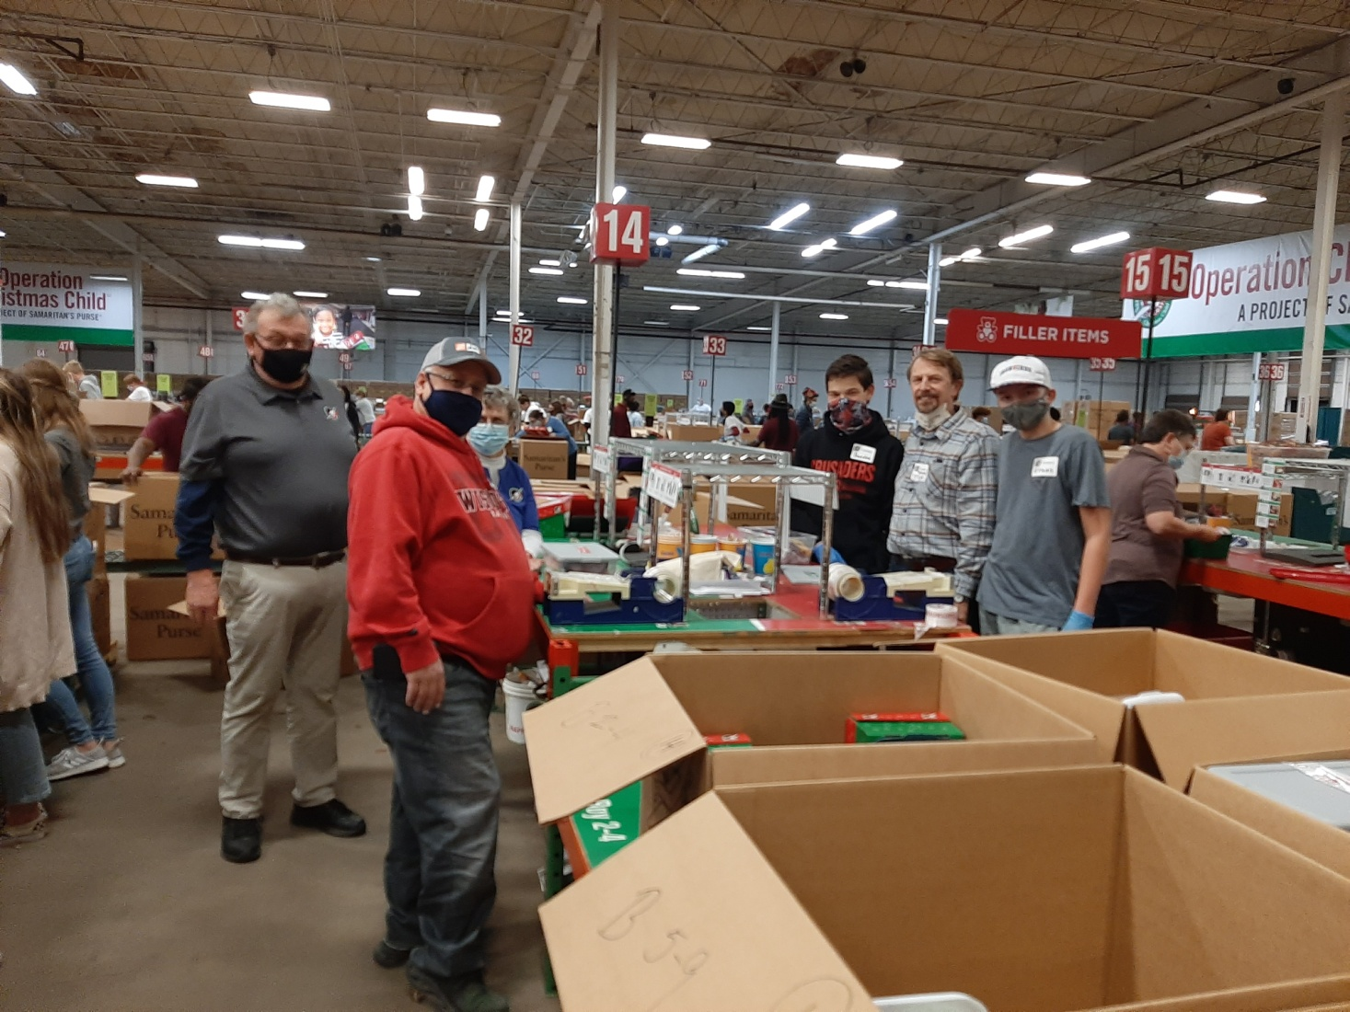

Slide 3
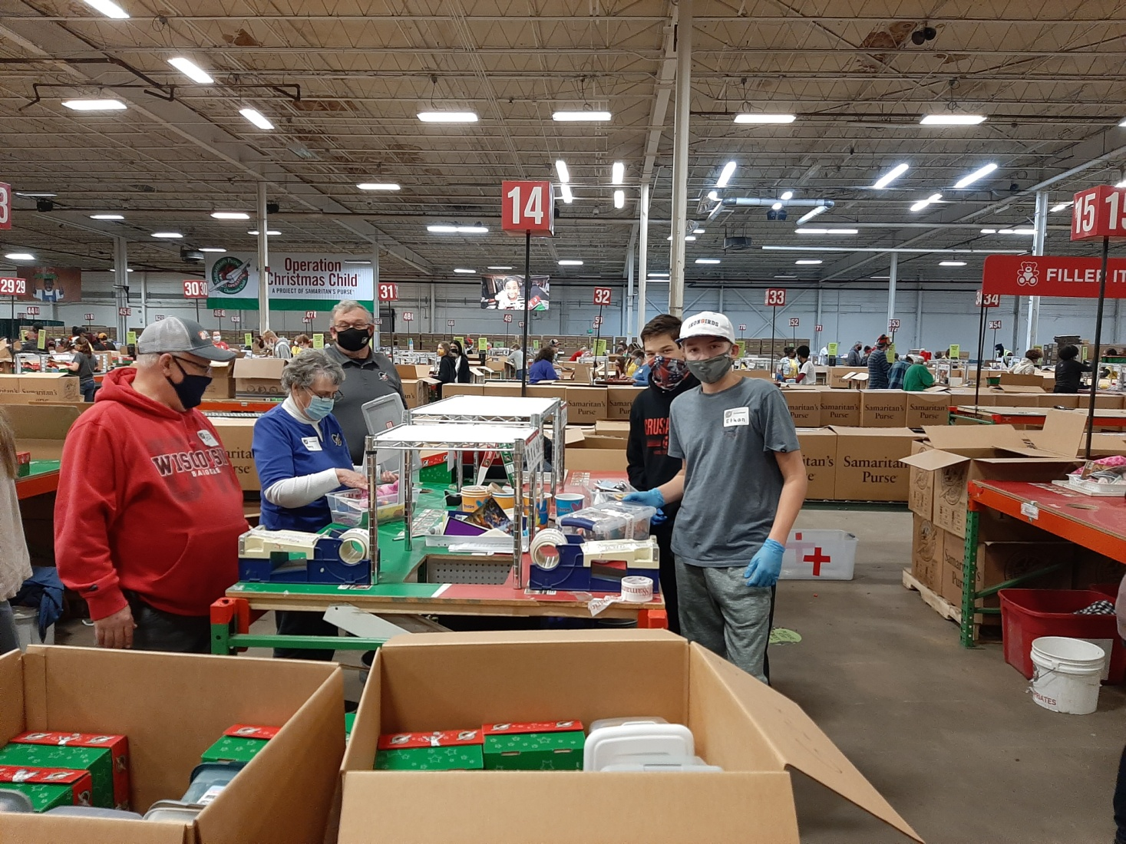

Slide 4


Slide 5
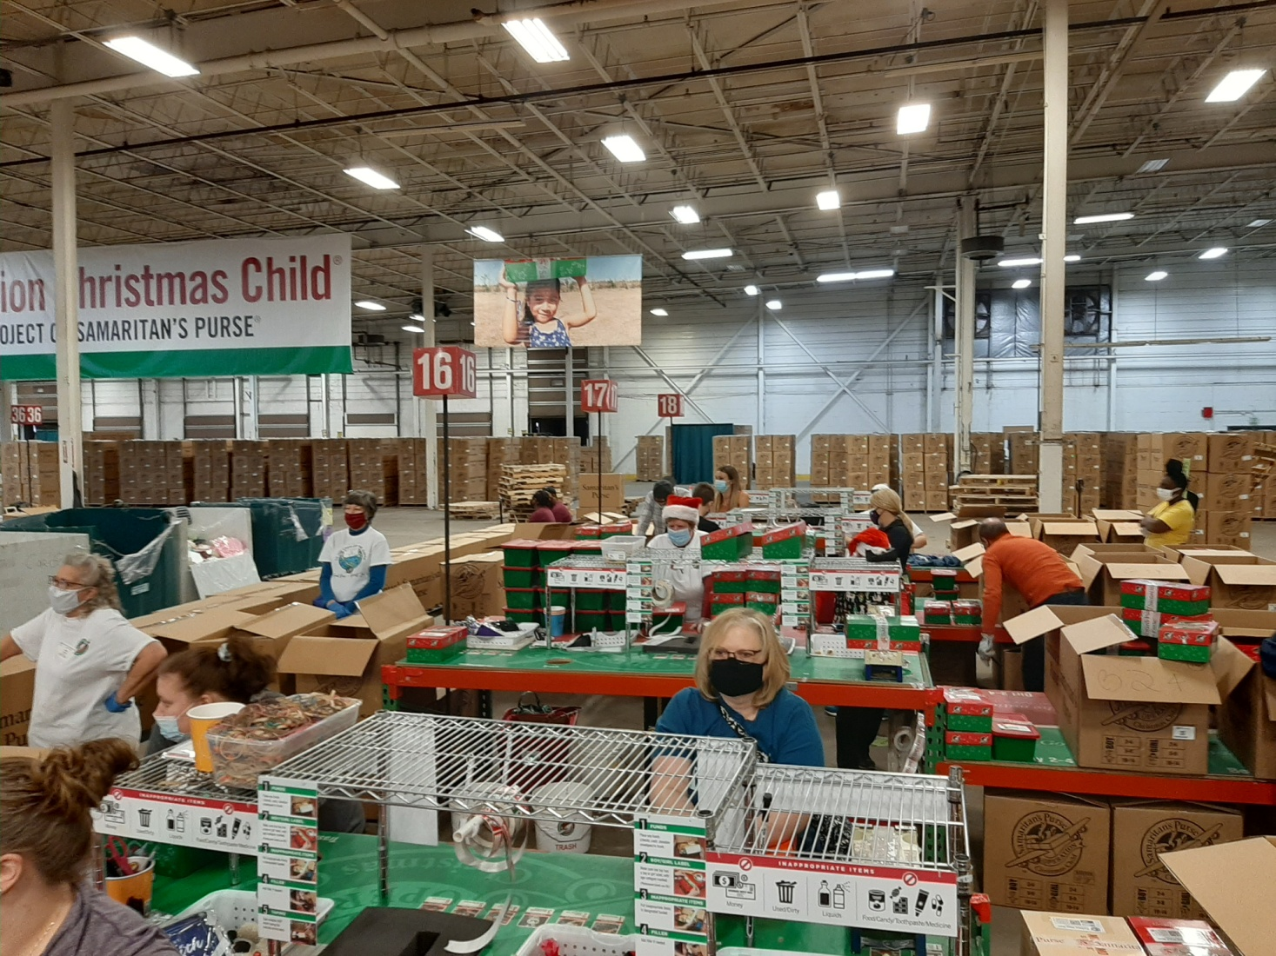

Slide 6
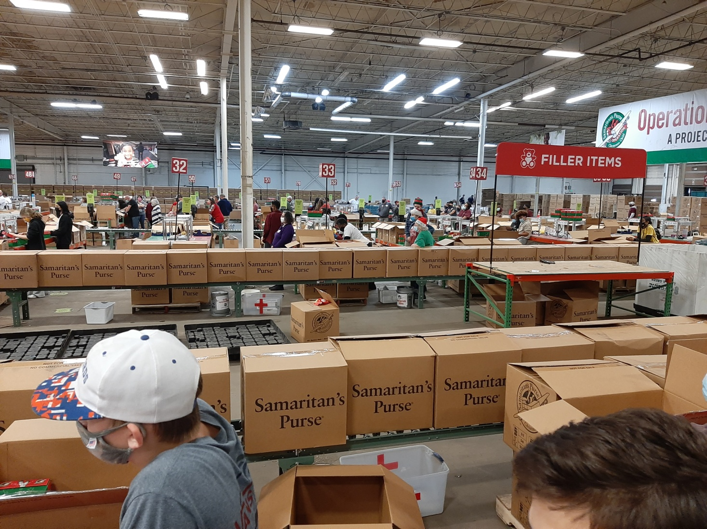

Slide 7
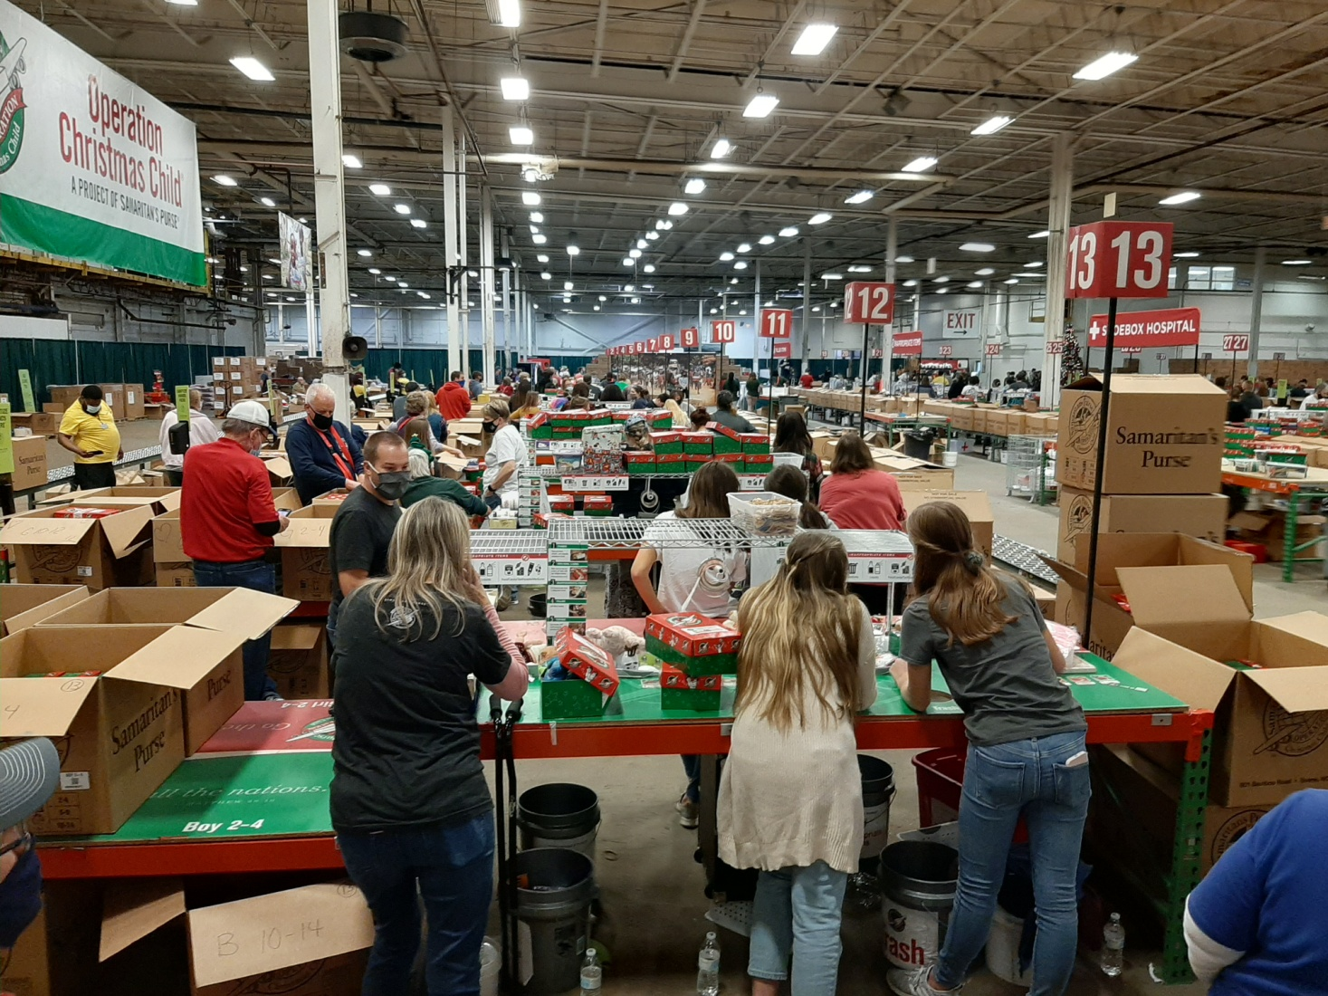

Slide 8
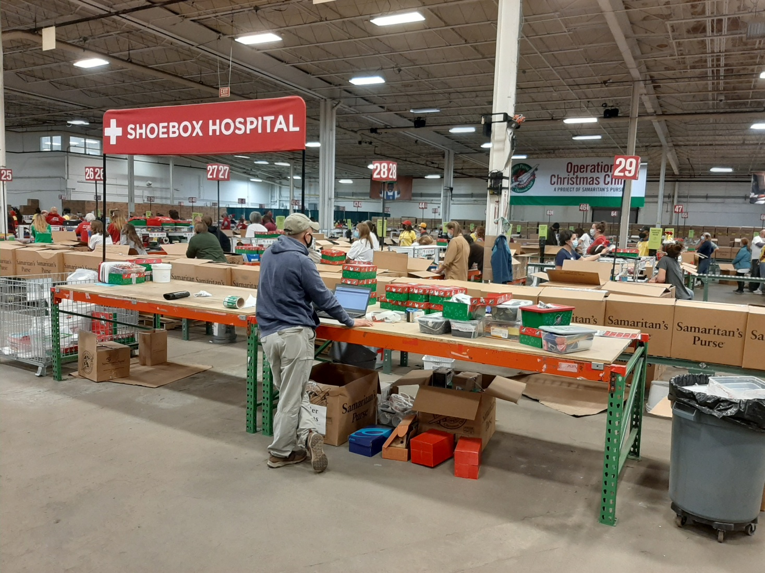

Slide 9
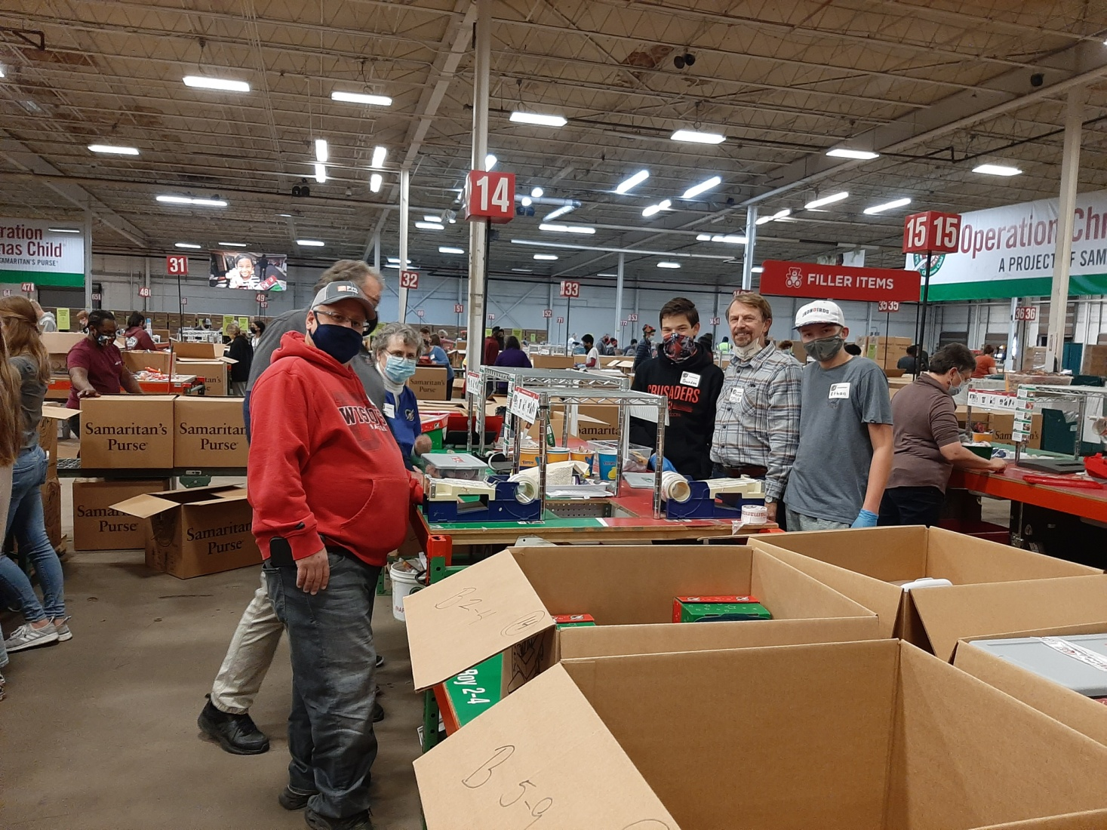

Slide 10
The Virgin Mary
Luke 1:26-38

Slide 11
Israel’s Messiah is Coming
Israel taken captive --- 600 years before Christ.
70 years in captivity.
Daniel’s prophecy---70 weeks (of years).
Daniel 9:26 --- From a decree to restore and rebuild Jerusalem…after 69 weeks (483 years) Messiah will be cut off.
Nehemiah 2:1-8 --- March 14, 445 B.C.

Slide 12
Israel’s Messiah is Coming
Some people were counting the years.
Simeon---”He was waiting for the consolation of Israel” Luke 2:25.
Anna the prophetess---”…was looking forward to the redemption of Jerusalem” (Luke 2:38).
Magi--- “We have seen His star in the East” (Matt. 2:2).

Slide 13
Luke 1:26-27
“In the sixth month, God sent the angel Gabriel to Nazareth, a town in Galilee, to a virgin pledged to be married to a man named Joseph, a descendant of David. The virgin’s name was Mary.”

Slide 14
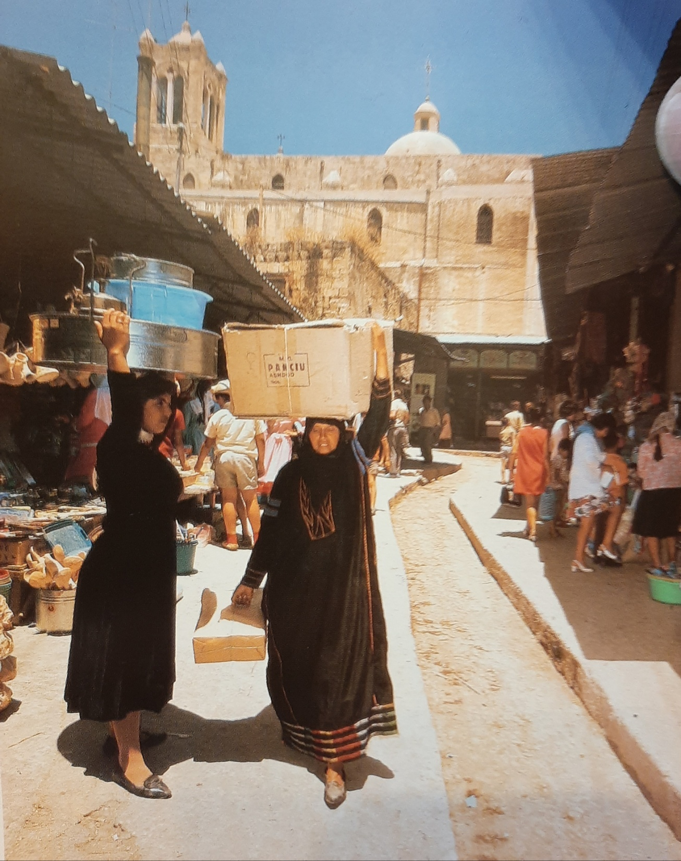
Market in
Nazareth

Slide 15
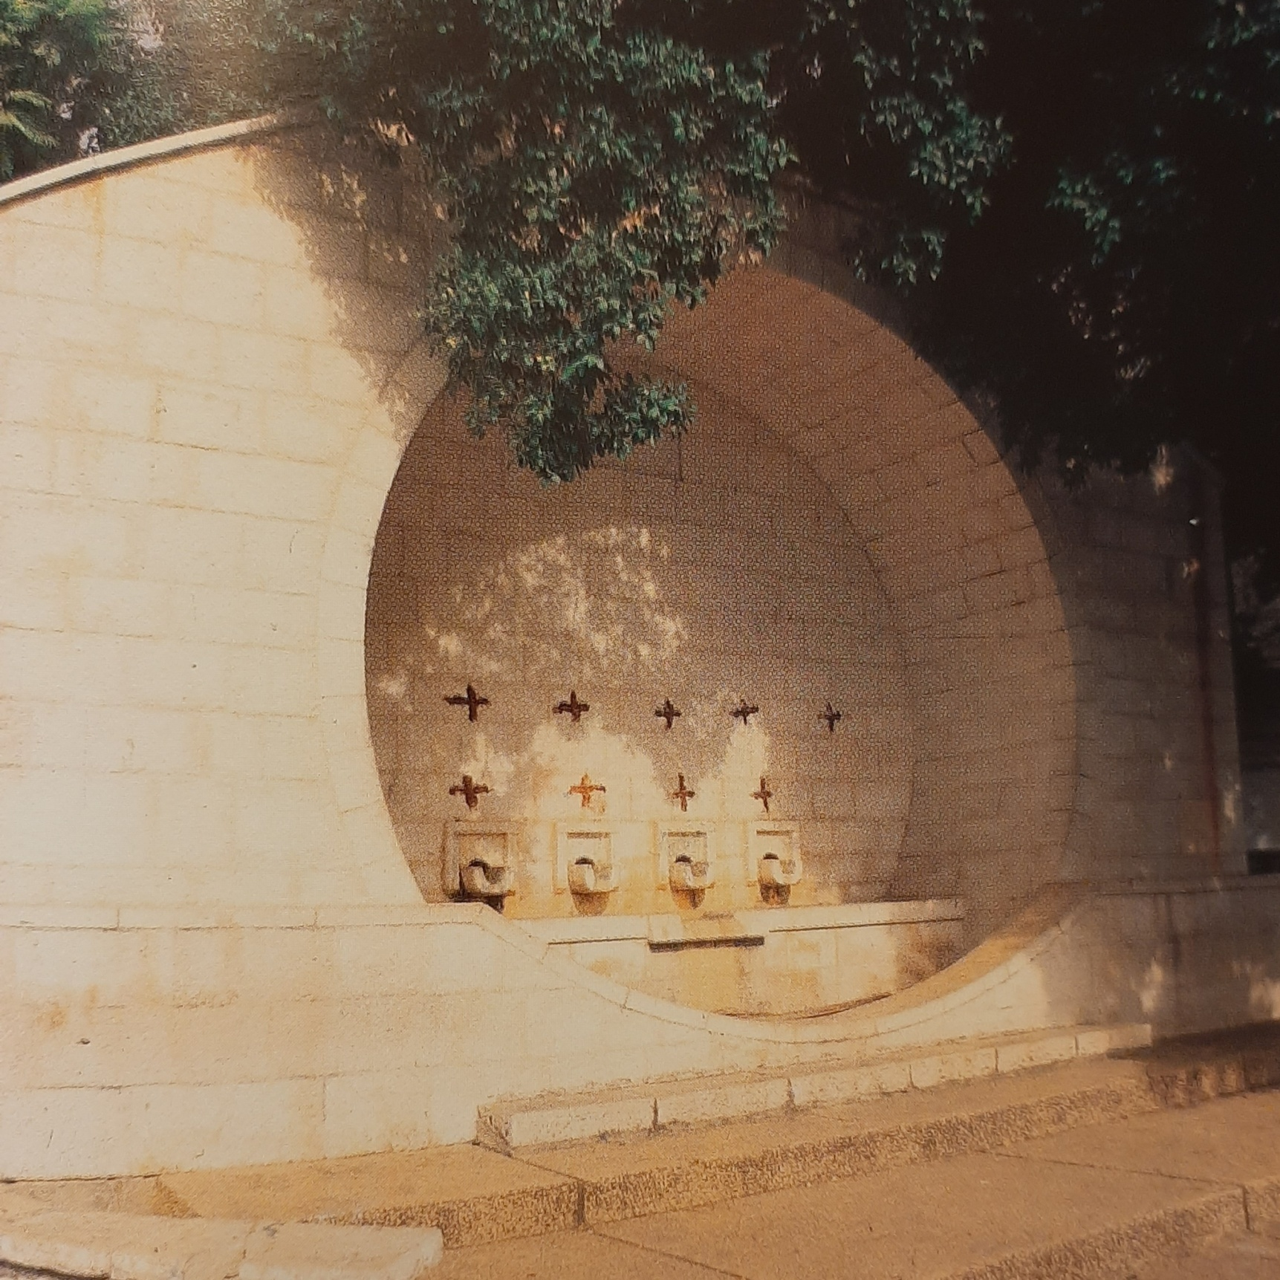
Mary’s Well

Slide 16
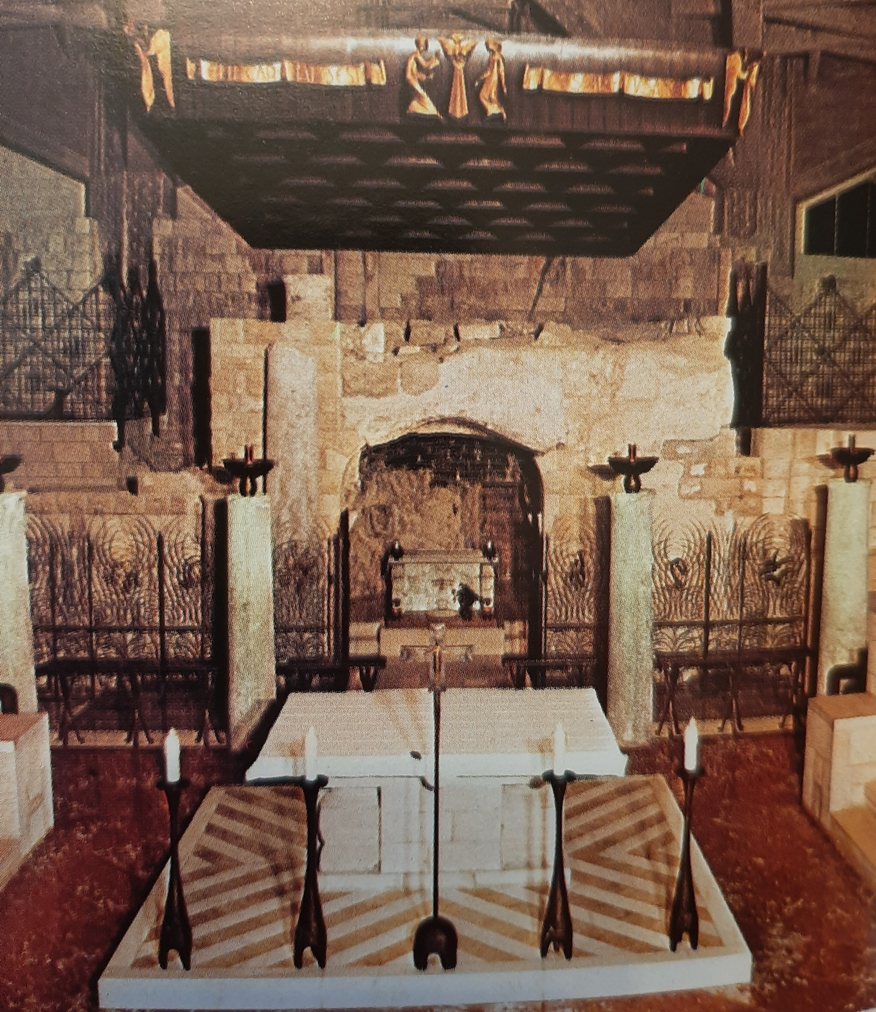
Grotto of the Annuncia-tion

Slide 17
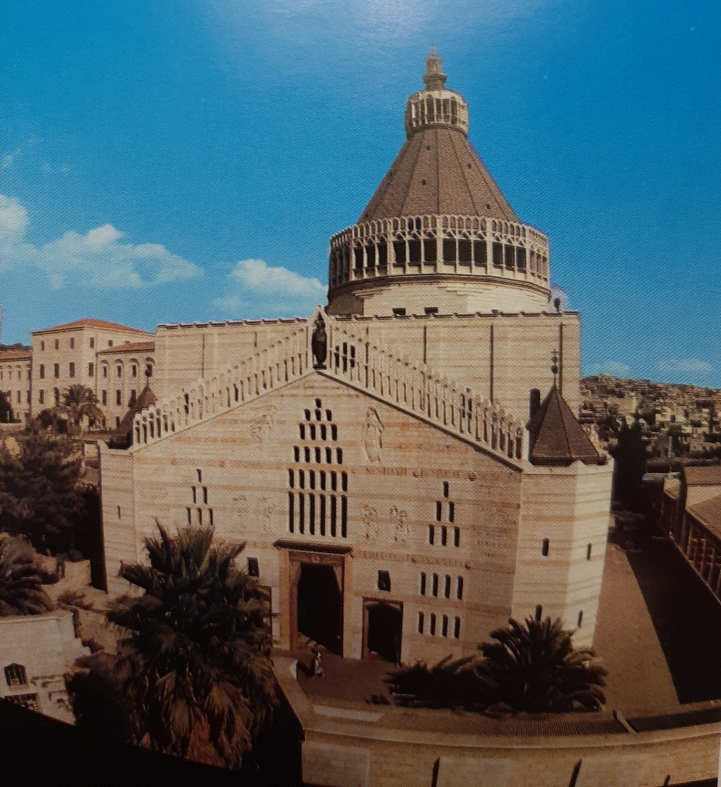
The Church of the Annunciation

Slide 18
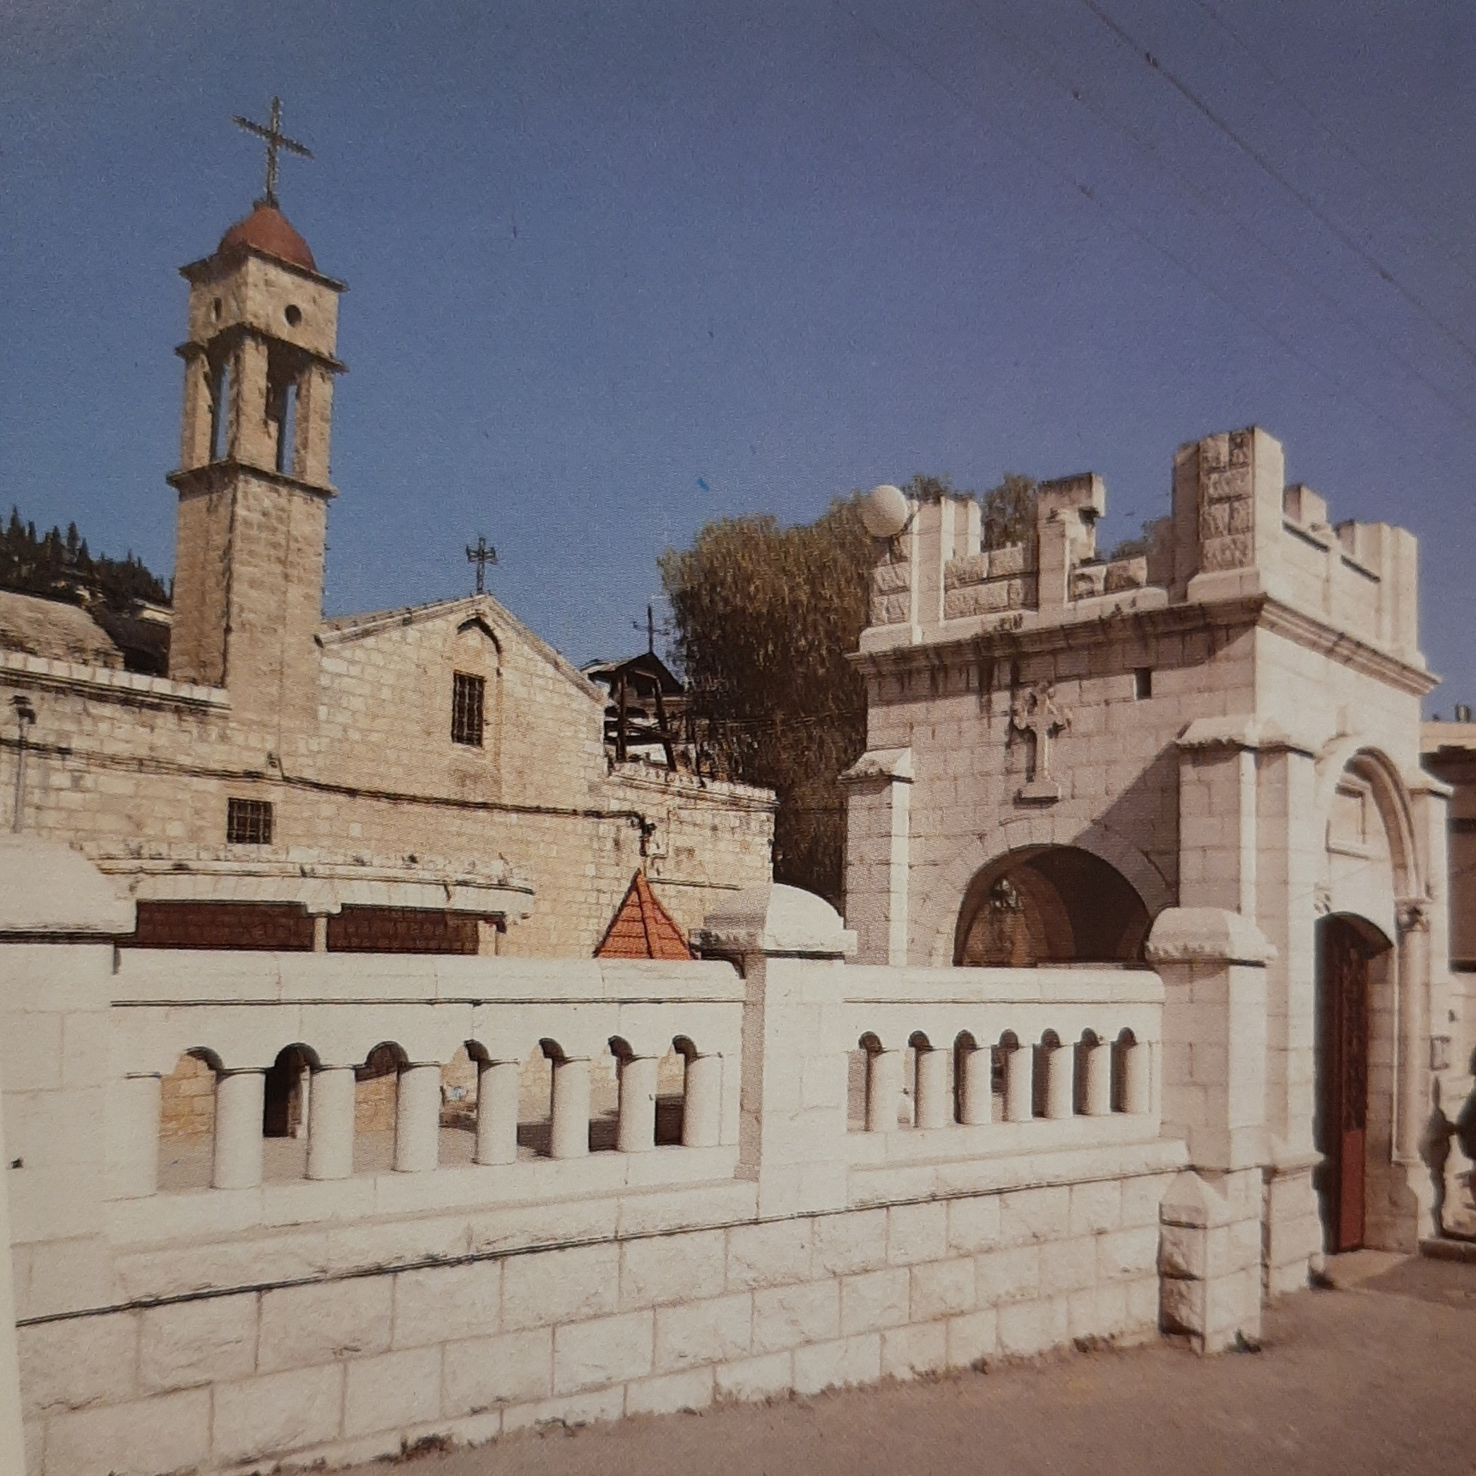
Church of St. Gabriel
12th
Century

Slide 19
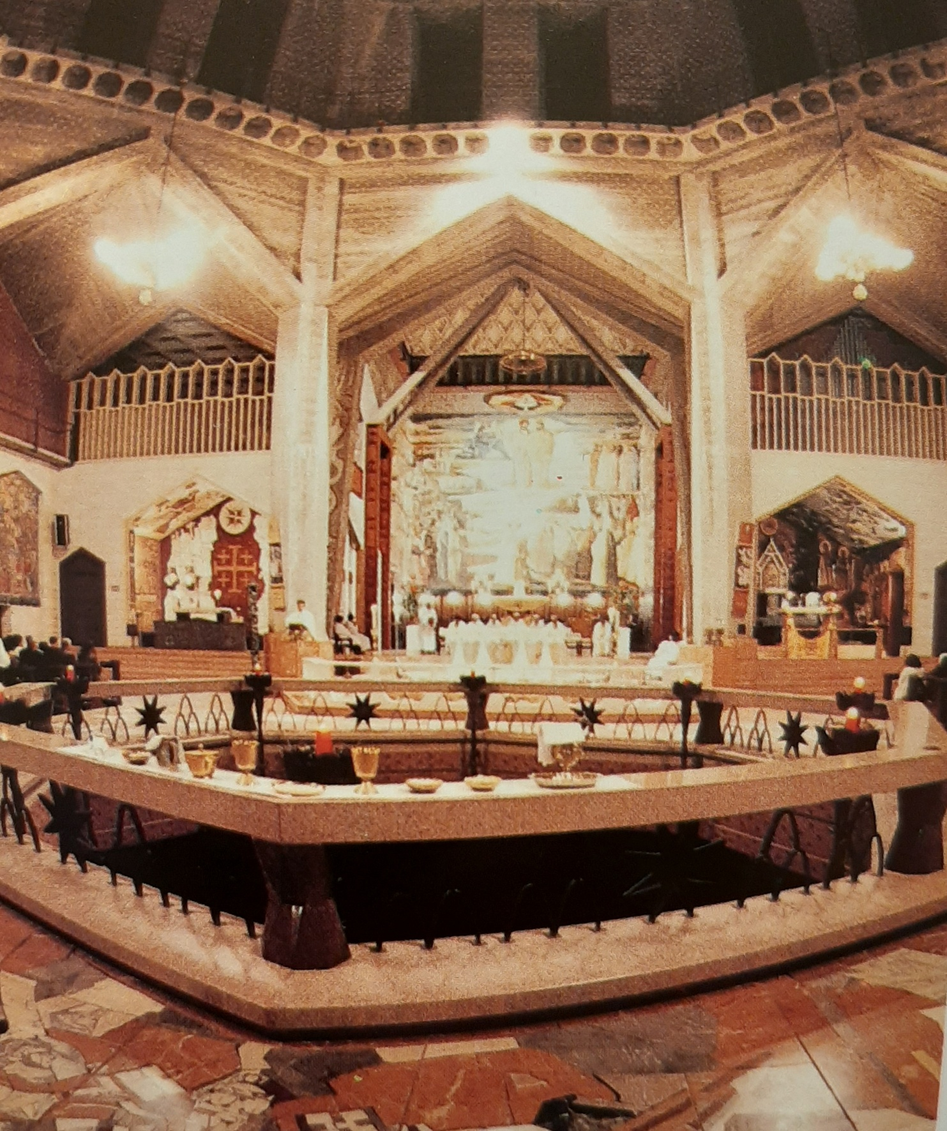
Church of St. Gabriel

Slide 20
Luke 1:26-38

Slide 21
Luke 1:26-27
“In the sixth month, God sent the angel Gabriel to Nazareth, a town in Galilee, to a virgin pledged to be married to a man named Joseph, a descendant of David. The virgin’s name was Mary.”

Slide 22
Luke 1:28
“The angel went to her and said, “Greetings, you who are highly favored! The Lord is with you.”

Slide 23
Luke 1:29-30
“Mary was greatly troubled at his words and wondered what kind of greeting this might be. But the angel said to her, “Do not be afraid, Mary, you have found favor with God.”

Slide 24
Luke 1:31-32
“You will be with child and give birth to a son, and you are to give him the name Jesus. He will be great and will be called the Son of the Most High. The Lord God will give him the throne of his father David.”

Slide 25
Luke 1:33
“And he will reign over the house of Jacob forever; his kingdom will never end.”

Slide 26
Luke 1:34
“How will this be,” Mary asked the angel, “since I am a virgin?”

Slide 27
Luke 1:35
“The angel answered, “The Holy Spirit will come upon you, and the power of the Most High will overshadow you. So the holy one to be born will be called the Son of God.”

Slide 28
Luke 1:36-37
“Even Elizabeth your relative is going to have a child in her old age, and she who was said to be barren is in her sixth month. For nothing is impossible with God .”

Slide 29
Luke 1:38
“I am the Lord’s servant,” Mary answered. “May it be to me as you have said.” Then the angel left her.”

Slide 30
The heavens have been silent for 400 years.
God was right on schedule.
“The plan of him who works out everything in conformity with the purpose of his will”
(Eph. 1:11).

Slide 31

The heavens have been silent for 400 years.
“But when the time had fully come, God sent his Son, born of a woman, born under law, to redeem us…” (Gal. 4:4).

Slide 32
4 Crucial Facts Mary needs to know.
1. The virgin will conceive and give birth to a human baby boy. (Luke 1:31)

Slide 33
Luke 1:34
“How will this be,” Mary asked the angel, “since I am a virgin?”

Slide 34
Isaiah 7:14
“Therefore the Lord himself will give you a sign: The virgin will be with child and will give birth to a son, and will call him Immanuel.”

Slide 35
4 Crucial Facts Mary needs to know.
2. God Himself is coming in human form. (Luke 1:32)

Slide 36
Luke 1:31-32
“You will be with child and give birth to a son, and you are to give him the name Jesus. He will be great and will be called the Son of the Most High.”

Slide 37
4 Crucial Facts Mary needs to know.
3. He will be named Jesus because “He will save His people from their sins.” (Luke 1:31 & Matthew 1:21)

Slide 38
Acts 4:12
“Salvation is found in no one else, for there is no other name under heaven given to men by which we must be saved.”

Slide 39
Acts 2:38
“Peter replied, “Repent and be baptized, every one of you, in the name of Jesus Christ for the forgiveness of your sins.”

Slide 40
Hebrews 10:10
“…We have been made holy through the sacrifice of the body of Jesus Christ once for all.”

Slide 41
4 Crucial Facts Mary needs to know.
4. He will be King of Israel. (Luke 1:32-33)

Slide 42
Luke 1:32
“The Lord God will give him the throne of his father David.”

Slide 43
Luke 1:33
“And he will reign over the house of Jacob forever; his kingdom will never end.”

Slide 44
The Future Kingdom Reign
God has had this in His plan from the beginning.
Israel as a nation rejected Him, but it did not thwart God’s plan.

Slide 45
The Lord’s Prayer
“Your kingdom come, your will be done on earth as it is in heaven…” (Matthew 6:10).

Slide 46
Romans 11:1-2
“I ask then: Did God reject his people? By no means!...God did not reject his people, whom he foreknew.”

Slide 47
Romans 11:25
“I do not want you to be ignorant of this mystery, brothers, so that you may not be conceited: Israel has experienced a hardening in part until the full number of the Gentiles has come in.”

Slide 48
Romans 11:26,27
“And so all Israel will be saved…”
“When I take away their sins.”

Slide 49
Revelation 19:11ff
“I saw heaven standing open and there before me was a white horse, whose rider is called Faithful and True…His name is the Word of God…He will rule them with an iron scepter….KING OF KINGS AND LORD OF LORDS.”

Slide 50
4 Crucial Facts Mary needs to know.
1. Virgin Conception.
2. God will become Man.
3. Jesus will save His people from sin.
4. He will Rule over Israel forever.

Slide 51
How will you respond to God’s Word?
“I can do everything through him who gives me strength.” (Phil. 4:13).
“If you love me, you will obey what I command.” (John 14:15)

Slide 52
Luke 1:38
“I am the Lord’s servant,” Mary answered. “May it be to me as you have said.”

Slide 53
How will you respond to God’s Word?
“Why do you call me, ‘Lord, Lord’ and do not do what I say?” (Luke 6:46).

Slide 54
How will you respond to God’s Word?
“And this is his command: to believe in the name of his Son, Jesus Christ, and to love one another as he commanded us. (1 John 3:23).

