Slide 2
JOHN 15:1-17
“I am the true vine, and my Father is the gardener.”

Slide 3
7th “I AM…”
I myself, and no one else is the True Vine.

Slide 4
Jesus says “I AM”
“I am the True Vine.” (John 15:1)
Ego Eimi (Greek)
Ego=“I”
Eimi=“I am.”
I myself and no one else am…

Slide 5
7 times Jesus says “I AM”
I am the bread of life (John 6)
I am the light of the world (John 8)
I am the door (John 10)
I am the good shepherd (John 10)
I am the resurrection and the life (John 11)
I am the way, the truth and the life (John 14)
I am the true vine (John 15)

Slide 6
The Key is to abide/remain in Jesus.
12 times in John 15.
Greek word is Meno . Root of menagerie– abode for animals.
The Noun form is in John 14:2– “mansions/rooms/abiding places.”

Slide 7
The True Vine
A branch must be vitally connected to the vine.
“Apart from me you can do nothing.” John 15:5

Slide 8
The Olivet Discourse– John 15-17
Jesus leaves the Upper Room (John 14:31).
They are walking to Gethsemane
(John 18:1).

Slide 9
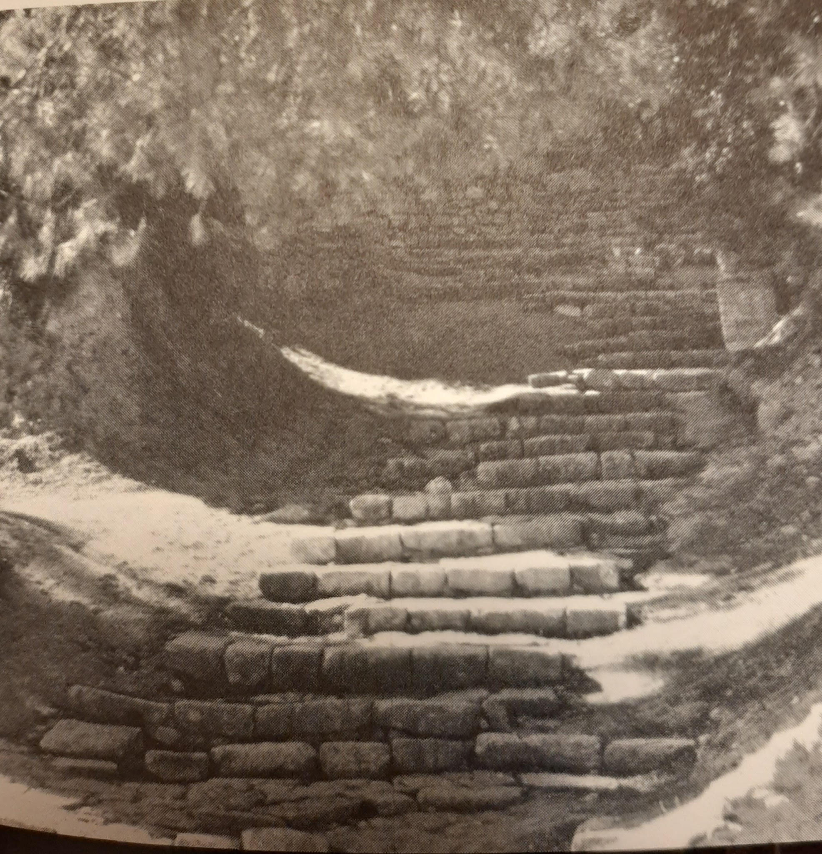
Ancient Steps to Gethsemane

Slide 10
I AM THE TRUE VINE
The word picture of the vine and the branches with the Gardener who takes care of it is a picture of the relationship of God to us.

Slide 11
I AM THE TRUE VINE
THE TRUE VINE—Jesus
THE GARDENER—God the Father
BRANCHES—People who profess faith
FRUIT—Christian virtues produced and manifested in one’s life.

Slide 12
THE BRANCHES
It is important to understand exactly who the BRANCHES represent.
There are 2 kinds of BRANCHES.
1. BRANCHES in Jesus (15:2ff).
2. BRANCHES not in Jesus (15:6).
Like the parable of the wheat and tares.

Slide 13
1. Branches in Christ
Some bear no fruit (15:2a).
Others do bear fruit (15:2b-17).
But all are those who abide/remain in Christ

Slide 14
2. Branches not in Christ (15:6)
These branches look like true branches.
But the Gardener knows that they do not actually abide/remain in Christ.
Like Judas Iscariot.

Slide 15
1. Branches in Christ
A. “No fruit” kind of branches– (15:2).
“He cuts off every branch in me that bears no fruit.”
Dr. David Wilkerson– Literally to cut off may mean “to lift up.”
Others liken this to the sin unto death (1 John 5:16-17), or the discipline of 1 Cor.5:5.

Slide 16
1. Branches in Christ
B. Branches that do bear fruit.
“He prunes them so that it will be even more fruitful.” (15:2b)
Pruning is cutting to promote growth and more fruit.

Slide 17
1. Branches in Christ
Pruning is no fun. It is both an art and a science.
Pruning gets rid of worthless growth,
And it then allows for more sunlight and sap to reach the remaining branches and leaves.

Slide 18
1. Branches in Christ
Bad things God prunes away:
Addictions, pornography, gossiping, foul language, temper tantrums, etc.
It can also be good things to allow for better things: Sports, video games, tv, internet, etc.

Slide 19
1. Branches in Christ
Matt. 6:33– “But seek first his kingdom and his righteousness, and all these things will be given to you as well.”

Slide 20
1. Branches in Christ
Luke 9:23– “If anyone would come after me, he must deny himself and take up his cross daily and follow me.”

Slide 21
1. Branches in Christ
Luke 14:27– “Anyone who does not carry his cross and follow me cannot be my disciple.”

Slide 22
4 Baskets of Fruit
1. No fruit (15:2).
2. Fruit (15:2b).
3. Much fruit (15:5 & 8).
4. Fruit that will last (15:16)

Slide 23
FRUIT
A. Conduct—Prayer (7), Joy (11), Love (12).
B. Character—Fruit of the Spirit (Gal. 5:22-23).
C. Converts– “The fields… are ripe for harvest.” John 4:35

Slide 24
Fruit
“I am the vine; you are the branches. If a man remains/abides in me and I in him, he will bear much fruit: apart from me you can do nothing.” John 15:5

Slide 25
The Key is to abide/remain in Jesus.
12 times in John 15! Jesus is saying, Come a little closer.
Psalm 42:1– “As the deer pants for streams of water, so my soul pants for you, O God.”

Slide 27
Just a Closer Walk with Thee
# 448

