Slide 1
FINISH THE RACE
ACTS 20:18-38

Slide 2
RACES VARY IN LENGTH
SHORT—A DASH, SPRINT
MEDIUM—RUN FAST BUT PACE YOURSELF
LONG---MARATHON

Slide 3
LIFE IS A MARATHON
THE APOSTLE PAUL RAN HIS RACE.
3 MISSIONARY JOURNEYS

Slide 4
ACTS 20:17-38
3RD MISSIONARY JOURNEY

Slide 5
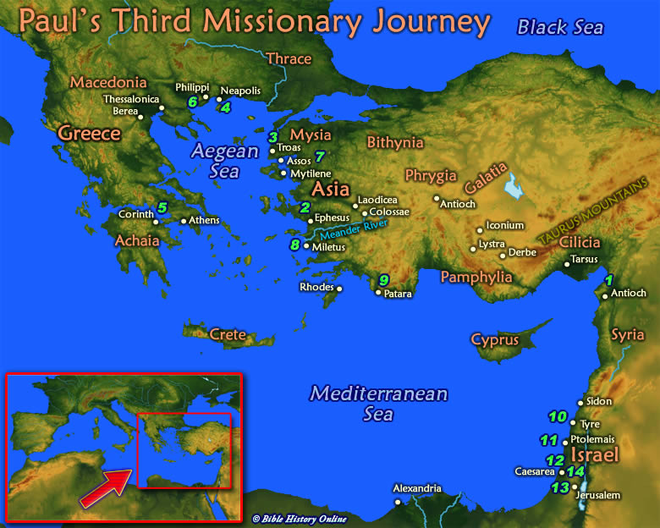

Slide 6
FINISH THE RACE
ACTS 20:17-38

Slide 7
PAUL’S MESSAGE
PAST—PRESENT--FUTURE
1. A LOOK BACK—20:18-21.
THE VERBS ARE IN THE PAST TENSE.

Slide 8
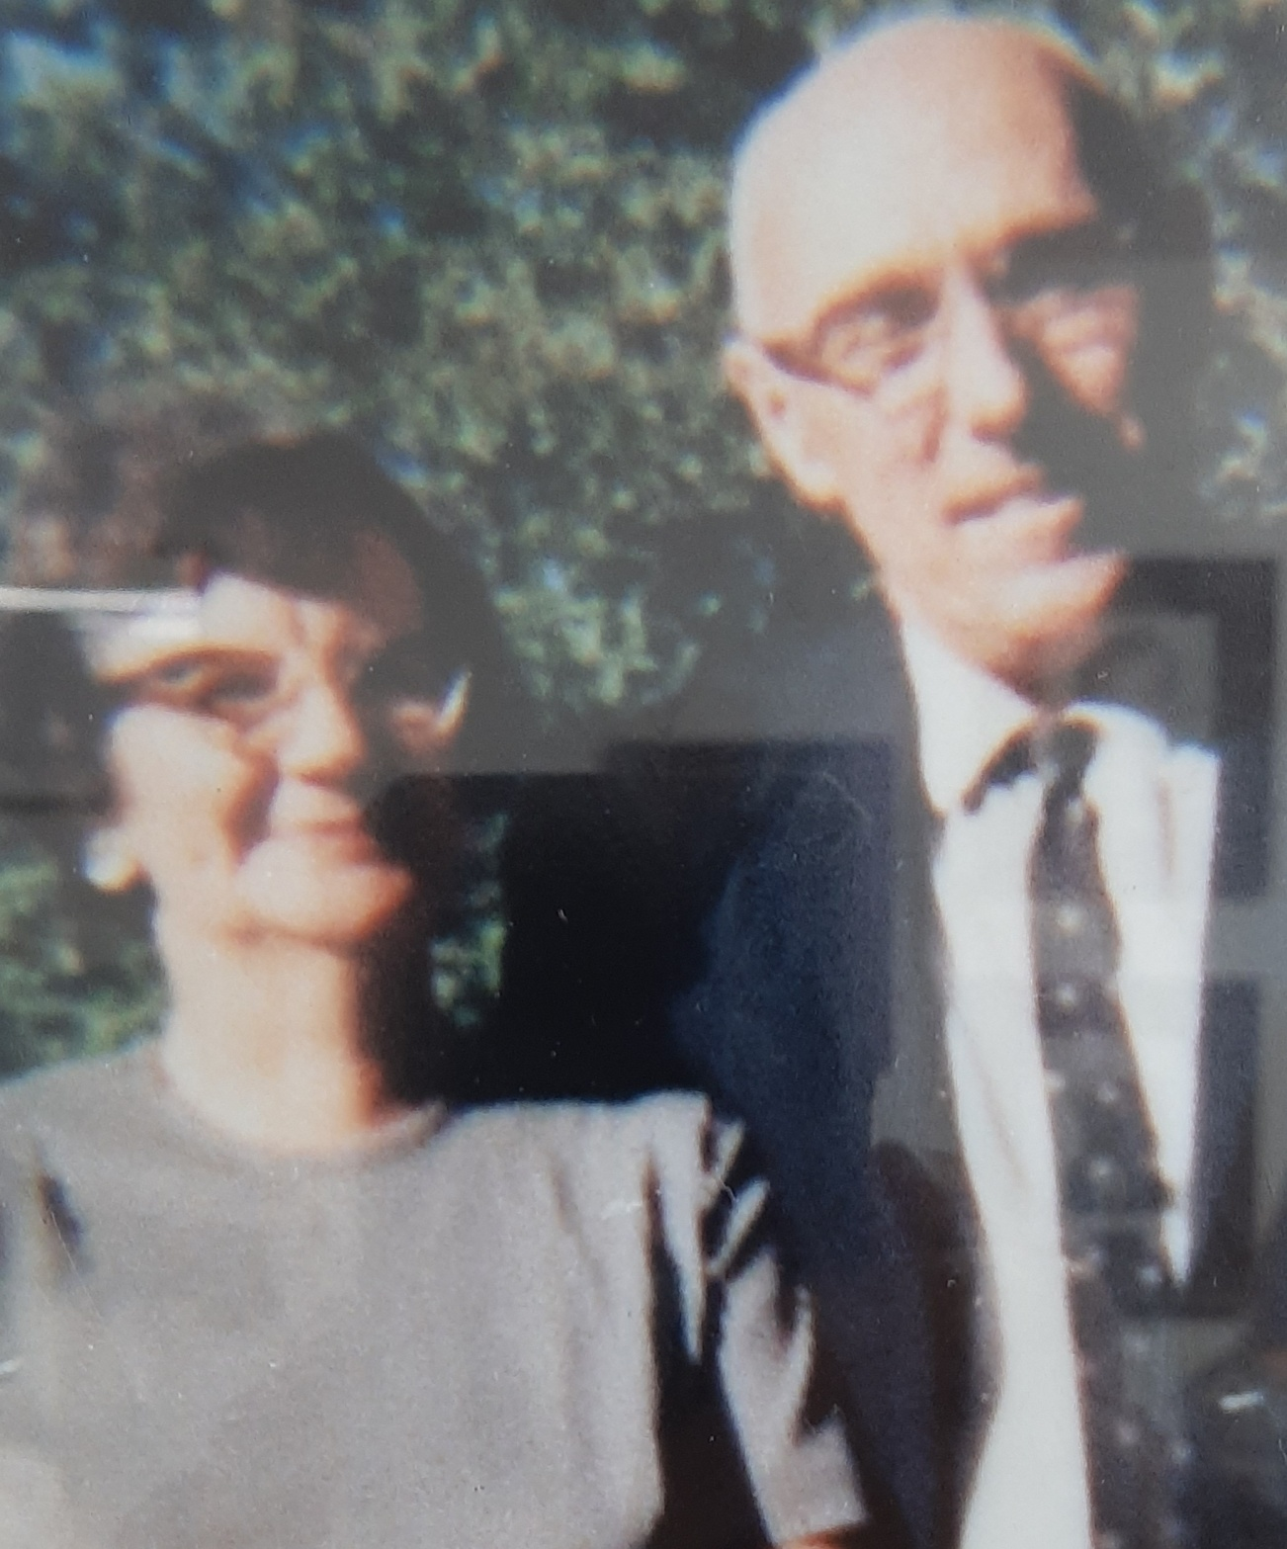
Rev. Bradley Spencer 1956-66

Slide 9
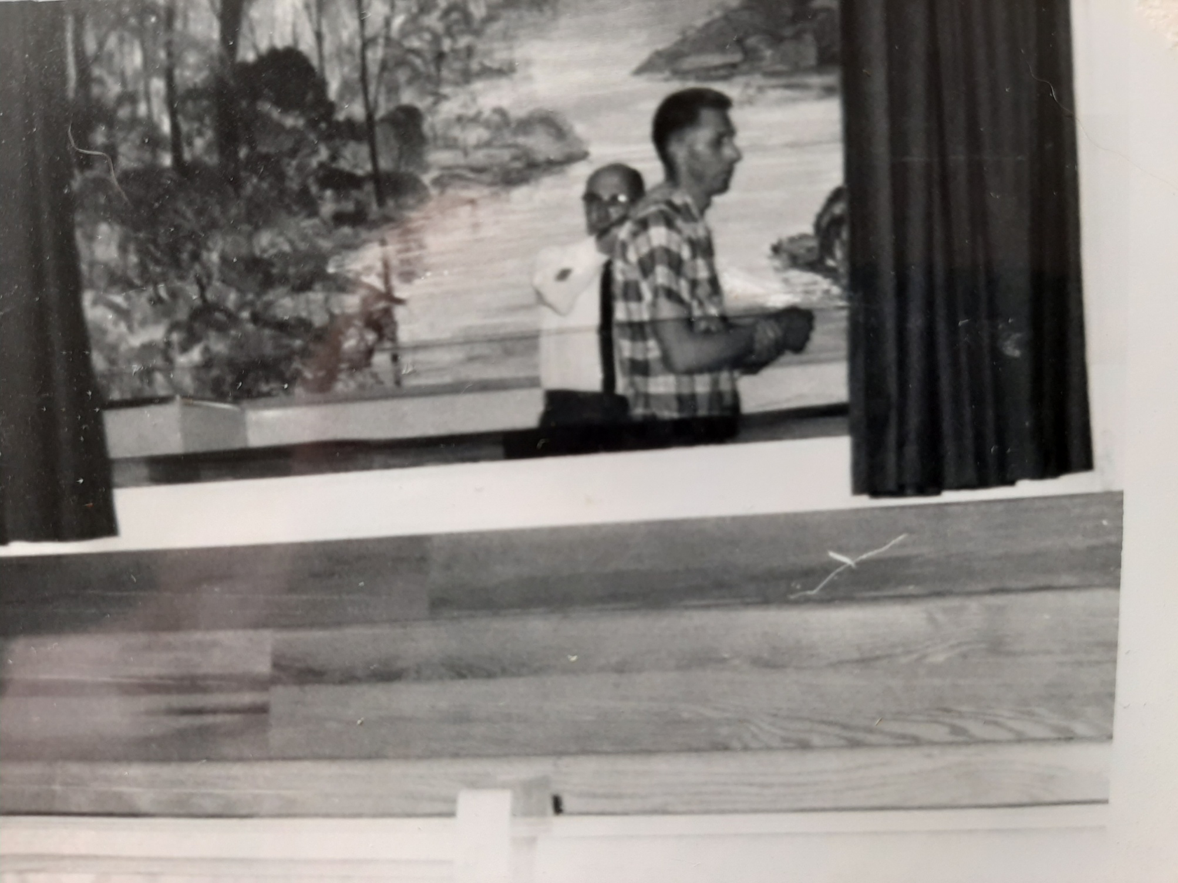
Rev. Bradley Spencer—1956-1966

Slide 10
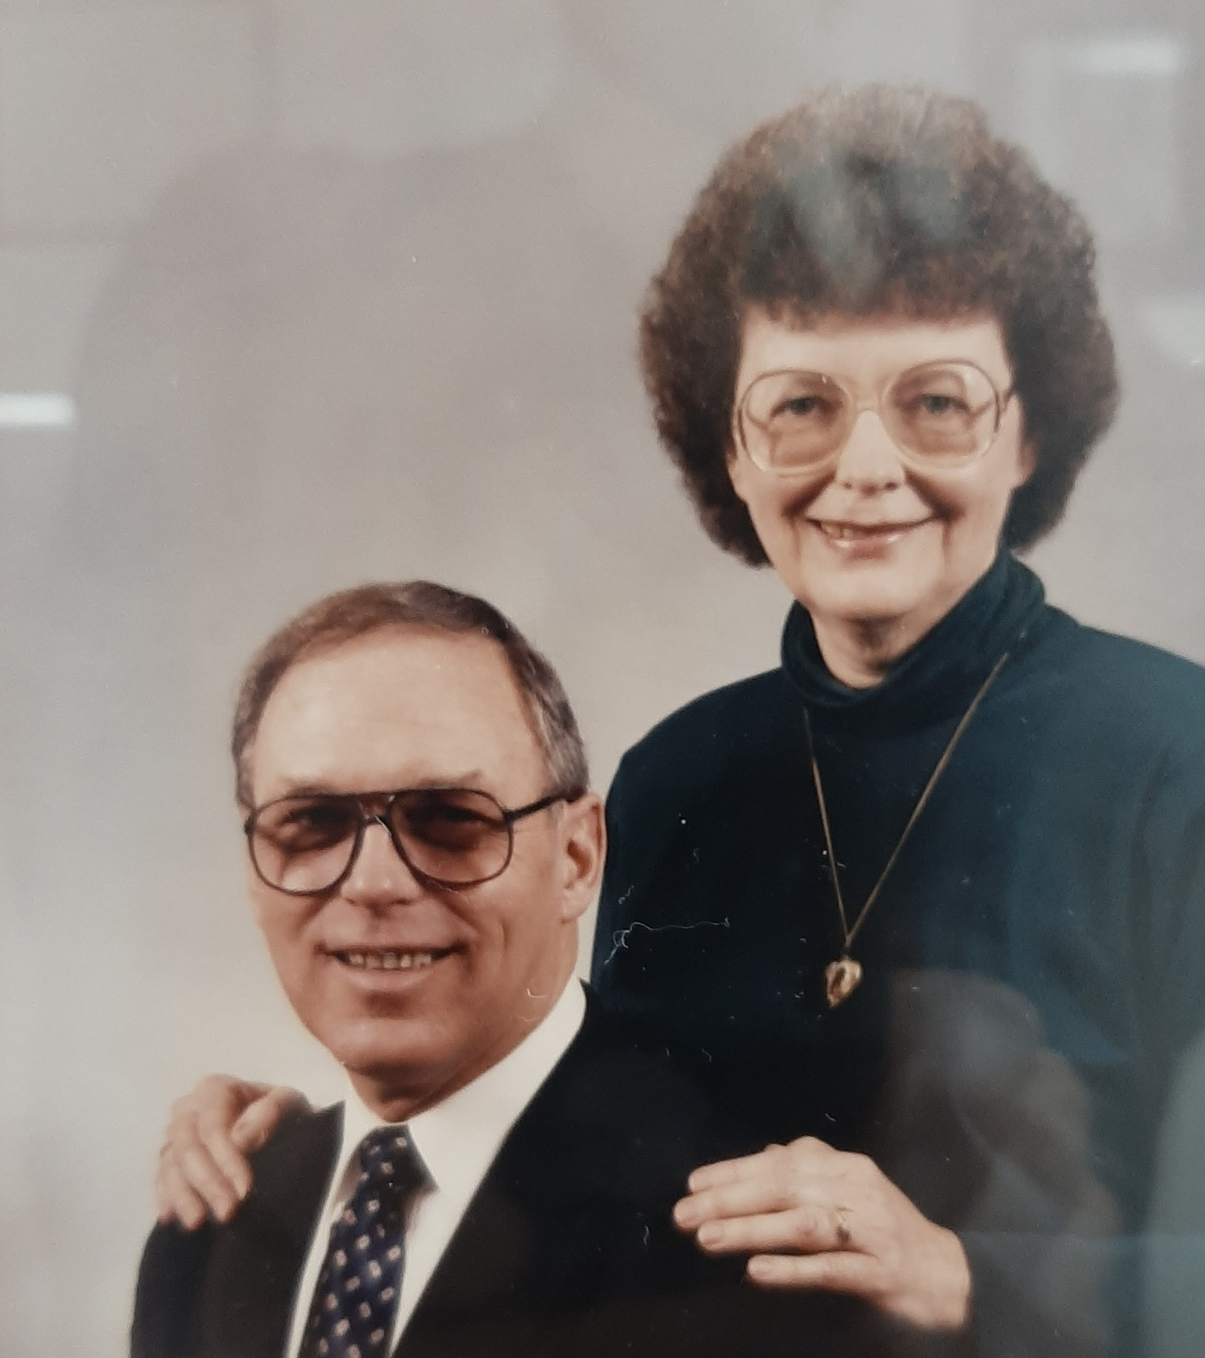
Rev.
Don Criswell
1966-69

Slide 11
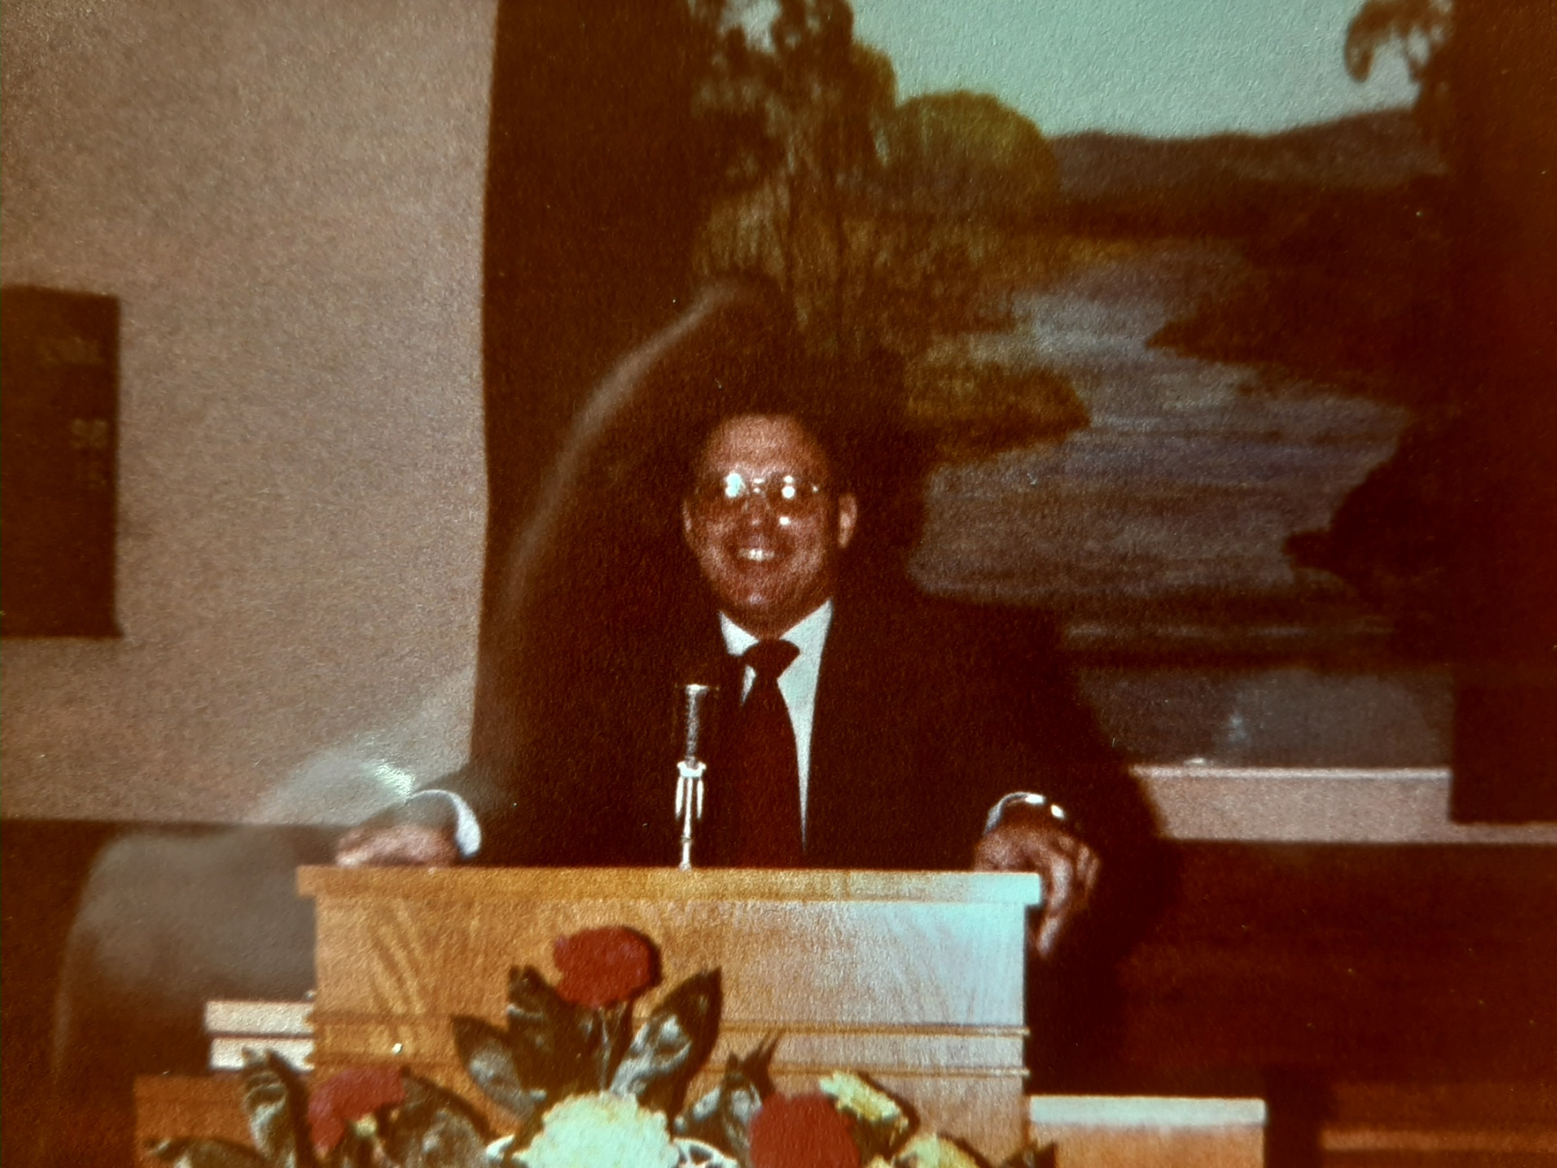
Rev. Don Criswell 1966-69

Slide 12
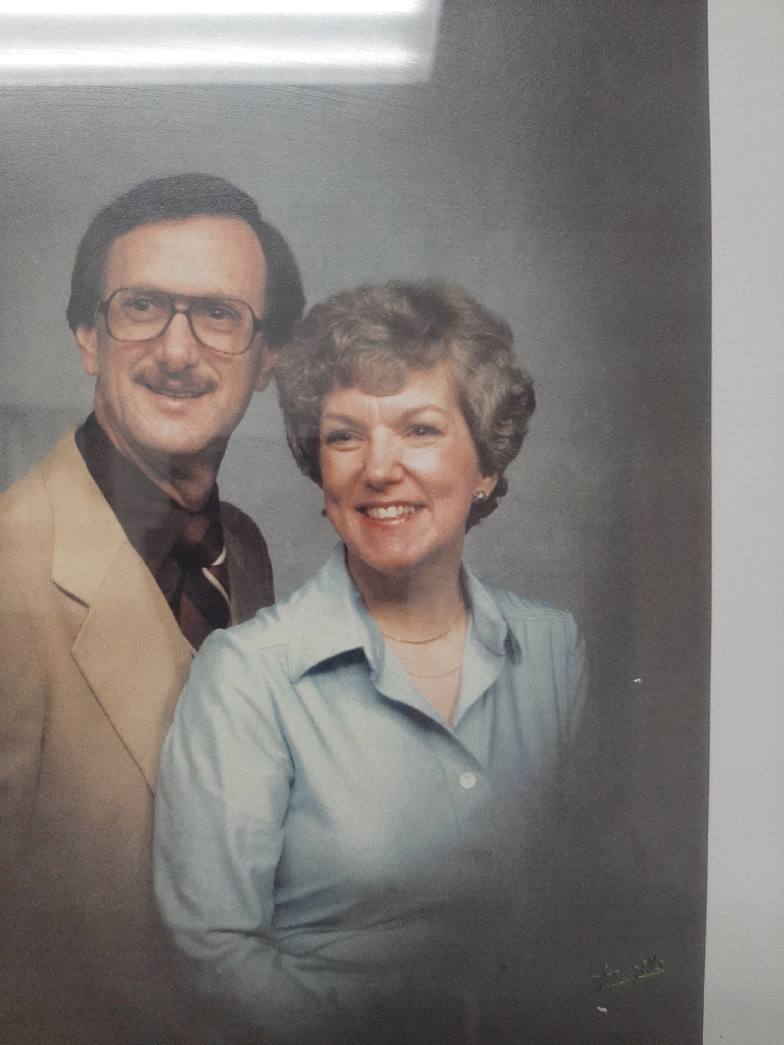
Rev.
David Heydt
1970-72

Slide 13
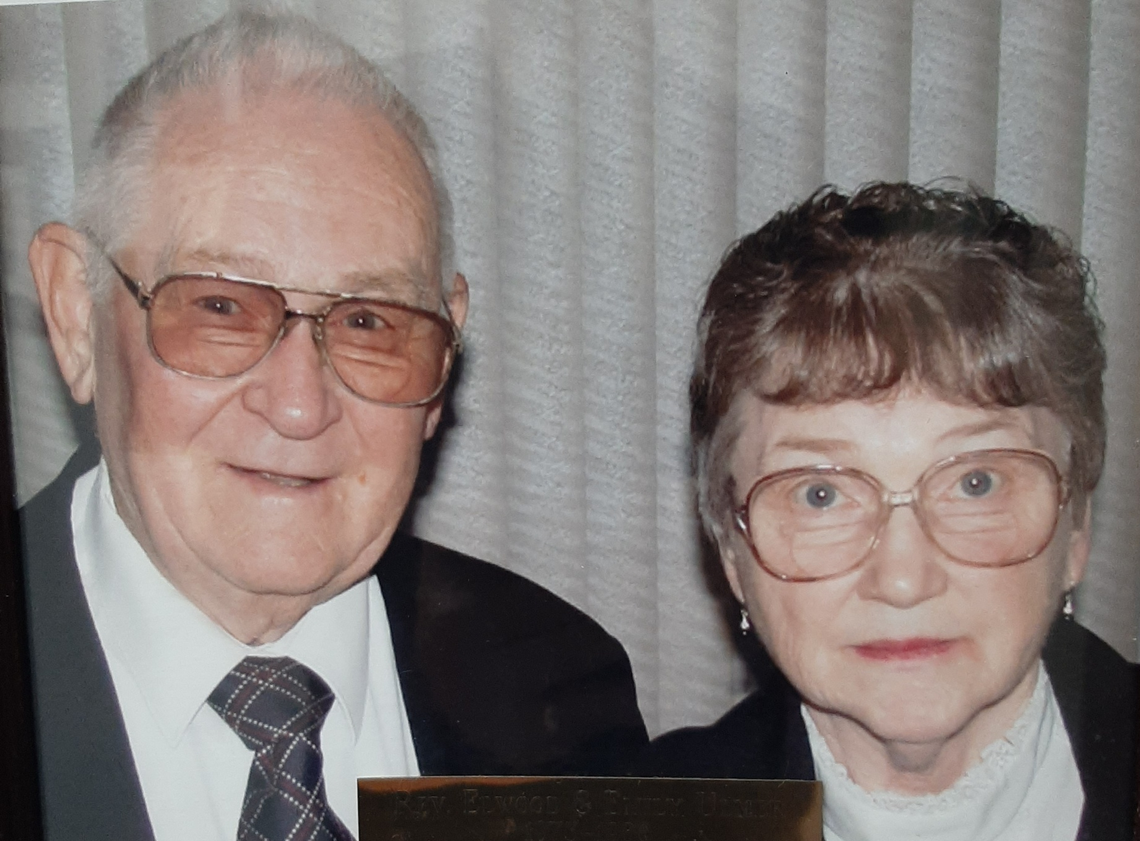
Rev. Elwood Ulmer 1973-80

Slide 14
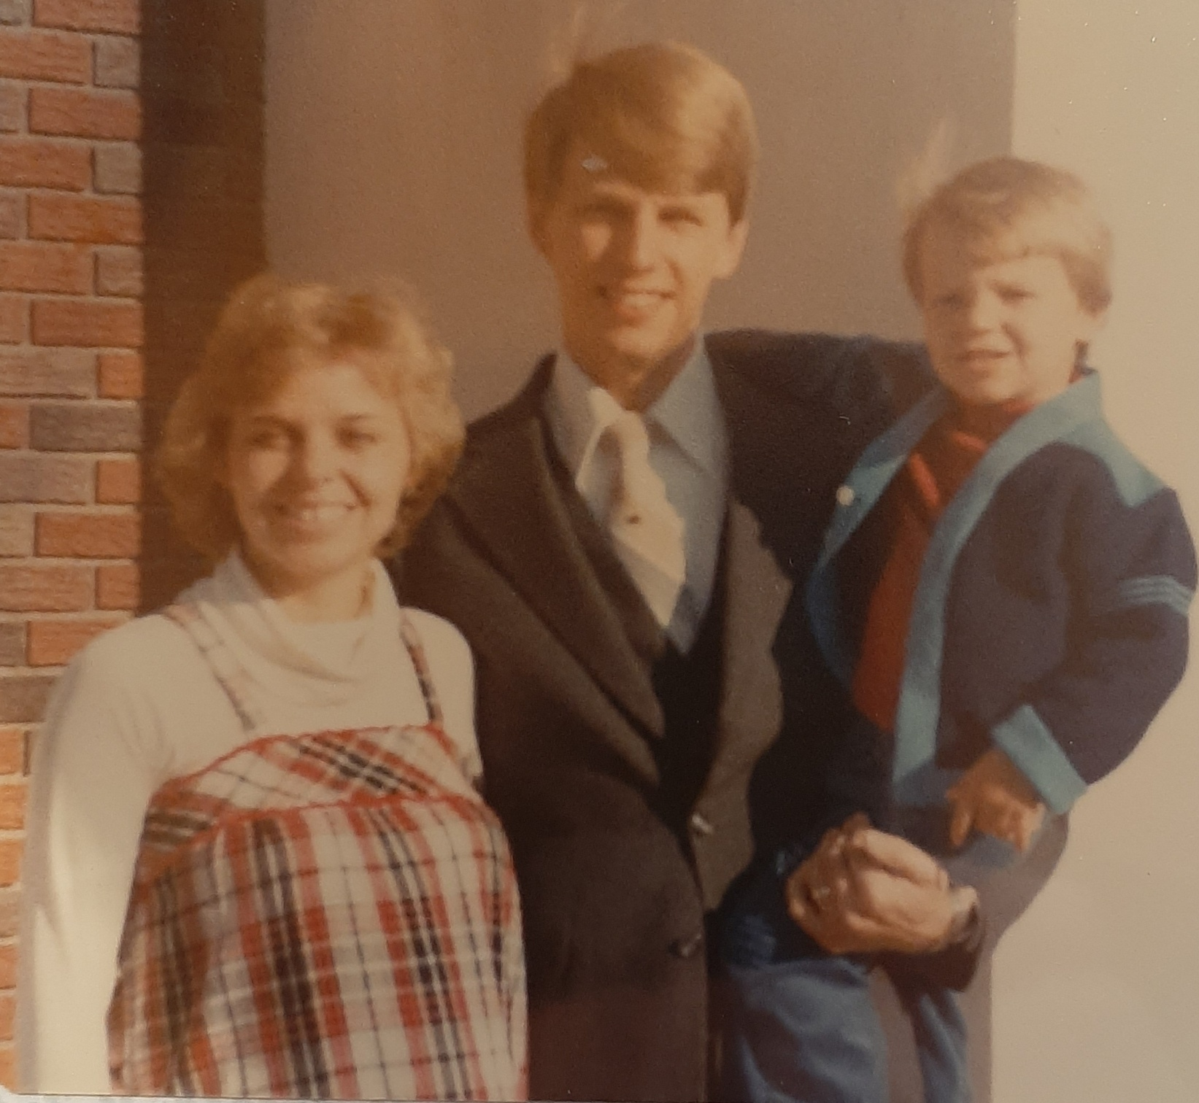
1980

Slide 15
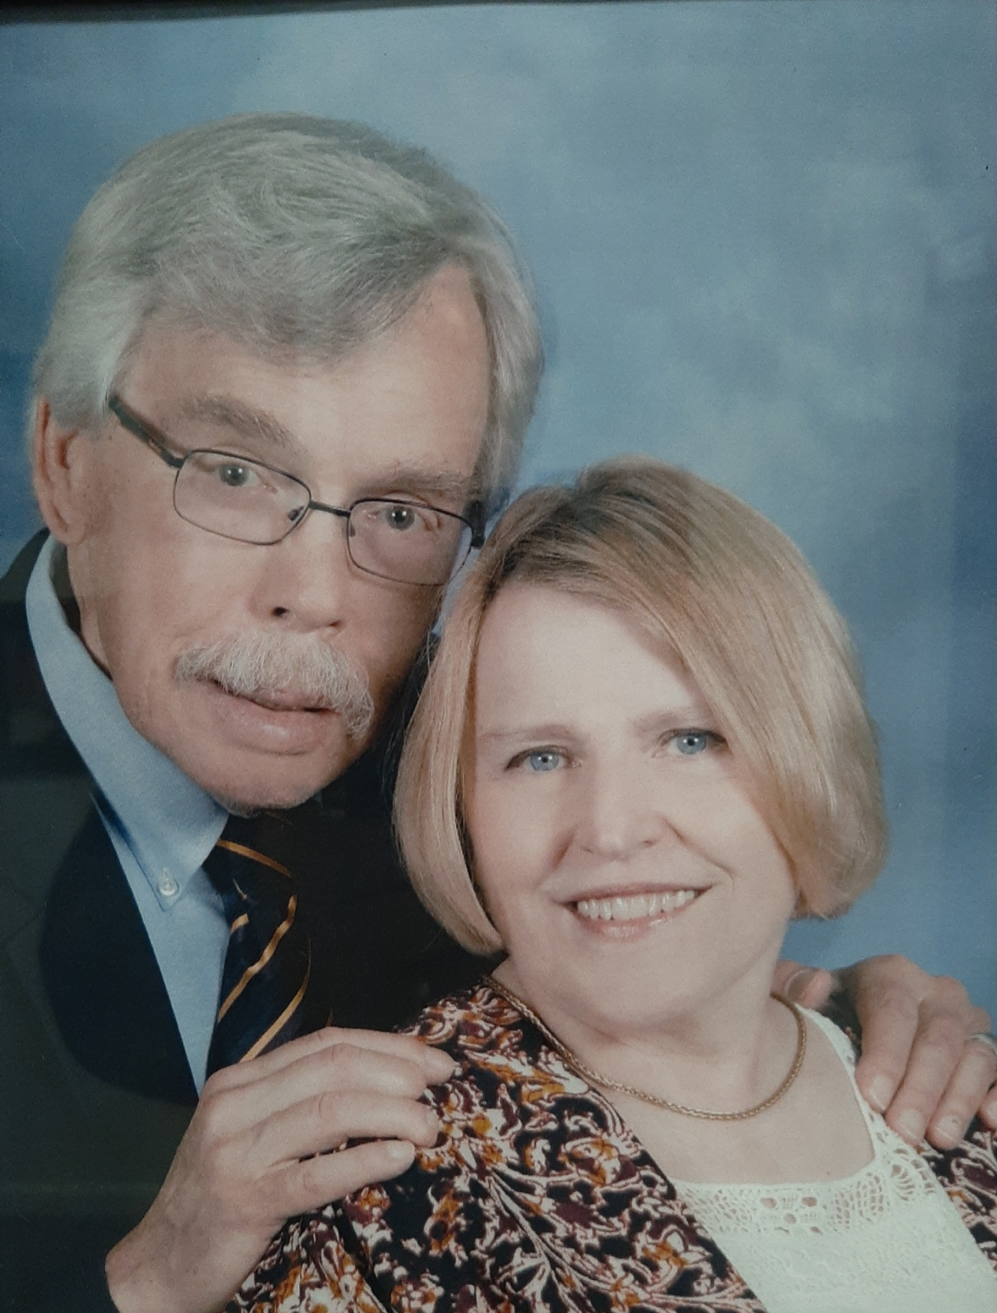
Rev. Dan Mohler
2003-Present

Slide 16
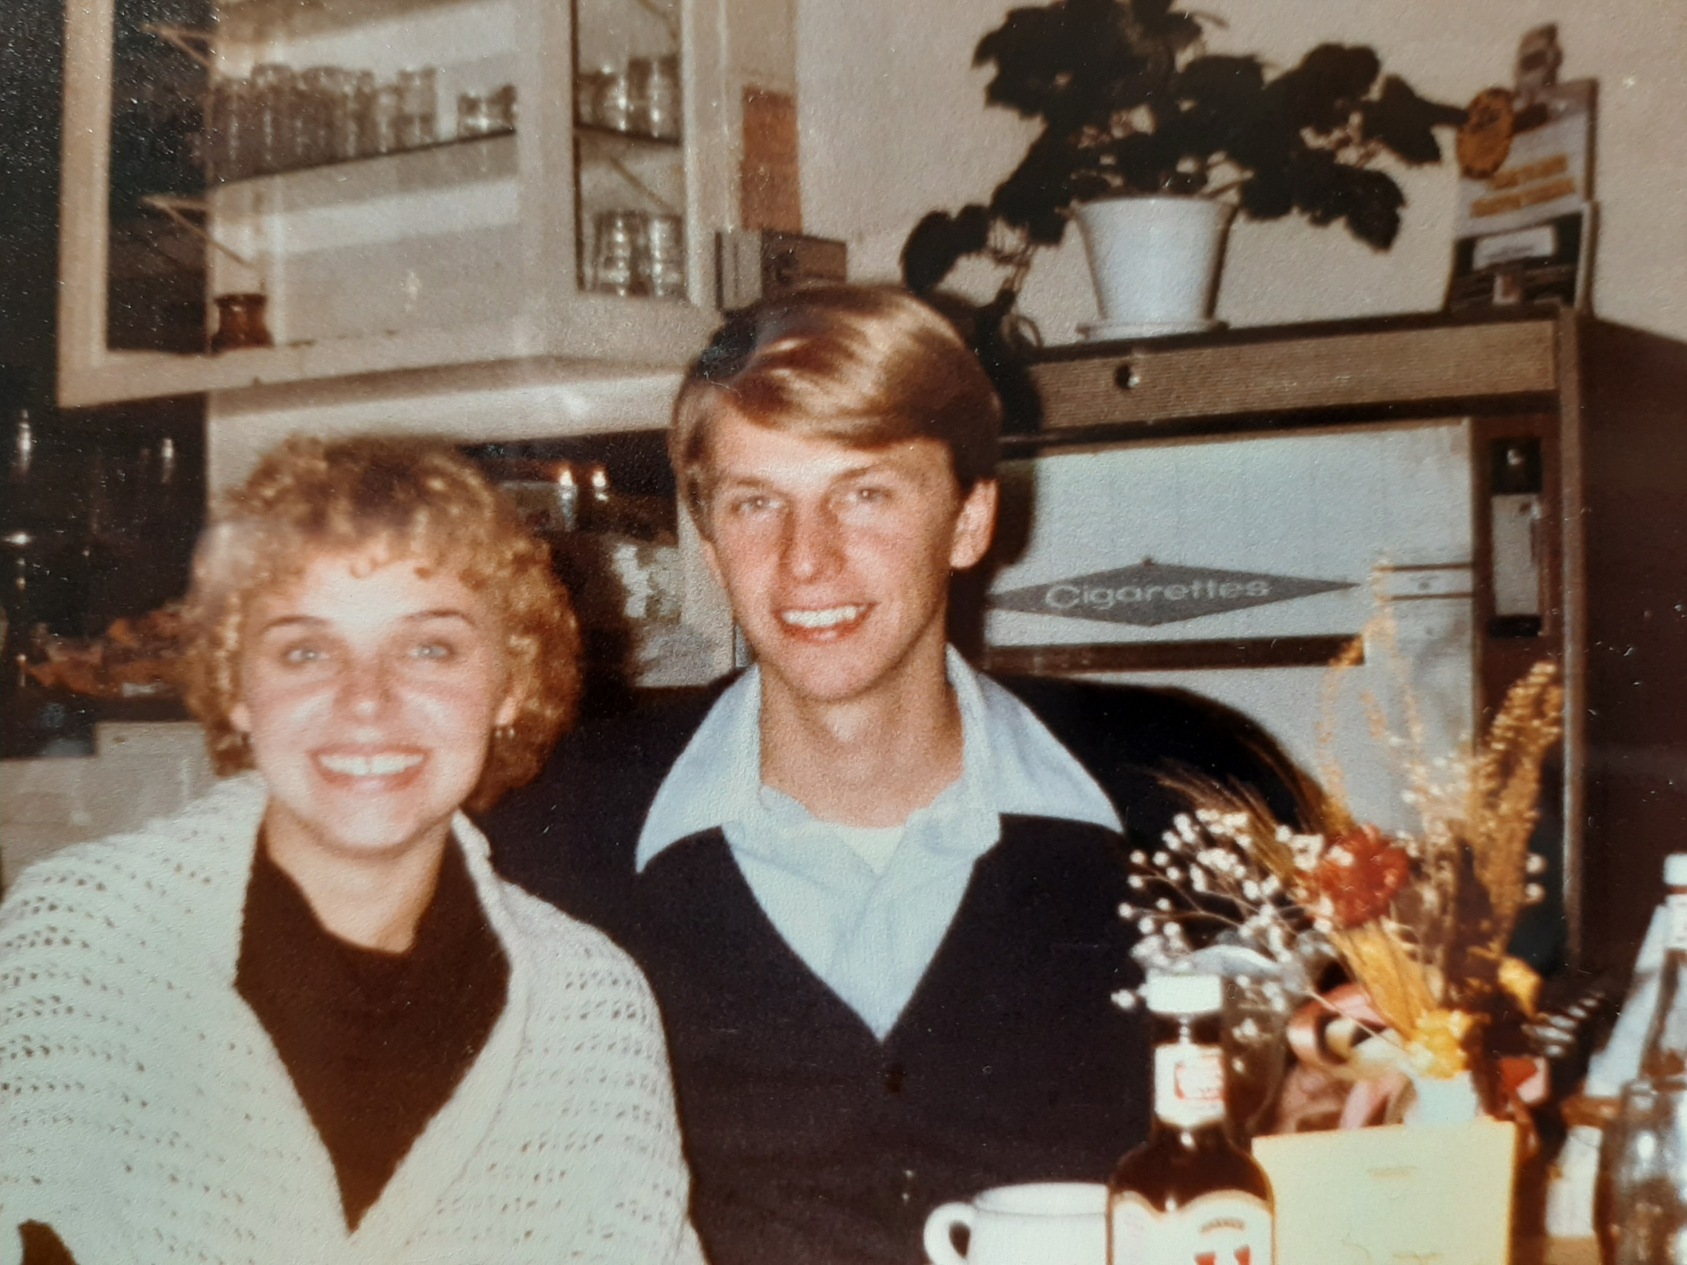
1982

Slide 17
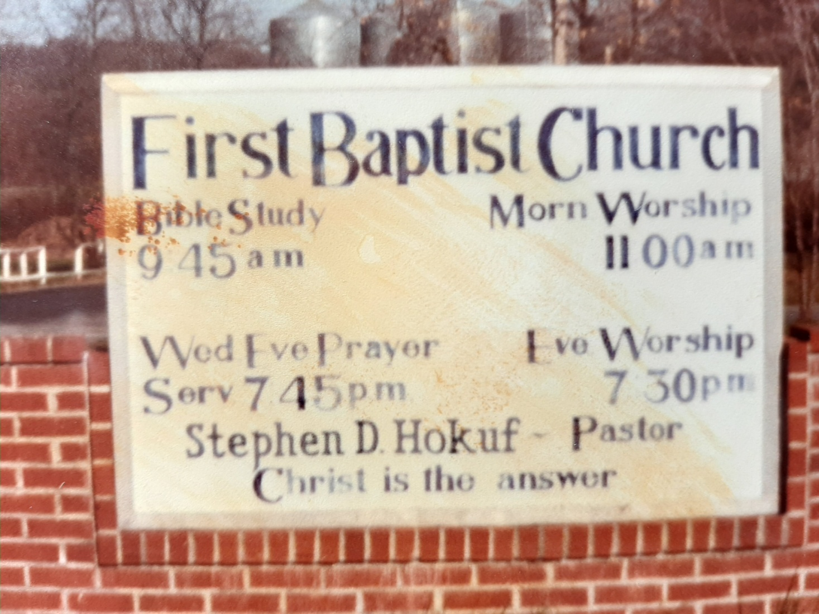
1981

Slide 18
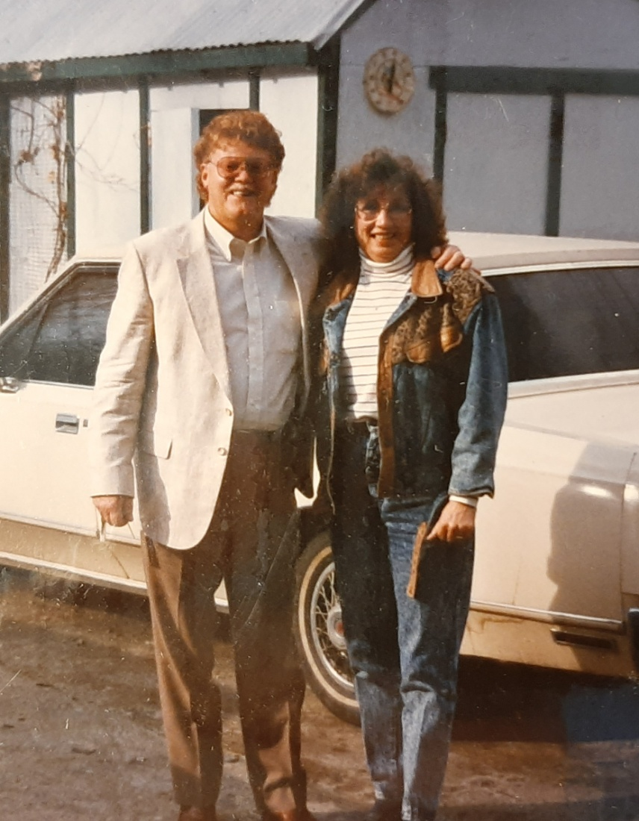
1985- Evangelist Richard and Phyllis Coss

Slide 19
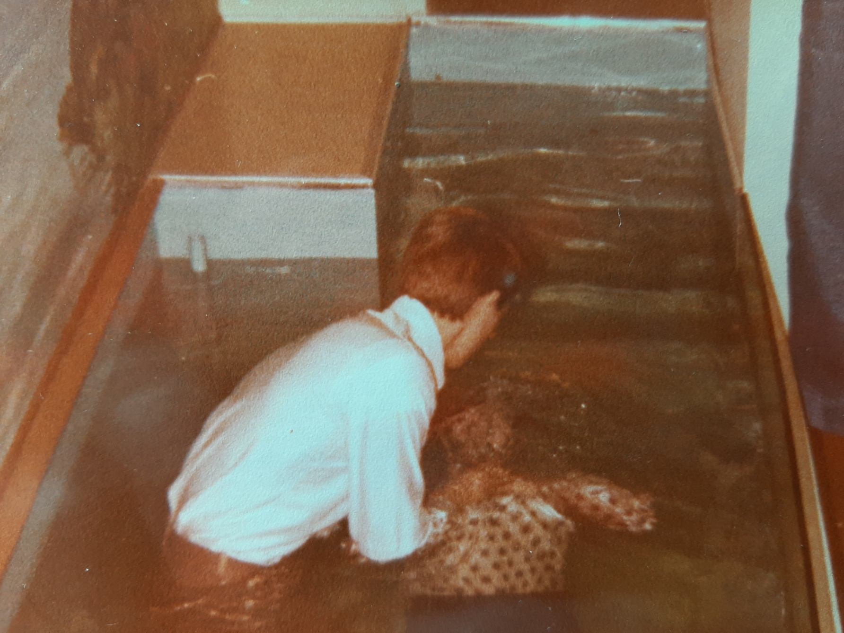
Baptism-1981

Slide 20
1980

Slide 21
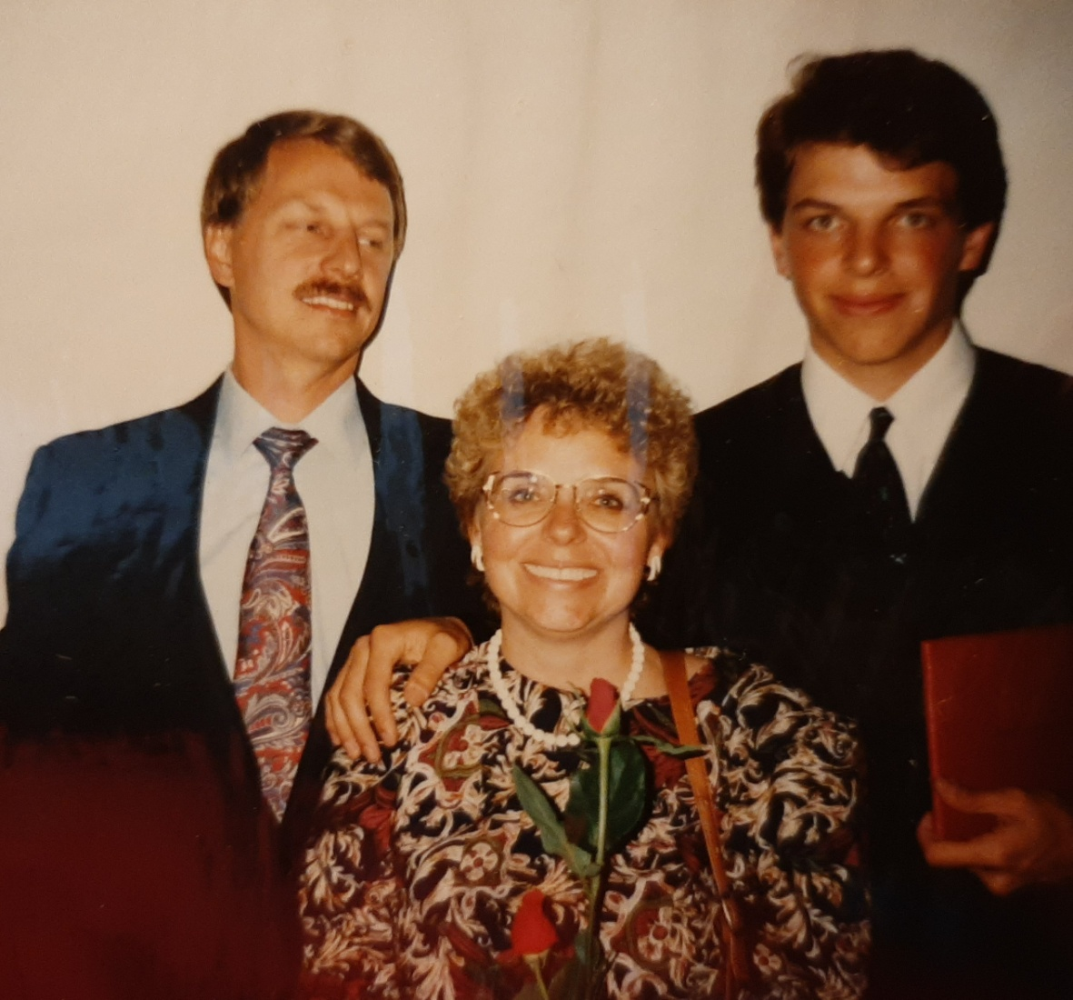
1995—Doug H.S. Graduation

Slide 22
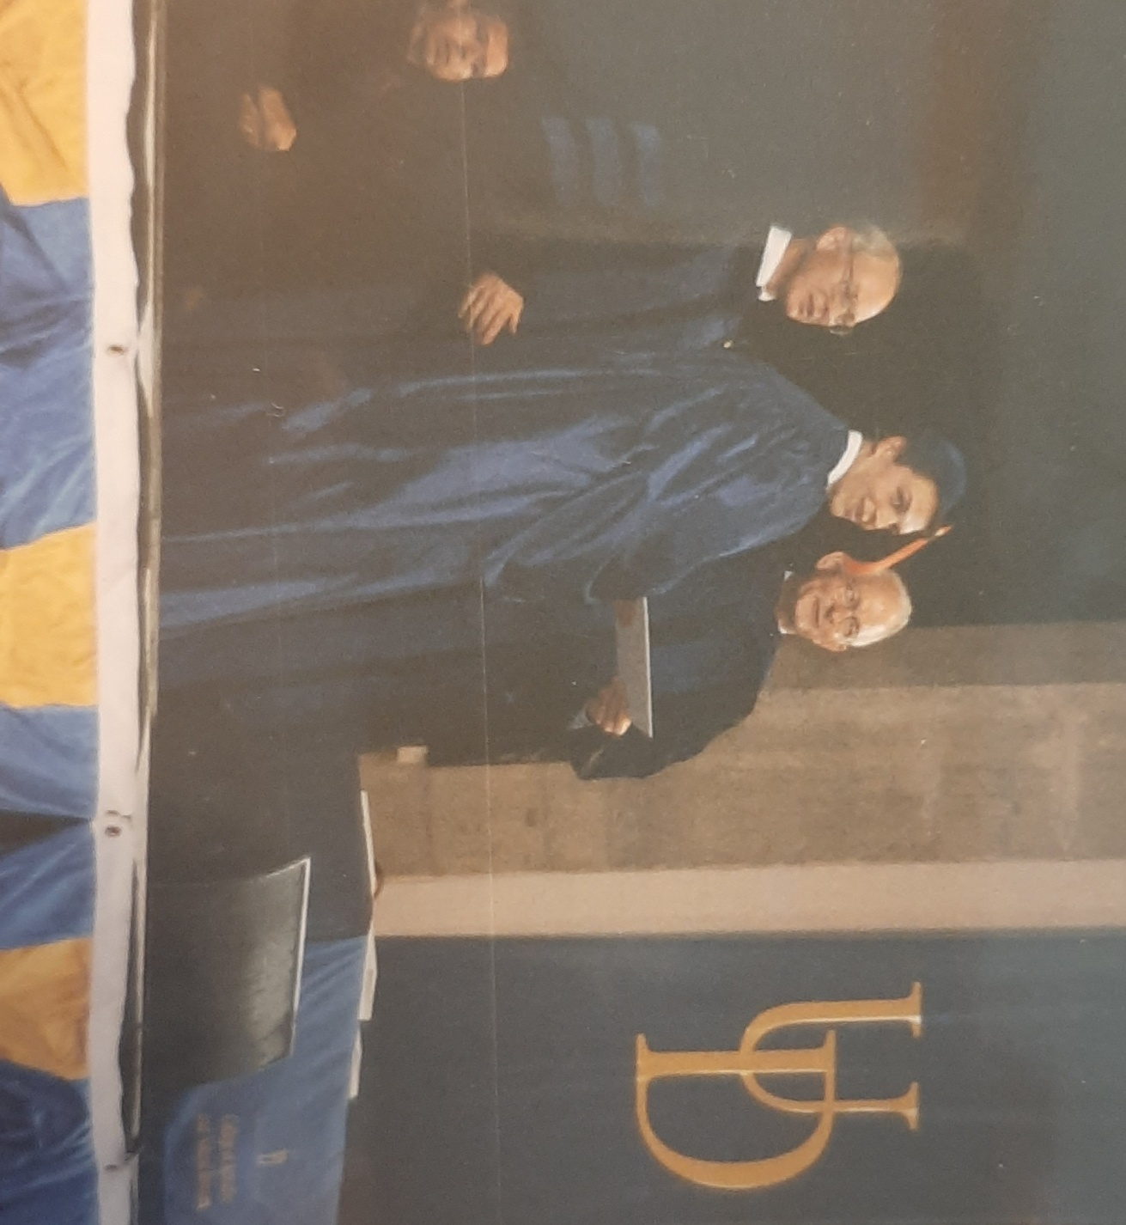
Doug—2003 Engineering

Slide 23
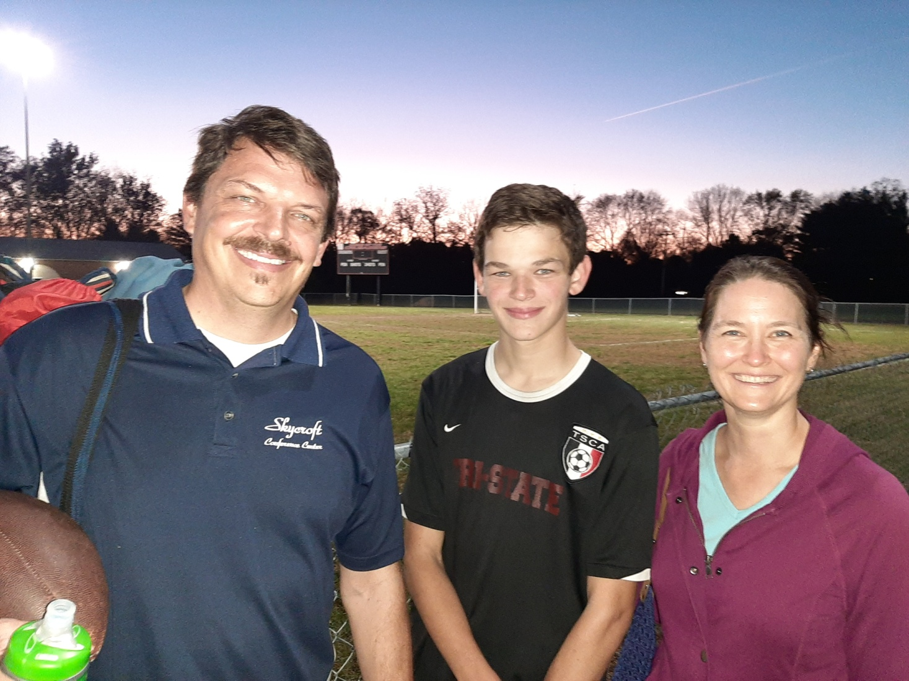
2020- Doug, Brandon & Deanna

Slide 24
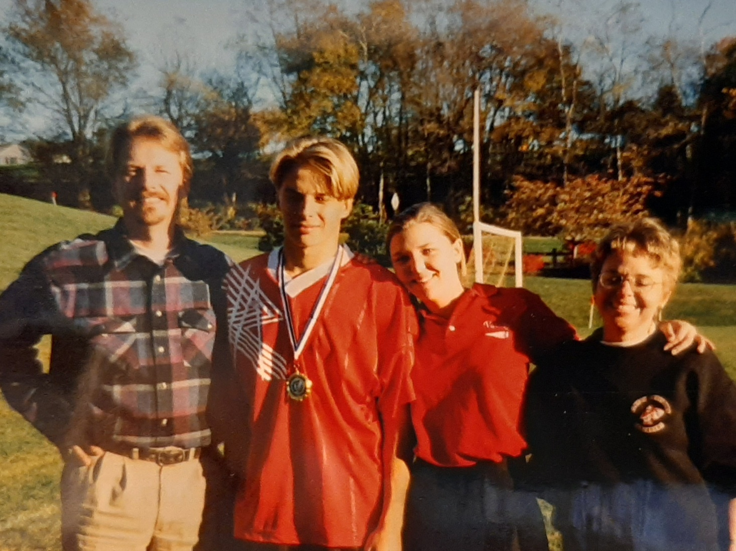
Elkton Christian School

Slide 25
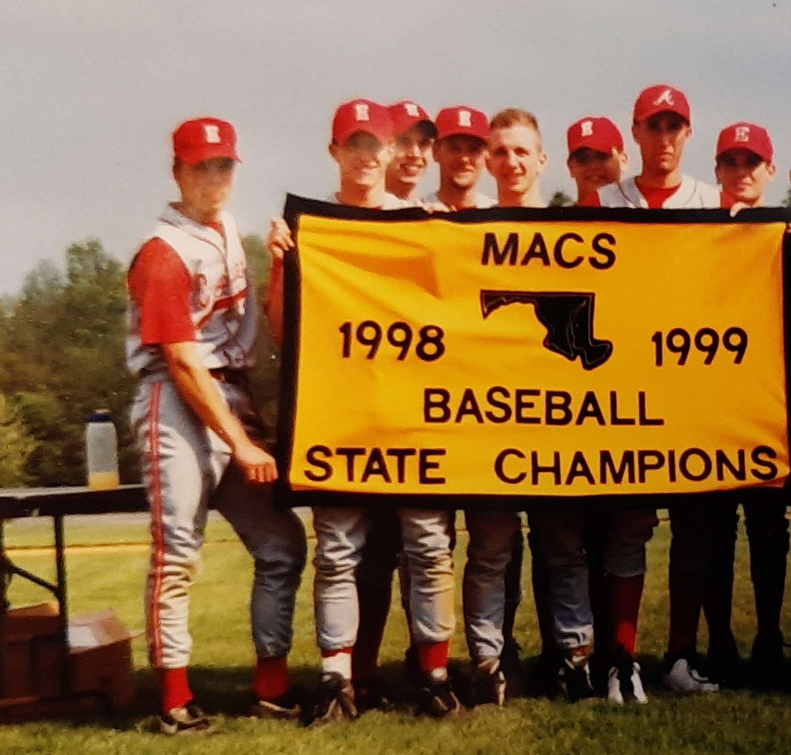
Ben-1999

Slide 26
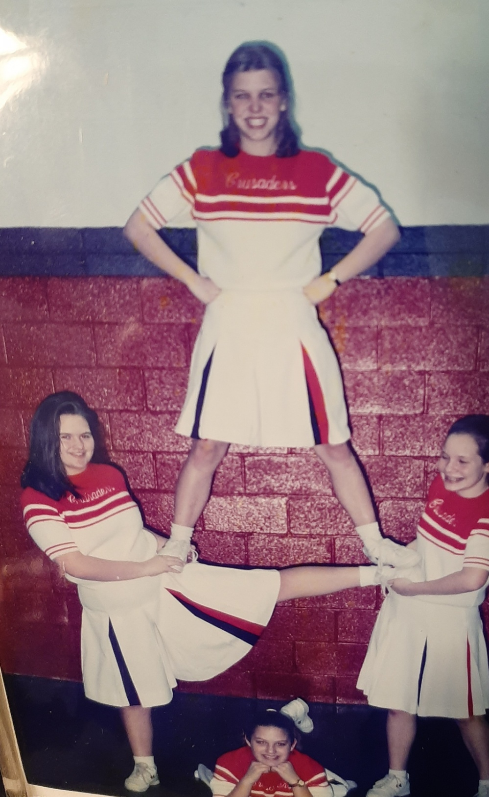
Laura-1997

Slide 27
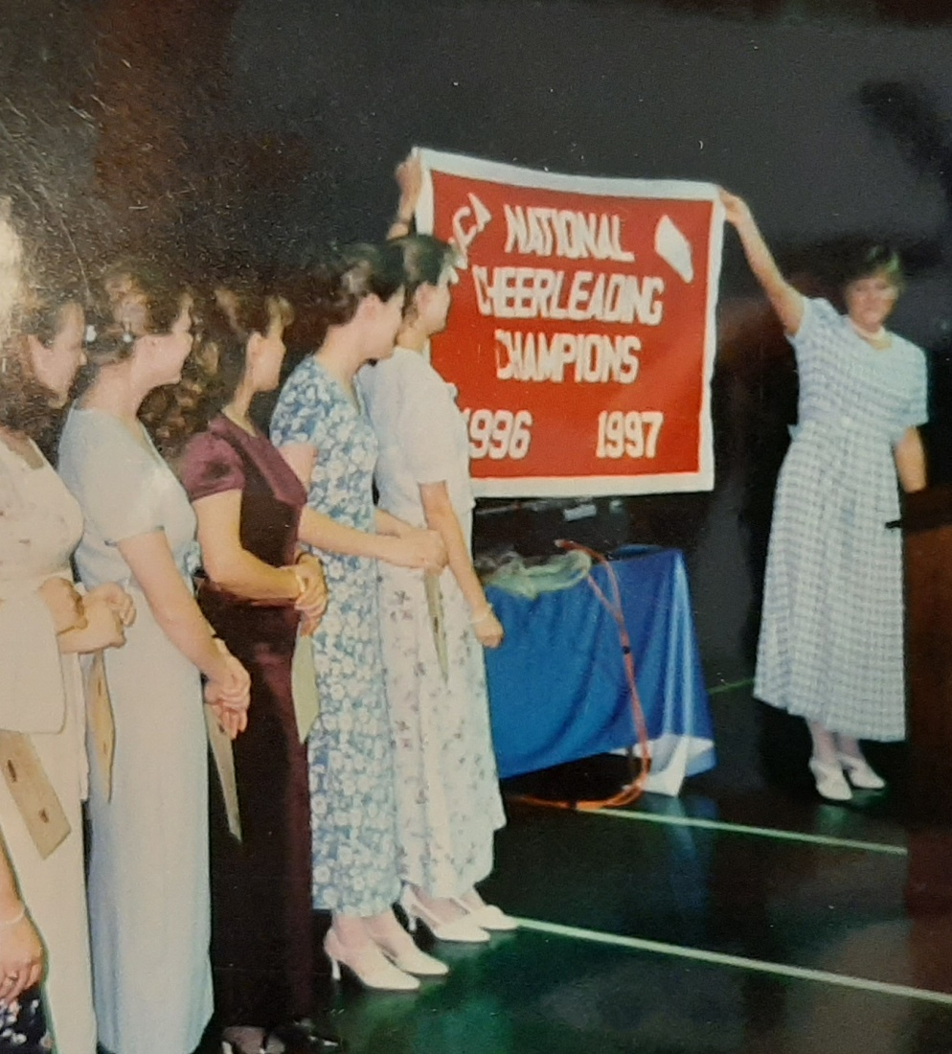
Laura—National Champs-1997

Slide 28
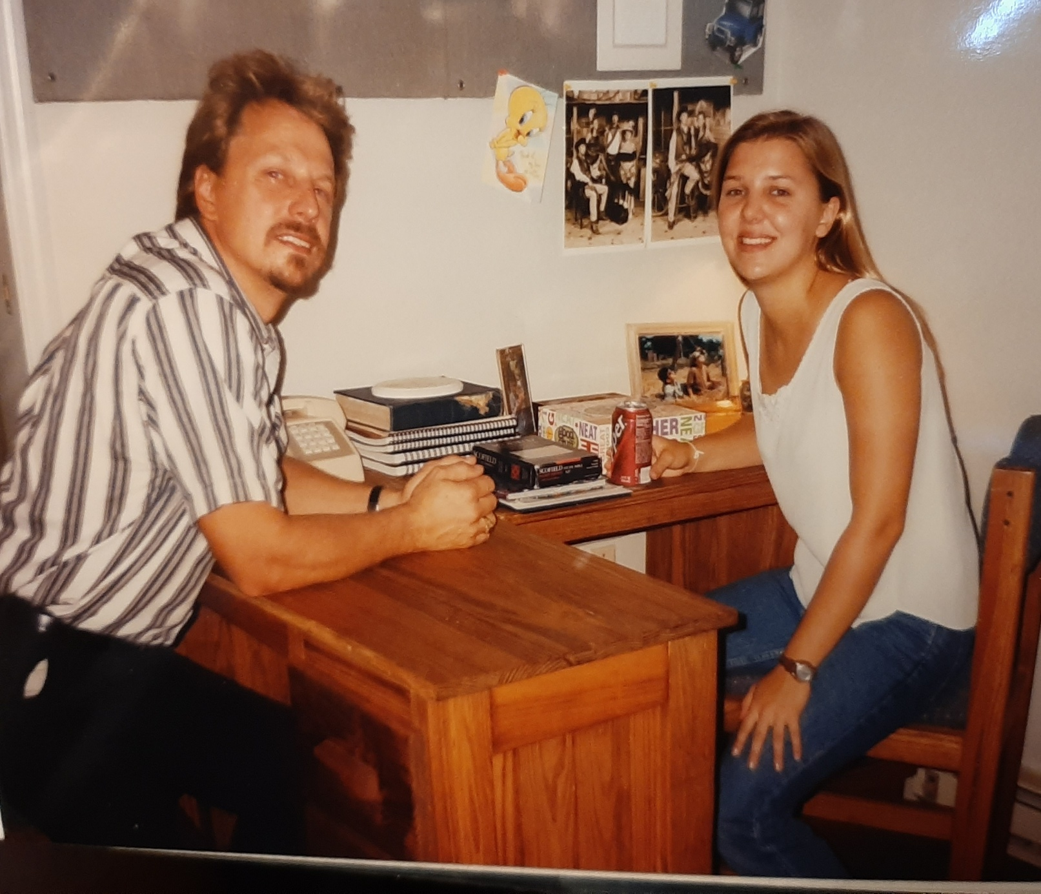
Laura @ PCB, 1999

Slide 29
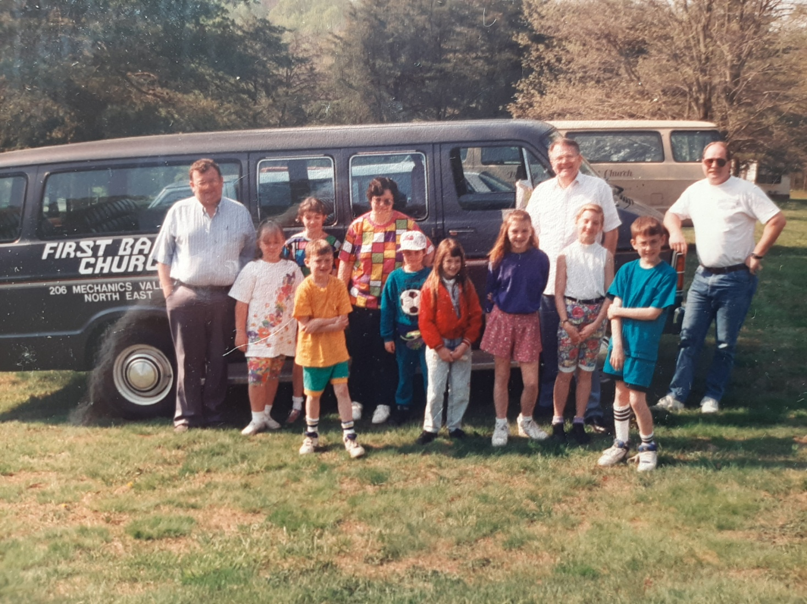
Children’s Worship Outing-80’s

Slide 30
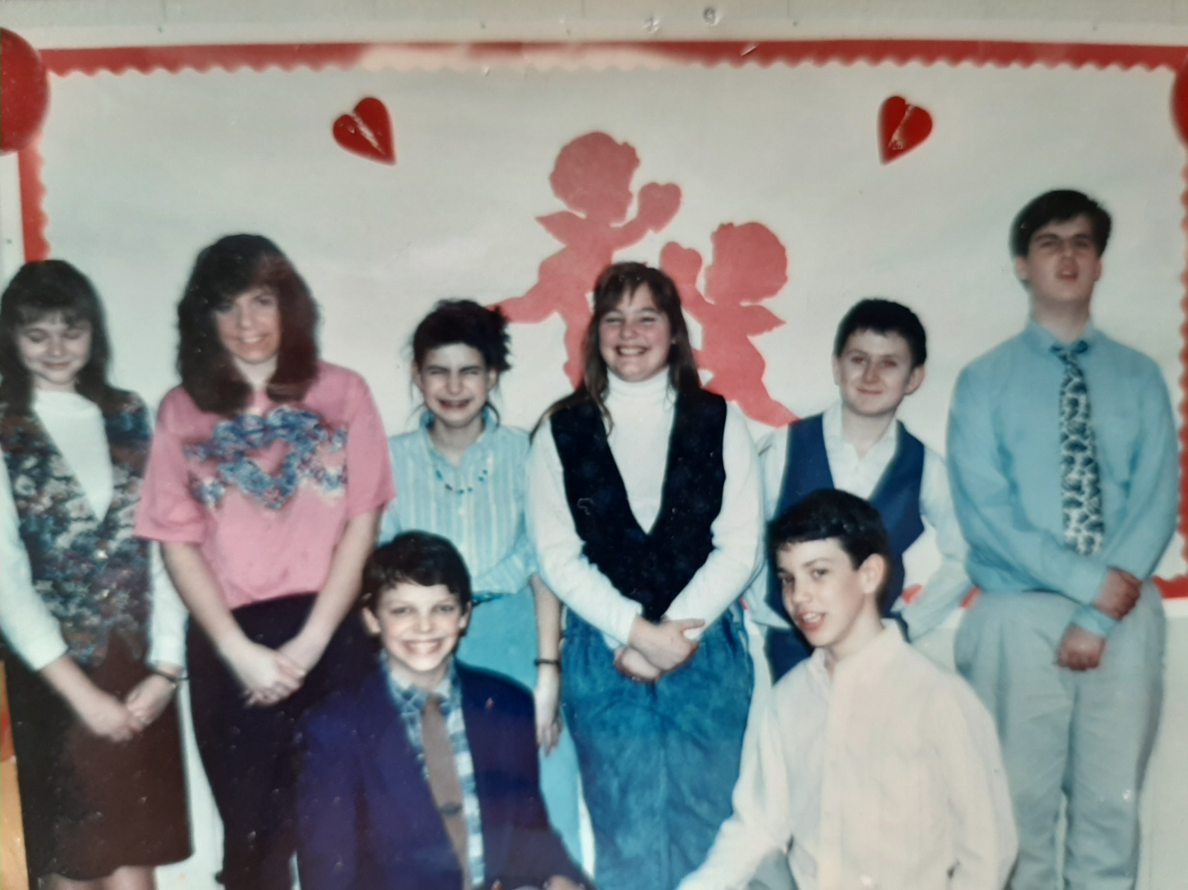
Youth Group—1980’s

Slide 31
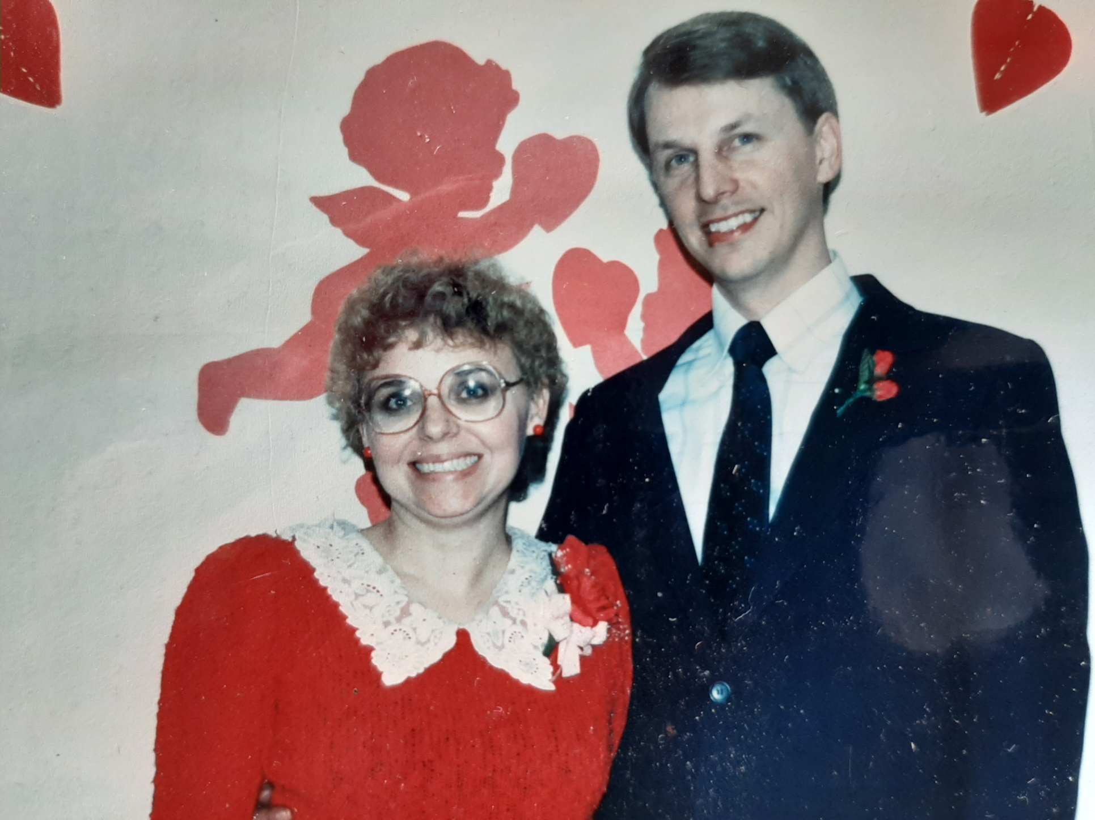
1980’s

Slide 32
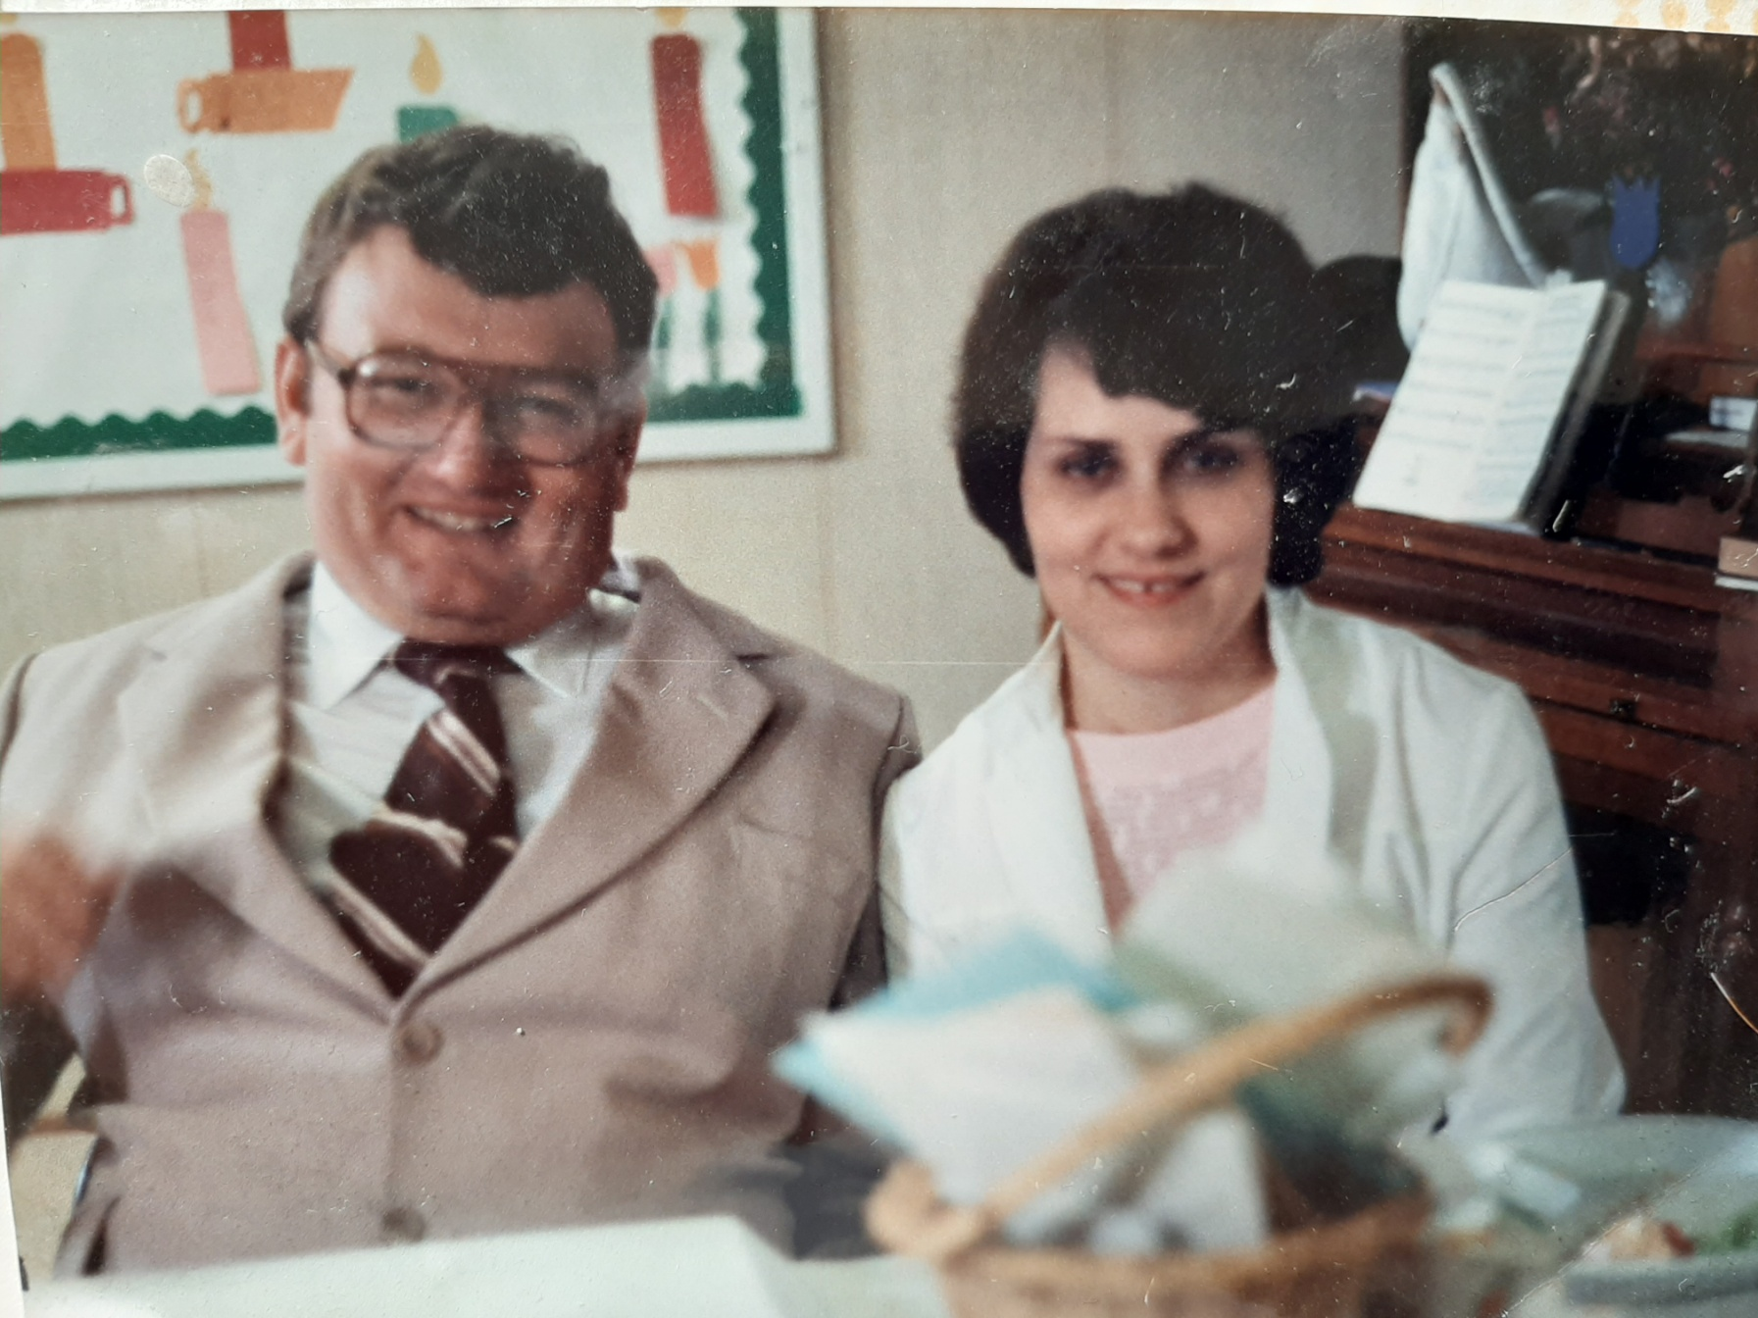
Bobby and Nancy Hudler-1982

Slide 33
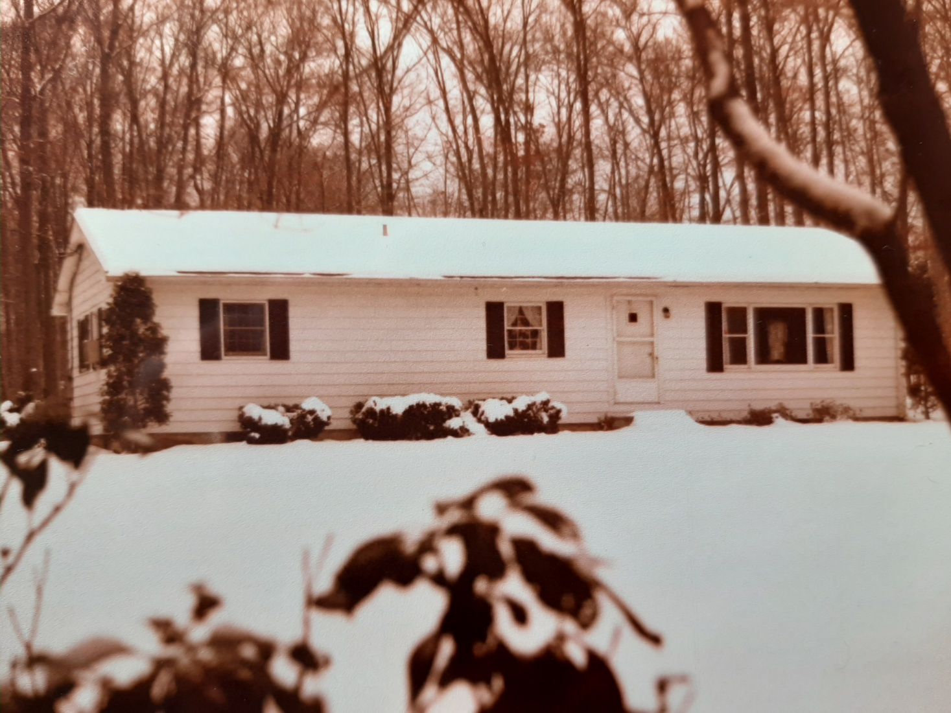
Parsonage 1970-1987

Slide 34
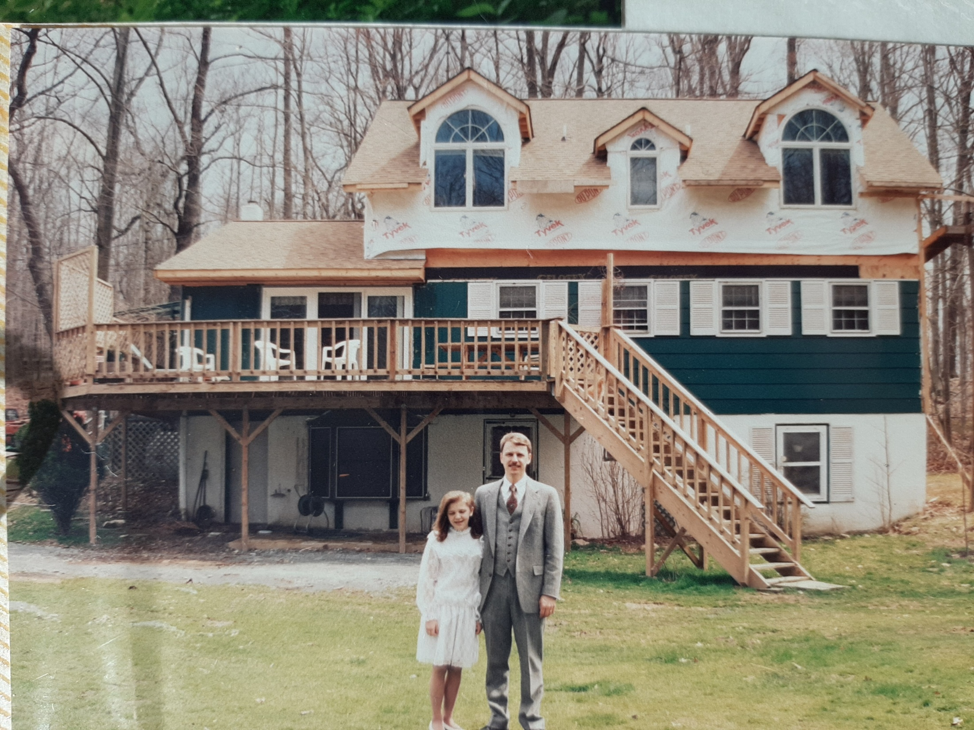
Hokuf’s Home—1985-1999
1990-Added 2nd Floor

Slide 35
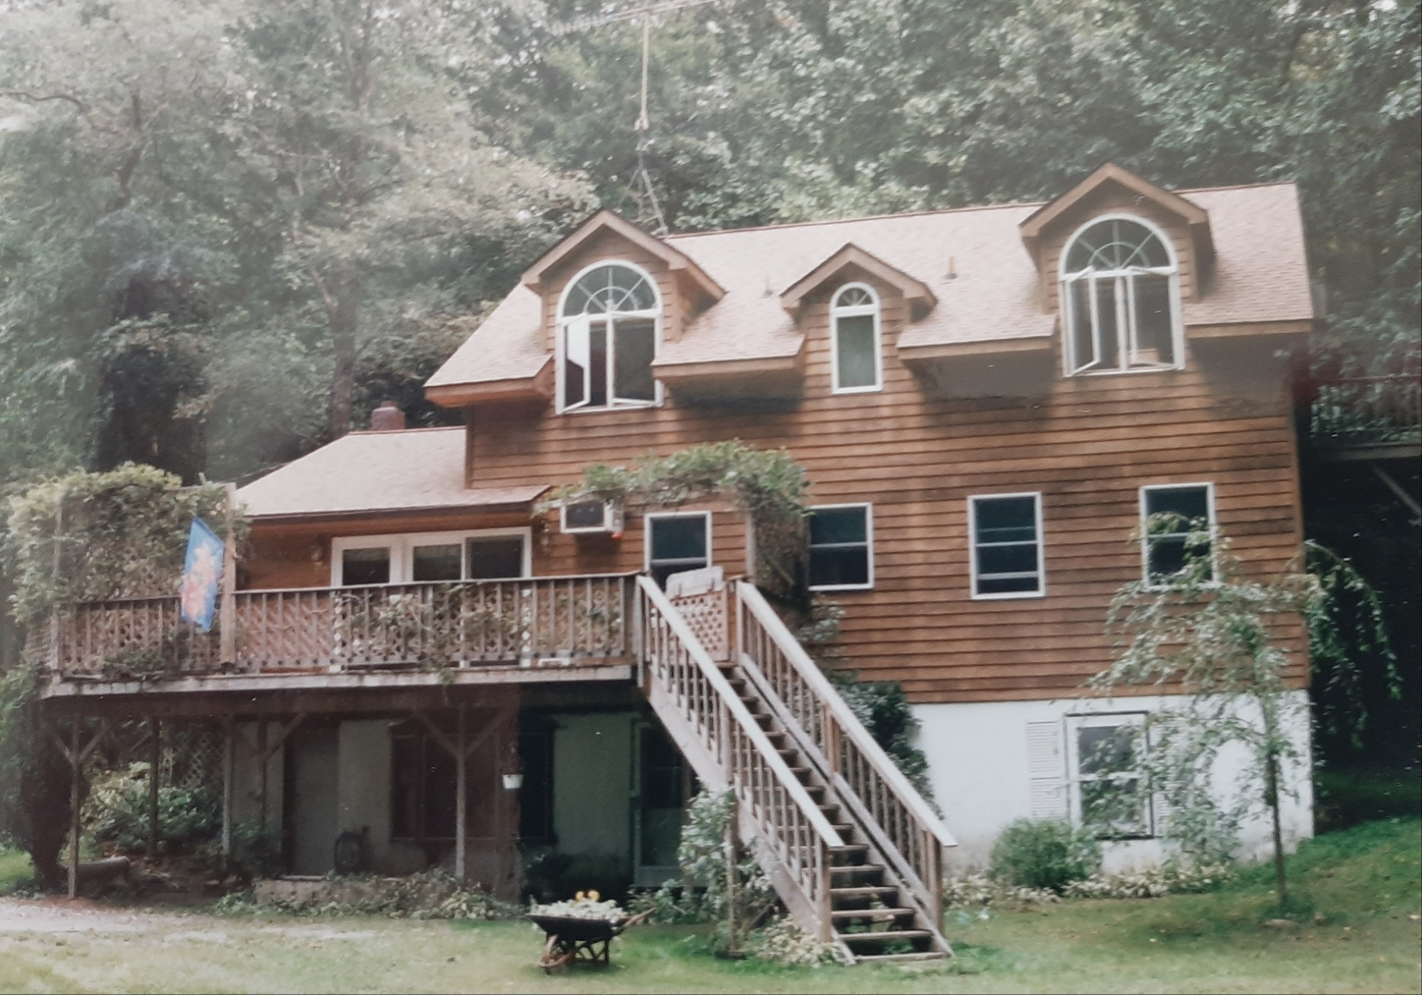
Finished

Slide 36
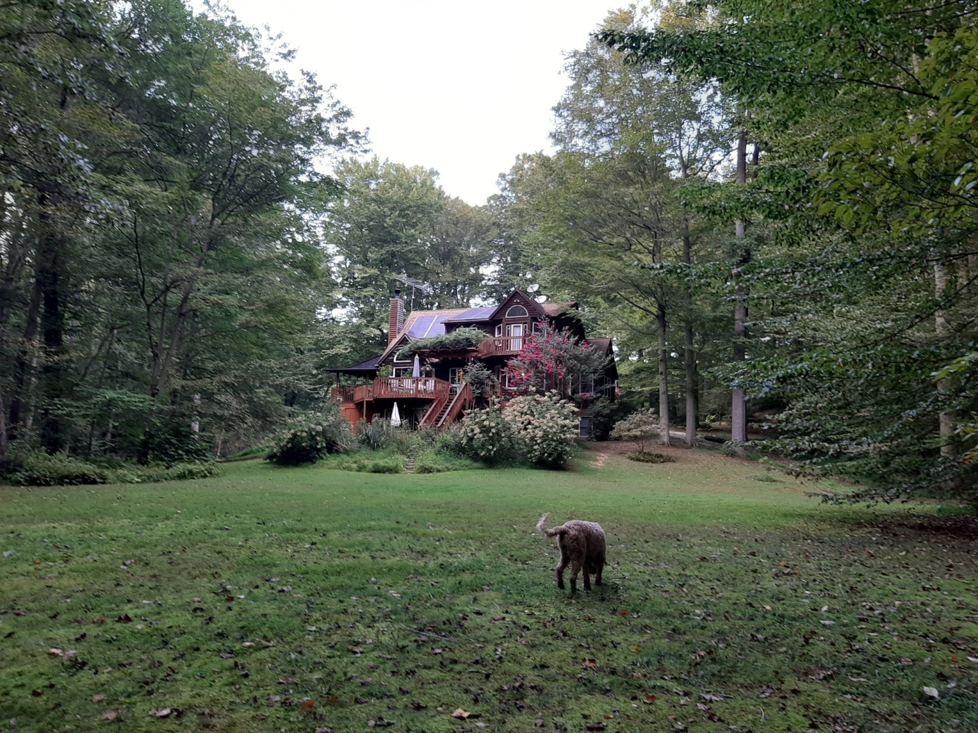
Hokuf’s Home—2000-Present

Slide 37
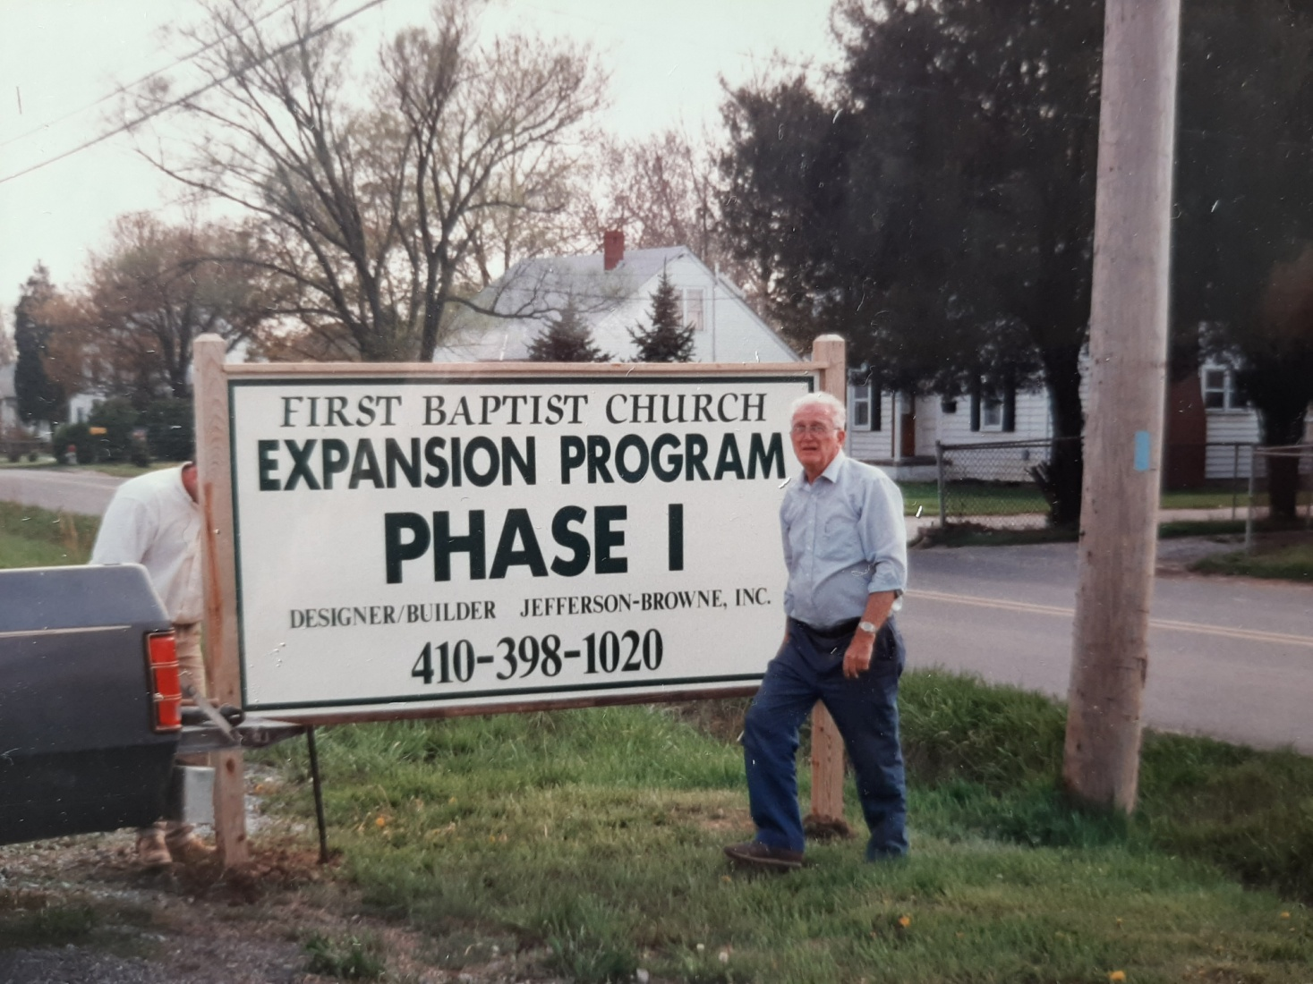
1991—Educational Wing
Challenge to Build

Slide 38
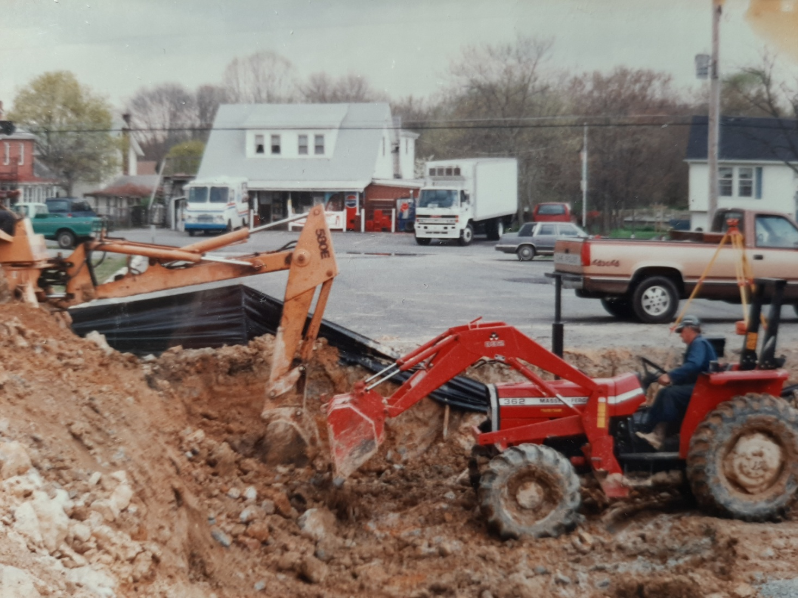
1992

Slide 39
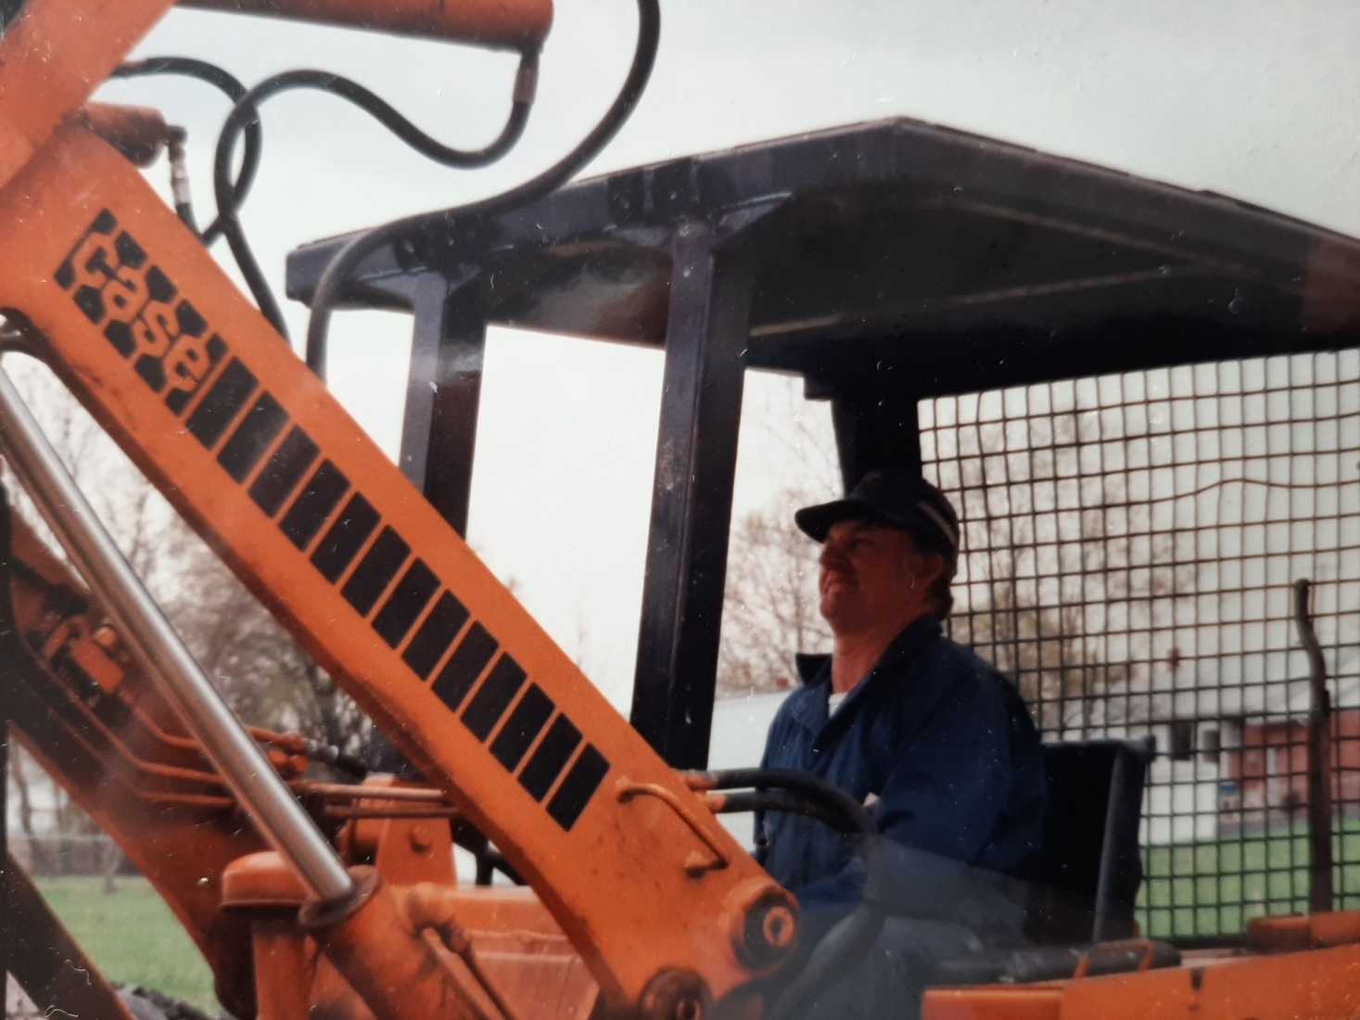
Bob Hudler

Slide 40
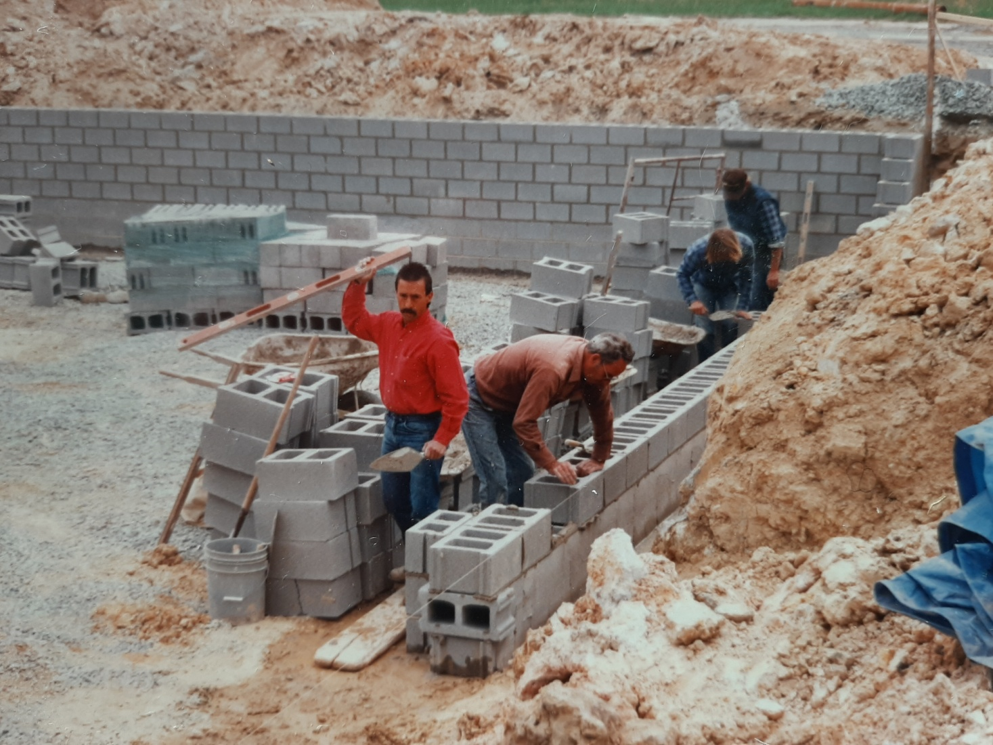
1992

Slide 41
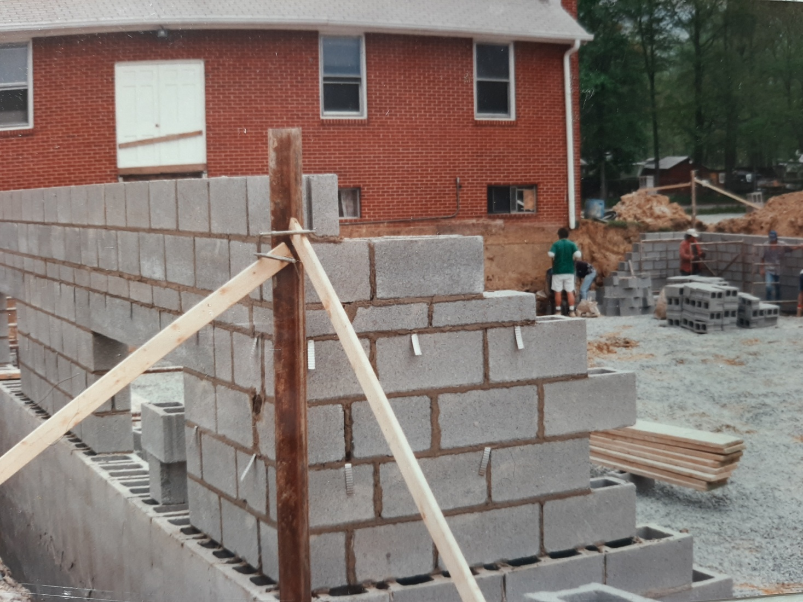
Ed. Wing

Slide 42
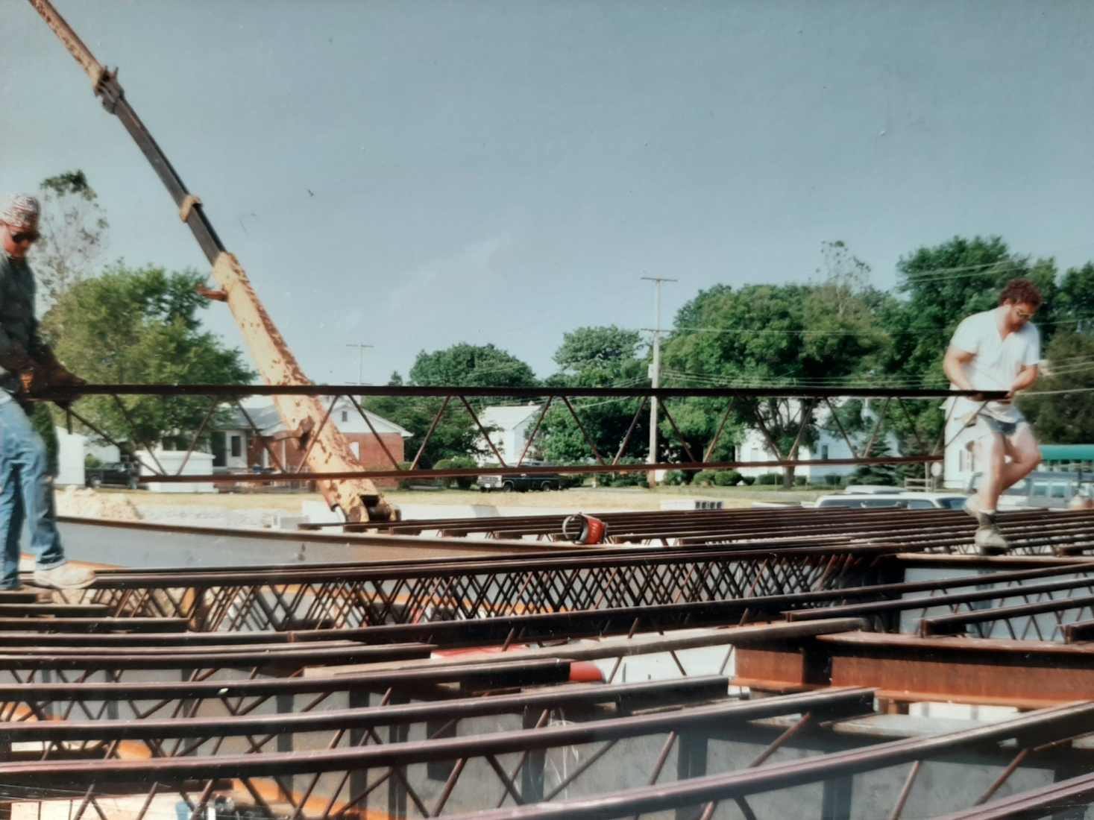
1992

Slide 43
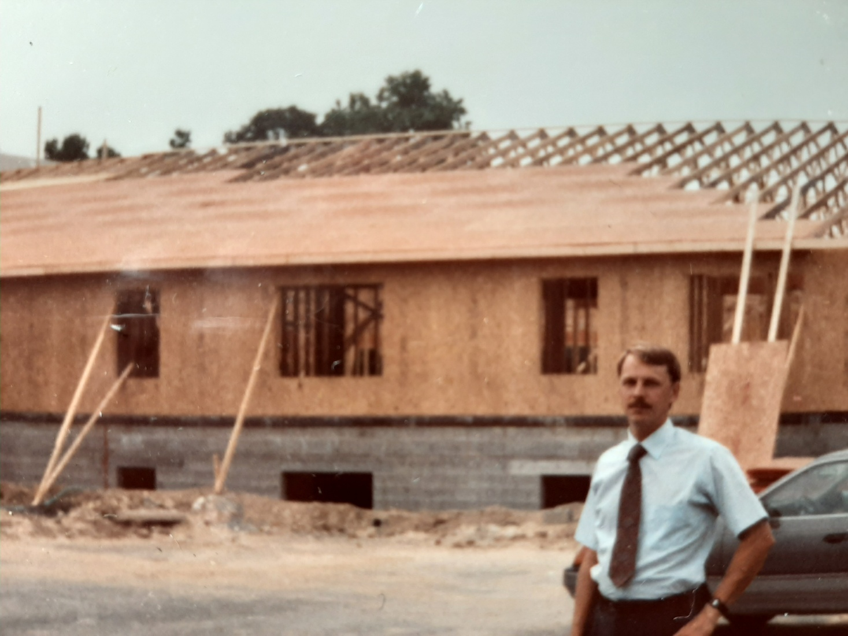
1992

Slide 44
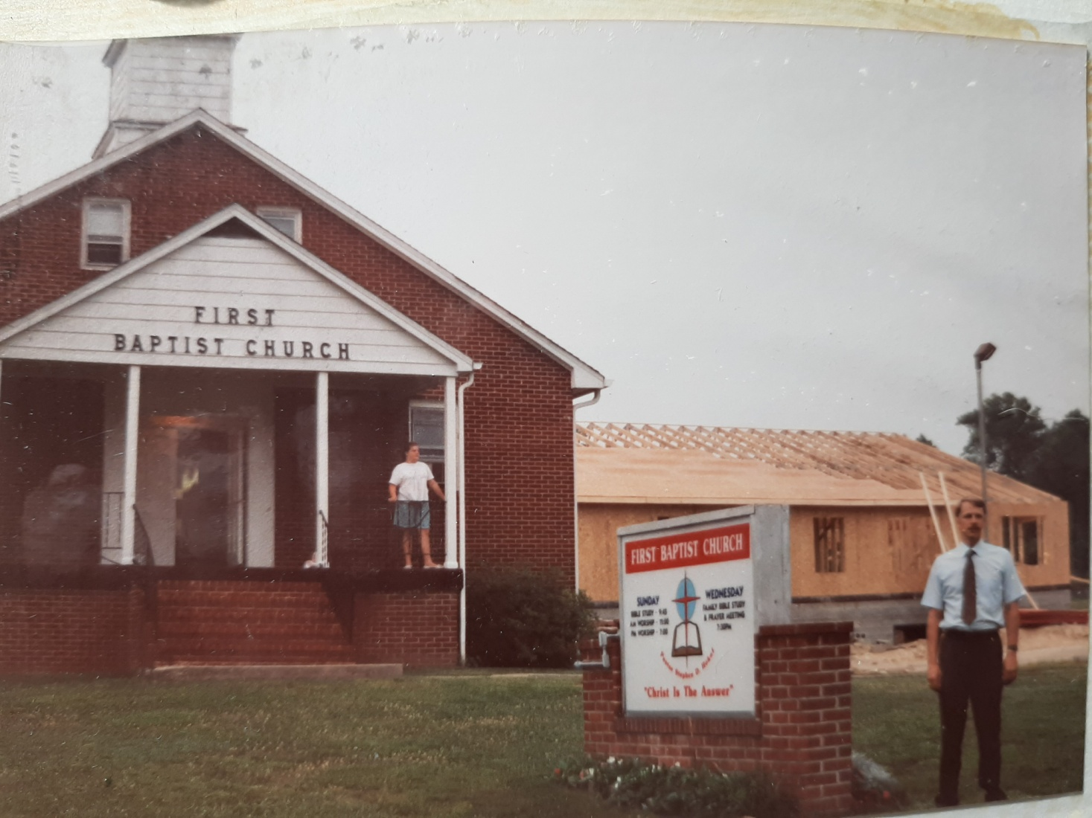
1992

Slide 45
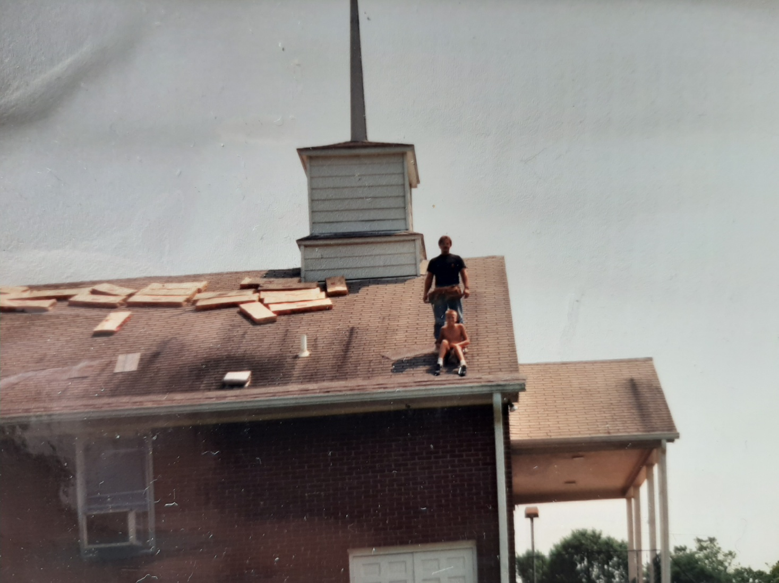
New Roof-1993, Ben & Dad

Slide 46
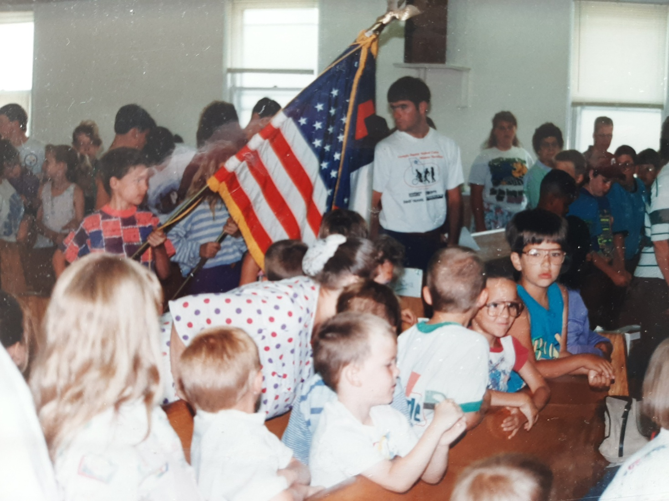
VBS-1991

Slide 47
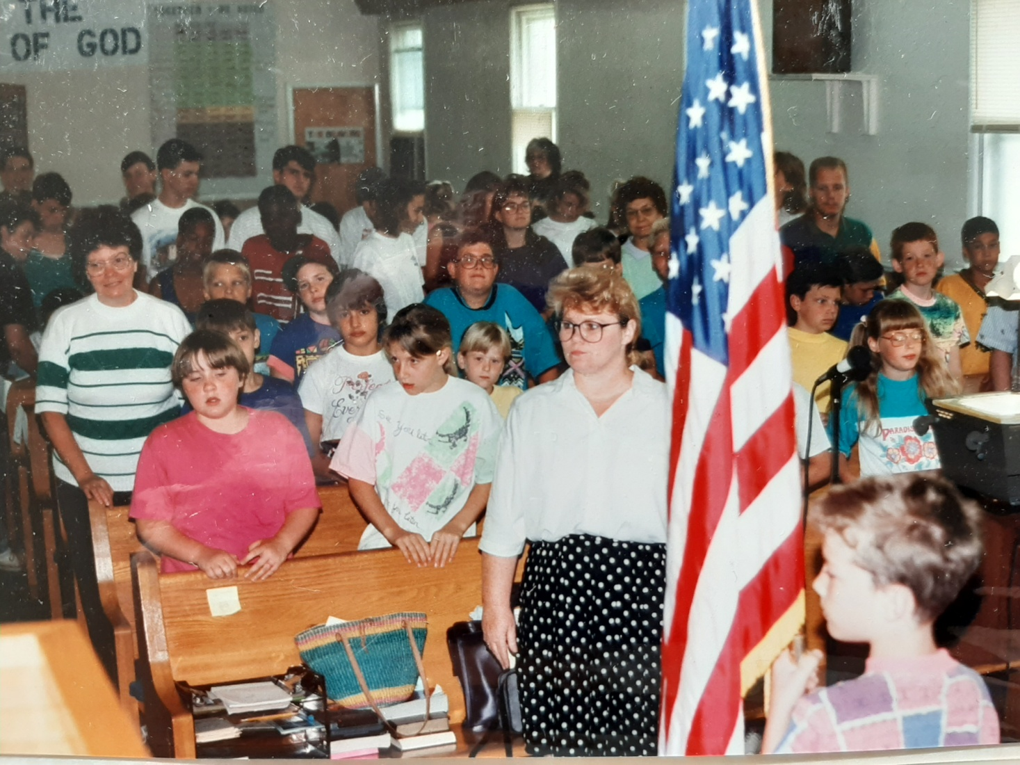
VBS 1991

Slide 48
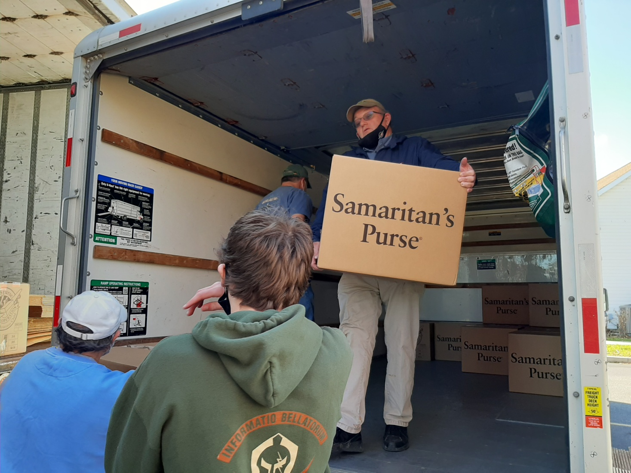
Bobby Hudler--2020

Slide 49
1. PAST– 20:18-21
MOTIVE— “I served the Lord.” Acts 20:19

Slide 50
1. PAST– 20:18-21
MOTIVE— “I served the Lord.”
EXAMPLE--- “You know how I lived the whole time I was with you, from the first day I came...” Acts 20:18

Slide 51
1. PAST– 20:18-21
MOTIVE— “I served the Lord.”
EXAMPLE--- “You know how I lived.”
BUSINESS--- “Taught you publicly and from house to house.” Acts 20:20

Slide 52
1. PAST– 20:18-21
MESSAGE---
“I have not hesitated to preach anything that would be helpful to you…” Acts 20:20
“…Must turn to God in repentance and have faith in our Lord Jesus.” Acts 20:21

Slide 53
1. PAST– 20:18-21,27
MESSAGE---
“For I have not hesitated to proclaim to you the whole will of God.” Acts 20:27

Slide 54
1. PAST– 20:18-21
MOTIVE— “I served the Lord.”
EXAMPLE--- “You know how I lived.”
BUSINESS--- “Taught you…”
MESSAGE--- “Turn to God in repentance and have faith in our Lord Jesus.”

Slide 55
2. PRESENT 20:22-27
“And now…” Acts 20:22

Slide 56
2. PRESENT 20:22-27
“I consider my life worth nothing to me, if only I may finish the race and complete the task the Lord Jesus has given me– the task of testifying to the gospel of God’s grace.” Acts 20:24.

Slide 57
3. FUTURE– 20:28-35
Keep watch—20:28
“Keep watch over yourselves and all the flock of which the Holy Spirit has made you overseers.” Acts 20:28

Slide 58
3. FUTURE– 20:28-35
Be shepherds–20:28
“Be shepherds of the church of God, which he bought with his own blood.” Acts 20:28

Slide 59
3. 6 FUTURE DANGERS
1. Savage wolves will distort the truth–29.
2. Carelessness-”Be on your guard.”-31.
3. Shallowness-”Build up”—32.
4. Coveteousness—33.
5. Laziness-”Hard work”--34.
6. Selfishness—35.

Slide 60
Acts 20:35
“Remembering the words the Lord Jesus himself said: “It is more blessed to give than to receive.”

Slide 61
3. FUTURE
“Now I commit you to God and to the word of his grace, which can build you up and give you an inheritance among all those who are sanctified.” 20:32

Slide 62
FINISH THE RACE
1. PAST
2. PRESENT
3. FUTURE

Slide 63
“Now I commit you to God and to the word of his grace, which can build you up and give you an inheritance among all those who are sanctified.” Acts 20:32

Slide 64
Acts 20:36
“When he had said this, he knelt down with all of them and prayed.”

Slide 65
Great is Thy Faithfulness
Hymn #54

