Slide 1
I AM THE GOOD SHEPHERD
JOHN 10

Slide 2
JOHN 10:1-30

Slide 3
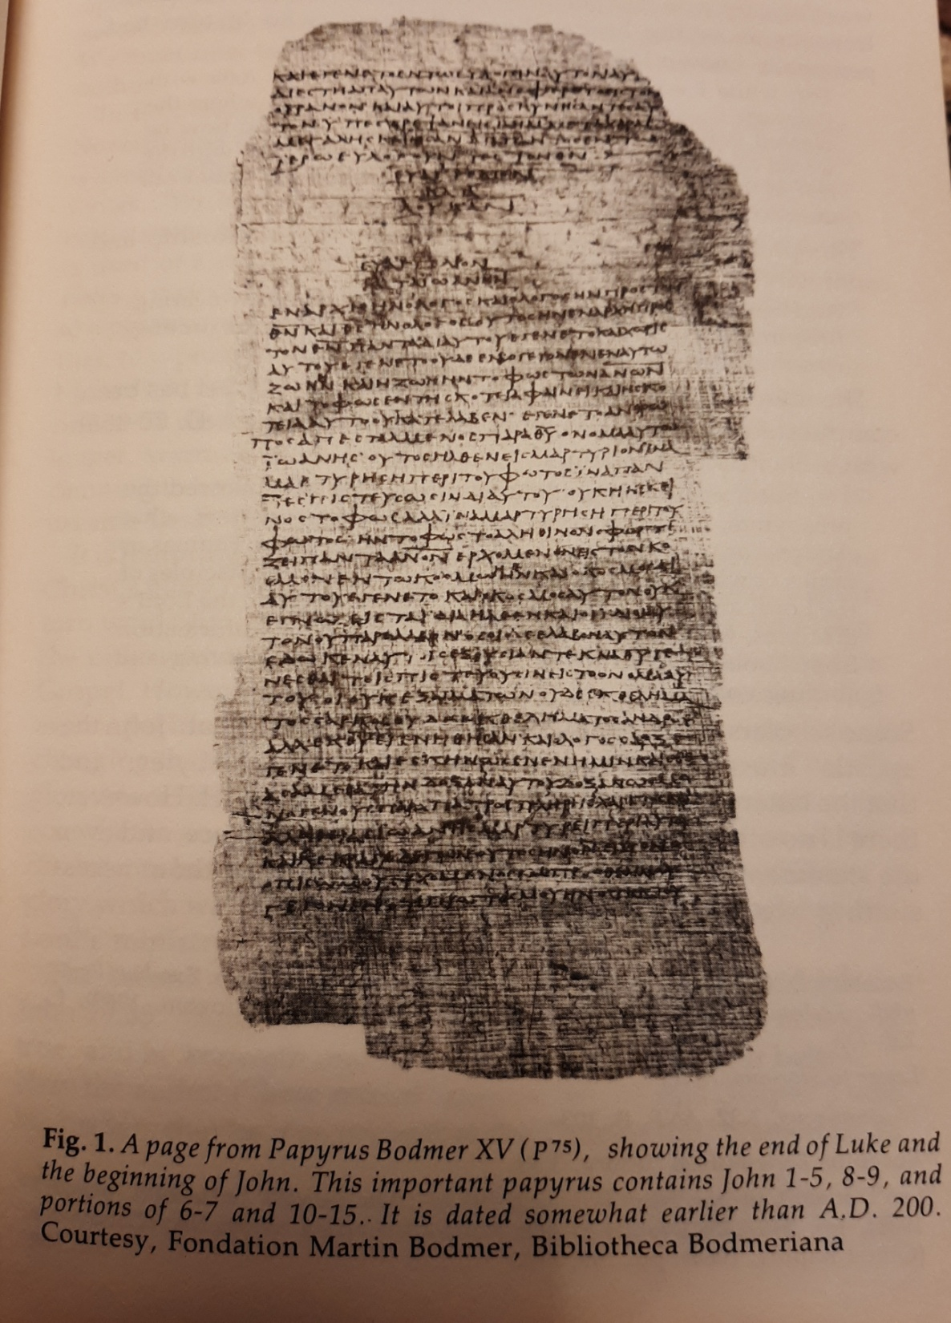
JOHN 1

Slide 4


Slide 5
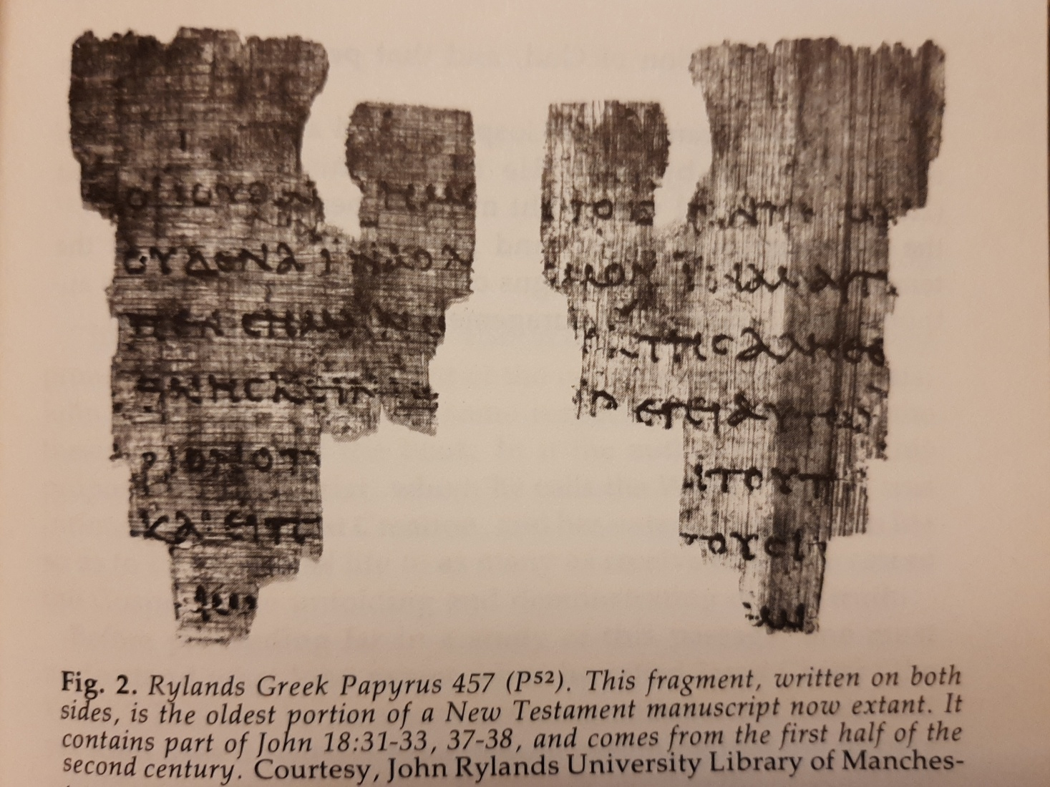
JOHN 18– Oldest NT Manuscript—
Early 100’s

Slide 6
John 10:11
“I am the good shepherd. The good shepherd lays down his life for the sheep.”

Slide 7
7 times Jesus says “I AM”
I am the bread of life (John 6)
I am the light of the world (John 8)
I am the gate (John 10:7)
I am the good shepherd (John 10:11)
I am the resurrection and the life (John 11)
I am the way, the truth and the life (John 14)
I am the true vine (John 15)

Slide 8
Jesus says “I AM”
“I am the gate for the sheep.” (John 10:7)
Ego Eimi (Greek)
Ego=“I”
Eimi=“I am.”
I myself and no one else am…

Slide 9
Jesus says “I AM”
“I am the good shepherd.” (John 10:11)
Ego Eimi (Greek)
Ego=“I”
Eimi=“I am.”
I myself and no one else am…

Slide 10
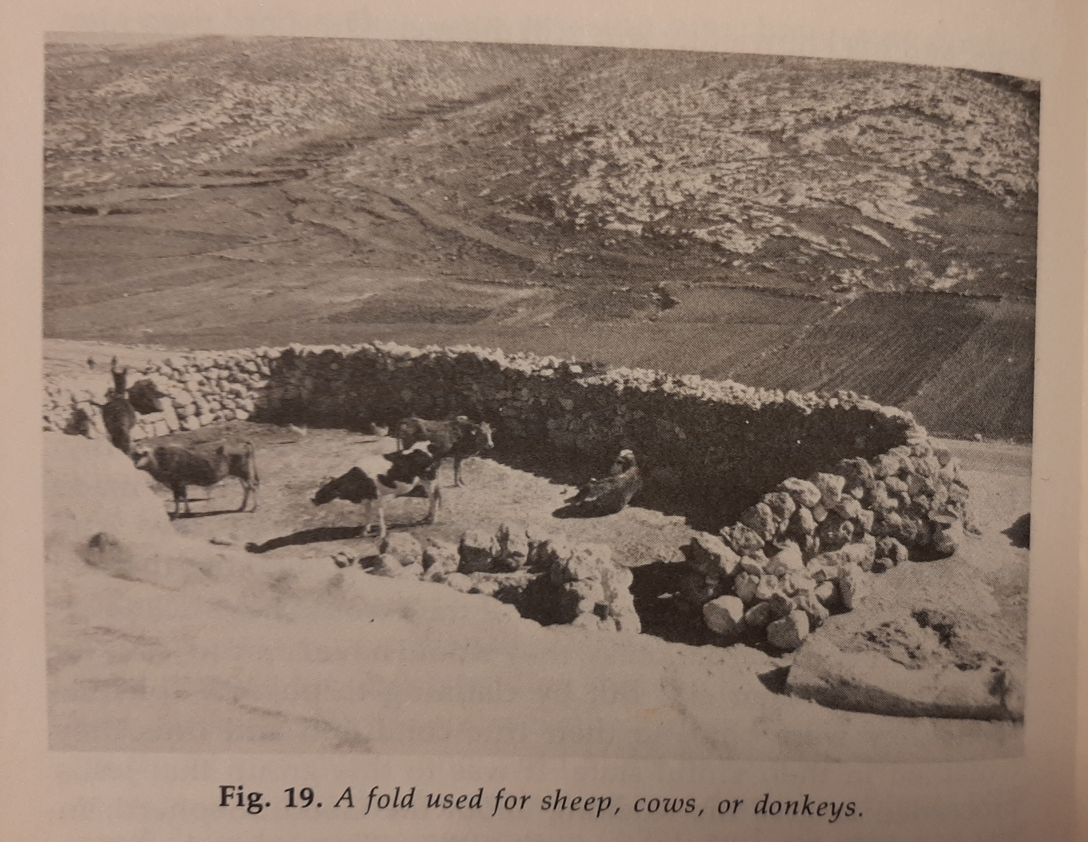

Slide 11
“I AM THE GATE”
The avenue to safety and sustenance.
The only True Shepherd of the sheep.

Slide 12
5 Others Described
Thief – 10:1 (sneaky, uses subtlety)
Robber– 10:1 (brigand, uses violence)
Watchman– 10:3 (porter or doorkeeper)
Stranger– 10:5 (falsely assumed leadership)
Hired Hand– 10:12 (not the owner, but should be good)

Slide 13
THE GOOD SHEPHERD
He is the focus of this whole discourse.
18 different statements describe Him.

Slide 14
THE SHEEP
The sheep are the ones that the Good Shepherd is concerned about.
My Sheep= Jewish believers, always in the plural here.
Other Sheep= Gentiles, non Jewish believers.
Not My Sheep= Unbelievers.

Slide 15
THE GOOD SHEPHERD AND HIS SHEEP
3 IMPORTANT RELATIONSHIPS BETWEEN THE SHEPHERD AND THE SHEEP.

Slide 16
1. LOVING RELATIONSHIP
The shepherd and the sheep is a familiar OT word picture.
Abel was a shepherd.
The patriarchs were shepherds.
Psalm 23 .
King David was a shepherd.

Slide 17
1. LOVING RELATIONSHIP
He calls them by name. (10:3)
They know His voice. (10:4)
They follow only Him. (10:4&5)

Slide 18
1. LOVING RELATIONSHIP
He voluntarily lays down His life for them. (10:11, 17 & 18)

Slide 19
1. LOVING RELATIONSHIP
He has come so they could have eternal life.
“I have come that they may have life, and have it to the full (more abundantly—KJV).” (10:10)

Slide 20
3 IMPORTANT RELATIONSHIPS BETWEEN THE SHEPHERD AND HIS SHEEP
LOVING
LIVING

Slide 21
2. LIVING RELATIONSHIP

Slide 22
2. LIVING RELATIONSHIP
The relationship is a 24/7, life long one.
He leads them out and brings them back.

Slide 23
2. LIVING RELATIONSHIP
He guides and never abandons them.
He protects and defends them.

Slide 24
2. LIVING RELATIONSHIP
He feeds and waters them.

Slide 25
2. LIVING RELATIONSHIP
The relationship is a 24/7, life long one.
He leads them out and brings them back.
He guides and never abandons them.
He feeds and waters them.
He protects and defends them.

Slide 26
3 IMPORTANT RELATIONSHIPS BETWEEN THE SHEPHERD AND HIS SHEEP
LOVING
LIVING
LASTING

Slide 27
3. LASTING RELATIONSHIP
The sheep are eternally secure in Him.
“Whoever enters through me will be saved.” (10:9)
“I am come that they may have life.” (10:10)

Slide 28
3. LASTING RELATIONSHIP
“I give them eternal life, and they shall never perish.” (10:28)
“No one can snatch them out of my hand.” (10:28)
“No one can snatch them out of my Father’s hand.” (10:29)

Slide 29
3. LASTING RELATIONSHIP
Eternal life by definition cannot be conditional and still be eternal.

Slide 30
3. LASTING RELATIONSHIP
Eternal life is a gift.
We do not earn it.
We do not deserve it.
Eternal life is by God’s grace, through faith.

Slide 31
3. LASTING RELATIONSHIP
We do not get eternal life by good works and we can not lose it by bad works.
“And if by grace, then it is no longer by works; if it were, grace would no longer be grace.” Romans 11:6

Slide 32
3. LASTING RELATIONSHIP
“If you do not believe that I am [the one I claim to be], you will indeed die in your sins.” John 8:24

Slide 33
3 IMPORTANT RELATIONSHIPS BETWEEN THE SHEPHERD AND HIS SHEEP
LOVING
LIVING
LASTING

Slide 34
Will you choose to believe?
John 10:31– “They took up stones to stone him…”
John 10:42– “Many believed in Jesus.”
John 10:11-13

