Slide 1
I AM THE RESURRECTION AND THE LIFE
JOHN 11:17-48

Slide 2
7 times Jesus says “I AM”
I am the bread of life (John 6)
I am the light of the world (John 8)
I am the door (John 10)
I am the good shepherd (John 10)
I am the resurrection and the life (John 11)
I am the way, the truth and the life (John 14)
I am the true vine (John 15)

Slide 3
John 11:17-48

Slide 4
John 11:25-26
“Jesus said to her, “I am the resurrection and the life. He who believes in me will live, even though he dies; and whoever lives and believes in me will never die. Do you believe this?”

Slide 5
Jesus says “I AM”
“I am the Resurrection and the Life.” (John 11:25)
Ego Eimi (Greek)
Ego=“I”
Eimi=“I am.”
I myself and no one else am…

Slide 6
We are only a few weeks from the cross.
The Disciples are afraid. John 11:16

Slide 7
8 times in this chapter John points us to BELIEVE.
11:14– “So that you may believe.”
11:25– “He who believes.”
11:26– “Whoever lives and believes…”
11:26– “Do you believe this?”

Slide 8
11:27– “Yes , Lord,” she told him, “I believe that you are the Christ, the Son of God, ..”
11:40– “Then Jesus said, “Did I not tell you that if you believed, you would see the glory of God?”

Slide 9
11:42– “…That they may believe that you sent me.”
11:45– “Many put their faith in him.”
11:48– “If we let him go on like this, everyone will believe in him…”

Slide 10
MIRACLES= Signs and Wonders
Acts 2:22– “Jesus of Nazareth, a man accredited by God to you by miracles, wonders and signs, which God did among you through him.…”

Slide 11
Miracles/Signs
Always point us to something.
Ask yourself , “Why?”
John says– To believe.

Slide 12
John 20:31
“But these are written that you may believe that Jesus is the Christ, the Son of God, and that by believing you may have life in his name.”

Slide 13
John wants them to BELIEVE.
11:14– “So that you may believe.”
First Jesus wanted to strengthen the faith of His disciples.

Slide 14
1. Strengthen the Disciples’ Faith
John 11:14-15– “Lazarus is dead, and for your sake I am glad I was not there, so that you may believe.”

Slide 15
1. Strengthen the Disciples’ Faith

Slide 16
1. Strengthen the Disciples’ Faith
John 11:16– “Then Thomas (called Didymus ) said to the rest of the disciples, “Let us also go, that we may die with him.”

Slide 17
2. Strengthen Mary and Martha’s Faith.

Slide 18
John 11:25-26
“Jesus said to her, “I am the resurrection and the life. He who believes in me will live, even though he dies; and whoever lives and believes in me will never die. Do you believe this?”

Slide 19
2. Strengthen Mary and Martha’s Faith.
John 11:40– “Did I not tell you that if you believed, you would see the glory of God?”

Slide 20
3. Strengthen the Faith of Us. (11:41-48)
Jeremy Camp’s “Dead Man Walking.”
Lazarus is a picture of us all.

Slide 21
3. Strengthen the Faith of Us. (11:41-48)
John 11:42– “Father, I thank you that you have heard me. I knew that you always hear me, but I said this for the benefit of the people standing here, that they may believe that you sent me.”

Slide 22
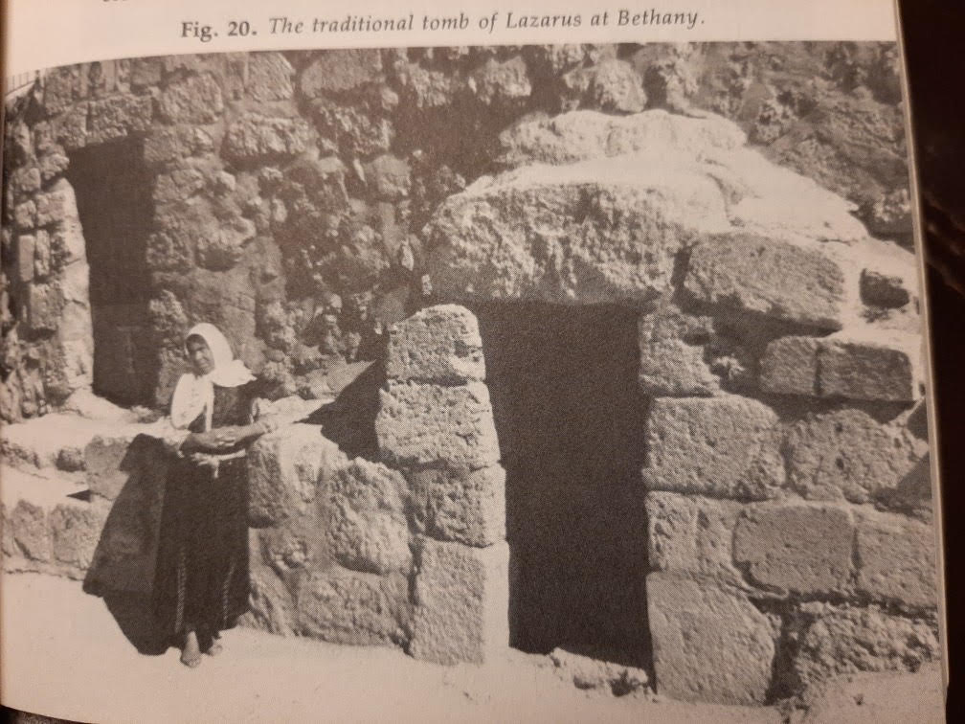

Slide 23
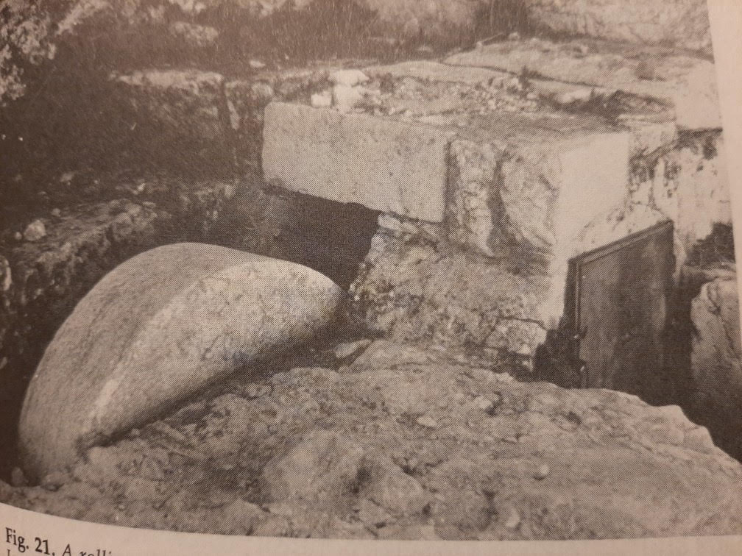

Slide 24
3. Strengthen the Faith of Us. (11:41-48)
John 11:45– “Therefore many of the Jews…put their faith in him.”

Slide 26
JESUS IS TENDERLY CALLING

