Slide 1
THE SIGN OF THE GREAT TRIBULATION
MATTHEW 24:15-25

Slide 2
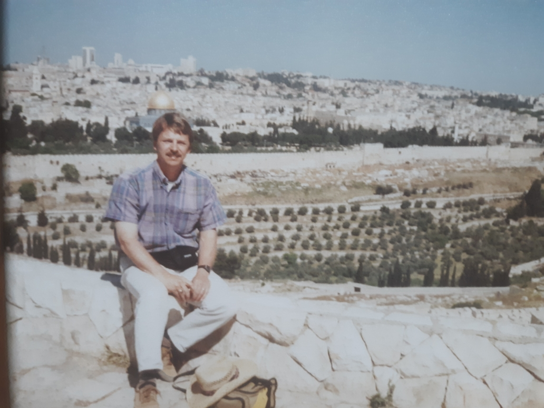

Slide 3
MATTHEW 24:1-14
3 QUESTIONS:
WHEN WILL THIS HAPPEN?
WHAT WILL BE THE SIGN OF YOUR COMING?
WHAT WILL BE THE SIGN OF THE END OF THE AGE?

Slide 4
1ST QUESTION
WHEN?– A.D. 70 THE DESTRUCTION OF JERUSALEM.

Slide 5
3RD QUESTION
WHAT WILL BE THE SIGN OF THE END OF THE AGE?

Slide 6
3rd Q. What will be the sign of the end of the age? (24:4-14)
Deception (24:4-5)
Wars and rumors of war (24:6)
Famines (24:7)
Pestilences (Luke 21:11)
Earthquakes (24:7)
Persecution (24:9-13)
False Prophets (24:11)
Increase of wickedness (24:12)
Love of most will grow cold (24:12)
Gospel to the whole world (24:14)

Slide 7
Back to their 2ND QUESTION
WHAT WILL BE THE SIGN OF THE SECOND COMING?

Slide 8
MATTHEW 24:15-35
“Then the end will come.” (24:14).
“Jerusalem will be trampled on by the Gentiles until the times of the Gentiles are fulfilled.” -- (Luke 21:24)

Slide 9
The Rapture
A Church truth that will be revealed by Paul 20-30 years hence.
“…We will be caught up together with a them in the clouds to meet the Lord in the air.”– 1 Thess. 4:17

Slide 10
Matthew 24
Spoken to a Jewish audience.
Christians will be gone, but God wants us to know.

Slide 11
The Sign of the Great Tribulation--Matt. 24:15
“The abomination that causes desolation.”
If you see this you were left behind.

Slide 12
1st Question-- What is it?
“The Abomination that causes (of—KJV) desolation.”
An OT term from Daniel.

Slide 13
Daniel 11:31
“Then they will set up the abomination that causes desolation.”
Antiochus Epiphanes IV set up an idol to Zeus on the temple altar and sacrificed a pig there. This happened in 168 B.C.

Slide 14
2nd Question—What is it not?
It is not the destruction of Jerusalem in A.D. 70.
It is something yet future.
“Then there will be great distress, unequaled from the beginning of the world until now– and never to be equaled again.”– Matt. 24:21

Slide 15
3rd Q—So what is it?
Rev. 13:14-15 – “He (the false prophet) ordered them to set up an image in honor of the beast who was wounded by the sword and yet lived. He was given power to give breath to the image of the first beast, so that it could speak and cause all who refused to worship the image to be killed.”

Slide 16
2 Thess. 2:4
“He will oppose and will exalt himself over everything that is called God or is worshiped, so that he sets himself up in God’s temple, proclaiming himself to be God.”

Slide 17
4th question—When will this happen?
Right in the middle of the 7 year Tribulation.

Slide 18
Daniel 9:27
“He will confirm a covenant with many for one ‘seven.’ In the middle of the ‘seven’ he will put an end to sacrifice and offering. And on a wing of the temple he will set up an abomination that causes desolation, until the end that is decreed is poured out on him.”

Slide 19
4 Ways to say “3 & a half years”.
Rev. 13:5– “42 months”.
Dan. 9:27– “Middle of the 7”.
Daniel 12:7– “It will be for a time, times and half a time.”
Daniel 12 :11– “1,290 days”.

Slide 20
5th Question—Why should we take heed?
After all Christians will be raptured before .
A warning to all to get saved.
Don’t wait.

Slide 21
Matt. 24:30
“At that time the sign of the Son of Man will appear in the sky, and all the nations of the earth will mourn. They will see the Son of Man coming on the clouds of the sky, with power and great glory.”

Slide 22
Matt. 24:32
“Now learn this lesson from the fig tree: As soon as its twigs get tender and its leaves come out, you know that summer is near.”

Slide 23
Matt. 24:33-34
“Even so , when you see all these things, you know that it is near, right at the door. I tell you the truth, this generation will certainly not pass away until all these things have happened.”

Slide 24
Matt. 24:35
“Heaven and earth will pass away , but my words will never pass away.”

