Slide 1
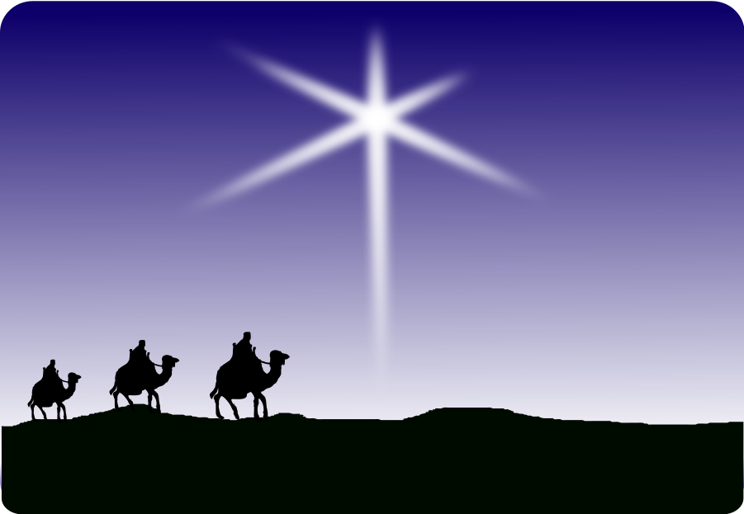
WISE MEN
STILL
SEEK HIM
MATTHEW 2:1-12

Slide 2
MATTHEW 2:1-2
“After Jesus was born in Bethlehem in Judea, during the time of King Herod, Magi (Wise men—KJV) from the east came to Jerusalem and asked, “Where is the one who has been born king of the Jews? We saw his star in the east and have come to worship him.”

Slide 3
MAGI
M
A
G
I

Slide 4
MAGI
M—Matchless Faith
A
G
I

Slide 5
Numbers 24:17
“A star will come out of Jacob, a scepter will rise out of Israel.”

Slide 6
Isaiah 60:1,3,6
“Arise, shine for your light has come, and the glory of the LORD rises upon you.”
“Nations will come to your light, and kings to the brightness of your dawn.”
“…Bearing gold and incense and proclaiming the praise of the LORD.”

Slide 7
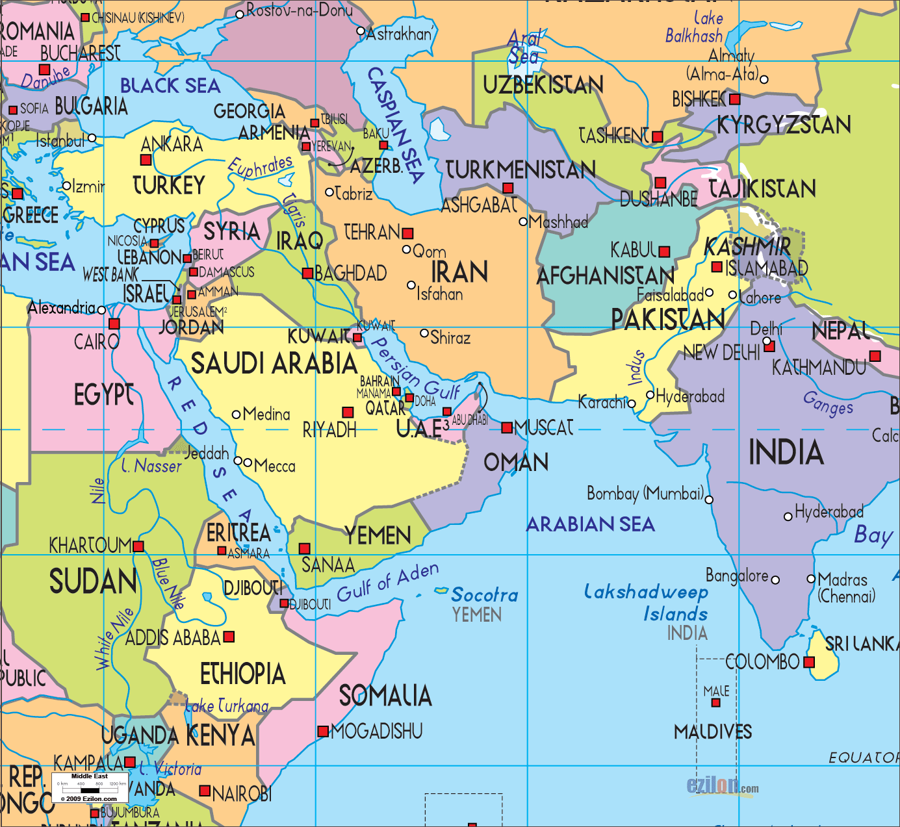

Slide 8
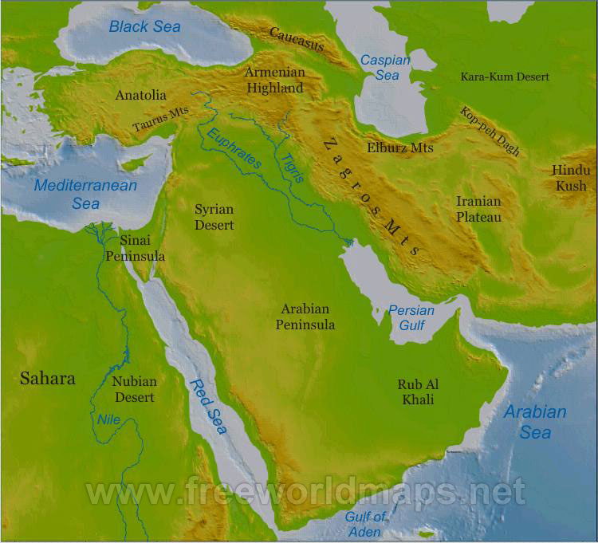

Slide 9
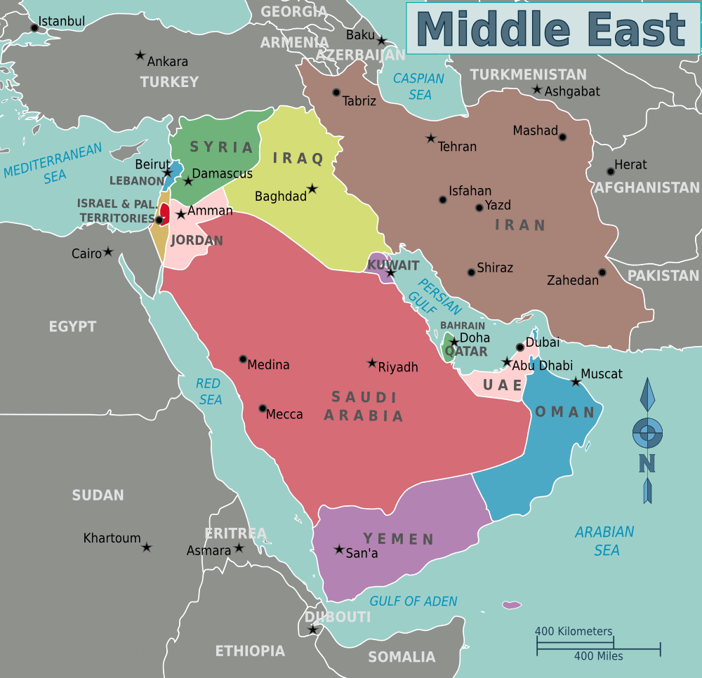

Slide 10
M---Matchless Faith
They responded in great faith to leave home and travel nearly 2,000 miles round trip.
Consider Abraham.
Moses
Paul
William Carey, Adoniram Judson, Charlotte “Lottie” Moon, Hudson Taylor, Jim Elliot, Bronson Hokuf, Pete & Wendy Scott, Chris & Laura Moyer….

Slide 11
YOU
Would you be one who would go?

Slide 12
MAGI
M—Matchless Faith
A---Accurate Discernment
G
I

Slide 13
A---Accurate Discernment
“Trust in the LORD with all your heart and lean not on your own understanding; in all your ways acknowledge him, and he will make your paths straight.” Prov. 3:5-6

Slide 14
Accurate Discernment
Moses---Burning bush.
Israel---Pillar of fire & the pillar of cloud.
Elijah—The still small voice.
Daniel---Angels & dreams.
Rich man in Hades--- “They have Moses and the Prophets; let them listen to them.” Luke 16:29
Magi---A star (they saw when they were) in the East.

Slide 15
MAGI
M—Matchless Faith
A---Accurate Discernment
G---Greater Wisdom
I

Slide 16
G---Greater Wisdom
King Herod
Chief Priests
Teachers of the law
They all knew he would be born in Bethlehem.

Slide 17
G---Greater Wisdom
Knowledge=intellectual information.
Wisdom=Info and Action.

Slide 18
G---Greater Wisdom
1 Chron. 12:32--- “Men of Issachar, who understood the times and knew what Israel should do…”

Slide 19
G---Greater Wisdom
Acts 13:36--- “David had served God’s purpose in his own generation….”

Slide 20
You
So, what do you do when the star you are following doesn’t end up where you thought it would?

Slide 21
MAGI
M--Matchless Faith
A---Accurate Discernment
G---Greater Wisdom
I---Intimate Worship

Slide 22
I--Intimate Worship
Matthew 2:9-12
“They were overjoyed.”
“They bowed down and worshiped him.”
“Then they opened their treasures and presented him with gifts of gold and of incense and of myrrh.”

Slide 23
“They returned to their country by another route.”

Slide 24
“Take the child and his mother and escape to Egypt.”

Slide 25
Charles Lamb
The 2 greatest literary characters of all time—Jesus and William Shakespeare. “The major difference between these two is that if Shakespeare came into this room we would all stand in honor and respect, but if Jesus Christ were here, we would all humbly bow and worship Him.”

Slide 26
M—MATCHLESS FAITH
A---ACCURATE DISCERNMENT
G---GREATER WISDOM
I----INTIMATE WORSHIP

