Slide 1
A MIGHTY FORTRESS
PSALM 46

Slide 2
VETERANS DAY
The Old Testament is full of military battles, imagery, and words related to war.

Slide 3
GOD IS OUR REFUGE
Psalm 46:1— “God is our refuge and strength, an ever-present help in trouble.”

Slide 4
GOD IS OUR FORTRESS
Psalm 46:1— “God is our refuge and strength, an ever-present help in trouble.”
Ps. 46:7– “The God of Jacob is our fortress. Selah.”

Slide 5
GOD IS OUR FORTRESS
Psalm 46:11– “The LORD Almighty is with us; the God of Jacob is our fortress. Selah.”

Slide 6
“A Mighty Fortress is our God.” Martin Luther , 1483-1546.

Slide 7
PSALM 46
This is a 3 stanza psalm of praise. Divided by the word SELAH.
Prob. by good King Hezekiah when God delivered from the Assyrians.
2 Kings 18-19; 2 Chr. 32; Is. 36-37.

Slide 8
PSALM 46
There are 3 Directives to truly Praise the LORD.
1. Be Strong
2. Be Glad
3. Be Still

Slide 9
1. Be Strong—46:1-3
Be strong in the LORD. He is our:
Refuge (literally “rock of refuge” or shelter)
Strength
Help

Slide 10
1. Be Strong
Therefore—
We will not fear!
Selah

Slide 11
3 Directives
1. Be Strong
2. Be Glad

Slide 12
2. Be Glad (46:4-7)
Be glad because:
A. A river flows in the city of God (4).
B. God is present (4b).
C. God will help (5).
D. God is with us (7).
Selah

Slide 13
“There is a river…”
Where is the river?
The spring of Gihon flows into the Pool of Siloam, through an underground tunnel.
To this day there is no river in Jerusalem.

Slide 14
Good King Hezekiah
In Hezekiah’s day when Assyria besieged Jerusalem, water was a matter of life and death.

Slide 15
Hezekiah’s Tunnel
They dug through solid rock before Sennacherib besieged Jerusalem.
1,777 feet long. They chiseled from both ends and met in the middle, just a few inches off.

Slide 16
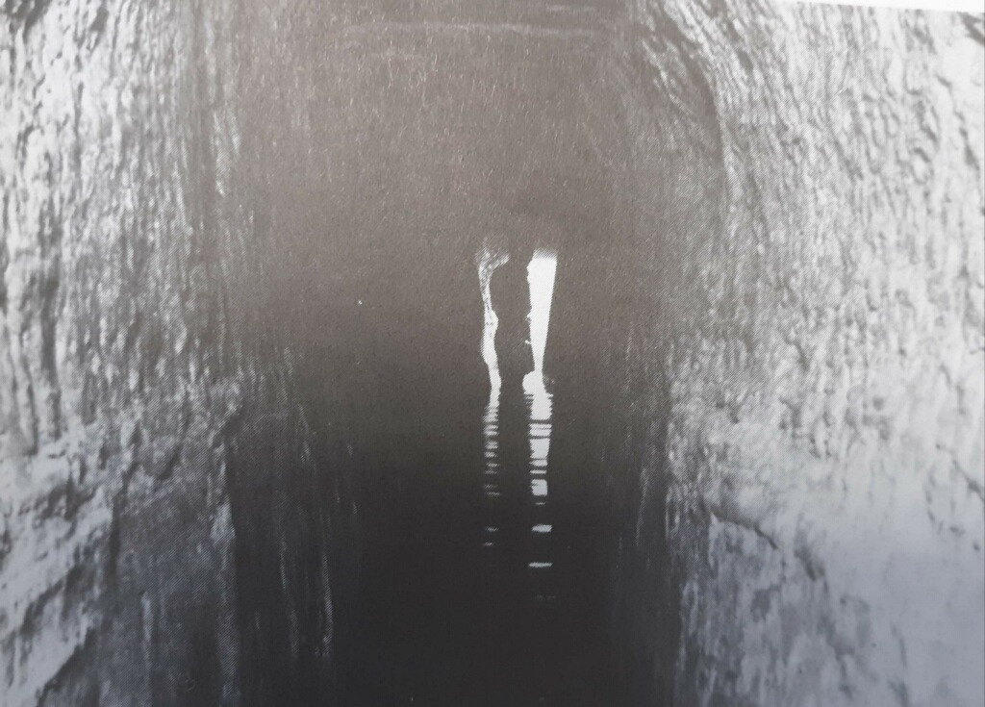
Hezekiah’s Tunnel

Slide 17
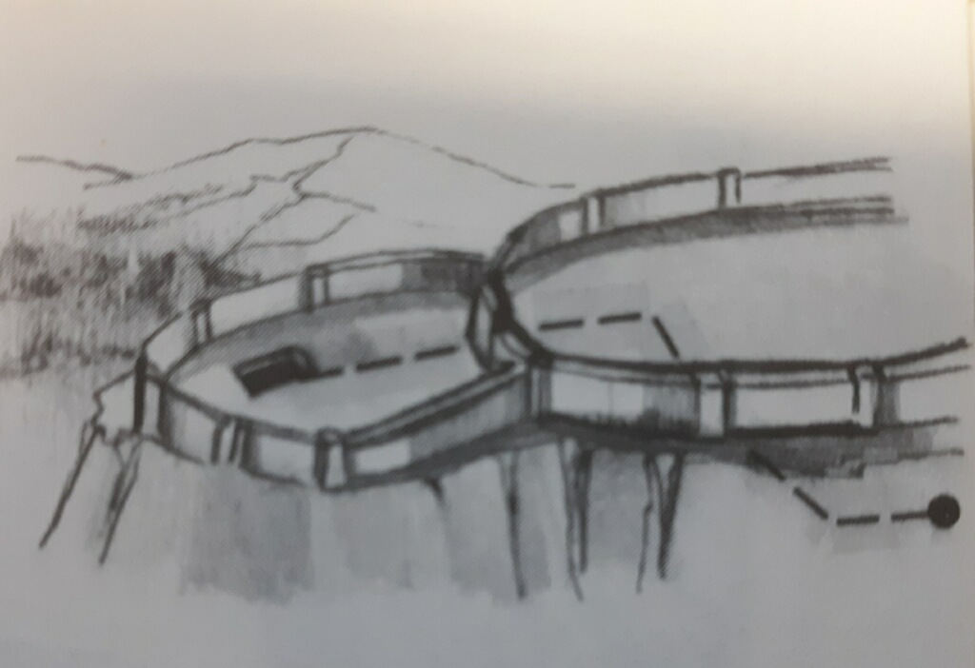
Gihon Spring to the Pool of Siloam

Slide 18
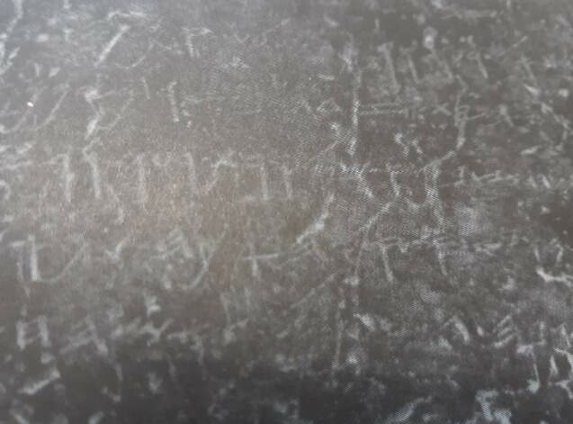
Hebrew Inscription of the Miners’ Work

Slide 19
“There is a river…”
“In that day…all the ravines of Judah will run with water. A fountain will flow out of the LORD’s house and will water the valley of acacias.” Joel 3:18

Slide 20
“There is a river…”
“A day of the LORD is coming…” (Zechariah 14:1-11)
“The Lord … His feet will stand on the Mount of Olives…”
“On that day living water will flow out from Jerusalem…”

Slide 21
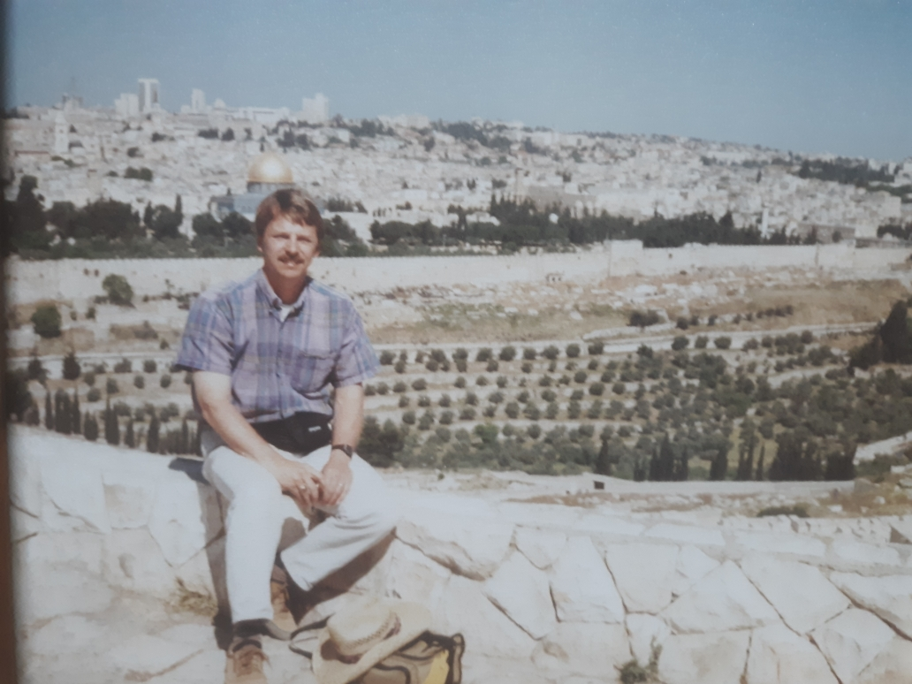
From the Mt. of Olives

Slide 22
“There is a river…”
Ezekiel 47:1-12.
“The man brought me back to the entrance of the temple, and I saw water coming out from under the threshold of the temple toward the east…”

Slide 23
From the Mt. of Olives

Slide 24
“There is a river…”
“The water was ankle deep…” (Ezekiel 47:3)
“The water was knee-deep…” (47:4)
“…the water was up to the waist.” (47:4b)
“Now it was a river that I could not cross…” (47:5)

Slide 25
“There is a river…”
“This water flows … down to the Arabah.” (Jordan River valley) (Ezk. 47:8)
“When it empties into the Sea, (Dead Sea) the water there becomes fresh…” (47:8b)

Slide 26
“There is a river…”
“Fruit trees of all kinds will grow on both banks of the river. Their leaves will not wither, nor will their fruit fail.” (Ezk. 47:12)
“Their fruit will serve for food and their leaves for healing.” (47:12b)

Slide 27
“There is a river…”
“On that day a fountain will be opened to the house of David and the inhabitants of Jerusalem, to cleanse them…” (Zechariah 13:1)
“…to cleanse them from sin and impurity.” !!!!

Slide 28
“There is a fountain filled with…”
This is a vivid illustration of the cleansing blood of Christ!!!!!
He is our only hope for cleansing from sin.
“…no man comes to the Father except through Me.” (John 14:6)

Slide 29
THE BLOOD OF CHRIST
“God presented him as a sacrifice of atonement, through faith in his blood.” Romans 3:25

Slide 30
THE BLOOD OF CHRIST
“Since now we have been justified by his blood, how much more shall we be saved from God’s wrath through him!” Romans 5:9

Slide 31
THE BLOOD OF CHRIST
“In him we have redemption through his blood, the forgiveness of sins.” Ephesians 1:7

Slide 32
THE BLOOD OF CHRIST
“In whom we have redemption through his blood, even the forgiveness of sins.” Colossians 1:14 (KJV)

Slide 33
THE BLOOD OF CHRIST
“Without the shedding of blood there is no forgiveness.” Hebrews 9:22

Slide 34
THE BLOOD OF CHRIST
“Jesus also suffered outside the city gate to make the people holy through his own blood. Let us, then go to him outside the camp, bearing the disgrace he bore.” Hebrews 13:12-13
Don’t be ashamed of the blood of Christ.

Slide 35
THE NEW JERUSALEM
“Then the angel showed me the river of the water of life, as clear as crystal, flowing from the throne of God and of the Lamb down the middle of the great street of the city…” Revelation 22:1ff

Slide 36
SELAH
“The LORD Almighty is with us; the God of Jacob is our fortress. SELAH” Psalm 46:7
Lit. Our “high tower.” From the root word for “cliff.”

Slide 37
3 Directives
1. Be Strong (1-3)
2. Be Glad (4-7)
3. Be Still (8-11)

Slide 38
3. BE STILL
“Be still (cease striving—NAS) and know that I am God.” Psalm 46:10
“The LORD Almighty is with us; the God of Jacob is our fortress [high tower]. Selah” Psalm 46:11

Slide 39
WHEN YOU FACE TROUBLES
Be Strong
Be Glad
Be Still: the LORD is God.
Jehovah says “I’ve got this.”

