Slide 1
THE EARTH IS THE LORD’S
PSALM 24

Slide 2
THE SHEPHERD PSALMS
PSALM 22—THE GREAT SHEPHERD
PSALM 23—THE GOOD SHEPHERD
PSALM 24—THE CHIEF SHEPHERD

Slide 3
THE SHEPHERD PSALMS
22—SAVIOR
23—SHEPHERD
24—SOVEREIGN

Slide 4
THE SHEPHERD PSALMS
22---PAST/HE GAVE HIS LIFE.
23---PRESENT/HE GIVES HIS LOVE.
24---FUTURE/HE WILL COME WITH HIS REWARD.

Slide 5
1 CORINTHIANS 10:11
“These things happened to them as examples and were written down as warnings for us, on whom the fulfillment of the ages has come.”

Slide 6
PSALM 24
Tradition tells us that this Psalm was written by David for the moving of the ark to Jerusalem.

Slide 7
1 Chronicles 13:3; 7-10
“Let us bring the ark of our God back to us…”
“They moved the ark of God…on a new cart.”
“Uzzah reached out his hand to steady the ark, because the oxen stumbled. The LORD’s anger burned against Uzzah and he struck him down…”

Slide 8
1 Chronicles 15:2; 12-15
“No one but the Levites may carry the ark of God…”
“We did not inquire of him about how to do it in the prescribed way.”

Slide 9
2 Samuel 6:1-16
“David was afraid of the LORD that day and said, “How can the ark of the LORD ever come to me?” (6:9)

Slide 10
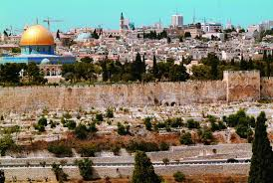
The Golden Gate/Eastern Gate

Slide 11
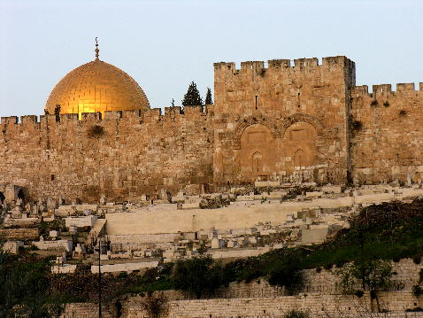

Slide 12
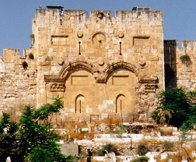

Slide 13
PSALM 24
1. HIS MAJESTY– 24:1-2
2. APPROACHING HIS MAJESTY– 24:3-6
3. WORSHIPING HIS MAJESTY– 24:7-10

Slide 14
1. HIS MAJESTY
“The earth is the LORD’s and everything in it, the world, and all who live in it; for he founded it upon the seas and established it upon the waters.” Ps. 24:1-2

Slide 15
1. HIS MAJESTY
“Every animal of the forest is mine, and the cattle on a 1000 hills.” Ps. 50:10

Slide 16
1. HIS MAJESTY
“The land is mine and you are but aliens and my tenants.” Lev. 25:23

Slide 17
1. HIS MAJESTY
“For in 6 days the LORD made the heavens and the earth, the sea, and all that is in them.” Ex. 20:11

Slide 18
1. HIS MAJESTY
“The world and its desires pass away, but the man who does the will of God lives forever.” 1 John 2:17
D.L. Moody’s life verse.

Slide 19
1. HIS MAJESTY
“Do you not know that your body is a temple of the Holy Spirit, who is in you, whom you have received from God? You are not your own; you were bought at a price. Therefore honor God with your body.” 1 Cor. 6:19-20

Slide 20
2. APPROACHING HIS MAJESTY
“Who may ascend the hill of the LORD? Who may stand in his holy place?” Ps. 24:3
“He who has clean hands and a pure heart, who does not lift up his soul to an idol or swear by what is false.” Psalm 24:4

Slide 21
2. APPROACHING HIS MAJESTY
“I am the way and the truth and the life. No one comes to the Father except through me.” John 14:6

Slide 22
2. APPROACHING HIS MAJESTY
“God made him who had no sin to be sin for us, so that in him we might become the righteousness of God.” 2 Cor. 5:21

Slide 23
2. APPROACHING HIS MAJESTY
“If anyone’s name was not found written in the book of life, he was thrown into the lake of fire.” Rev. 20:15

Slide 24
2. APPROACHING HIS MAJESTY
“Nothing impure will ever enter it, nor will anyone who does what is shameful or deceitful, but only those whose names are written in the Lamb’s book of life.” Rev. 21:27

Slide 25
Matthew 10:28
“Do not be afraid of those who kill the body but cannot kill the soul. Rather, be afraid of the One who can destroy both soul and body in hell.”

Slide 26
3. WORSHIPING HIS MAJESTY
“Lift up your heads, O you gates; be lifted up, you ancient doors, that the King of glory may come in. Who is this King of glory? The LORD strong and mighty, the LORD mighty in battle.” Ps. 24:7-8

Slide 27
3. WORSHIPING HIS MAJESTY
“Lift up your heads, O you gates; lift them up, you ancient doors, that the King of glory may come in. Who is he, this King of glory? The LORD Almighty---he is the King of glory.” Ps. 24:9-10

Slide 28
Ezekiel 43:1-7
“I saw the glory of the God of Israel coming from the east…”
“The glory of the Lord entered the temple through the gate facing east…”

Slide 29
Ezekiel 43:1-7
“The glory of the LORD filled the temple…”
“This is the place of my throne and the place for the soles of my feet. This is where I will live among the Israelites forever…”

Slide 30
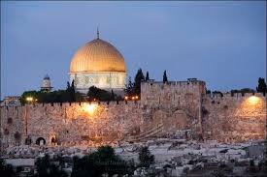

Slide 32
3. WORSHIPING HIS MAJESTY
“In that day this song will be sung…”
“Open the gates that the righteous nation may enter, the nation that keeps faith.”
“You will keep in perfect peace him whose mind is steadfast, because he trusts in you. Trust in the LORD forever, for the LORD, the LORD, is the Rock eternal (lit. Rock of Ages).” Isaiah 26:1-4

Slide 33
3. WORSHIPING HIS MAJESTY
“But we see Jesus, who was made a little lower than the angels, now crowned with glory and honor…” Hebrews 2:9

Slide 34
3. WORSHIPING HIS MAJESTY
“Here I am! I stand at the door and knock. If anyone hears my voice and opens the door, I will come in and eat with him, and he with me.” Rev. 3:20
The Infinite pleads with the finite.
The Holy one pleads with the unholy.

Slide 35
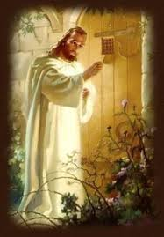

Slide 36
3.WORSHIPING HIS MAJESTY
“Now the dwelling of God is with men, and he will live with them. They will be his people, and God himself will be with them and be their God.” Rev. 21:3

