Slide 1
WHAT IS MAN?
PSALM 8

Slide 2
HUMAN LIFE IS SACRED
If we get this wrong…

Slide 3
PSALM 8

Slide 4
David gives us 4 Reasons human beings are Sacred.

Slide 5
1. Human life is sacred because We are special to God
What is Man? (Psalm 8:4)
God is mindful of us above all of His creation!
God cares for us!
God crowned us with glory and honor!

Slide 6
Psalm 8:3
“When I consider your heavens, the work of your fingers, the moon and the stars, which you have set in place,”

Slide 7
Psalm 8:4
“What is man that you are mindful of him, the son of man that you care for him?”

Slide 8
Psalm 8:5
“You made him a little lower than the heavenly beings and crowned him with glory and honor.”

Slide 9
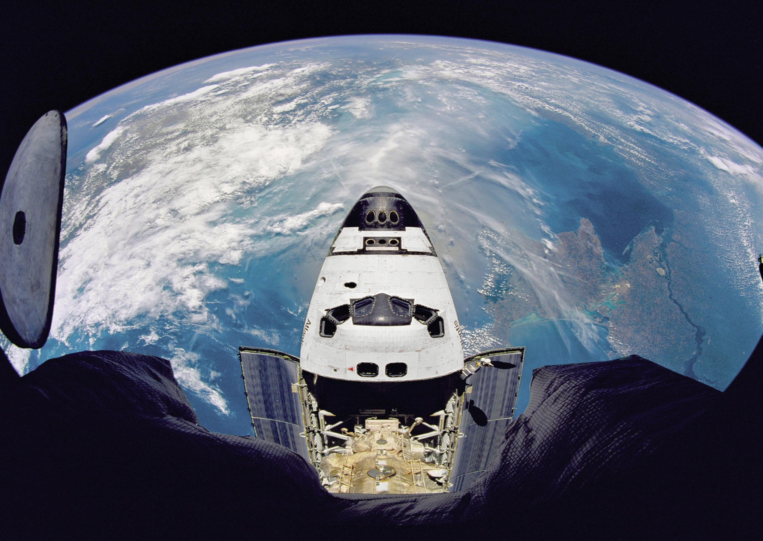

Slide 10
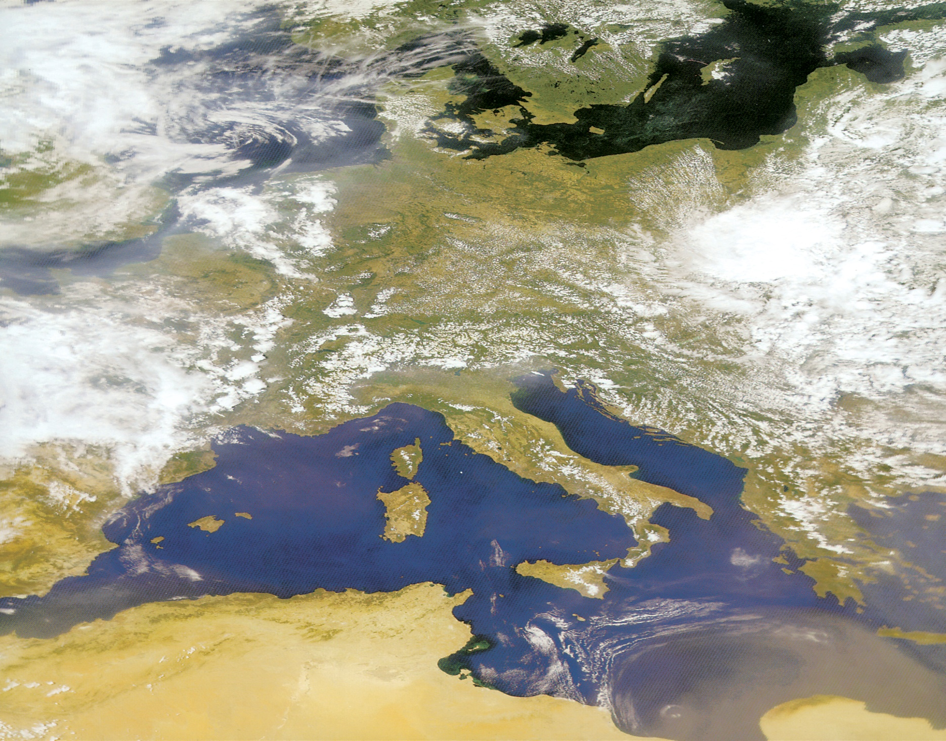

Slide 11
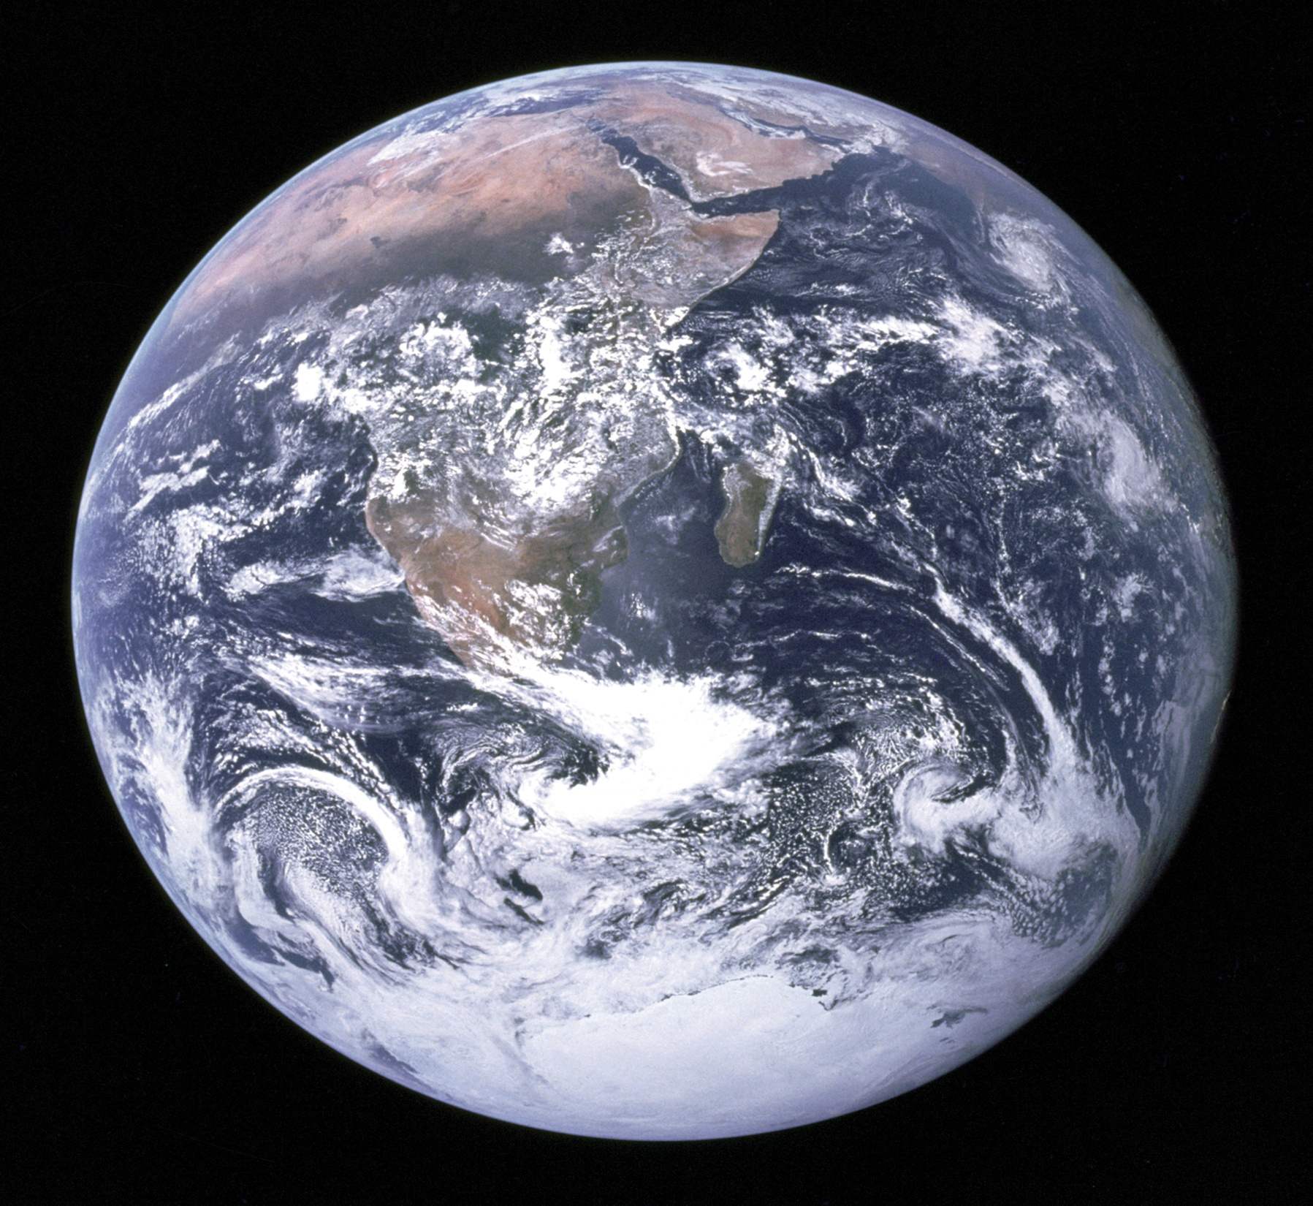

Slide 12
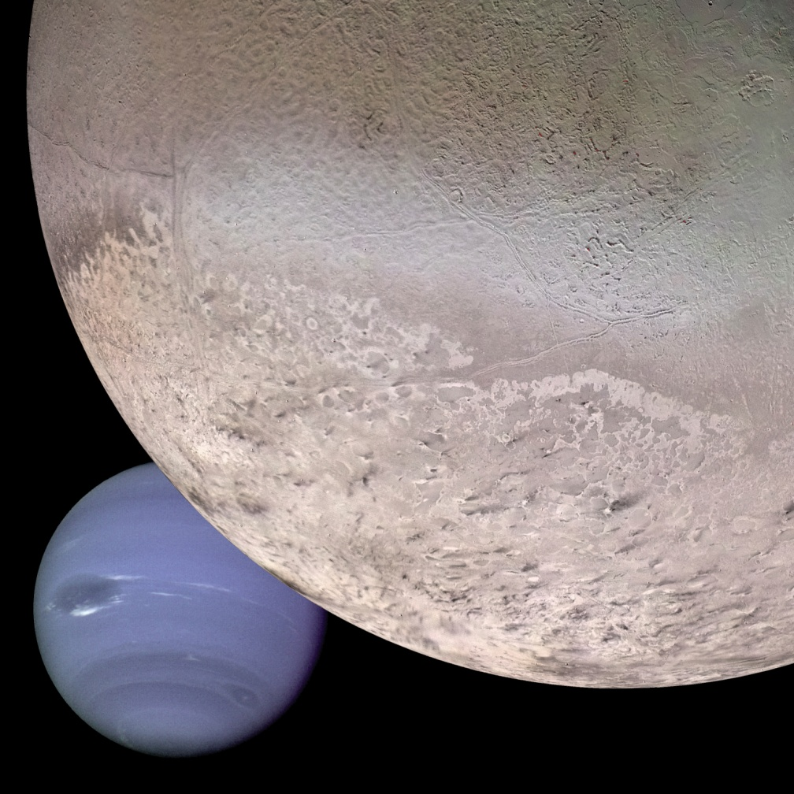

Slide 13
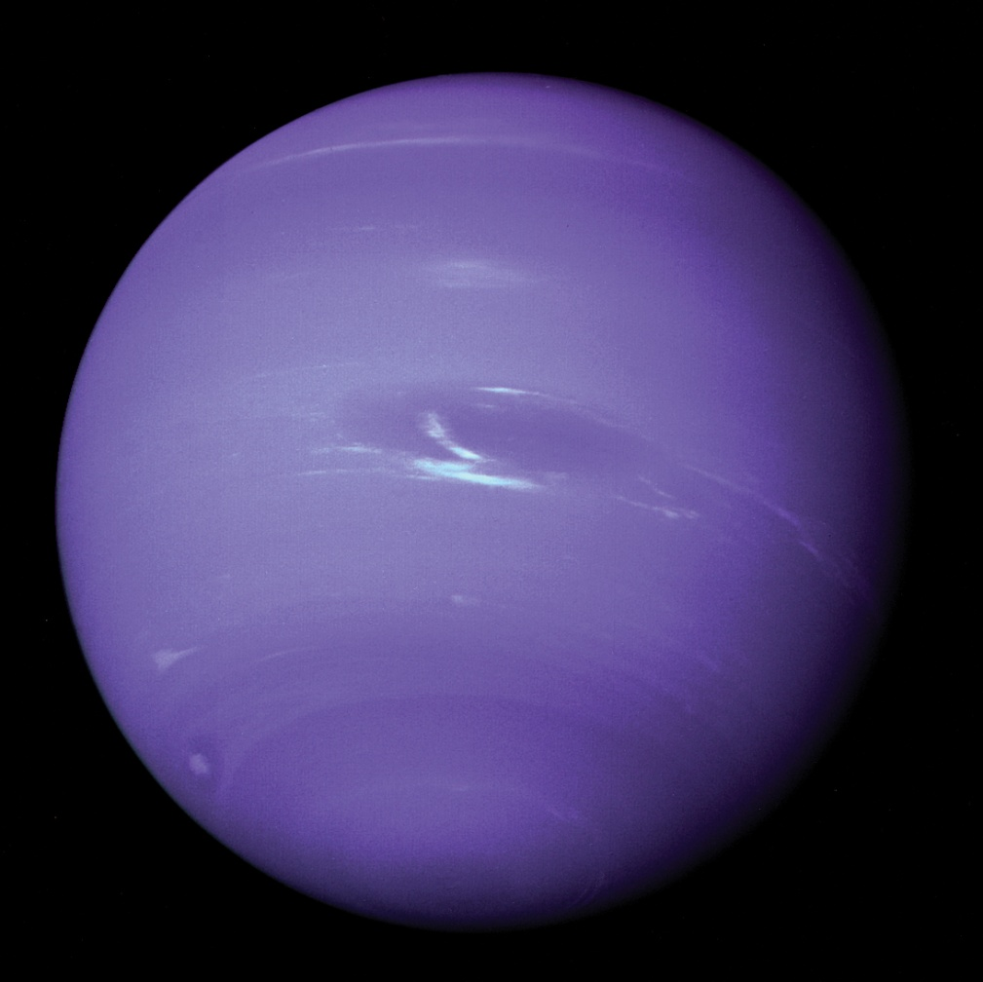

Slide 14
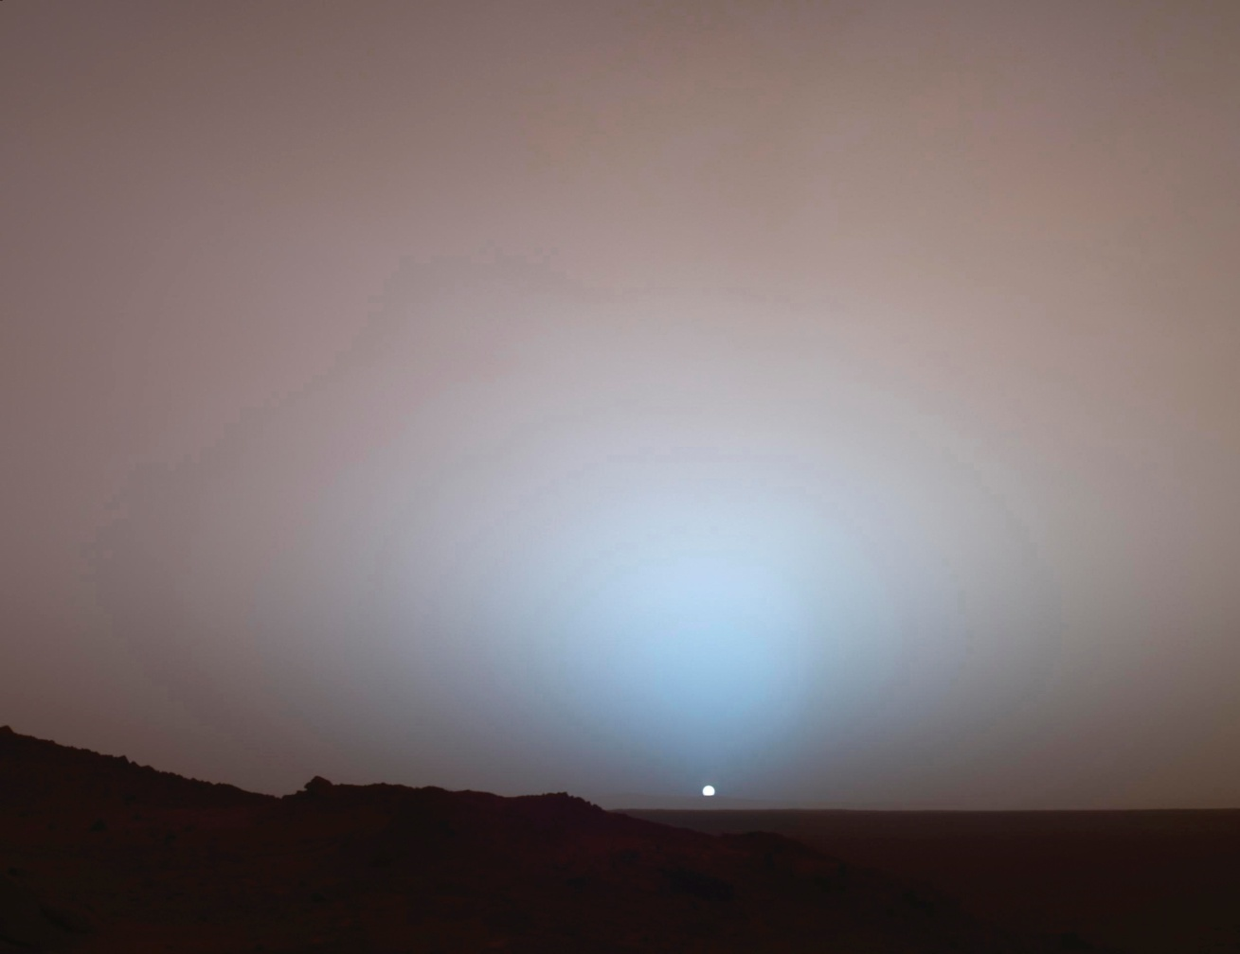

Slide 15
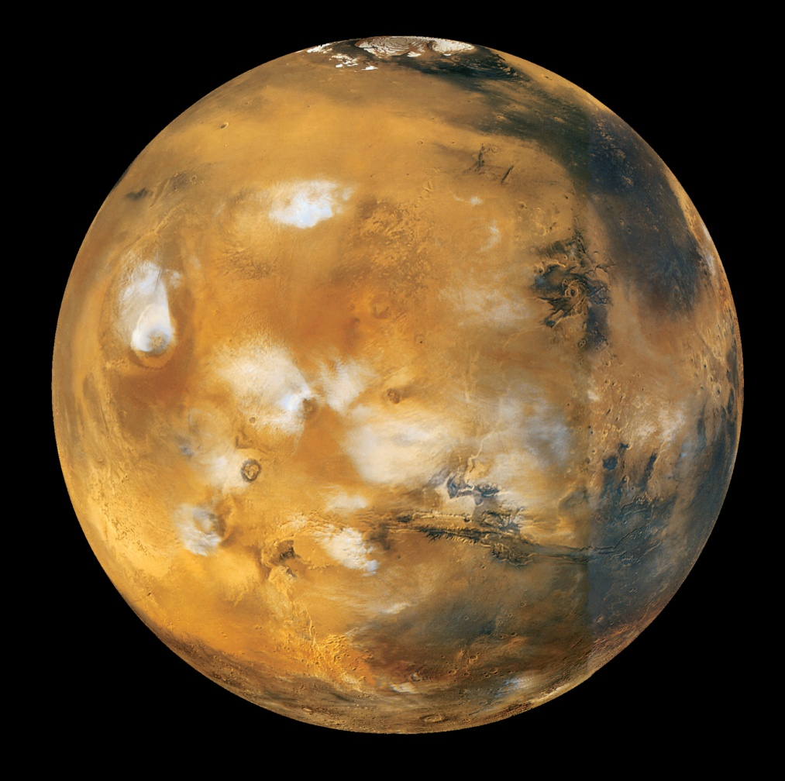

Slide 16
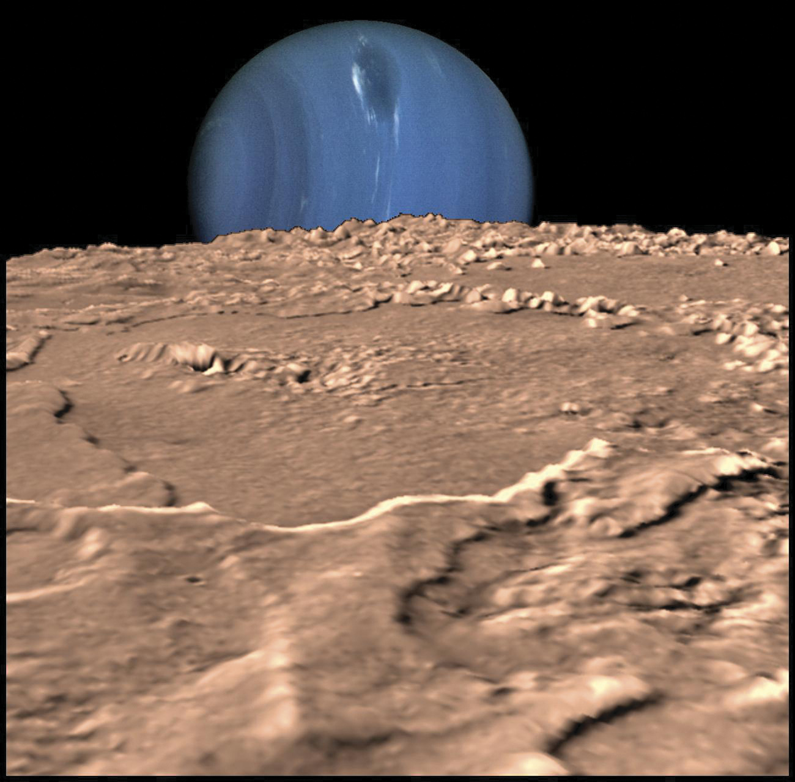

Slide 17
Human life is Sacred because:
1. We are special to God.
2. God Himself created us.

Slide 18
2. Human life is sacred because God created us.
“You made him a little lower than the heavenly beings (angels).” (Ps. 8:5)
“Let us make man in our image, in our likeness…” Genesis 1:26

Slide 19
2. God created us.
“So God created man in his own image, in the image of God he created him; male and female he created them.” Gen. 1:27

Slide 20
2. God created us.
“The LORD God formed the man from the dust of the ground and breathed into his nostrils the breath of life, and the man became a living being.” Gen. 2:7

Slide 21
2. God created us.
“Do not be afraid, for I am with you…everyone who is called by my name, whom I created for my glory, whom I formed and made.” Isaiah 43:5 & 7

Slide 22
2. God created us.
“Do not be afraid, for I am with you…everyone who is called by my name, whom I created for my glory, whom I formed and made.” Isaiah 43:5 & 7

Slide 23
Human life is Sacred because:
1. We are special to God.
2. God Himself created us.
3. God gave us dominion over all of creation.

Slide 24
3. Human life is sacred because God gave us Dominion over the rest of creation.
“You made him ruler over the works of your hands; you put everything under his feet.” Psalm 8:6

Slide 25
3. God gave man dominion.
“Be fruitful and increase in number; fill the earth and subdue it. Rule over the fish of the sea and the birds of the air and over every living creature that moves on the ground.” Gen. 1:28

Slide 26
3. God gave man dominion.
“Be fruitful and increase in number; fill the earth and subdue it. Rule over the fish of the sea and the birds of the air and over every living creature that moves on the ground.” Gen. 1:28

Slide 27
3. God gave us dominion.
“This is the divine Magna Charta for all true scientific and material progress….He is commanded to “subdue,” i.e. acquire a knowledge and mastery over his material environment, to bring its elements into the service of the race.” (Scofield note)

Slide 28
3. God gave man dominion.
“Then God said, “I give you every seed-bearing plant on the face of the whole earth and every tree that has fruit with seed in it. They will be yours for food.” Gen. 1:29

Slide 29
1 Cor. 15:27
“For he “has put everything under his feet.” Now when it says that “everything” has been put under him, it is clear that this does not include God himself, who put everything under Christ.”

Slide 30
Human life is Sacred because:
1. We are special to God.
2. God Himself created us.
3. God gave us dominion over all of creation.

Slide 31
4. Human life is sacred because God Himself became MAN.
“But we see Jesus, who was made a little lower than the angels, now crowned with glory and honor because he suffered death, so that by the grace of God he might taste death for everyone.” Hebrews 2:9

Slide 32
Evolution disagrees with every point!!!!

Slide 33
1. Evolution says there is No God.
Human life is sacred because we are special to God.

Slide 34
1. Evolution says there is No God.
Theistic evolution tries to say both are true, God just used evolution to accomplish it, but the Bible’s account is not taken literally.

Slide 35
2. Evolution says man evolved.
Human life is sacred because God created us.
Evolution=from the goo, to you, through the zoo.

Slide 36
3. Evolution says man is only an animal, like an advanced monkey/primate.
Human life is sacred because God gave us dominion over the rest of creation.

Slide 37
4. Evolution Denies Jesus is the Creator God become man.
Human life is sacred because God Himself became man.

Slide 38
What is Man?
You need to decide.
What/who was Neanderthal man? Piltdown man? Java man? Peking man? Cro-Magnon man?
Where do dinosaurs fit in?
Could God really have created the universe in 6 days?

Slide 39


