Slide 1


Slide 2
THE MYSTERY OF THE MIDDLE WALL
EPHESIANS 3:1-12

Slide 3
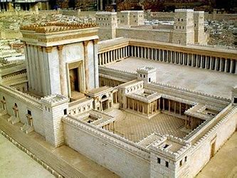

Slide 4
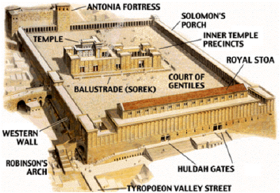

Slide 5
GOD’S PLAN FOR THIS CHURCH AGE
Ephesians 3:1-12
“A MYSTERY MADE KNOWN TO [PAUL],”
“BY REVELATION .” (3:2)

Slide 6
MYSTERY
Something unknown to previous generations, but now revealed.

Slide 7
1. The Plan of God Revealed (3:1-9a)
Not that Gentiles would be saved.
Not that Christ would die.

Slide 8
1. The Plan of God Revealed (3:6)
“This mystery is that through the gospel the Gentiles are heirs together with Israel, members together of one body, and sharers together in the promise in Christ Jesus.” (3:6)

Slide 9
1. The Plan of God Revealed (3:6)
LEGALLY= Changed and included, as “Heirs together with Israel.”

Slide 10
1. The Plan of God Revealed (3:6)
VITALLY = Changed and included , as “Members together of one body.”

Slide 11
1. The Plan of God Revealed (3:6)
SOCIALLY = Changed and included as “Sharers together in the promise in Christ Jesus.”

Slide 12
1. The Plan of God Revealed (3:6)
“This mystery is that through the gospel the Gentiles are heirs together with Israel, members together of one body, and sharers together in the promise in Christ Jesus.” (3:6)

Slide 13
1. The Plan of God Revealed (3:7-8)
Paul was only– “a servant of this gospel.”
“God’s grace given me.”
“I am less than the least of all God’s people.”
“This grace was given me.”

Slide 14
1. The Plan of God Revealed (3:8b)
“…To preach to the Gentiles the unsearchable riches of Christ.”

Slide 15
1. The Plan of God Revealed (3:9a)
“…And to make plain to everyone the administration of this mystery.”

Slide 16
2. The Purpose of the Mystery (3:9b-11)
Why a mystery?
“Which for ages past was kept hidden in God…” (3:9b)

Slide 17
2. The Purpose of the Mystery (3:10).
“His intent was that now, through the church, the manifold wisdom of God should be made known to the rulers and authorities in the heavenly realms.”

Slide 18
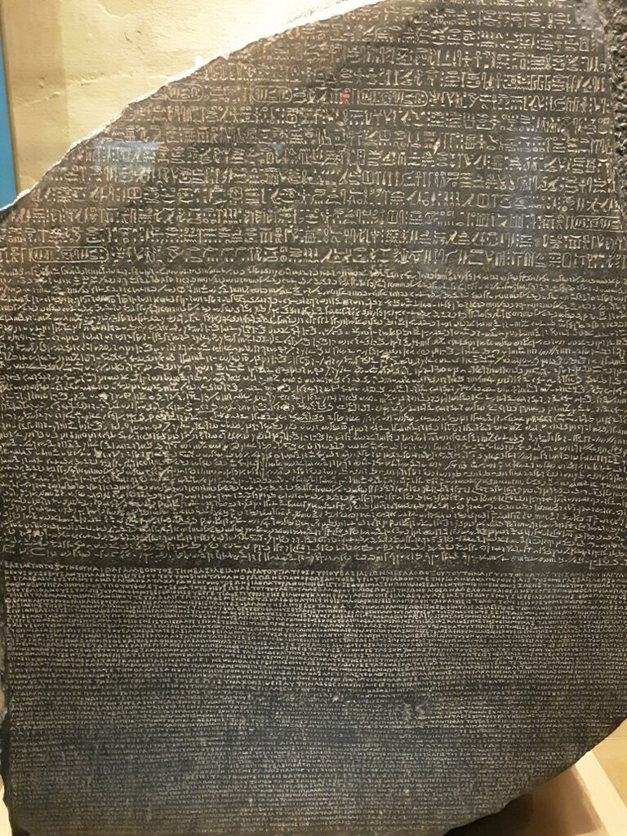
The Rosetta Stone

Slide 19
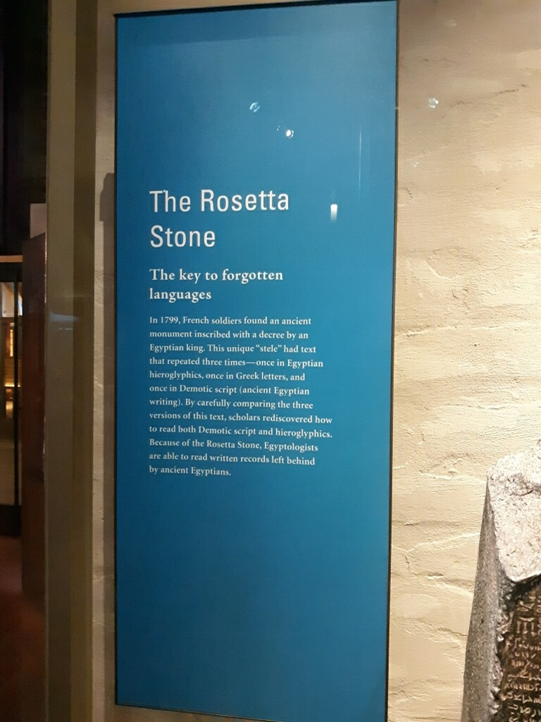

Slide 20
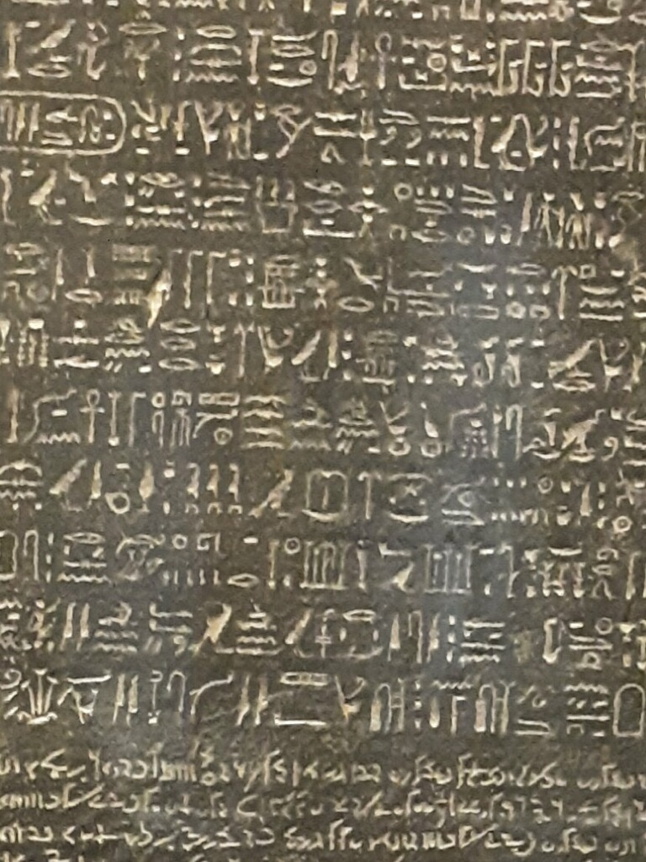
Hieroglyphics

Slide 21
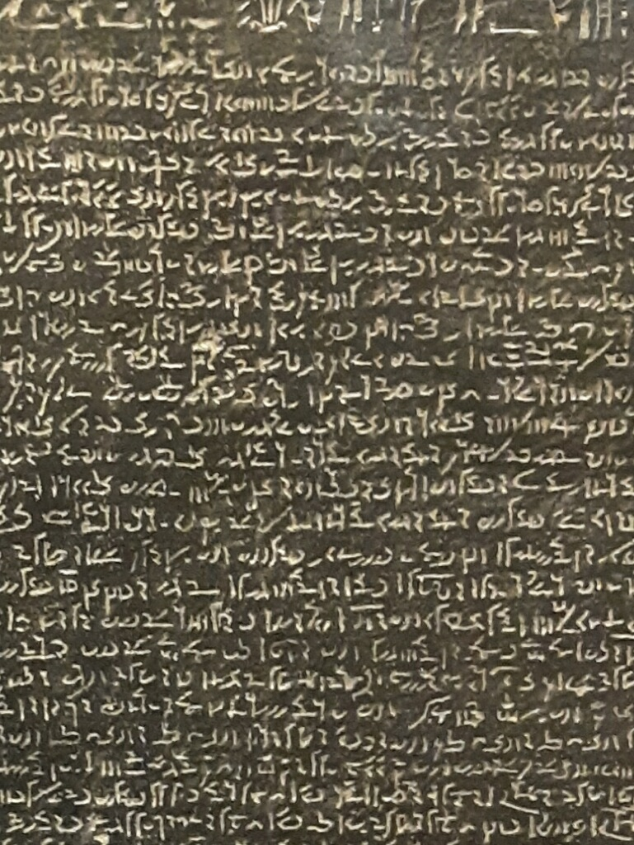
Demotic--
Ancient Egyptian

Slide 22
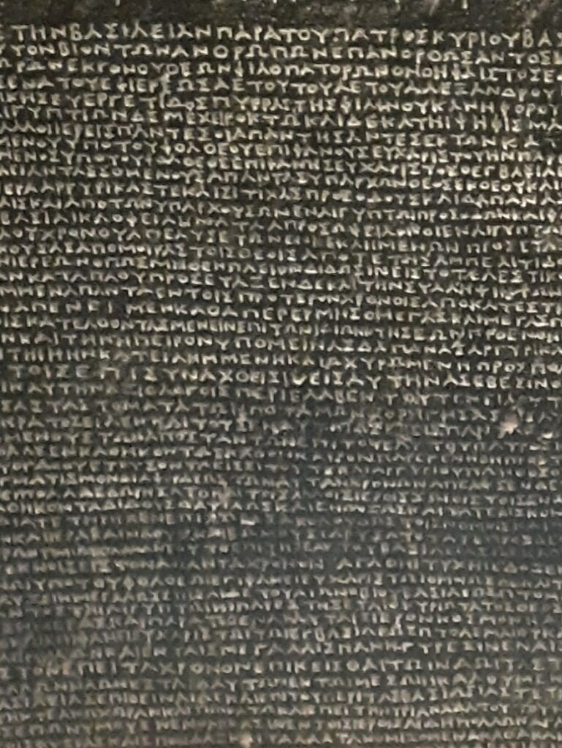
Greek

Slide 23
The Rosetta Stone

Slide 24
2. The Purpose of the Mystery (3:11)
“According to his eternal purpose which he accomplished in Christ Jesus our Lord.”

Slide 25
3. The Privilege of the Mystery (12)
“In him and through faith in him we may approach God with freedom and confidence.”

Slide 26
3. The Privilege of the Mystery (12)
Courage--- To approach God.
Access--- Freedom to approach God.
Confidence--- To talk/pray to God about anything.

Slide 27
3. The Privilege of the Mystery (12)

Slide 29
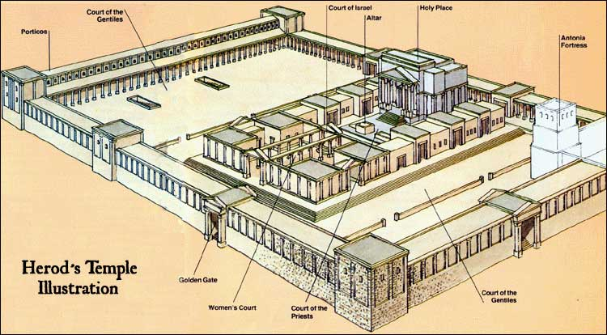

Slide 31
