Slide 1
LIVING A LIFE WORTHY OF YOUR CALLING
EPHESIANS 4:1-16

Slide 3
LIVING A LIFE WORTHY OF YOUR CALLING
EPHESIANS 4:1-16

Slide 4
EPHESIANS 1-3
DOCTRINAL BASIS of all that will follow in 4-6.

Slide 5
EPHESIANS 4-6
DUTY/ RESPONSIBILITY in Christ.

Slide 6
EPH. 1-3/ EPH. 4-6
DOCTRINE

Slide 7
EPH. 1-3/ EPH. 4-6
DOCTRINE-----DUTY.

Slide 8
EPH. 1-3/ EPH. 4-6
DOCTRINE-----DUTY.
RICHES

Slide 9
EPH. 1-3/ EPH. 4-6
DOCTRINE-----DUTY.
RICHES-----RESPONSIBILTIES.

Slide 10
EPH. 1-3/ EPH. 4-6
DOCTRINE-----DUTY.
RICHES---------RESPONSIBILTIES.
WEALTH

Slide 11
EPH. 1-3/ EPH. 4-6
DOCTRINE-----DUTY.
RICHES---------RESPONSIBILTIES.
WEALTH-------WALK.

Slide 12
EPH. 1-3/ EPH. 4-6
DOCTRINE-----DUTY.
RICHES---------RESPONSIBILTIES.
WEALTH-------WALK.
POSITION

Slide 13
EPH. 1-3/ EPH. 4-6
DOCTRINE---DUTY.
RICHES-------RESPONSIBILTIES.
WEALTH-----WALK.
POSITION—PRACTICAL RESPONSE.

Slide 14
LIKE ISRAEL
MOSES

Slide 15
LIKE ISRAEL
MOSES---JOSHUA

Slide 16
LIKE ISRAEL
MOSES---JOSHUA
THE PROMISED LAND---

Slide 17
LIKE ISRAEL
MOSES---JOSHUA
THE PROMISED LAND---TAKE THE PROMISED LAND.

Slide 18
EPHESIANS 4:1-16
LET’S TAKE THIS PROMISED LAND!

Slide 19
EPH. 4:1
“As a prisoner for the Lord, then, I urge you to live a life worthy of the calling you have received.”

Slide 20
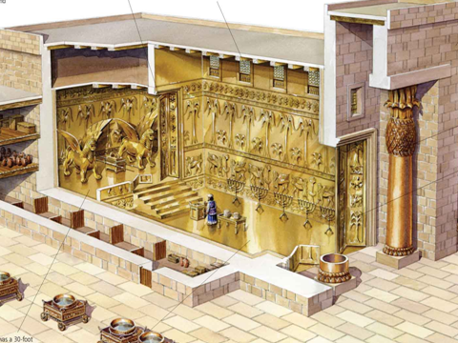

Slide 21
EPH. 4:1
“As a prisoner for the Lord, then,…
…I urge you…
…to live a life worthy of the calling you have received.”

Slide 22
EPH. 4:3
“Make every effort …
…to keep the unity of the Spirit…
… through the bond of peace.”

Slide 23
“I URGE/BEG YOU…”
Live a life worthy…

Slide 24
“I URGE/BEG YOU…”
Live a life worthy…
Keep the unity of the Spirit…

Slide 25
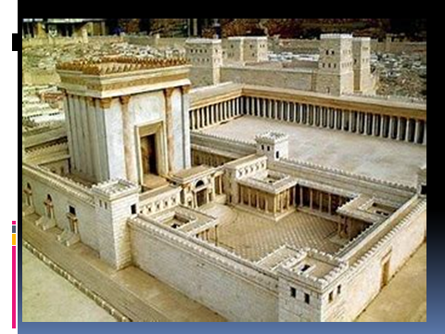

Slide 26
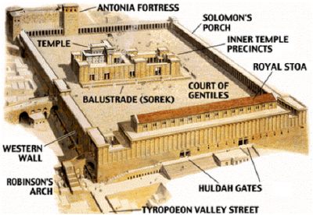

Slide 27
“I URGE/BEG YOU…”
“Keep the unity of the Spirit…”---This is the main idea of this whole section of Scripture (4:1-16), until we all reach the unity in the faith (4:13).

Slide 28
“I URGE/BEG YOU…”
“Keep the unity of the Spirit…”---This is the main idea of this whole section of Scripture (4:1-16), until we all reach the unity in the faith (4:13).

Slide 29
“I URGE/BEG YOU…”
“Keep the unity of the Spirit…”---This is the main idea of this whole section of Scripture (4:1-16), until we all reach the unity in the faith (4:13).

Slide 30
HOW TO WALK WORTHY (1-3)
HUMBLE– To think or judge with lowliness.
The Romans and Greeks did not have a word for humility. It was foreign and abhorrent to them. (John Wesley)

Slide 31
HOW TO WALK WORTHY
HUMBLE
GENTLE

Slide 32
HOW TO WALK WORTHY
HUMBLE
GENTLE– “Meekness” (KJV). Mild spirited, self-controlled. Used of a wild animal now tamed.

Slide 33
HOW TO WALK WORTHY
HUMBLE
GENTLE
PATIENT

Slide 34
HOW TO WALK WORTHY
HUMBLE
GENTLE
PATIENT– “Long-suffering” (KJV). To endure negative circumstances and not give in to them.

Slide 35
HOW TO WALK WORTHY
HUMBLE
GENTLE
PATIENT
LOVING

Slide 36
HOW TO WALK WORTHY
HUMBLE
GENTLE
PATIENT
LOVING– Agape love, it gives continuously and unconditionally.

Slide 37
HOW TO WALK WORTHY
HUMBLE
GENTLE
PATIENT
LOVING
PEACE

Slide 38
HOW TO WALK WORTHY
HUMBLE
GENTLE
PATIENT
LOVING
PEACE– The bond that holds God’s people together.

Slide 39
WHY WE KEEP THE UNITY (4-6)
ONE BODY

Slide 40
WHY WE KEEP THE UNITY (4-6)
ONE BODY-- We are one with every other Christian. There is no Jew, Gentile, male, female, slave or free in this body.

Slide 41
WHY WE KEEP THE UNITY
ONE BODY
ONE SPIRIT

Slide 42
WHY WE KEEP THE UNITY
ONE BODY
ONE SPIRIT– The Holy Spirit.

Slide 43
WHY WE KEEP THE UNITY
ONE BODY
ONE SPIRIT
ONE HOPE

Slide 44
WHY WE KEEP THE UNITY
ONE BODY
ONE SPIRIT
ONE HOPE– Christ likeness, eternal perfection and glory.

Slide 45
WHY WE KEEP THE UNITY
ONE BODY
ONE SPIRIT
ONE HOPE
ONE LORD

Slide 46
WHY WE KEEP THE UNITY
ONE BODY
ONE SPIRIT
ONE HOPE
ONE LORD—No other name under heaven whereby we must be saved.

Slide 47
WHY WE KEEP THE UNITY
ONE BODY
ONE SPIRIT
ONE HOPE
ONE LORD
ONE FAITH

Slide 48
WHY WE KEEP THE UNITY
ONE BODY
ONE SPIRIT
ONE HOPE
ONE LORD
ONE FAITH– The doctrine revealed in the NT.

Slide 49
WHY WE KEEP THE UNITY
ONE BODY
ONE SPIRIT
ONE HOPE
ONE LORD
ONE FAITH
ONE BAPTISM

Slide 50
WHY WE KEEP THE UNITY
ONE BODY
ONE SPIRIT
ONE HOPE
ONE LORD
ONE FAITH
ONE BAPTISM– Spirit baptism and water baptism in the name of Christ.

Slide 51
WHY WE KEEP THE UNITY
ONE BODY
ONE SPIRIT
ONE HOPE
ONE LORD
ONE FAITH
ONE BAPTISM
ONE GOD AND FATHER OF ALL

Slide 52
WHY WE KEEP THE UNITY
ONE BODY
ONE SPIRIT
ONE HOPE
ONE LORD
ONE FAITH
ONE BAPTISM
ONE GOD AND FATHER OF ALL

Slide 53
GOD GIVES GRACE/GIFTS (7-16)

Slide 54
GOD GIVES GRACE/GIFTS (7-16)
“Grace has been given as Christ apportioned it” (7).

Slide 55
GOD GIVES GRACE/GIFTS (7-16)
APOSTLES

Slide 56
GOD GIVES GRACE/GIFTS (7-16)
APOSTLES
PROPHETS

Slide 57
GOD GIVES GRACE/GIFTS (7-16)
APOSTLES
PROPHETS
EVANGELISTS

Slide 58
GOD GIVES GRACE/GIFTS (7-16)
APOSTLES
PROPHETS
EVANGELISTS
PASTORS

Slide 59
GOD GIVES GRACE/GIFTS (7-16)
APOSTLES
PROPHETS
EVANGELISTS
PASTORS
TEACHERS

Slide 60
GOD GIVES GRACE/GIFTS (7-16)
APOSTLES
PROPHETS
EVANGELISTS
PASTORS AND TEACHERS

Slide 61
GOD GIVES GRACE/GIFTS (7-16)
APOSTLES
PROPHETS
EVANGELISTS
PASTORS AND TEACHERS
TO PREPARE (equip, train) GOD’S PEOPLE…

Slide 62
GOD GIVES GRACE/GIFTS (7-16)
APOSTLES
PROPHETS
EVANGELISTS
PASTORS AND TEACHERS
TO PREPARE GOD’S PEOPLE…
SO THAT…

Slide 63
WHAT SHOULD HAPPEN…

Slide 64
WHAT SHOULD HAPPEN…
WORKS OF SERVICE (12)

Slide 65
WHAT SHOULD HAPPEN…
UNITY IN THE FAITH (13)

Slide 66
WHAT SHOULD HAPPEN…
UNITY IN THE FAITH (13a).
UNITY IN THE KNOWLEDGE OF THE SON OF GOD (13b).

Slide 67
WHAT SHOULD HAPPEN…
UNITY IN THE FAITH (13a).
UNITY IN THE KNOWLEDGE OF THE SON OF GOD (13b).
MATURITY (13c)

Slide 68
WHAT SHOULD HAPPEN…
UNITY IN THE FAITH (13a).
UNITY IN THE KNOWLEDGE OF THE SON OF GOD (13b).
MATURITY (13c).
FULLNESS OF CHRIST (13d).

Slide 69
WHAT SHOULD HAPPEN…
UNITY IN THE FAITH (13a).
UNITY IN THE KNOWLEDGE OF THE SON OF GOD (13b).
MATURITY (13c).
FULLNESS OF CHRIST (13d).
STABILITY—not tossed about (14).

Slide 70
WHAT SHOULD HAPPEN…
UNITY IN THE FAITH (13a).
UNITY IN THE KNOWLEDGE OF THE SON OF GOD (13b).
MATURITY (13c).
FULLNESS OF CHRIST (13d).
STABILITY (14).
GROW UP IN ALL THINGS (15).

Slide 71
WHAT SHOULD HAPPEN…
UNITY IN THE FAITH (13a).
UNITY IN THE KNOWLEDGE OF THE SON OF GOD (13b).
MATURITY (13c).
FULLNESS OF CHRIST (13d).
STABILITY (14).
GROW UP IN ALL THINGS (15).
BUILD UP IN LOVE (16).

Slide 72
Ephesians 4:16
“AS EACH PART DOES ITS WORK.”

Slide 73
LIVING A LIFE WORTHY OF YOUR CALLING
EPHESIANS 4:1-16

Slide 74
EPH. 4:1
“As a prisoner for the Lord, then, I urge you to live a life worthy of the calling you have received.”

Slide 75
EPH. 4:3
“Make every effort …
…to keep the unity of the Spirit…
… through the bond of peace.”

Slide 76
“I URGE/BEG YOU…”
“Keep the unity of the Spirit…”---This is the main idea of this whole section of Scripture (4:1-16), until we all reach the unity in the faith (4:13).

