Slide 1
WHAT DIFFERENCE DOES IT MAKE?
1 CORINTHIANS 15:12-28

Slide 2
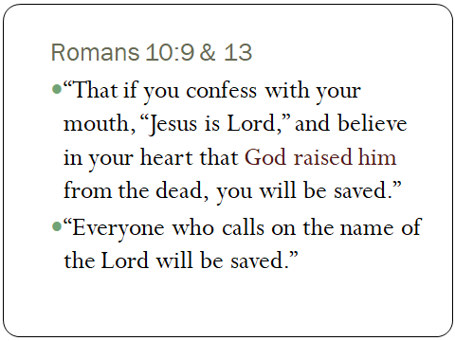

Slide 3
1 Cor. 15:12-28

Slide 4
4 Reasons the Resurrection is of
1st Importance

Slide 5
1. Proves the Penalty was Paid
1 Cor. 15:14– “If Christ has not been raised, our preaching is useless and so is your faith.”

Slide 6
1. Proves the Penalty was Paid
Romans 4:25– “He was delivered over to death for our sins and was raised to life for (because of-NAS) our justification.”
Why die? For our sins.
Why raised? On account of our justification.

Slide 7
1. Proves the Penalty was Paid
On the cross-- “It is finished.”
1 John 2:2-- “He is the atoning sacrifice for our sins, and not only for ours but also for the sins of the whole world.”

Slide 8
2. Provides Profound Power
1 Cor. 15:17– “If Christ has not been raised, your faith is futile; you are still in your sins.”

Slide 9
2. Provides Profound Power
Phil. 3:10– “I want to know Christ and the power of his resurrection…”

Slide 10
2. Provides Profound Power
Ephesians 1:19-20– “…His incomparably great power for us who believe. That power is like the working of his mighty strength, which he exerted in Christ when he raised him from the dead...”

Slide 11
2. Provides Profound Power

Slide 12
3. Proves Predicted Prophecy
1 Cor. 15:20, 23– Christ “the first fruits of those who have fallen asleep.”
“First Fruits” – An OT sacrifice of the first ripe of the crop or of the tree, offered on the Day of First fruits– Pentecost.

Slide 13
3. Proves Predicted Prophecy
Romans 1:4– “Declared with power to be the Son of God by his resurrection from the dead: Jesus Christ our Lord.”

Slide 14
3. Proves Predicted Prophecy
John 10:18– “No one takes it from me, but I lay it down of my own accord. I have authority to lay it down and authority to take it up again. This command I received from my Father.”

Slide 15
3. Proves Predicted Prophecy
John 10:33– “We are not stoning you for any of these,” replied the Jews, “but for blasphemy, because you, a mere man, claim to be God.”

Slide 16
3. Proves Predicted Prophecy
John 2:18, 19– “What miraculous sign can you show us to prove your authority to do all this?” Jesus answered them, “Destroy this temple, and I will raise it again in 3 days.”

Slide 17
3. Proves Predicted Prophecy
John 19:7– “The Jews insisted, “We have a law, and according to that law he must die, because he claimed to be the Son of God.”

Slide 18
3. Proves Predicted Prophecy
Romans 1:4– “Declared with power to be the Son of God by his resurrection from the dead: Jesus Christ our Lord.”

Slide 19
3. Proves Predicted Prophecy

Slide 20
4. Provides the Promised Place
1 Cor. 15:24-28— “Then the end will come, when he hands over the kingdom to God the Father…”
“He must reign until he has put all his enemies under his feet. The last enemy to be destroyed is death.”

Slide 21
4. Provides the Promised Place
John 14:1-3– “In my Father’s house…I am going there to prepare a place for you…”

Slide 23
4 Reasons
1. Proves the Penalty was Paid
2. Provides Profound Power
3. Proves Predicted Prophecy
4. Provides the Promised Place

