Slide 1
FINISH THE RACE
ACTS 20:18-38

Slide 2
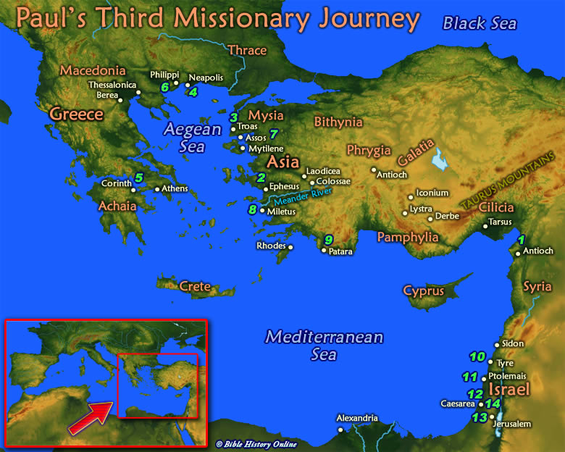

Slide 3
ACTS 18:23—21:16
3RD MISSIONARY JOURNEY PROBABLY 4 YEARS, A.D. 53-57.
OVERLAND TO EPHESUS—3 YEARS.
THRU MACEDONIA AND ACHAIA ,
TO CORINTH.
RETRACE STEPS TO MILETUS TO MEET THE ELDERS OF EPHESUS.
ON TO JERUSALEM FOR PENTECOST.

Slide 11
FINISH THE RACE
ACTS 20:16-38

Slide 12
PAUL’S FAREWELL MESSAGE
A LOOK BACK—20:18-21.
THE VERBS ARE IN THE PAST TENSE.

Slide 13
1. A LOOK BACK 18-21
MOTIVE— “I served the Lord.”
EXAMPLE--- “You know how I lived.”
BUSINESS--- “Taught you…”
MESSAGE--- “Turn to God in repentance and have faith in our Lord Jesus.”

Slide 14
2. A LOOK AHEAD 22-27
“And now…”
“I consider my life worth nothing to me, if only I may finish the race and complete the task the Lord Jesus has given me– the task of testifying to the gospel of God’s grace.” 24.

Slide 15
3. A LOOK INWARD 28-35
Keep watch—28
Be shepherds–-28

Slide 16
3. A LOOK INWARD 28-35
6 Dangers
1. Savage wolves –29.
2. Carelessness—31.
3. Shallowness—32.
4. Coveteousness—33.
5. Laziness—34.
6. Selfishness—35.

Slide 17
4. A LOOK UPWARD-32
“An inheritance among all those who are sanctified.”

Slide 18
FINISH THE RACE
1. A LOOK BACKWARD
2. A LOOK FORWARD
3. A LOOK INWARD
4. A LOOK UPWARD

