Slide 1
WHEAT & WEEDS
ACTS 19:1-20

Slide 2
ACTS 18:21 at the end of the
2nd Miss. Journey
“But as he left [Ephesus] , he promised, “I will come back if it is God’s will.”

Slide 3
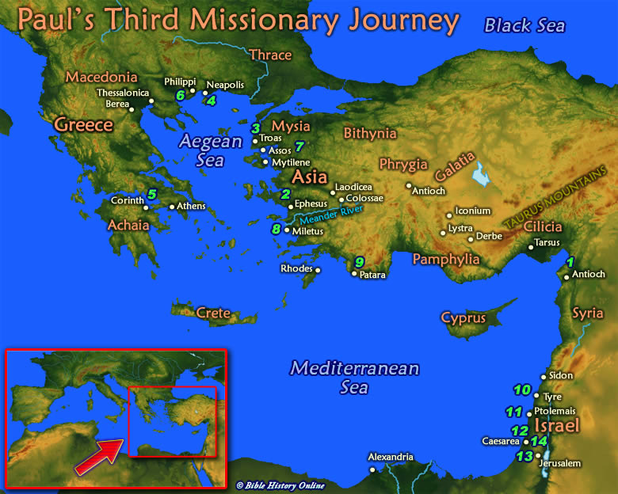
3RD MISS. JOURNEY

Slide 4
3RD MISSSIONARY JOURNEY
ANTIOCH– 18:23
GALATIA– 18:23
PHRYGIA– 18:23
EPHESUS– 19:1

Slide 9
Acts 19:1-20
From Antioch to Ephesus is about 600 miles!

Slide 10
NOTICE 4 GROUPS CHARACTERISTIC
OF MOST CHURCHES

Slide 11
1. ACTS 19:1-7
“BELIEVERS,” but not born-again!
In this transition period they are sort of like Old Testament believers.

Slide 12
Romans 8:9
“If anyone does not have the Spirit of Christ, he does not belong to Christ.”

Slide 13
Romans 8:16
“The Spirit himself testifies with our spirit that we are God’s children.”

Slide 14
Eph. 1:13-14
“Having believed, you were marked in him with a seal, the promised Holy Spirit, who is a deposit guaranteeing our inheritance until the redemption of those who are God’s possession—to the praise of his glory.”

Slide 15
1 John 5:11
“God has given us eternal life, and this life is in his Son. He who has the Son has life; he who does not have the Son of God does not have life.”

Slide 16
2. UNBELIEVERS
Acts 19:8-10
“Some of them became obstinate; they refused to believe and publicly maligned the Way.”
They hardened their hearts

Slide 17
3. IMPOSTERS
Acts 19:11-16
7 sons of Sceva.
Exorkiston, only place in the Bible (19:13).

Slide 18
Satan’s forces had prob. Co-operated with them in the past to let them appear to be real.
Like Pharaoh’s magicians, and others still to this day.

Slide 19
Matt. 7:21ff
“…Lord, Lord, did we not prophesy in your name, and in your name drive out demons and perform many miracles?”

Slide 20
Matt. 24:4
“Jesus answered, “Watch out that no one deceives you…”

Slide 21
Matt.24:24
“For false Christs and false prophets will appear and perform great signs and miracles to deceive even the elect—if that were possible.”

Slide 22
Matt. 25:31ff
“Depart from me…” 25:41
“They will answer, “Lord, when did we see you hungry?…” 25:44
“They will go away to eternal punishment.” 25:46

Slide 23
Matt. 13:24-30 the parable of the wheat and tares/weeds.
“…His enemy came and sowed weeds among the wheat…”

Slide 24
4. COMMITTED BELIEVERS
Acts 19:17-20
“Many of those who believed now came and openly confessed their evil deeds [practices].”

Slide 25
Kept on openly confessing (imperfect tense) and disclosing their evil practices (secret magic spells).

Slide 26
Burned their scrolls – hand crafted and very expensive.
50,000 drachmas=a piece of silver equal to a day’s wage!
150 years salary! $15 million @ $100k/yr.

Slide 27
Acts 19:20
“In this way the word of the Lord spread widely and grew in power.”

Slide 28
Paul had the heart of a shepherd.
He leads the sheep to the heart of The Shepherd.

Slide 29
Acts 20:28
“Keep watch over yourselves and all the flock of which the Holy Spirit has made you overseers.”

Slide 30
Acts 20:28
“Be shepherds of the church of God, which he bought with his own blood.”

Slide 31
Acts 20:29
“I know that after I leave, savage wolves will come in among you and will not spare the flock.”

Slide 32
4 GROUPS
1. “BELIEVERS” BUT LOST.
2. UNBELIEVERS.
3. IMPOSTERS.
4. TRUE BELIEVERS.

