Slide 1
A CHURCH ON A MISSION
ACTS 15:36-16:10

Slide 2
A CHURCH WITH A MISSION
ACTS 15:36-16:10

Slide 3
CHURCH
ON A MISSION
ACTS 15:36-16:10

Slide 4
A CHURCH
ON MISSION
ACTS 15:36-16:10

Slide 5
CHURCH ON A MISSION
ACTS 15:36-16:10

Slide 6
CHURCH ON MISSION
ACTS 15:36-16:10

Slide 7
HOW TO DISCERN GOD’S WILL
When I was a child….
At crucial points in life we make big decisions that affect us for years to come.

Slide 8
ACTS 15:36-16:10

Slide 9
1. THE CHURCH’S PLAN
Acts 15:22-- “Then the apostles and elders, with the whole church, decided….”
Acts 15:40-- “Commended by the brothers to the grace of the Lord.”

Slide 10
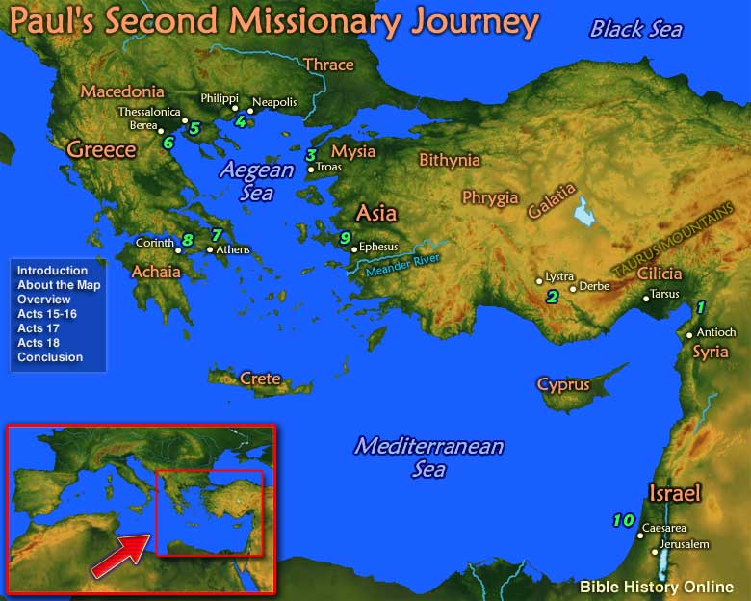

Slide 11
2. PAUL’S PLAN
Acts 15:36– “Some time later Paul said to Barnabas, “Let us go back and visit the brothers in all the towns where we preached the word of the Lord and see how they are doing.”

Slide 13
PAUL’S PASSION
Acts 15:36– “Let us go back and visit the brothers in all the towns where we preached the word of the Lord….”

Slide 14
Hudson Taylor (1832-1905)
“I have a stronger desire than ever to go to China. That land is ever in my thoughts. Think of it—360,000,000 souls, w/o God or hope in the world! Poor, neglected China! Scarcely anyone cares about it.”

Slide 15
MISSIONARY MENTALITY
“A missionary mentality is a key component… transformational churches know, understand, and are deeply in love with their cities, communities, and people.” (Stetzer & Rainer)

Slide 16
3. BARNABAS’ PLAN
Acts 15:37– “Barnabas wanted to take John, also called Mark, with them, but Paul….”

Slide 17
3. BARNABAS’ PLAN
Acts 15:39– “Barnabas took Mark and sailed for Cyprus….”

Slide 19
Acts 15:41
Paul and Silas... “went through Syria and Cilicia, strengthening the churches.”

Slide 21
Acts 16:1
Paul and Silas, “Came to Derbe and then to Lystra…”

Slide 23
ACTS 16:6
“Paul and his companions traveled throughout the region of Phrygia and Galatia.”

Slide 25
ACTS 16:7
“Paul and his companions … came to the border of Mysia….”

Slide 27
ACTS 16:6ff
“Paul and his companions traveled throughout the region of Phrygia and Galatia…they came to the border of Mysia…down to Troas.”

Slide 29
4. GOD’S PLAN
Acts 16:9– “During the night Paul had a vision of a man of Macedonia standing and begging him, “Come over to Macedonia and help us.”

Slide 31
4. GOD’S PLAN
Acts 16:10-- “We got ready at once to leave for Macedonia, concluding that God had called us to preach the gospel to them.”

Slide 32
5. GOD’S PERSONNEL
Acts 15:40– In Antioch--“Paul chose Silas….”

Slide 33
5. GOD’S PERSONNEL
Acts 16:1 – In Lystra--“…A disciple named Timothy….”

Slide 34
5. GOD’S PERSONNEL
Acts 16:10– In Troas--“We (now w/Luke) got ready at once to leave for Macedonia.”

Slide 35
BREAKOUT CHURCHES
(Thom Rainer)
AWARE
Of the needs

Slide 36
BREAKOUT CHURCHES
AWARE
BELIEF
That God is leading

Slide 37
BREAKOUT CHURCHES
AWARE
BELIEF
CRISIS
We must change

Slide 38
BREAKOUT CHURCHES
AWARE
BELIEF
CRISIS

Slide 39
FIRST BAPTIST CHURCH
AWARE
BELIEF
CRISIS

Slide 40
AWARE—
WHERE IS GOD WORKING?

Slide 41
BELIEF---WHERE IS GOD LEADING YOU/US?

Slide 42
CRISIS--WHAT ARE YOU/ WE GOING TO DO?

Slide 43
FIRST BAPTIST CHURCH
AWARE
BELIEF
CRISIS

