Slide 1
WHEREVER HE LEADS- I’LL GO
ACTS 13

Slide 2
1. DIRECTION FROM THE HOLY SPIRIT (13:1-5).
“Set apart for me Barnabas and Saul for the work to which I have called them.” 13:2

Slide 3
BARNABAS AND PAUL
BARNABAS=“SON OF ENCOURAGEMENT.”
SAUL=“ASKED FOR”, HEBREW.
PAUL=“LITTLE”, GREEK/ROMAN (13:9 , 1st time he is called Paul).

Slide 4
ACTS OF PAUL & THECA 3
“A man of small stature, with a bald head and crooked legs, in good state of body, with eyebrows meeting, and nose somewhat hooked, full of friendliness, for now he appeared like a man, and now he had the face of an angel.”

Slide 5
THE GOSPEL GOES TO THE CITIES
HALF OF THE WORLD LIVES IN CITIES AS OF 2013.
40 CITIES ARE MENTIONED IN ACTS.
ON THE 1ST MISSIONARY JOURNEY THEY GO TO 6 CITIES.

Slide 6
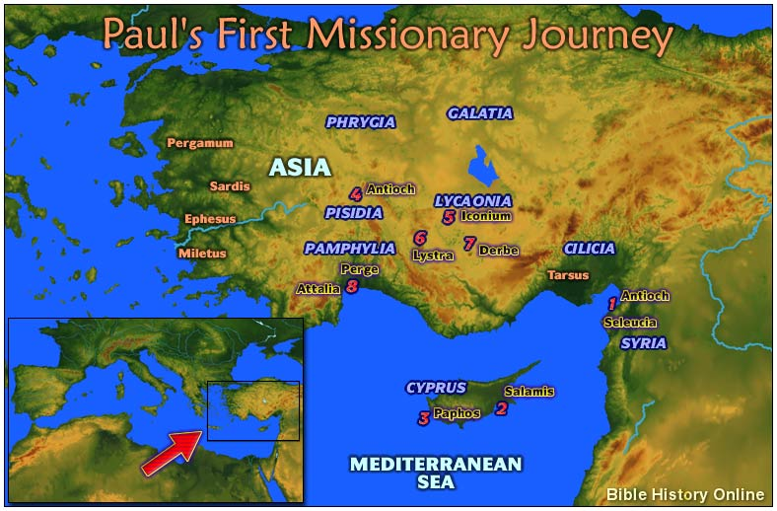

Slide 7
2. DECEPTION FROM THE DEVIL (6-12).
Satan was upset no doubt.
Sorcerer=MAGOS the same word for the Magi that came to Bethlehem.
Sergius Paulus, the proconsul becomes the 1st (named) convert of Paul.

Slide 8
3. DESERTED BY JOHN MARK (13:13).
Mark is Barnabas’ cousin (Col. 4:10).
“Deserted them…and had not continued with them in the work. They had such a sharp disagreement that they parted company.” (15:38-39).

Slide 9
4. DISCIPLE-MAKING THROUGH PREACHING (14-41).
This is the 1st recorded sermon of Paul. And it is the longest!
There are 8 recorded in Acts.

Slide 10
4. DISCIPLE-MAKING (14-41).
THREE PART SERMON.
1. PREPARATION
2. DECLARATION
3. INVITATION

Slide 11
4. DISCIPLE-MAKING (14-41).
PREPARATION: HE RECOUNTS ISRAEL’S HISTORY (16-25).
PATRIARCHS
EGYPT
40 YEARS IN WILDERNESS
CONQUER 7 NATIONS OF CANAAN
JUDGES
KINGS

Slide 12
4. DISCIPLE-MAKING (14-41).
KING DAVID (22): “I have found David son of Jesse a man after my own heart; he will do everything I want him to do.” Quote of 1 Sam. 13:14.

Slide 13
4. DISCIPLE-MAKING (14-41).
THE SAVIOR JESUS (23).
“From this man’s descendants God has brought to Israel the Savior Jesus, as He promised.”

Slide 14
4. DISCIPLE-MAKING (14-41).
DECLARATION (26-37).
The Message of Salvation (26).
They “did not recognize Jesus.” (27).
Executed (28).
Buried (29).
“But God raised him from the dead.” (30).

Slide 15
4. DISCIPLE-MAKING (14-41).
“We tell you the good news: What God promised our fathers he has fulfilled … by raising up Jesus.” (32-33).

Slide 16
4. DISCIPLE-MAKING (14-41).
Quotes Psalm 2:7.
Isaiah 55:3.
Psalm 16:10.
God not only knew, He actually planned all that happened.

Slide 17
4. DISCIPLE-MAKING (14-41).
INVITATION (38-41).
The free gift of God “through Jesus the forgiveness of sins…” (38).

Slide 18
4. DISCIPLE-MAKING (14-41).
“Through him everyone who believes is justified…” (39).
Closes with a warning from Habakkuk 1:5.

Slide 19
5. DISPUTATION BY THE JEWS (42-52).
“Since you reject it…we now turn to the Gentiles.” (46).
“The word of the Lord spread through the whole region.” (49).

Slide 20
5. DISPUTATION BY THE JEWS (42-52).
“And the disciples were filled with joy and with the Holy Spirit.” (52).

Slide 21
WHEREVER HE LEADS
DIRECTION FROM GOD
DECEPTION FROM THE DEVIL
DESERTION BY MARK
DISCIPLE-MAKING THROUGH PREACHING
DISPUTATION BY THE JEWS

