Slide 1
Being One
John 17:11, 20-23

Slide 2
John 17:11
I am no longer in the world,
but they are in the world,
and I am coming to You. Holy Father,
protect them by Your name
that You have given Me,
so that they may be one as We are one.
1/3

Slide 3
John 17:20-21
I pray not only for these,
but also for those who believe in Me
through their message.
21 May they all be one,
as You, Father, are in Me and I am in You. May they also be one in Us,
so the world may believe You sent Me.
2/3

Slide 4
John 17:22-23
I have given them the glory You have given Me.
May they be one as We are one.
23 I am in them and You are in Me.
May they be made completely one,
so the world may know You have sent Me and have loved them as You have loved Me.
3/3

Slide 5
Being One
With the Lord
In Marriage
With Family
As the Church
With Like Minded Churches
As Part of God’s Kingdom

Slide 6
Don’t Be One With
The World
Non-Believers
Those Who Change the Word of God
Those Who Ignore or Dilute the Word of God

Slide 7
Being One
With Like-Minded Churches
Is to form an “Association of Churches”

Slide 8
Being One
In the New Testament, an Association of Churches is referred to as “the Churches of” a particular Region, such as, “the Churches of Galatia.”

Slide 9
An Association of Churches
Is a Group of Like-Minded Churches
Usually Located Somewhat Close to Each Other
Who Choose to Fellowship With Each Other
Who Choose to Work Together to Advance the Gospel
Who Choose to Be One

Slide 10
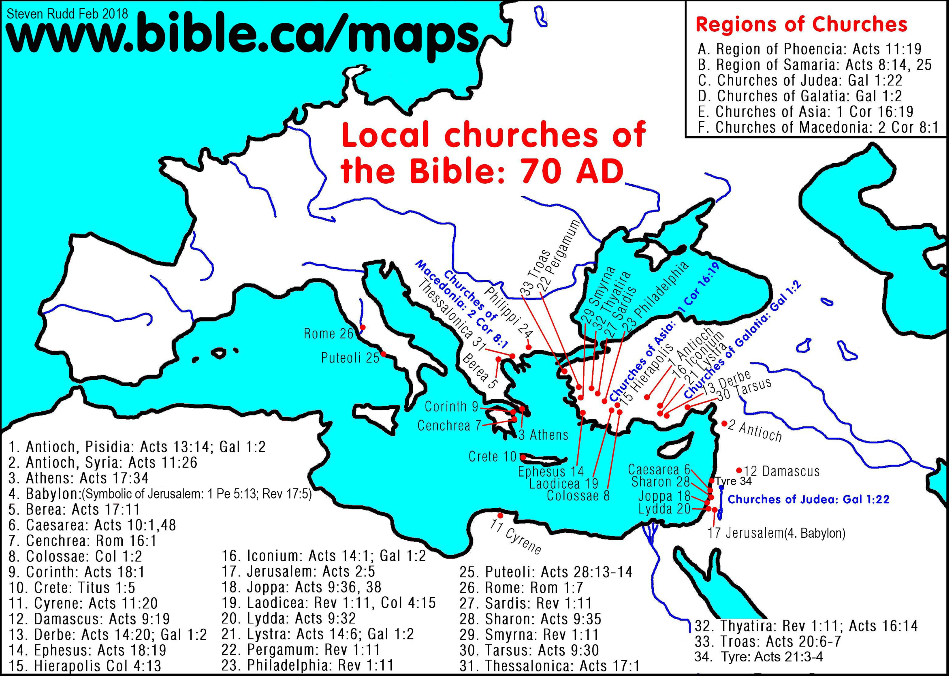
Associations of Churches in the New Testament

Slide 11
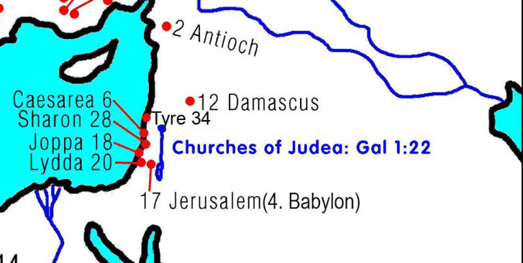
Phoenicia Association Peter and John
Cyprus
Phoenicia
1/6

Slide 12
Samaria Association Peter and John
Churches of Samaria
2/6

Slide 13
Judea Association Peter and John
3/6

Slide 14
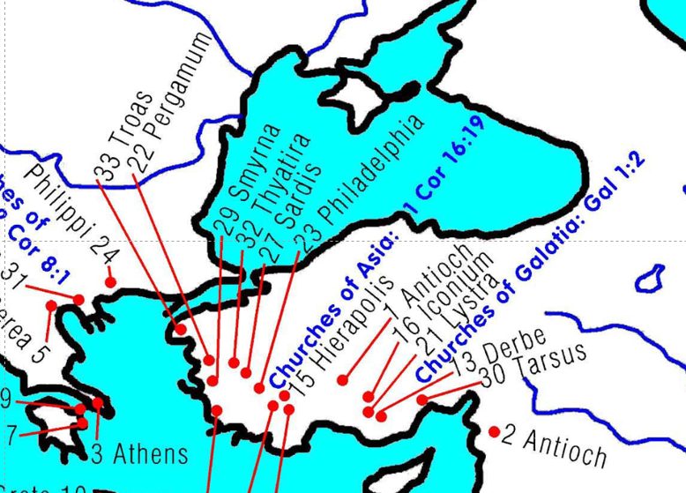
Galatia Association Paul and Timothy
4/6

Slide 15
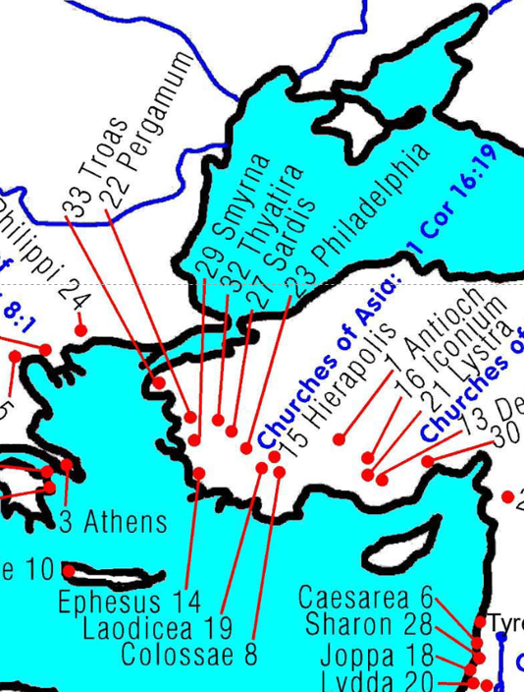
Asia Association Paul and Timothy Later, John
5/6

Slide 16
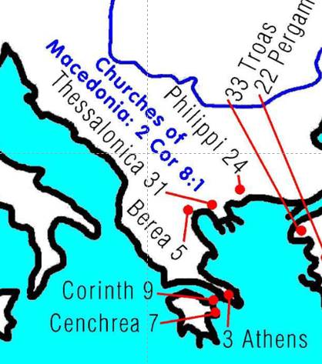
Macedonia Association Paul and Timothy
6/6

Slide 17
Today Begins the Southern Baptist Week of Prayer for Associations
Arundel
Baltimore
Blue Ridge
Delaware
Eastern
Mid-Maryland
Montgomery
Potomac
Prince George’s
Susquehanna
Western
Lancaster
York

Slide 18
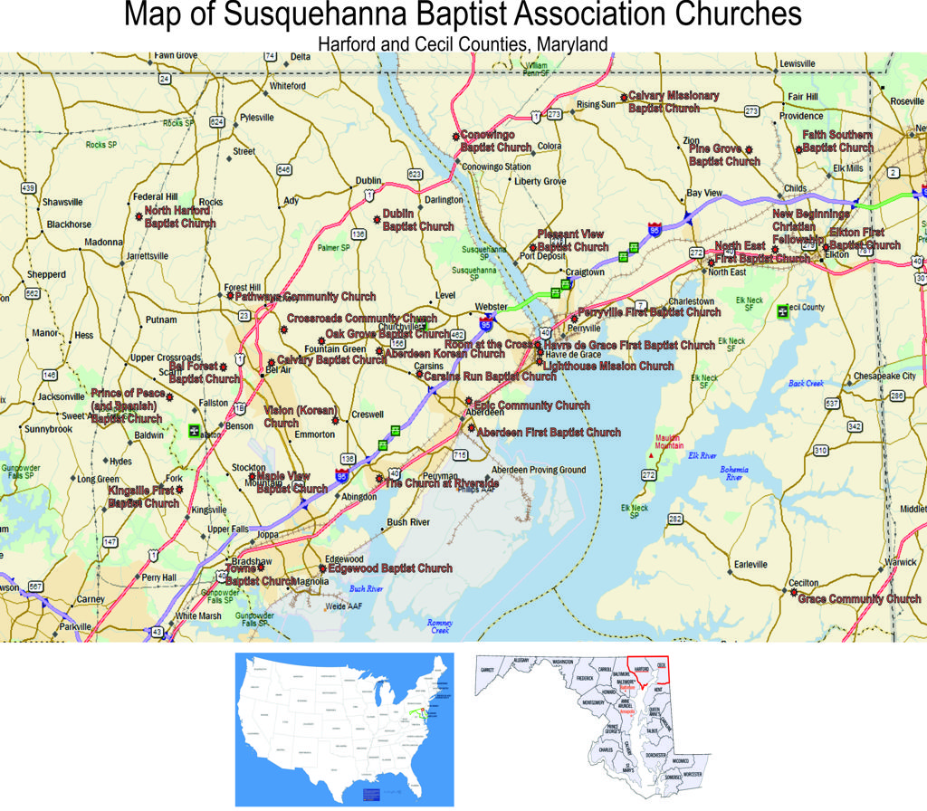

Slide 19
Helping Start New Churches and New Associations of Churches

Slide 20
Pray that We Can Be One
With the Lord
As a Church
As an Association
As a State Convention
As a National Convention
As an International Mission to the World
As a Part of the Greater Kingdom of God

Slide 21
Are You One With the Lord?

