Slide 1
WITH THE HEART,
ONE BELIEVES
ROMANS 10:8-13

Slide 2
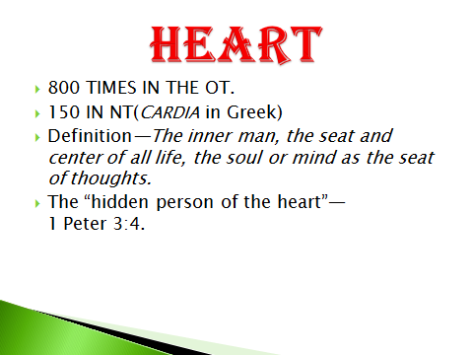

Slide 3
1. OUR HEART IS WHO WE REALLY ARE.
God gives us a free will, to choose to follow and obey Him---or not.
We are not robots to be programmed, or animals to be tamed.

Slide 4
PROVERBS 23:7
“For as he thinks in his heart, so is he.” (KJV)

Slide 5
1 Peter 3:4
“The hidden person of the heart…”

Slide 6
2. THE HEART NEEDS GOD’S HELP.
Even if we choose to follow Him we need His help.

Slide 7
Jeremiah 17:9
“The heart is deceitful above all things and beyond cure. Who can understand it?”

Slide 8
Jeremiah 24:7
“I will give them a heart to know me, that I am the LORD. They will be my people, and I will be their God, for they will return to me with all their heart.”

Slide 9
Jeremiah 29:13-14
“You will seek me and find me when you seek me with all your heart. I will be found by you.”

Slide 10
Jer. 31:31-34
“I will make a new covenant…”
“I will put my law in their minds and write it on their hearts. I will be their God, and they will be my people.”
“For I will forgive their wickedness and will remember their sins no more.”
Quoted in Hebrews 8:8-12 as being fulfilled in Jesus.

Slide 11
Jer. 32:38-41
“They will be my people, and I will be their God. I will give them singleness of heart and action.”
“I will rejoice in doing them good and will assuredly plant them in this land with all my heart and soul.”

Slide 12
3. WE NEED A NEW HEART.
The problem with our heart is so deep seated it requires radical “open heart surgery.”

Slide 13
Ezekiel 11:19-20
“I will give them an undivided heart and put a new spirit in them; I will remove from them their heart of stone and give them a heart of flesh.”
“They will be my people, and I will be their God.”

Slide 14
Ezekiel 36:26-29
“I will give you a new heart and put a new spirit in you; I will remove from you your heart of stone and give you a heart of flesh. And I will put my Spirit in you…”
“…You will be my people, and I will be your God. I will save you from all your uncleanness.”

Slide 15
Ezekiel 37:1ff
The vision of dry bones that come to life.
“Then you, my people, will know that I am the LORD …I will put my Spirit in you and you will live…” (37:13-14).

Slide 16
4. GOD’S SPIRIT IN US GIVES US LIFE AND A NEW HEART.
The way that God does this “open heart surgery” is through His Spirit.

Slide 17
John 14:16-17
“I will ask the Father, and he will give you another Counselor to be with you forever---the Spirit of truth.”
“He lives with you and will be in you”

Slide 18
John 7:38-39
“Whoever believes in me, as the Scripture has said, streams of living water will flow from within him.” By this he meant the Spirit, whom those who believed in him were later to receive. Up to that time the Spirit had not been given, since Jesus had not yet been glorified.”

Slide 19
1 Cor. 12:13
“For we were all baptized by one Spirit into one body—whether Jews or Greeks, slave or free---and we were all given the one Spirit to drink.”

Slide 20
John 7:65
“He (Jesus) went on to say, ‘This is why I told you that no one can come to me unless the Father has enabled him’.”

Slide 21
Acts 16:14
“Lydia a dealer I purple cloth from the city of Thyatira, who was a worshiper of God. The Lord opened her heart to respond to Paul’s message.”

Slide 22
5. TRUE FAITH IN OUR HEART IS WHAT GOD REQUIRES.
God knows our heart inside out. He knows if we are sincere or not.

Slide 23
Hebrews 10:22
“Let us draw near to God with a sincere heart in full assurance of faith.”

Slide 24
Hebrews 4:12
“For the word of God is living and active. Sharper than any double-edged sword, it penetrates even to dividing soul and spirit, joints and marrow; it judges the thoughts and attitudes of the heart.”

Slide 25
Romans 10:8-13
“The word of faith we are proclaiming:
“That if you confess with your mouth, “Jesus is Lord,” and believe in your heart that God raised him from the dead, you will be saved.”
“For it is with your heart that you believe and are justified, and it is with your mouth that you confess and are saved.”
“Everyone who calls on the name of the Lord will be saved.”

Slide 26
---Salvation is not complicated.
Admit that you are a sinner in need of God’s salvation.
“Believe with your heart”, and
“Confess with your mouth, ‘Jesus is Lord.’”

Slide 27
---Salvation is not far away or hard to find.
“The word is near you; it is in your mouth and in your heart.” (10:8).

Slide 28
However,
---Salvation IS A CHOICE AND will not be accepted by everyone.
“But not all the Israelites accepted the good news.” (10:16).

Slide 29
---Salvation is available to all.
“Everyone who calls on the name of the Lord will be saved.” (10:13).

