Slide 1
THE SPIRIT OF TRUTH
John 14-16

Slide 2
The Spirit of Truth
Jesus reveals to His disciples much about the coming Holy Spirit in both the Upper Room Discourse (Jn. 13-14) and the Olivet Discourse (Jn. 15-17).

Slide 3
The Spirit of Truth
4 times He calls Him the “Paraclete”. This Greek word literally means “one called alongside,” i.e. to one’s aid.
It was used in a court of law to denote the counsel for the defense, an advocate.

Slide 4


THE SPIRITUAL CHRISTIAN,
UNDER THE CONTROL OF THE SPIRIT
INTERESTS
ACTIVITIES
MONEY
LEISURE
WORK
LOST

Slide 5

THE WORLDLY CHRISTIAN,
A SELF-DIRECTED LIFE

Slide 6
THE ONE W/O THE HOLY SPIRIT,
LOST (1 COR. 2:14)
INTERESTS
ACTIVITIES
MONEY
LEISURE
WORK
LOST

Slide 7
GENUINE &WHOLESOME
SPIRITUALITY
This is the goal of all Christian living.
1.GENUINE=spiritual vs. hypocritical.
2. WHOLESOME=Balanced vs. imbalanced.
3. SPIRITUALITY=to have the mind of Christ, & follow in His steps, directed by the leading of the Holy Spirit.

Slide 8
Dr. Charles Ryrie
“Probably the most important doctrinal fact underpinning the spiritual life is the believer’s union with Christ.”
“Therefore, if anyone is in Christ, he is a new creation; the old has gone, the new has come!” 2 Cor. 5:17

Slide 9
What can Jesus do for me?
Only Jesus can do all of these things. Colossians 2:13-15.
He can give you life.
He can forgive your sins.
He can cancel your sin debt.
He can give you victory.
“The wages of sin is death, but the gift of God is eternal life in Christ Jesus our Lord.” (Romans 6:23)

Slide 10
1 John 2:1
“My dear children,…we have one who speaks to the Father in our defense (PARACLETE)—Jesus Christ, the Righteous One.”

Slide 11
1. ANOTHER COUNSELOR
John 14:16-17
“And I will ask the Father, and he will give you another Counselor to (abide with you—KJV) be with you forever—the Spirit of truth.”

Slide 12
John 14:17
“The Spirit of truth….he lives with you and will be in you.”

Slide 13
2. THE COUNSELOR (Jn. 14:26)
“But the Counselor, the Holy Spirit, whom the Father will send in my name, will teach you all things and will remind you of everything I have said to you.”

Slide 14
1 Cor. 2:9-13
“No eye has seen, no ear has heard, no mind has conceived what God has prepared for those who love him”---but…
“God has revealed it to us by his Spirit.”

Slide 15
3. THE COUNSELOR…
WILL TESTIFY.
“He will testify about me (Jesus).” John 15:26
The 3rd member of the trinity’s purpose is not to glorify Himself.
All 3 persons of the Godhead are mentioned twice in this one verse!

Slide 16
John 15:26
“When the Counselor comes, whom I will send to you from the Father, the Spirit of truth who goes out from the Father, he will testify about me.”

Slide 17
4. THE COUNSELOR…
WILL COME.
John 16:7-15

Slide 18
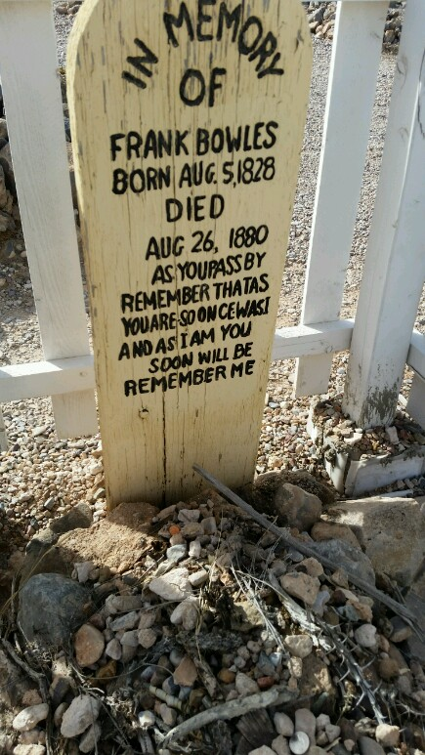
A. TO THE WORLD…
1. Sin (9)
2. Righteousness (10)
3. Judgment (11)

Slide 19


Slide 21
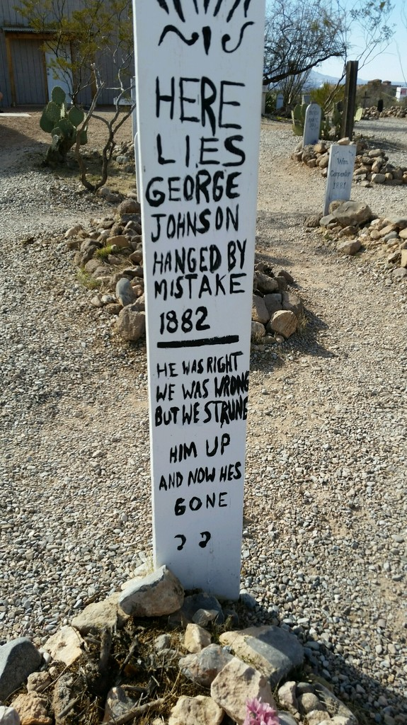

Slide 22
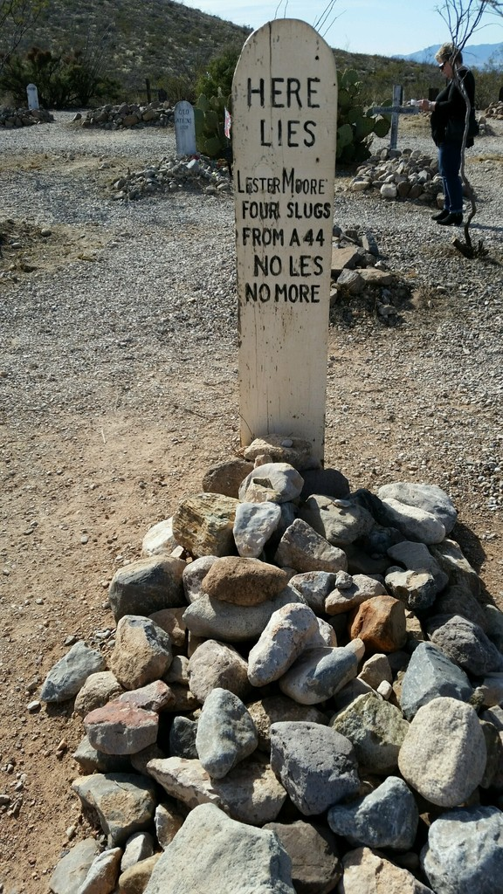

Slide 23
B. TO BELIEVERS
1. Guide into all TRUTH (Jn. 16:13a).
2. Tell you WHAT IS TO COME (Jn. 16:13b).

Slide 24
C. TO CHRIST
“He will bring glory to me…” Jn. 16:14

