Slide 1
THE GLORY OF CHRIST
COLOSSIANS 1:15-20

Slide 2
Christ is the Scarlet Thread of the Bible
Old Testament—Preparation
Gospels—God became man
Acts—The message spreads to all the Earth
Epistles—Christ is explained, theology
Revelation---Christ is on the throne

Slide 3
Colossians—Our Salvation
1.Hope secured
2. Inheritance
3. Rescued
4. Brought into His Kingdom
5. Redeemed
6. Forgiven
7. Reconciled
8. Holy in His Sight

Slide 4
Colossians--Christ
Paul wants us to see the Glory that belongs to Jesus Christ alone.
He answers 3 important Questions…
1. WHO IS HE?
2. WHAT IS HE?
3. WHY IS HE?

Slide 5
1. WHO IS HE?
“He is the image of the invisible God, the firstborn over all creation.” 1:15
1. Visible image of the invisible God.
God became man
“The virgin will be with child and will give birth to a son, and they will call him Immanuel”—which means, “God with us.” Matt. 1:23

Slide 6
1. WHO IS HE?
John 8:58 “Before Abraham was born, I am !”
John 10:30 “I and the Father are one.”
John 10:36 “…I said, “I am God’s Son.””

Slide 7
1. WHO IS HE?
2. “The firstborn over all creation.” Col. 1:15b
Vine’s Expository Dictionary—”the clause means both that He was the Firstborn before all creation and that He Himself produced creation.”
The firstborn had rights and privileges, recall Jacob scheming to get it from Esau (Gen. 25:33; Heb. 12:16).
The Jehovah’s Witnesses try to say that this means Jesus was a created being.

Slide 8
2. WHAT IS HE?
1. CREATOR—He created all things.
“For in 6 days the LORD made the heavens and the earth, the sea, and all that is in them…” Exodus 20:11

Slide 9
2. WHAT IS HE? CREATOR
“By faith we understand that the universe was formed at God’s command, so that what is seen was not made out of what was visible.” Hebrews 11:3

Slide 10
2. WHAT IS HE?
2. CONTROLLER-- “By Him all things hold together.” Col. 1:17
Not only did Christ create all things, He also sustains all things.
Coulomb’s Law—Like charges repel.
The “God Particle”—Higgs Boson (1964) Found in 2012. The particle that gives mass to the universe, and holds every nucleus of every atom in the universe together.

Slide 11
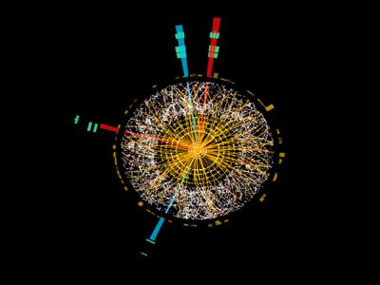
HIGGS BOSON PARTICLE

Slide 12
2. WHAT IS HE?
“The Son is…sustaining all things by his powerful word.” Heb. 1:3
Consider Laminin—a cross-shaped protein that holds every living cell together.

Slide 13
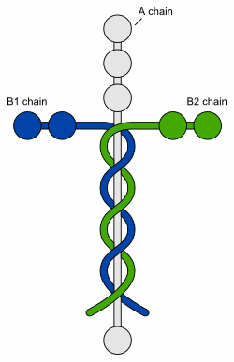
Laminin

Slide 14
3. WHY IS HE?
Why is He what he is?
“He is the head of the body…”
“He is the beginning and the firstborn from among the dead…”
“So that in everything he might have the supremacy.”
“God was pleased to have all his fullness dwell in him.”

Slide 15
And Jesus can live in you!
“For of his fullness we have all received, and grace upon grace.” John 1:16

