Slide 1
THE LORD BUILDS
HIS HOUSE
PSALM 127
PSALM 128

Slide 2
HAPPY MOTHER’S DAY
“Unless the LORD builds the house, its builders labor in vain.” Psalm 127:1
“Sons are a heritage from the LORD, children a reward from him.” Ps. 127:3
“…and may you live to see your children’s children.” Ps. 128:6

Slide 3
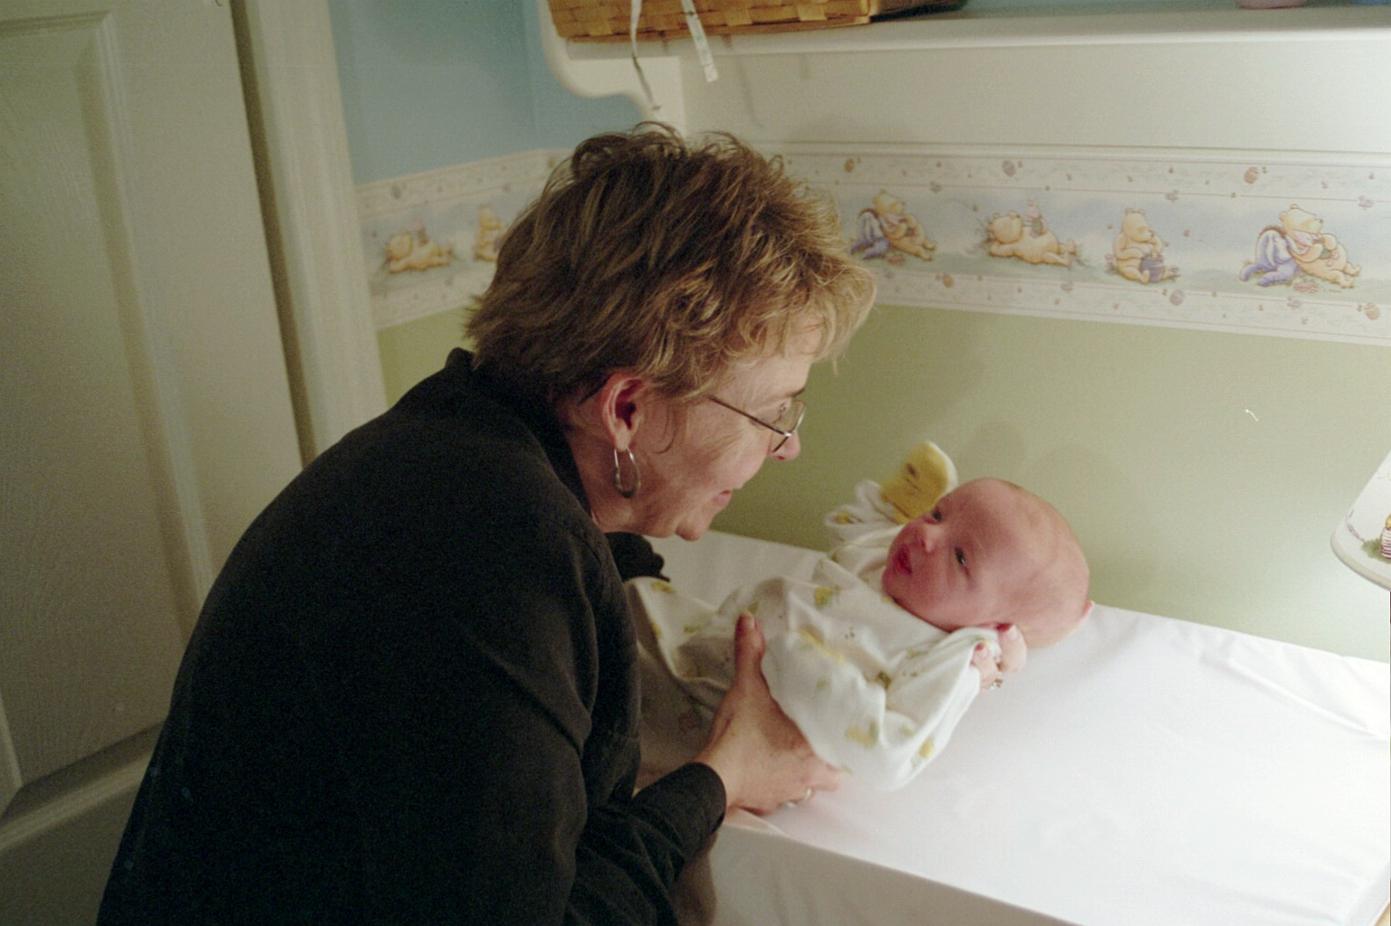
THE LORD BUILDS
HIS HOUSE

Slide 4
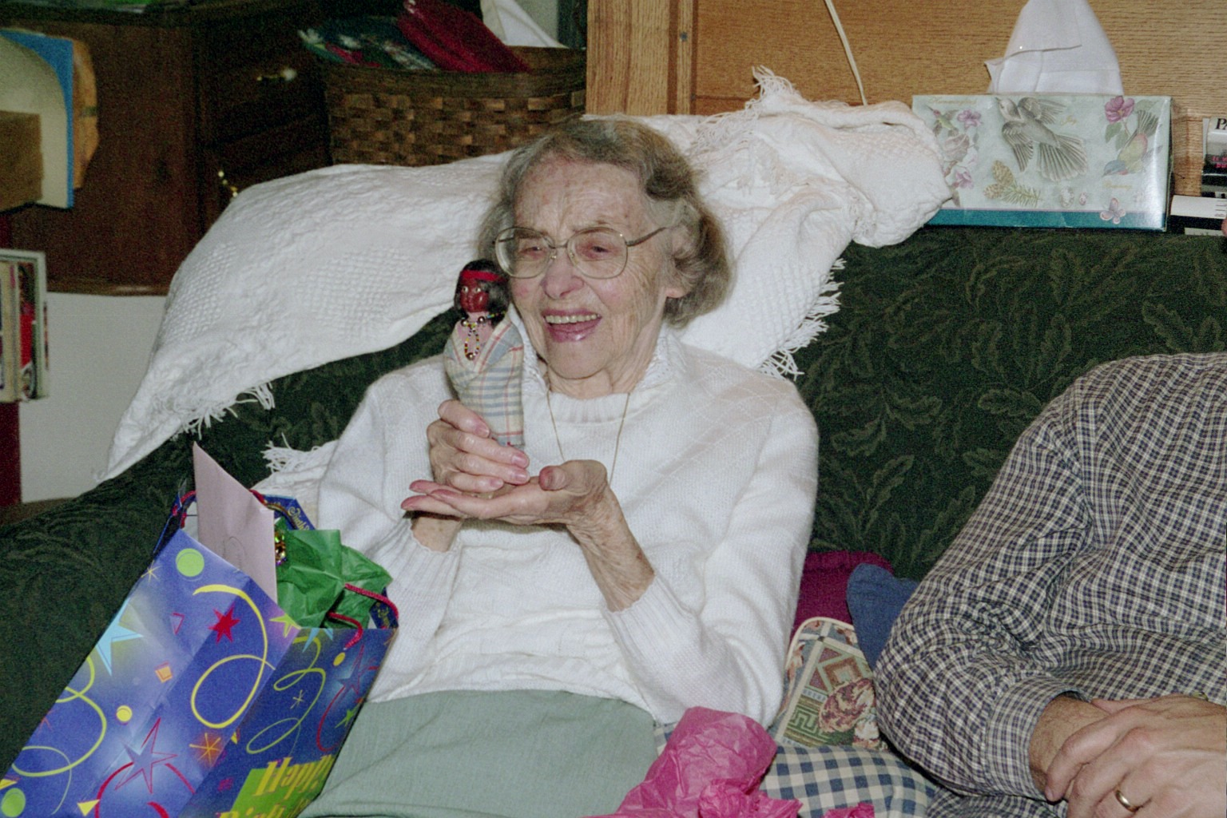
Janet’s Mom—Betty Muller

Slide 5
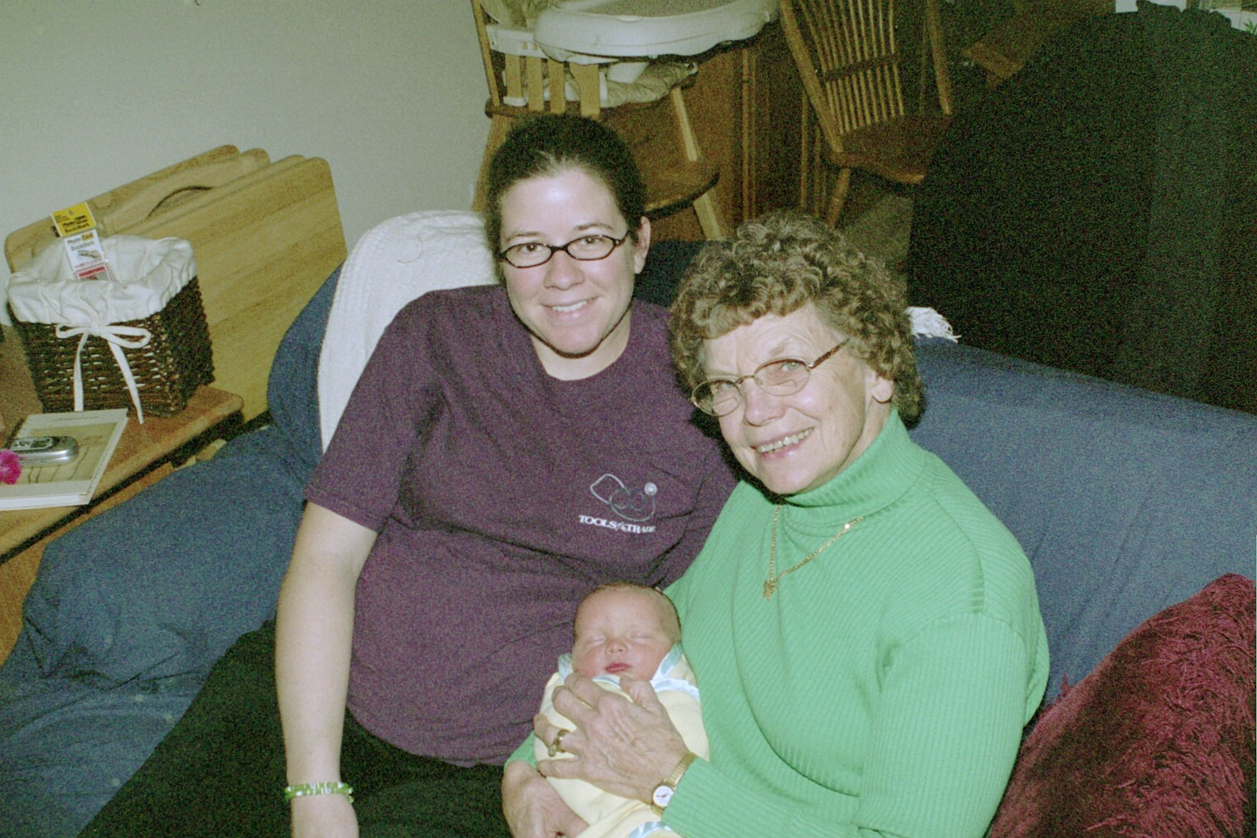
MY MOM & Jenny & Ethan

Slide 6
Proverbs 14:1
“The wise woman builds her house, but with her own hands the foolish one tears hers down.”

Slide 7
M-O-T-H-E-R-S
M-MOTIVATED BY LOVE
1 Corinthians 13
Without love I am nothing
Love never fails
The greatest is love

Slide 8
M-O-T-H-E-R-S
M-MOTIVATED BY LOVE
O-ONLY ONE MAN
Keep thee only unto him so long as you both shall live.

Slide 9
M-O-T-H-E-R-S
M-motivated by love
O-only one man
T-True beauty

Slide 10
1 Peter 3:3 & 4
“Your beauty should not come from outward adornment…instead it should be that of your inner self, the unfading beauty of a gentle and quiet spirit, which is of great worth in God’s sight.”

Slide 11
M-O-T-H-E-R-S
M-motivated by love
O-only one man
T-true beauty
H-habitually in the word of God

Slide 12
Psalm 119:9, 11, & 105
“How can a young man (or woman) keep his way pure? By living according to your word.”
“I have hidden your word in my heart that I might not sin against you.”
“Your word is a lamp to my feet and a light for my path.”

Slide 13
M-O-T-H-E-R-S
M-MOTIVATED BY LOVE
O-ONLY ONE MAN
T-TRUE BEAUTY
H-HABITUALLY IN GOD’S WORD
E-EQUAL TO THE TASK

Slide 14
PROVERBS 31
“She watches over the affairs of her household and does not eat the bread of idleness. Her children arise and call her blessed; her husband also, and he praises her: Many women do noble things, but you surpass them all.” Prov. 31:27-29

Slide 15
M-O-T-H-E-R-S
M-MOTIVATED BY LOVE
O-ONLY ONE MAN
T-TRUE BEAUTY
H-HABITUALLY IN GOD’S WORD
E-EQUAL TO THE TASK
R-RESTS IN GOD

Slide 16
Proverbs 31:30
“Charm is deceptive, and beauty is fleeting; but a woman who fears the LORD is to be praised.”
“Fear of the LORD”=The constant awareness that God knows and sees all that I say, think, or do.

Slide 17
M-O-T-H-E-R-S
M-MOTIVATED BY LOVE
O-ONLY ONE MAN
T-TRUE BEAUTY
H-HABITUALLY IN GOD’S WORD
E-EQUAL TO THE TASK
R-RESTS IN GOD
S-SAVED BY FAITH

Slide 18
Luke 1:46 &47
“And Mary said: ‘My soul glorifies the Lord and my spirit rejoices in God my Savior.”

Slide 19

M-O-T-H-E-R-S
M-MOTIVATED BY LOVE
O-ONLY ONE MAN
T-TRUE BEAUTY
H-HABITUALLY IN GOD’S WORD
E-EQUAL TO THE TASK
R-RESTS IN GOD
S-SAVED BY FAITH

Slide 20
M-O-T-H-E-R-S
M-MOTIVATED BY LOVE
O-ONLY ONE MAN
T-TRUE BEAUTY
H-HABITUALLY IN GOD’S WORD
E-EQUAL TO THE TASK
R-RESTS IN GOD
S-SAVED BY FAITH

