Slide 1
I AM THE WAY, THE TRUTH,
AND THE LIFE
JOHN 14:6

Slide 2
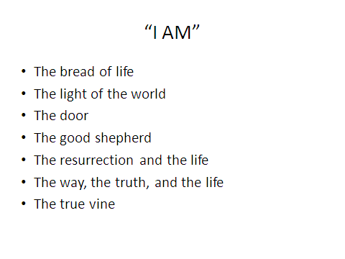

Slide 3
John 14:6
“I am the way, and the truth, and the life. No one comes to the Father except through Me.”

Slide 4
“THE WAY” became a name for the early church
Acts 9:2 Saul arrested those “who belonged to the Way.”
Acts 19:9 some “refused to believe and publicly maligned the Way.”
Acts 19:23 A riot “about the Way.”
Acts 22:4 Paul says, “I persecuted the followers of this Way to their death.”
Acts 24:14 Paul tells Gov. Felix that he is a “follower of the Way.”
Acts 24:22 Gov. Felix is “well acquainted with the Way.”

Slide 5
HOW DO WE KNOW JESUS IS
WHO HE SAYS HE IS?
1. Over 300 prophecies fulfilled in His first coming alone.
2. Names of Jesus only possible if He is GOD.
3. Works of Jesus could only be done by GOD.
4. Worship is given (and accepted) which is only due to GOD.
5. The claims Jesus made for Himself could only be true if He is GOD.
6. Jesus possesses all the attributes of Deity.
7. The resurrection is the final proof that Jesus is who He said He was. God’s stamp of approval (Romans 1:4).

Slide 6
Do you know Jesus as the way, the truth , and the life?
The church is built on strong pillars of faith.
They have stood tests from every angle.
Our faith stands because it rests on absolute truth that is resting in the absolute authority of God Himself.
Christ’s claim is absolute and He offers no other option.
Share the gospel with others.
“I am a nobody, telling everybody, there is Somebody, who can save anybody.” Melvin Graham

